Slide 1
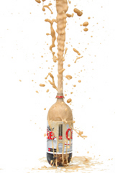
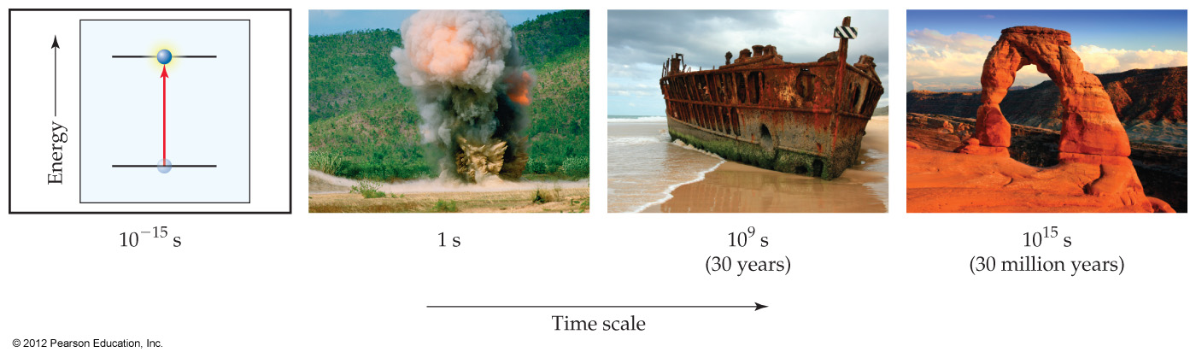
Kinetic Time Scales
Light absorption
Explosions
Corrosion
Geological

Slide 2
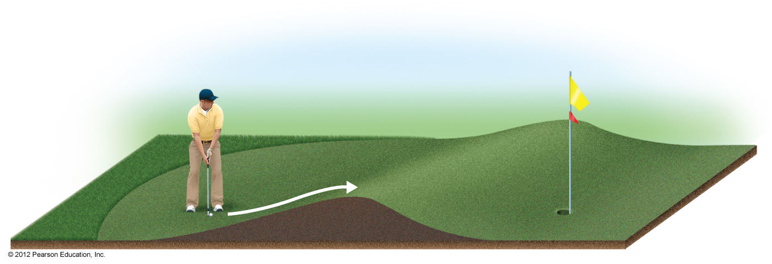
Energy Barrier in Reactions
Chemical and physical reactions have energy barriers, or an activation energy (E_{a}), that must be overcome to permit reaction
Unassisted reaction → Diet Coke bottle left open for several days
Catalysts act to lower this energy barrier and enhance speed
Mentos (and other additives) can be considered catalysts for the physical reaction in which dissolved CO₂ changes to gaseous CO₂
Catalyzed reaction much faster than unassisted reaction (control)

Slide 3
Mentos as a Catalyst
http://www.stevespanglerscience.com/experiment/original-mentos-diet-coke-geyser

Slide 4
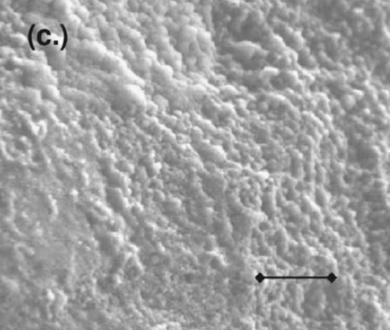
Mentos as a Catalyst
Contributing factors
Rough surfaces
Promotes nucleation, or formation, of CO₂ bubbles from dissolved CO₂
Rapid descent of “catalyst” particles
Low friction from surfactants and shape
Relatively heavy
Rapid reaction in large bottles
Scanning Electron Microscope (SEM) image of Mentos candy surface
Scale bar is 20 μm long (20 millionths of a meter)
Coffey, T. S., Am. J. Phys. 2008, 76, 551.

Slide 5
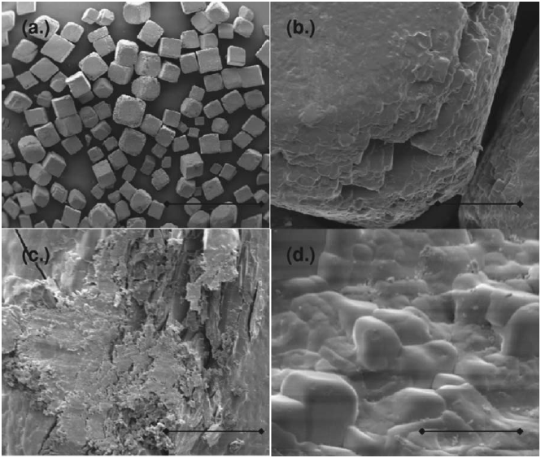
Table Salt as a Catalyst
Contributing factors
Rough surfaces
Slower descent into bottle
Smaller particles
Slower reaction in larger bottle
High surface area-to-volume ratio
Along with surface roughness, promotes rapid reaction in smaller scale systems (indoor experiments)
SEM images of table salt
Scale bars are (a) 2.0 mm; (b) 100 µm; (c) 50 µm; and (d) 20 μm long
Coffey, T. S., Am. J. Phys. 2008, 76, 551.

