Slide 1
Protein Self-Assembly

Slide 2
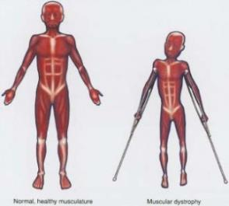
Disease Review
Muscular Dystrophy
Genetic disorder
A protein to protect muscle is not created properly
Causes muscles to weaken and break apart over time

Slide 3
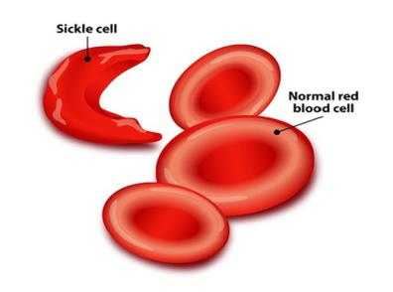
Disease Review
Sickle Cell Anemia
Genetic disorder
Mutation in genes causes proteins to misfold
Sickle cells have an abnormal shape compared to regular red blood cells

Slide 4
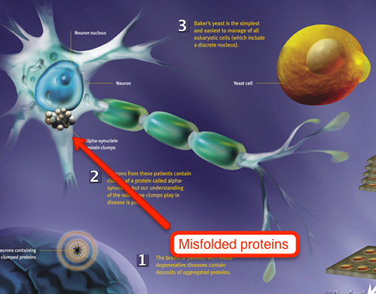
Disease Review
Parkinson’s Disease
Possible causes:
Genes
Environmental factors
Neurons that control body movement slowly die
Body movement is affected, symptoms include:
Tremors
One cause being researched:
Misfolded proteins, called alpha-synuclein, clump at neuron surface and cause dopamine secreting brain cells to die

Slide 5
Disease Review
After reviewing all of the diseases from yesterday, what was something you noticed that they all had in common?
Discuss with a partner

Slide 6
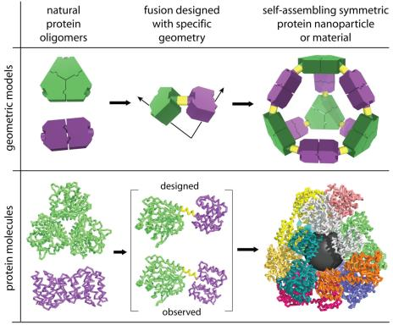
Self Assembly
Process in which an unorganized system will spontaneously form an organized structure
When proteins misfold or do not self assemble correctly, problems occur
Happens commonly at the NANO SCALE
Notes:
Teachers Note:
Self-assembly is a process in which a disordered system will spontaneously form an organized structure as a result of local interactions among the components
- For example, Hemoglobin monomers have attractive interactions that promote self assembly into tetramers
- Less common process at large scales, but very common at nanoscales

Slide 7
Self Assembly
http://www.youtube.com/watch?v=nbzpHRgrRBY
Module presentation

Slide 8
After Module
After module, question for thought:
Who here has a messy room?
If you were to shake your room really hard and at the right temperature, would everything come together in it’s own place?

Slide 9
Citations
http://www.stemcellmd.org/conditions-treated/genetic-disorders/muscular-dystrophy/
http://www.whatayear.org/11_06.html
https://www.blackaids.org/news-2012/1459-sickle-cell-disease-cuts-hiv-risk-in-us-blacks-400000-person-review
http://www.whatayear.org/11_06_whiteboard.html

