Slide 1
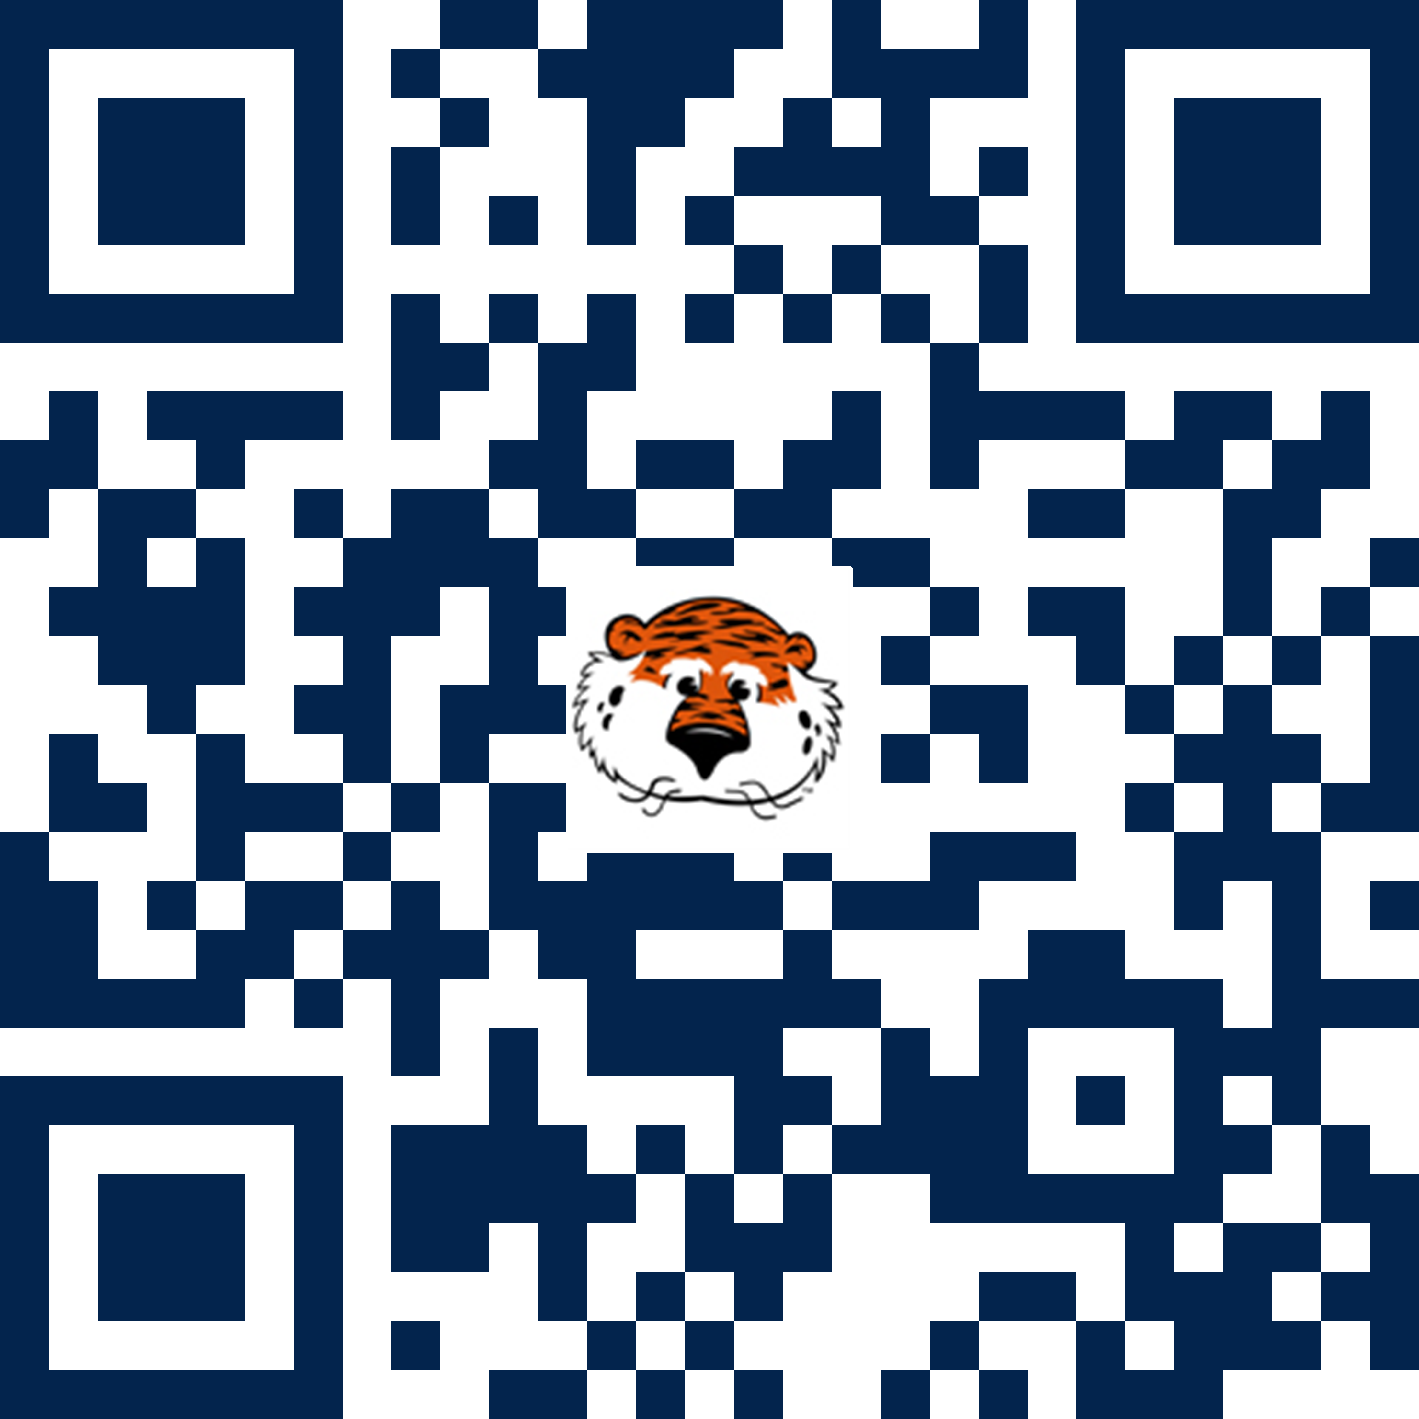

Students: If you need to speak to someone regarding or need help to resolve a conflict, check out how the COSAM Champions can help you.
Visit COSAM’s website, auburn.edu/cosam, to see a list of the Champions or scan this QR code:

