Slide 1
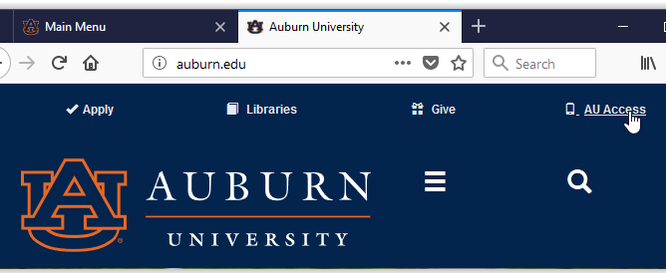
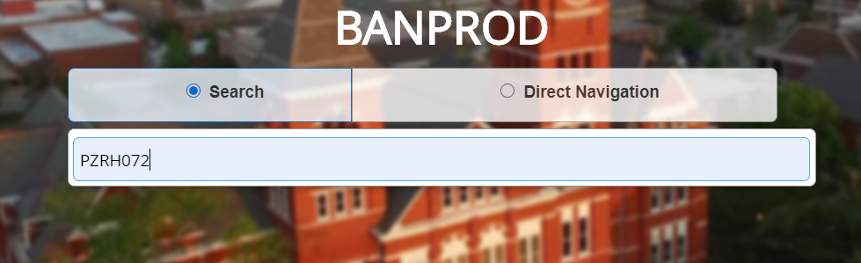
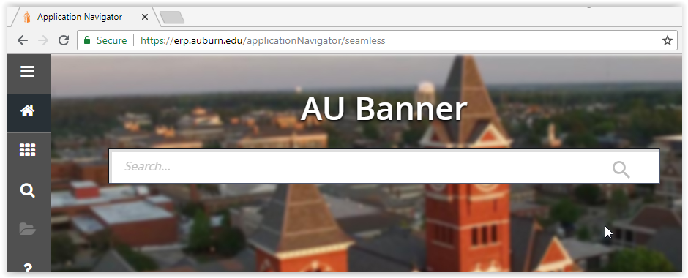

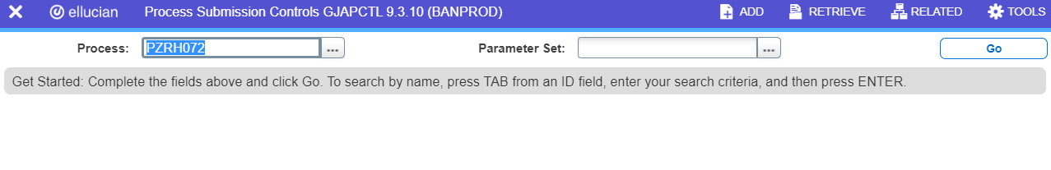
PZRH072 – Termination EE Listing by Division
This report will provide a listing of terminations by division for a designated begin and end date.
1
Banner Admin
erp.auburn.edu
1
AU Access
2
AU Authenticate and 2-factor DUO
2
Employee Tab -> Banner9 Admin
3
Search Field Type PZRH072
4
Select the result
5
Submission Control -> Go
LF 7.2020
Page 1

Slide 2
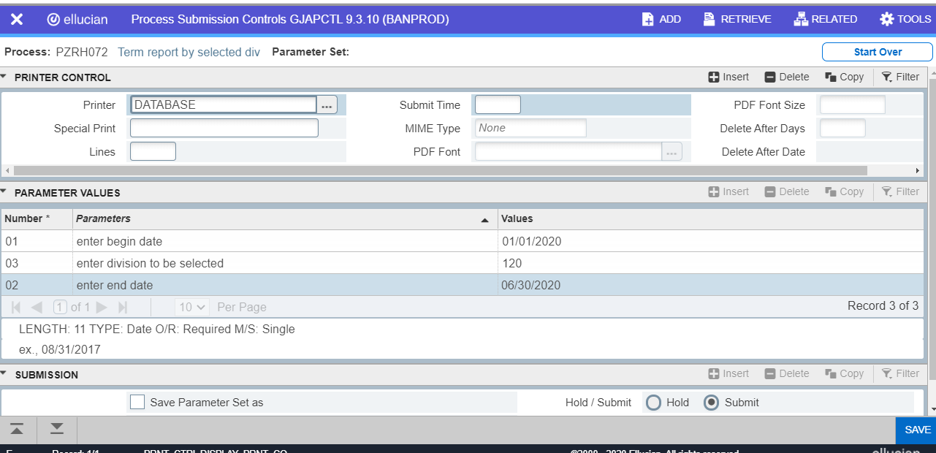
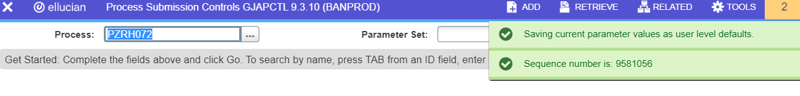
6
Parameter Values
Click on … select Database and click OK in pop-up window
EXAMPLE
2. Enter begin date xx/xx/xxxx
3. Enter Division 3-digit number
4. Enter the end date xx/xx/xxxx
5. Cursor MUST click within the Submission Block
6. Click on SAVE
7
If the report was submitted with no errors, the runner will receive a sequence number. If you save the parameter set, then you will also see message regarding default values.
8
Check your email:
LF 7.2020
Page 2
Notes:
From Subject Received Size Categories
non-reply@auburn.edu pzrh072 - terminations by selected division 7:31 PM 58 KB

