Slide 1



Practical Ways You Can Support Successful Searches
aub.ie/searches
Jenna Richards
Assistant Manager, Talent Acquisition

Slide 2
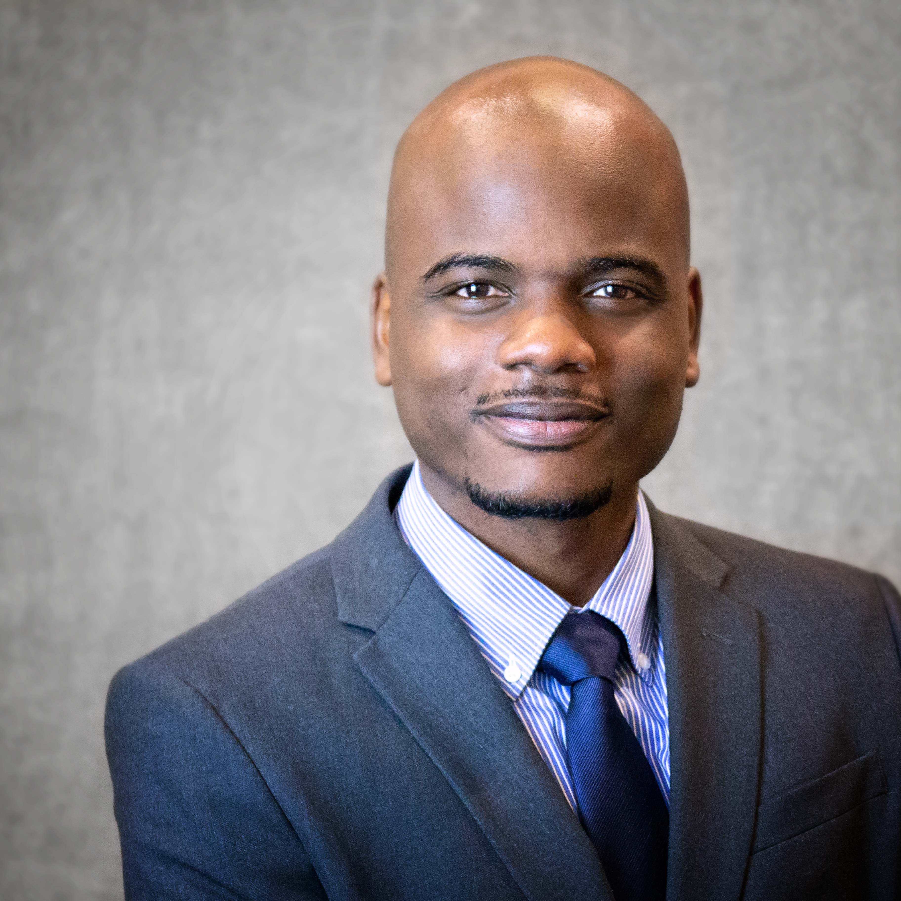
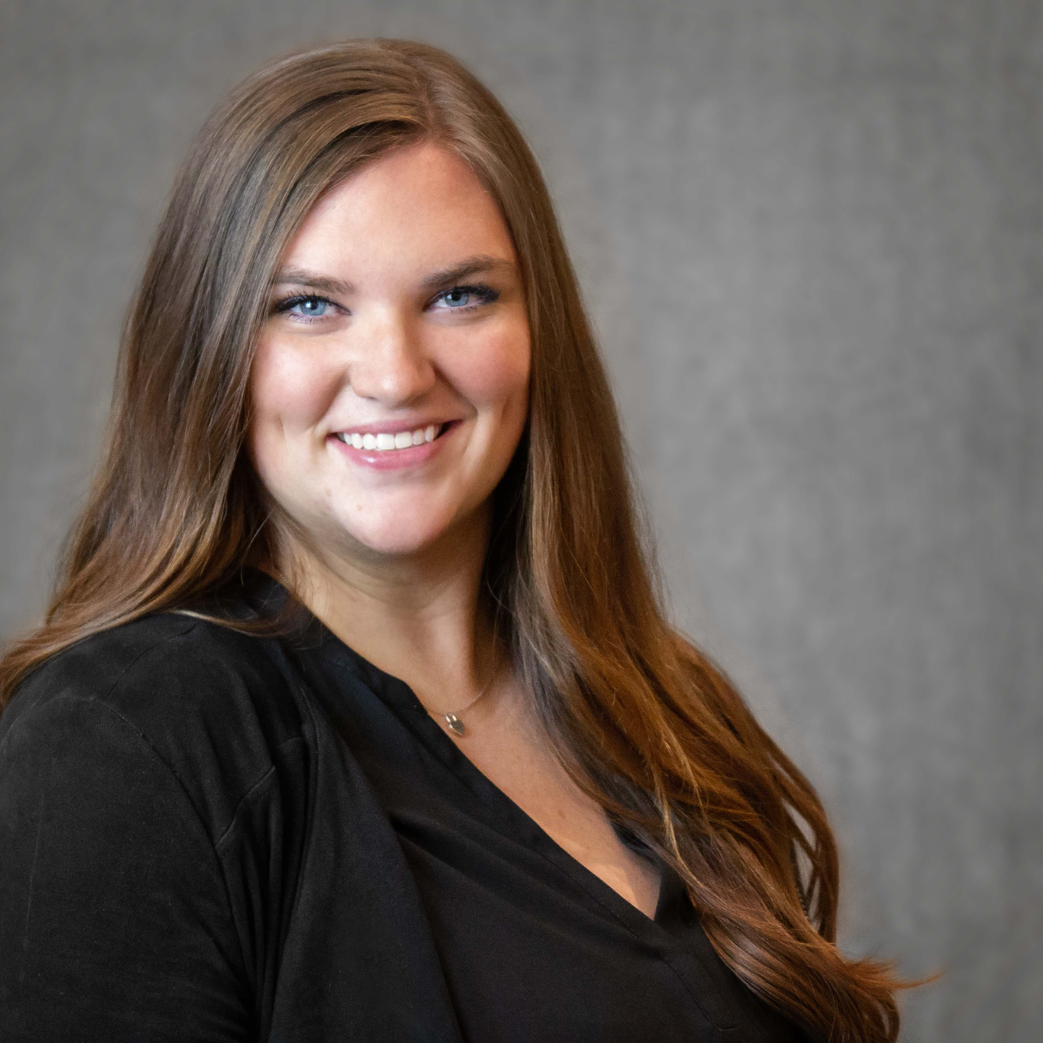
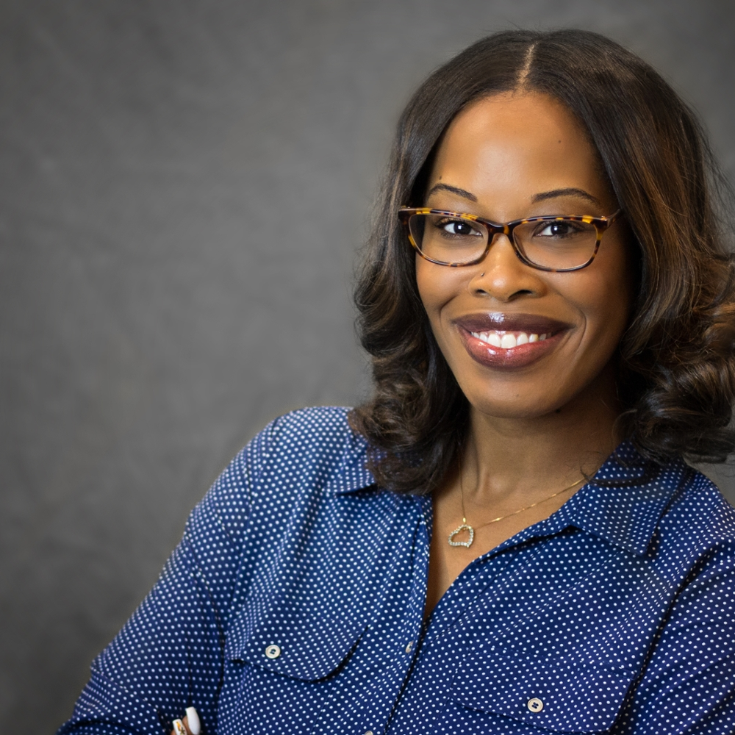
Talent Acquisition at Auburn
Jarvis Matthews
Talent Acquisition Specialist
Colleges/Provost Office
Hannah Russell
Talent Acquisition Specialist
Business Divisions
Angela Graham
Talent Acquisition Specialist
TES/Student, all Colleges/Divisions
Our team builds strategies and facilitates processes for attracting, engaging, and securing talent for Auburn.

Slide 3
1
Practical ways You Can Support
Successful Searches
Perform fair, equitable, and inclusive employment searches or provide guidance to your department.
2
Share your knowledge of employment search processes with your department.
3
Promote and model elevated candidate experiences.

Slide 4
This Session’s Connection to The
2019-2024 Auburn Strategic Plan
Elevated Auburn Experience
Exceptional and Engaged
Faculty and Staff
Operational Excellence
The Strategic Plan focuses on the student experience, but we believe that when candidates visit campus and receive an elevated experience, it sets the expectation for the environment we want them to create here at Auburn.
The Strategic Plan includes increased collaboration working toward shared goals, as well as increased employee training.
Faculty and staff are core to the mission of Auburn.
The Strategic Plan calls for an increased focus on recruiting the best and brightest faculty and staff.

Slide 5
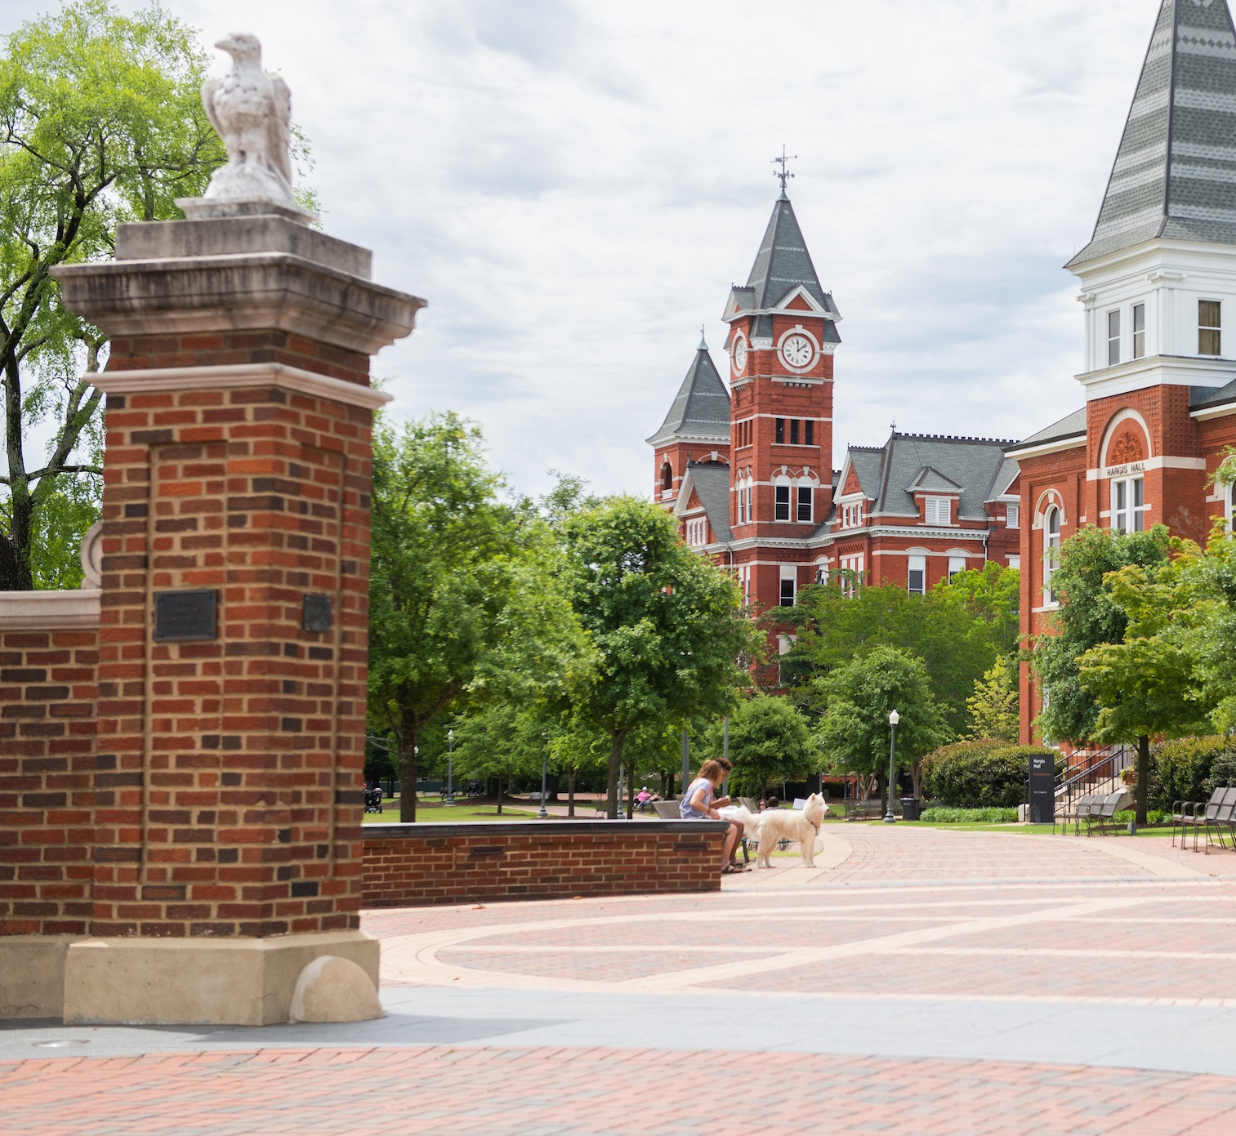
Perform fair, equitable, and inclusive employment searches.
In this section, we’ll discuss:
Search Committee Responsibilities and Expectations

Slide 6
What is a search committee?
Group of people formed to assist the responsible hiring manager in recruiting, reviewing applications, and selecting candidates for a posted position.
Auburn University requires search committees for all Non-Faculty and Faculty positions in order to ensure that all recruitment practices are compliant with employment laws and University policy.
It is our obligation and responsibility to perform employment searches that are fair, equitable, and do not discriminate against someone because of their protected class.
Protected classes include race, color, religion, gender identity, sexual orientation, pregnancy, national origin, age, disability, veteran status.

Slide 7
Why do we Need them?
It is our obligation and responsibility to perform employment searches that are fair, equitable, and do not discriminate against someone because of their protected class.
By using search committees, we lower the risk for candidates to be able to challenge our employment decisions.
Protected classes include race, color, religion, gender identity, sexual orientation, pregnancy, national origin, age, disability, veteran status.
This responsibility extends to all facets of an employment search, including: job postings, recruitment, application and hiring process, pre-employment testing, and disability accommodations.
Beyond that……it’s the right thing to do!

Slide 8
Diverse Search Committees Are Essential
Search committees should include members with varied demographic identities. Examples: age, race, gender, etc.
A variety of lived experiences and perspectives facilitates robust intellectual exchange, which is part of the culture of a university.
We all have a tendency to be drawn to candidates who are like us, which is a form of bias. Bias can be conscious or unconscious, where we don’t realize that our decisions are based on assumptions or preconceived notions.
Making a decision with a group of people can help us challenge assumptions, offer fresh perspectives, and ensure that employment decisions are based solely on a candidate’s qualifications for a position.

Slide 9
Search Committee Expectations
Follow all employment laws that pertain to employment decisions
Make hiring decisions without discriminating against protected groups of people
Promote and model diversity, equity, and inclusion throughout the employment search.
Remain aware of how unconscious biases (positive and negative) impact assumptions individuals make about candidates based on race, gender, ethnicity, age, sexual orientation, family/marital status, etc.
Check and recheck bias throughout all employment search processes.
Welcome all committee members’ perspectives and question any decisions that may be influenced by bias.
Apply evaluation criteria evenly and fairly to all candidates.
Provide all candidates with a consistent level of engagement, criticism, flexibility, etc.
Keep all information CONFIDENTIAL!

Slide 10
Search Committee Roles And Responsibilities
Hiring Supervisor:
    The supervisor of the job
    Leads committee or appoints Search Chair
    Has final decision on candidates
Search Chair:
  - Appointed to lead and facilitate employment search
Search Committee Member:
  - Participates in the interview and selection process as a voting member.
HR Liaison:
  - Designated HR professional within a college or division

Slide 11
Preparing the Search committee
Search committees should be briefed by the Hiring Supervisor or Search Chair prior to review of applications.
There are several things that need to be established, including:
  Expectations for committee
  Timeline of the search
  Sharing required qualifications for candidates
  Discussion of ideal candidate attributes
  Interview and engagement plans
  How candidates will be evaluated
  How the final decision will be made
  Dissemination of confidentiality form

Slide 12
Share your knowledge of employment search processes with your department
In this section, we’ll discuss:
Non-Faculty recruitment processes and procedures

Slide 13
Employment Search Phases
Form search committee
Initial search committee
kickoff
Post job
Review applications
Select candidates for interview
Interview
candidates
Evaluate
candidates
Select
finalist

Slide 14
Posting & Advertising
Postings are submitted to the Talent Acquisition team through the college/division Human Resources Liaison.
The main goal of the posting is to attract them to apply, provide a snapshot of responsibilities, and outline the required qualifications.
We post all jobs in a number of standard sources, but jobs may be posted through other avenues as appropriate.

Slide 15
Ways you can Support
Recruitment!
Suggest relevant professional or community sources (websites, journals, etc.) related to the position’s discipline.
Networking with university and industry contacts to promote the vacancy.
Announcing the vacancy to the department/college/division to attract internal candidates
Advertising on department/college/division and Central HR social media.
Contacting Career Services departments at other institution for referrals.
Attending career fairs or requesting for the Talent Acquisition Specialist to attend one on the unit’s behalf.
Request Strategic Search Service from the Talent Acquisition team!

Slide 16
Reviewing Applications
All applicants must apply to the posting to be considered.
Applications are immediately available for review.
When reviewing applications, search committee members should focus on the following:
- Does the candidate meet the minimum education and experience requirements?
- Alignment of qualifications to what the supervisor is looking for
- Are there any red flags on the application/resume/cover letter?

Slide 17
Interviewing
Prior to interviewing, the supervisor or search chair should conduct screening call to ensure the candidate is still interested, and that they are comfortable with the salary range.
After the screening call, candidates must be approved for interview by the Talent Acquisition team.
Most interview processes begin with an initial virtual interview and then an on-site interview.
Supervisors/Search Chairs can design their own interview processes, but should do so in a way that considers the candidate experience and the time/effort of their search committee.

Slide 18
Evaluating Candidates
Evaluating candidates and selecting a finalist is one of the most critical parts of the employment process.
The same criteria should be used to evaluate all candidates.
Candidate evaluations should be documented and retained within the department.
Once a finalist is selected, appropriate selection and non-selection reasons should be submitted to the HR Liaison, who will provide them to the Talent Acquisition team.
The Talent Acquisition team will trigger notifications to those who were not interviewed. Interviewed candidates should be notified during the hiring process for the selected candidate.

Slide 19
Promote & model elevated candidate experiences
In this section, we’ll discuss:
How to attract, engage, and secure candidates

Slide 20
We are in a competitive job market
….what does that mean?
There are more open jobs than qualified candidates to fill them.
Candidates have the power. They want the most competitive compensation from the most competitive employer.
We have to do more than we used to in order to attract and recruit candidate.
This starts from the time they view the job posting and continues until they begin working.

Slide 21
Candidate 1
Candidate 2
6 months after applying, someone from AU contacts her for an interview, they did not ask any pay questions.
She has lost interest, but is willing to consider an interview.
She is scheduled to come to campus and doesn’t know who she’s interviewing with. She’s never been to campus before.
She gets to the interview, but is a little frazzled. She isn’t sure where to go, and the receptionist wasn’t aware she was coming. They scramble to find the interviewers.
Her interview was very formal and intimidating.
On her way out, she saw that she has a parking ticket.
The supervisor waited 4 weeks to call her with an offer close to her current pay.
The day after she applied, she gets a phone call from the Search Chair, where they discussed pay, interview timelines, and next steps.
The next week, she is invited for an on-site interview.
Prior to the interview, the search chair sends a comprehensive interview guide and she knows exactly what to expect.
When she walks into her hotel room, there is an Auburn welcome basket, snacks, and a handwritten card.
The interviewers gave her a warm welcome and a casual experience.
She goes to lunch with the supervisor and another department leader at 1856. She takes a golf cart tour of campus before heading back to her hotel.
The supervisor follows up with a decision the following week with an offer, which included the pay she was looking for.
Let’s compare
experiences….
…who is more likely
to accept an offer?

Slide 22
How to attract candidates
Candidate 1
Create job postings that are exciting, easy to digest, and speak to the right audience.
Ensure that we are advertising in the right places.
Ensure your department’s digital presence is attractive – web content, social media, etc.
Create a social media recruitment strategy with your Talent Acquisition Specialist.
Candidate 1

Slide 23
How to engage candidates
Conduct engagement calls with candidates that are highly qualified within a few days from application – particularly if the interviews won’t take place for weeks.
Over-communicate to candidates throughout the process with updates or additional information.
Candidates who don’t hear anything back quickly move on, become disinterested, or accept other jobs.
We can’t emphasis this enough: keep the process moving!
Create welcoming and memorable on-site interview experiences. We are being interviewed as an employer. This is the time to roll out the “red carpet” and make people fall in love with Auburn!
Candidate 1
Candidate 1

Slide 24
Elevated interview experience ideas:
If they are traveling, book their hotel for them (ideally the AU Hotel)
Order a welcome gift basket to be in their room upon arrival
Check on them on check-in day to ensure everything went smoothly
Give them a contact in case they need something
Give candidates an agenda ahead of time
Show them the office space
If it’s a full interview day, secure a space for them to decompress between interviews (with refreshments)
Assign a buddy to walk them around and check in on them throughout their visit
Limiting the number of people they have to interview with – consider casual conversations with some stakeholders instead.
Schedule a meal (we recommend 1856)
Schedule a campus tour
Candidate 1
Candidate 1

Slide 25

Candidate 1
Candidate 1

Slide 26


