Slide 1


Non-faculty and faculty onboarding – ‘ALL ABOARD’
Kristine Ball
Manager, Onboarding Center
August 2, 2023, 9:30-10:20 a.m. and 10:30-11:20 a.m., Oak Room II

Slide 2


Non-faculty & faculty onboarding
“all aboard”

Slide 3
Non-faculty & faculty ONBOARDING
“all aboard”

Slide 4
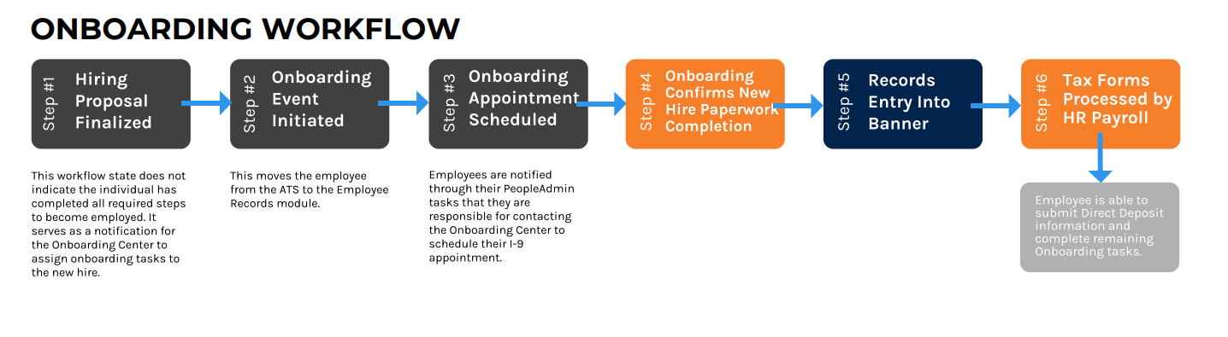
Captain hr: charting a course for success
Onboarding workflow - Departmental perspective

Slide 5
Crew harmony: commitment to collaboration
Onboarding key players
Human Resource Liaisons
Possess overarching Employee Records Module access
Responsible for notifying OBC of unique departmental onboarding needs
Department Admins/Hiring Manager
Typically possess department view only access in the Employee Records Module
Responsible for ensuring the accuracy of information within the hiring proposal
Departmental Onboarding Contact
Serves as the primary point of contact for the OBC.
Responsible for addressing questions and concerns related to the new employee’s onboarding progress
Supervisor
Assists with new hire transition into the University
Responsible for setting clear expectations and providing guidance to new employee
Onboarding Specialist
Initiates and monitors completion of onboarding tasks
Responsible for processing work authorizations
New Employee
Responsible for completing onboarding tasks in a timely manner.

Slide 6
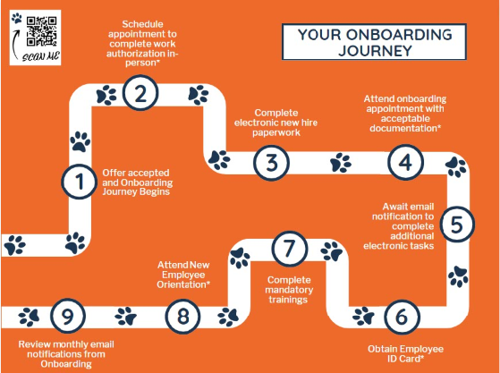
New hire journey – setting sail for successful onboarding

Slide 7
Non-faculty & Faculty PA Onboarding Checklists
New hires are assigned onboarding checklists in phases:
Phase I: Initial Onboarding tasks
Phase II: Employee type onboarding tasks
Assigned when hiring proposal is finalized
Schedule an appointment to complete I9
Complete New Hire Paperwork (PDF, tax forms)
Attend Onboarding Appointment
Review AA/EEO Policies
Assigned when Banner record becomes active
Activate AU Access/Email
Install DUO
Setup Direct Deposit
Obtain employee ID card
Complete audit and compliance tasks
Notes:
New hires are assigned onboarding checklists in phases:

Slide 8
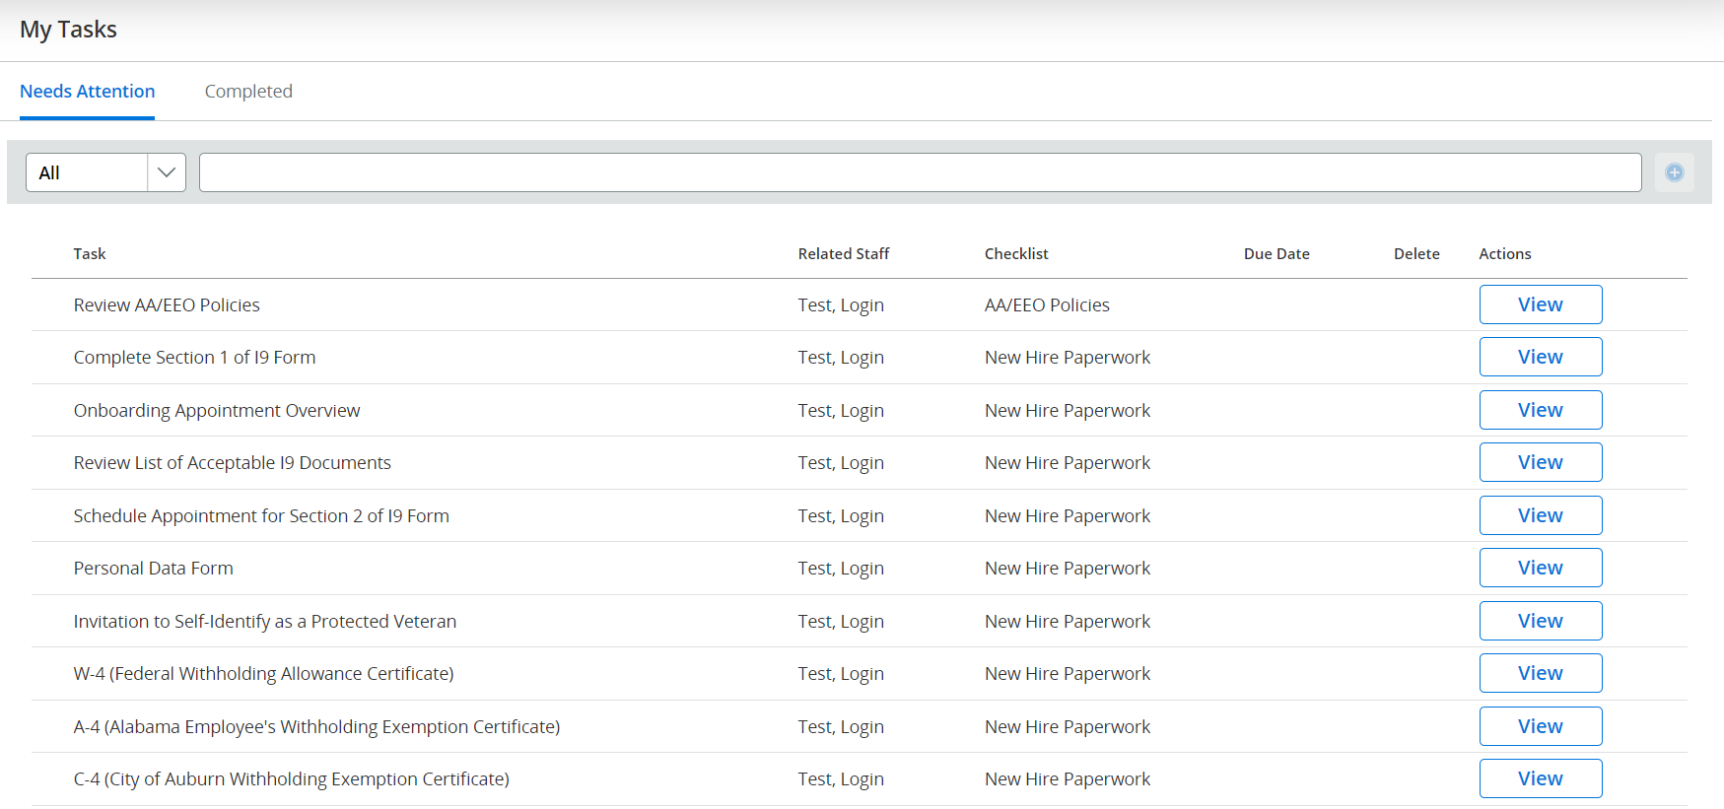
PA onboarding checklists
Employee view – Initial onboarding tasks

Slide 9
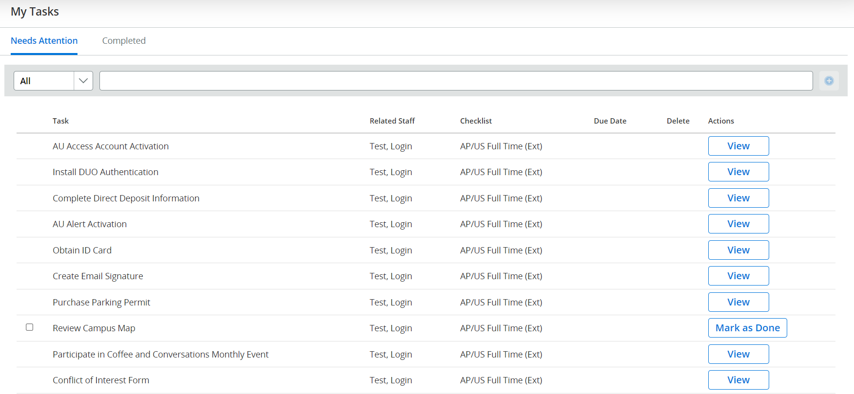
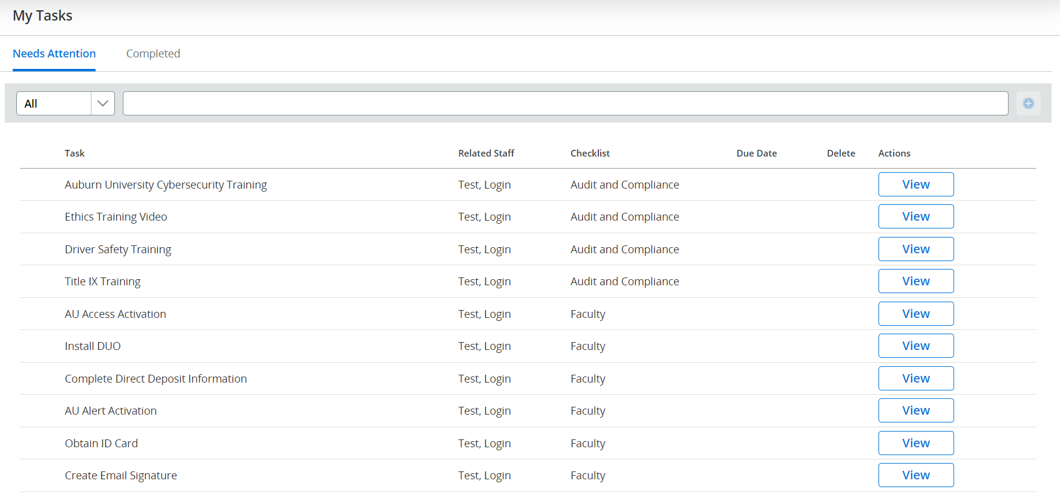
PA onboarding checklists
Employee view – Employee type checklist

Slide 10
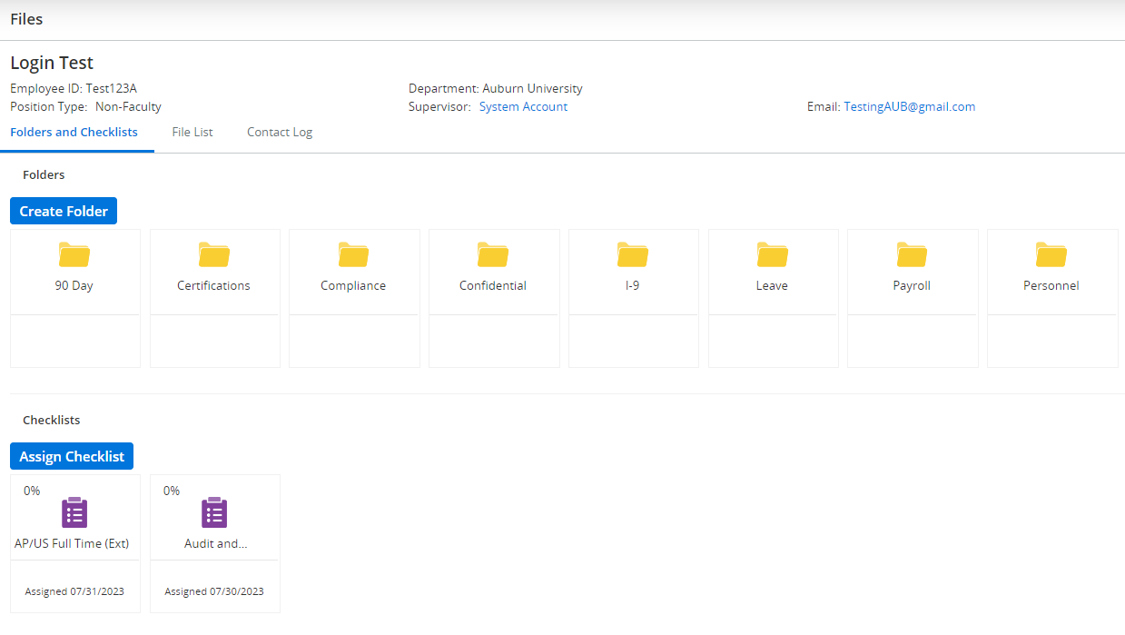
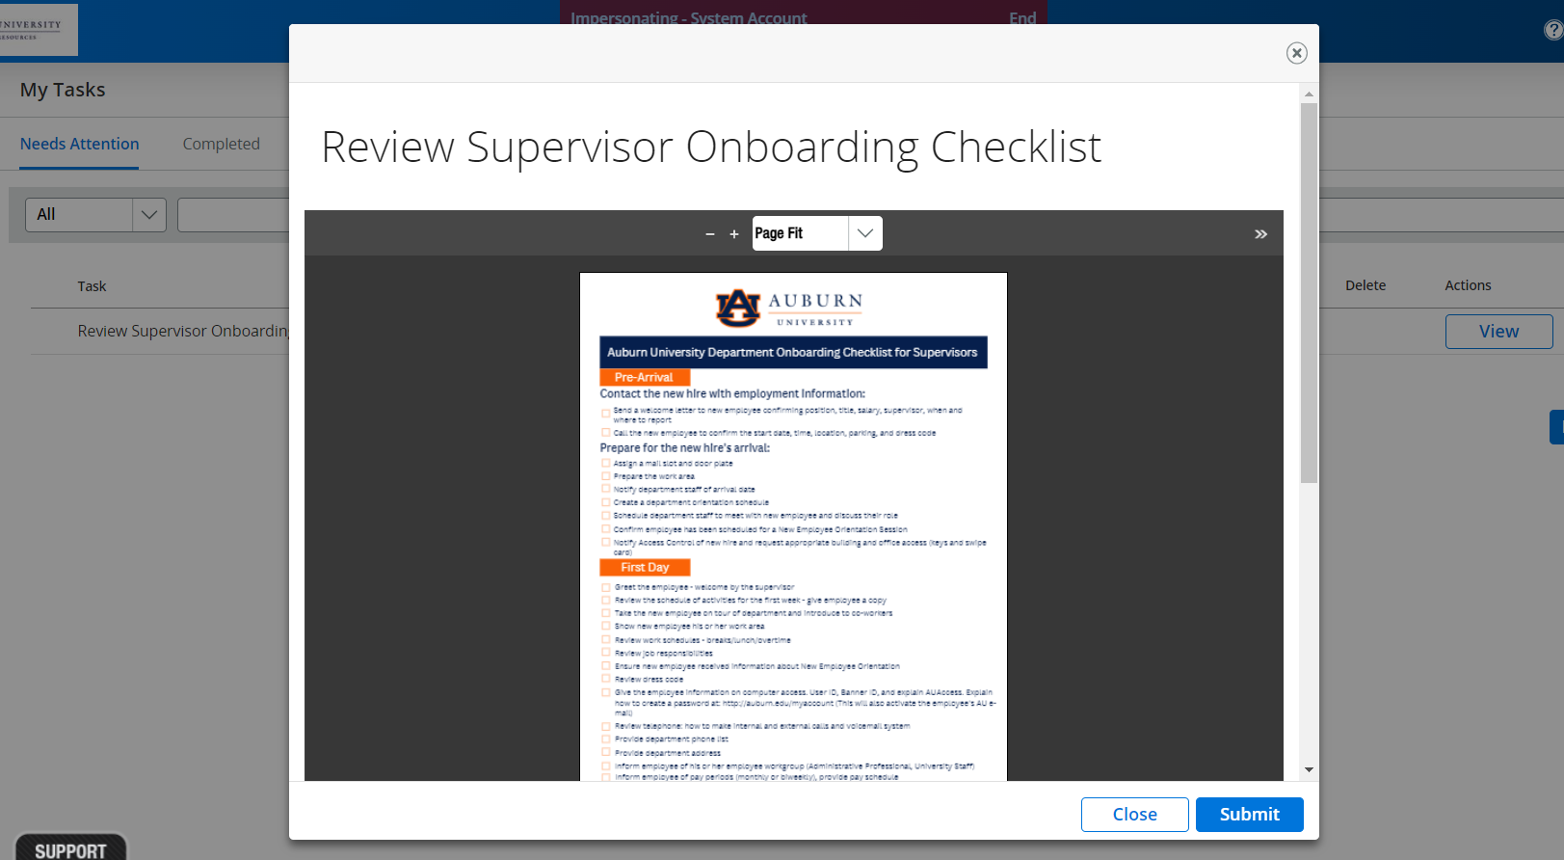
Departmental view

Slide 11
Foreign nationals
sailing safely through unchartered territory…

Slide 12
Foreign national Checklist
2-step process
Step 1: tax compliance form
Step 2: Foreign national information system
Located on tax compliance website
Available form options
Foreign National Tax Form and Document Upload
Lawful/Conditional Permanent Resident Status
Change of Status to US Citizen*
Requires upload of work authorization documents and visa
Following the submission of the tax compliance form, employees receive login information to activate their FNIS account
Requires account setup
Employees receive username and must request a temporary password to successfully register their account
Must complete all required sections
Must review and acknowledge submission
Work Authorization dates are sent by tax compliance
Department
Human Resources
Form I9 cannot be processed until work authorization dates are received
Notes:
Highlight access/visibility issues

Slide 13
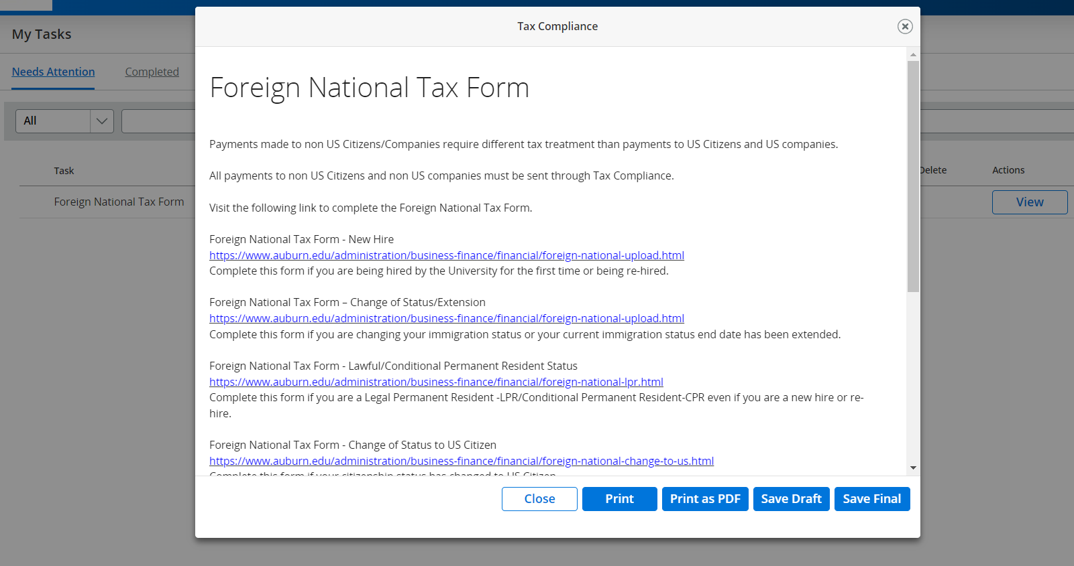
PA onboarding checklists
Foreign national

Slide 14
PA email notifications
When?
Who?
Where?
PA notifications are systematically driven in the Employee Records Module
as checklists are assigned in the ERM
as checklist due dates approach
as outstanding tasks remain in queue
as action needs to be taken on documents
New employees
Departmental Onboarding Contacts
Hiring Managers
Supervisors
Initial PA notifications are sent to the email provided in the application/hiring proposal
24 hours following Banner entry, future PA notifications are sent to Auburn email addresses*

Slide 15
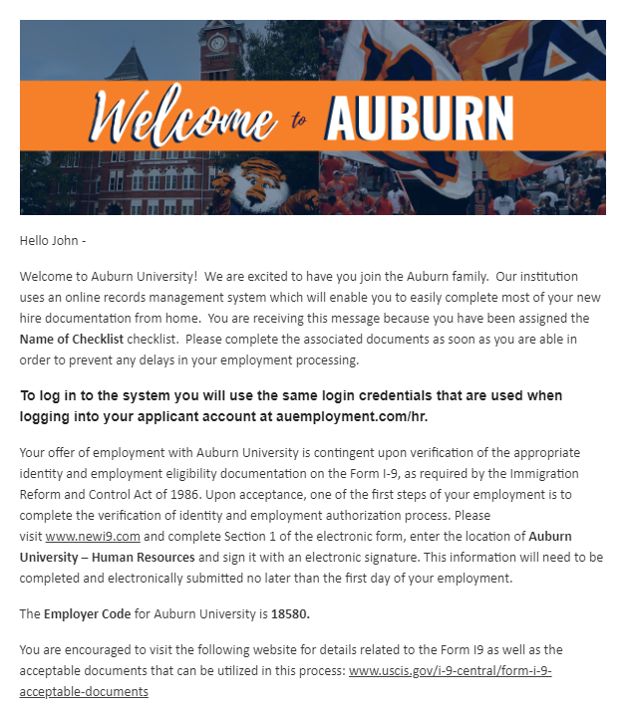
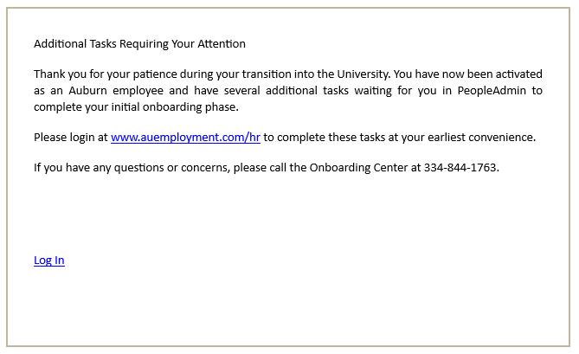
PA Email notification examples
Initial welcome email
Task Reminder Email

Slide 16
onboarding – hoist the sail and take control
Best practices to ensure smooth sailing through tumultuous times
When can employees setup direct deposit?
The most commonly asked question we receive in onboarding is related to when employees can setup their direct deposit. Employees must complete both section 1 and section 2 of their Form I9 as well as their electronic new hire paperwork before they are able to input their direct deposit information in Banner.
Develop a Departmental Onboarding Guide
Identify internal processes to guide departmental onboarding
Consider unique trainings, activities, nuances, or cultural implications that may impact the onboarding experience
Conduct supervisor training
Ensure that supervisors understand hiring and onboarding processes
Provide the supervisor onboarding checklist as a quick reference to effective onboarding
Attend HRD Onboarding Training
Onboarding launched an HRD training in the Spring 2023. Register for future sessions through Elevated!
Ask Questions, Make NO Assumptions!
Both Student Employment and Onboarding are here to support your hiring efforts.
Work Authorization Documents
Communicate with employees EARLY in the hiring process about work authorization verification and required documentation
Only original documents can be accepted
NO EXCEPTIONS!… but there maybe options*
PeopleAdmin is your “FRIEND”
The system provides insight to the onboarding progress of each new employee
Frequent monitoring allows you to anticipate delays before they arise
Be aware of self-reporting accuracy

Slide 17

finding true north – onboarding misconceptions
Rehires do not complete form i-9
Individuals with prior employment with the University must complete work authorization each time they are rehired, if they have been TERMEE’d
Individuals that have been TERMJB’d do not require a new I9
Social security letters are issued at obc
Foreign National employees that need to obtain a social security number for work authorization purposes must work with the Office of International Programs and their department to obtain required documentation to submit with their Social Security Application.
ID cards are issued same day as OB appointment
EPAF processing is required before an employee can obtain their ID card
Employees are usually able to schedule an ID card appointment within 48 hours of completing their Form I9
Employees that begin work remotely must wait until they are on campus before they can obtain their ID

Slide 18
common misconceptions continued…
Completion of the tax compliance form only is sufficient
Username and banner ids are assigned in onboarding
Foreign national employees should complete all us tax forms
Completion of foreign national tax compliance is a multi-step process.
Step 1: Completion of tax compliance form
Step 2: Activation of FNIS account
Step 3: Completion of FNIS account profile
Step 4: Confirmation of information sent in FNIS
Step 5: Receipt of work authorization dates
Banner ID and username are established/verified during the background check phase of the employment process.
Banner ID and usernames are provided to new employees during onboarding appointment
Most foreign national employees are not required to complete the Federal Employee’s Withholding Certification (Form W-4)
This form is only applicable to US citizens and Lawful Permanent Residents
Applicable federal tax forms are processed through the Foreign National Information System and are initiated by the Tax Compliance Office.

Slide 19
Onboarding faqs – anchoring on facts
Do internal transfers require a probationary period review? No, transferring departments should work together to complete an annual performance review for non-faculty internal transfers.
When do faculty receive Canvas and email access?
Faculty are provisioned or ”flagged” for Canvas access at the time their hiring proposal is finalized.
Under extenuating circumstances Faculty can be flagged per department and Provost office approval prior to HP finalization.
Email can be accessed to earlier than 30 days prior to hire date due to security reasons.
Email activation requires completion of Form I9/work authorization, new hire paperwork, and EPAF processing.
Employees receive email notifications from PeopleAdmin to complete account activation tasks once their EPAF has been successfully processed.
What is the reverification process?
Foreign national employees with specified work authorization dates must provide updated documentation to support extended employment on or before the expiration of their current work authorization.
Employees receive Banner email notifications 90 days in advance to take action to update work authorization.
What actions are needed to activate an employee in Banner?
Within 30 days of hire date
Finalized hiring proposal
Completed work authorization (incl. tax compliance, where appl.)
PeopleAdmin New Hire Paperwork
Can new hires complete a virtual I9* if they do not live in Auburn?
Currently, Form I9 work authorization verification must be completed in person.
New hires may contact the Onboarding Center at 334-844-1763 to coordinate the completion of a reciprocal I9.
New hires that reside throughout the State of Alabama may utilize local county extension offices to complete their work authorization (this applies to all employee types)
New hires that reside outside of the state typically complete work authorization at local higher ed institutions.
Foreign National new hires that reside outside of the U.S. will not need to complete work authorization until they touch U,S, soil.

Slide 20
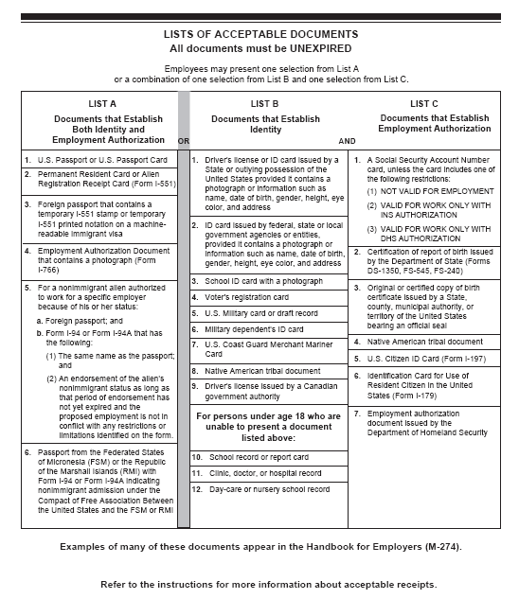
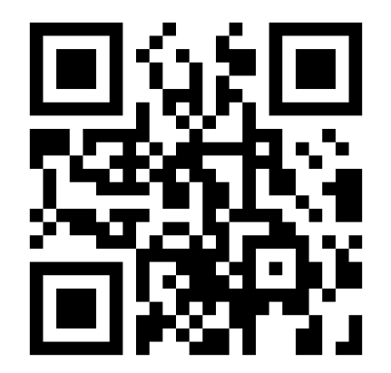
Additional faqs
How do I access tasks or monitor employee onboarding progress in peopleadmin?
What documents should employees bring to their onboarding appointment?
It is recommended that employee's access PeopleAdmin through AU Access instead of links embedded in email notifications.
Once you are logged in to AU Access:
Click Employees tab under AU Access
Scroll down to the employee tools section of the page
Click the PeopleAdmin AU Talent Management icon
In the top left corner of the screen, click the three blue horizontal dots
A menu should appear, Select the option that says Employee Records
The Employee Records Module should open in a new window in your browser
Outstanding tasks should be listed here
.

Slide 21
Are there additional resources to guide through the onboarding process?
PeopleAdmin
Aub.ie/pa7
ERM Manual, Training Videos (ERM overview, Probationary Period Review Form)
Onboarding Center Website
New Employee Resources
Videos
Timelines
Campus and Community
FAQs
Departmental Resources
Role clarification
Hiring and onboarding workflows
FAQs
HRD Onboarding Course
HR104C: Onboarding: Making Connections and Bridging Gaps
Focus on departmental onboarding activities
Explore new hires’ transition from University onboarding to departmental onboarding
Onboarding Center
Address: 1530 E Glenn Ave, Auburn, AL 36830
East Glenn Transit Line
Phone: 334-844-1763 / Email: onboard@auburn.edu
*Staff:
Jennifer Gilliland
Gene Sludge
Kesha Chapman
Kristine Ball

Slide 22
QUESTIONS?

Slide 23
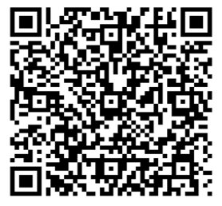
Thank you for attending!
We would love your feedback. Please scan the QR code to fill out a feedback form.

