Slide 1
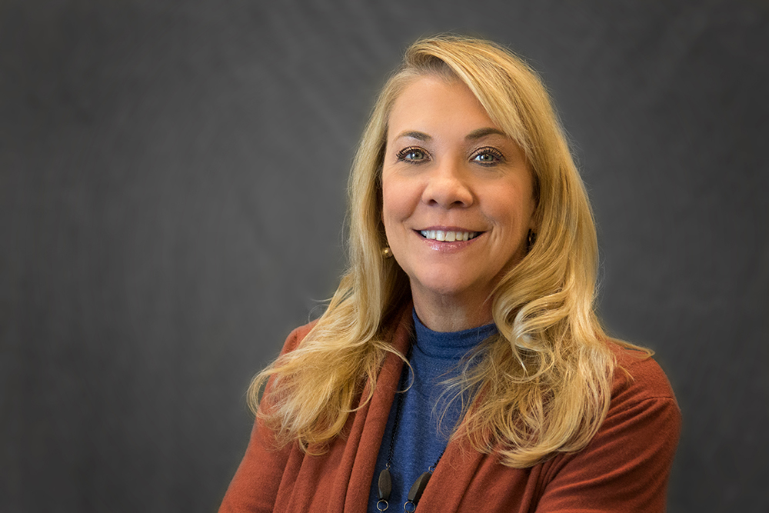


DOCUMENTING THE EMPLOYEE LIFE CYCLE
Ann Shore and Sonya Dixon
UHR Benefits and Campus Relations
August 2, 2023, 1-1:50 p.m., Oak Room II

Slide 2


Employee Lifecycle related to payroll & employee Benefits
Ann shore, Executive Director, Peb , Human resources

Slide 3
EMPLOYEE LIFE CYCLE
Agenda
Employee is hired (after Onboarding)
Employment Tenure
Employee Dies while an active employee
Employee resigns
Nonretirement termination
Retirements termination
Other things to know

Slide 4
An employee is hired: Employee life cycle
Must attend New Employee Orientation within 30 days of hire date
Benefit election/enrollment must be completed within 30 days of hire date per AU Section 125 Plan.
Benefits are covered in detail with active enrollment during NEO for all full-time benefit eligible employees.
Onboarding in department to cover many items including:
Kronos training; clocking if non-exempt
Requesting annual/sick/other leave
Pay schedules
Department specific information
Ideally-who admins and HRLs are in the department
What else is best practice?

Slide 5
During employment of the employee :
Employee lifecycle
Annual Leave Accrual (Excluding F9 Faculty and Coaches)
-Full time eligible employees accrue at 13.34 hours per month (160 hours per year)
-Part time employees who have an FTE accrue at a prorated amount based on the FTE
Sick Leave Accrual
Full time employees accrue at rate of 8 hours per month (96 hours per year)
Requests time off in Kronos
Supervisor approval/Timekeeper
Takes different types of leave over employment tenure
Uses health and welfare benefits to include health, dental, vision, supplemental plans, retirement plans, disability, etc.
PEB here to assist!
benefit@auburn.edu; payroll@auburn.edu

Slide 6
During Employment of the employee :
Employee Lifecycle
If eligible may use leave to include:
FMLA- REQUIRED NOT OPTIONAL – Must be eligible and must be approved by HR
Annual Leave
Sick Leave
Paid Parental Leave
Salary Continuation Plan
Bereavement Leave
Jury Duty Leave
Military Leave
On the Job Injury (OJI)
Professional Improvement Leave (PIL)
Leave without pay
Voluntary or Involuntary

Slide 7
Employee dies while employed
Employee Lifecycle
Contact Linda Sanders in PEB for life insurance information
PEB sends beneficiary paperwork/information for The Standard (term life insurance)
Basic to $35k for full time benefit eligible
Certified death certificate required with claim form/PEB will assist with form completion
PEB sends information for RSA Teacher’s Retirement to family/beneficiary
If the employee is not eligible to retire the beneficiary receives member contributions, total interest earned and one year of the employee’s annual salary
If the employee is eligible to retire and the beneficiary is a spouse, the spouse has a choice of a lifetime monthly benefit option 2 (100%)
If the beneficiary is not a spouse the beneficiary has a choice of option 3 (50%) or the beneficiary can choose to receive the member contributions, total interest earned and one year of the employee’s salary
Certified death certificate required along with RSA Survivor Beneficiary Form- PEB will process and send to TRS

Slide 8
Employee dies while employed
Employee Lifecycle
Contact Debra Walters in PEB regarding welfare benefits to include health, dental, vision
COBRA offered on certain plans if eligible dependents covered (see above bullet)
May be eligible for other reimbursement from supplemental plans such as Cancer Plans, Critical Illness, additional life insurance
Options with voluntary retirement plans based on beneficiary – rollover, cash out, etc.
Final paycheck issued
Annual leave payout issued if employee has balance (up to 173.3 hours)
Advise Employee Relations
Advise if Employee Assistance Program (EAP) is needed for department and or family
Use correct termination code on EPAF with date of death – Sonya has list to distribute
Stress importance of updated beneficiary information in Self Service Banner

Slide 9
Employee resigns (not trs retirement)
Employee lifecycle
Assign correct termination reason on EPAF
Send EPAF and resignation letter to humnres@auburn.edu
Ensure EPAF is the last day of employment (date on letter)
PEB will send COBRA information where applicable
Employee will contact RSA/TRS if vested at appropriate age requirement; RSA will contact AU PEB for certification; if employee not vested, they contact TRS for options
Some portability options with supplemental plans such as life, cancer, critical illness
Choices regarding voluntary retirement plans (403b, 457b, Roth) to include rollovers, cash out or leave at AU
Annual leave, if available, up to 173.3 hours will be paid out
Bi-weekly-next pay period
Monthly/Semi-monthly- as soon as possible after PLOP is processed

Slide 10
Vested employee retires (trs retirement)
Employee lifecycle
Employee meets in advance with Linda Sanders in PEB for completion of paperwork; employee is required to complete certain things, covered in meeting with due dates communicated- MUST MEET TRS DEADLINES!
All completed paperwork must be submitted to TRS a minimum of 30 days in advance and maximum of 90 days in advance of retirement date
Select correct termination reason on EPAF-RETD and correct termination date
Send EPAF and resignation letter to humnres@aubur.edu
PEB will send COBRA paperwork where applicable
Some portability options with supplemental plans such as life, cancer, critical illness
Choices regarding voluntary retirement plans (403b, 457b, Roth) to include rollovers, cash out or leave at AU
Annual leave, if available, up to 173.3 hours will be paid out
Bi-weekly-next pay period
Monthly/Semi-monthly- as soon as possible after PLOP is processed

Slide 11
aU Annual retirement seminars
Employee Lifecycle
Annual retirement seminars held at AU include
RSA/TRS/PEEHIP*
Social Security Administration
Tier I retirement- Johnson Sterling
Tier II retirement- Johnson Sterling
* Employees invited include employees that are already vested and/or within 5 years of vesting eligibility

Slide 12
Other information
Employee lifecycle
HRD classes for Payroll, Benefits, Kronos, Financial Wellness, etc.
Tiger Perks program
Postdoc benefits are different per Graduate School request-separate BAG for them
Dependent Education Benefit
Employee Education Benefit
All employee are eligible for the Employee Assistance Program (EAP)
Up to six “free” visits per year per covered employee/eligible dependent
New health plan option this year- High Deductible Health Plan with Health Savings Account
Watch for emails, postcards, Governance group meetings, Town Halls
OPEN ENROLLMENT DATES ARE DIFFERENT FOR 2023
October 16-November 15, 2023
NO LATE ENROLLMENTS OR CHANGES WILL BE ALLOWED

Slide 13
Questions? Comments?
war eagle!

Slide 14
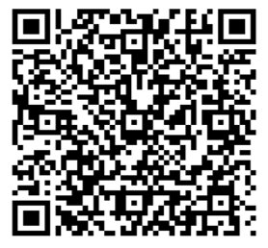
Thank you for attending!
We would love your feedback. Please scan the QR code to fill out a feedback form.

Slide 16
OPEN

