Slide 1

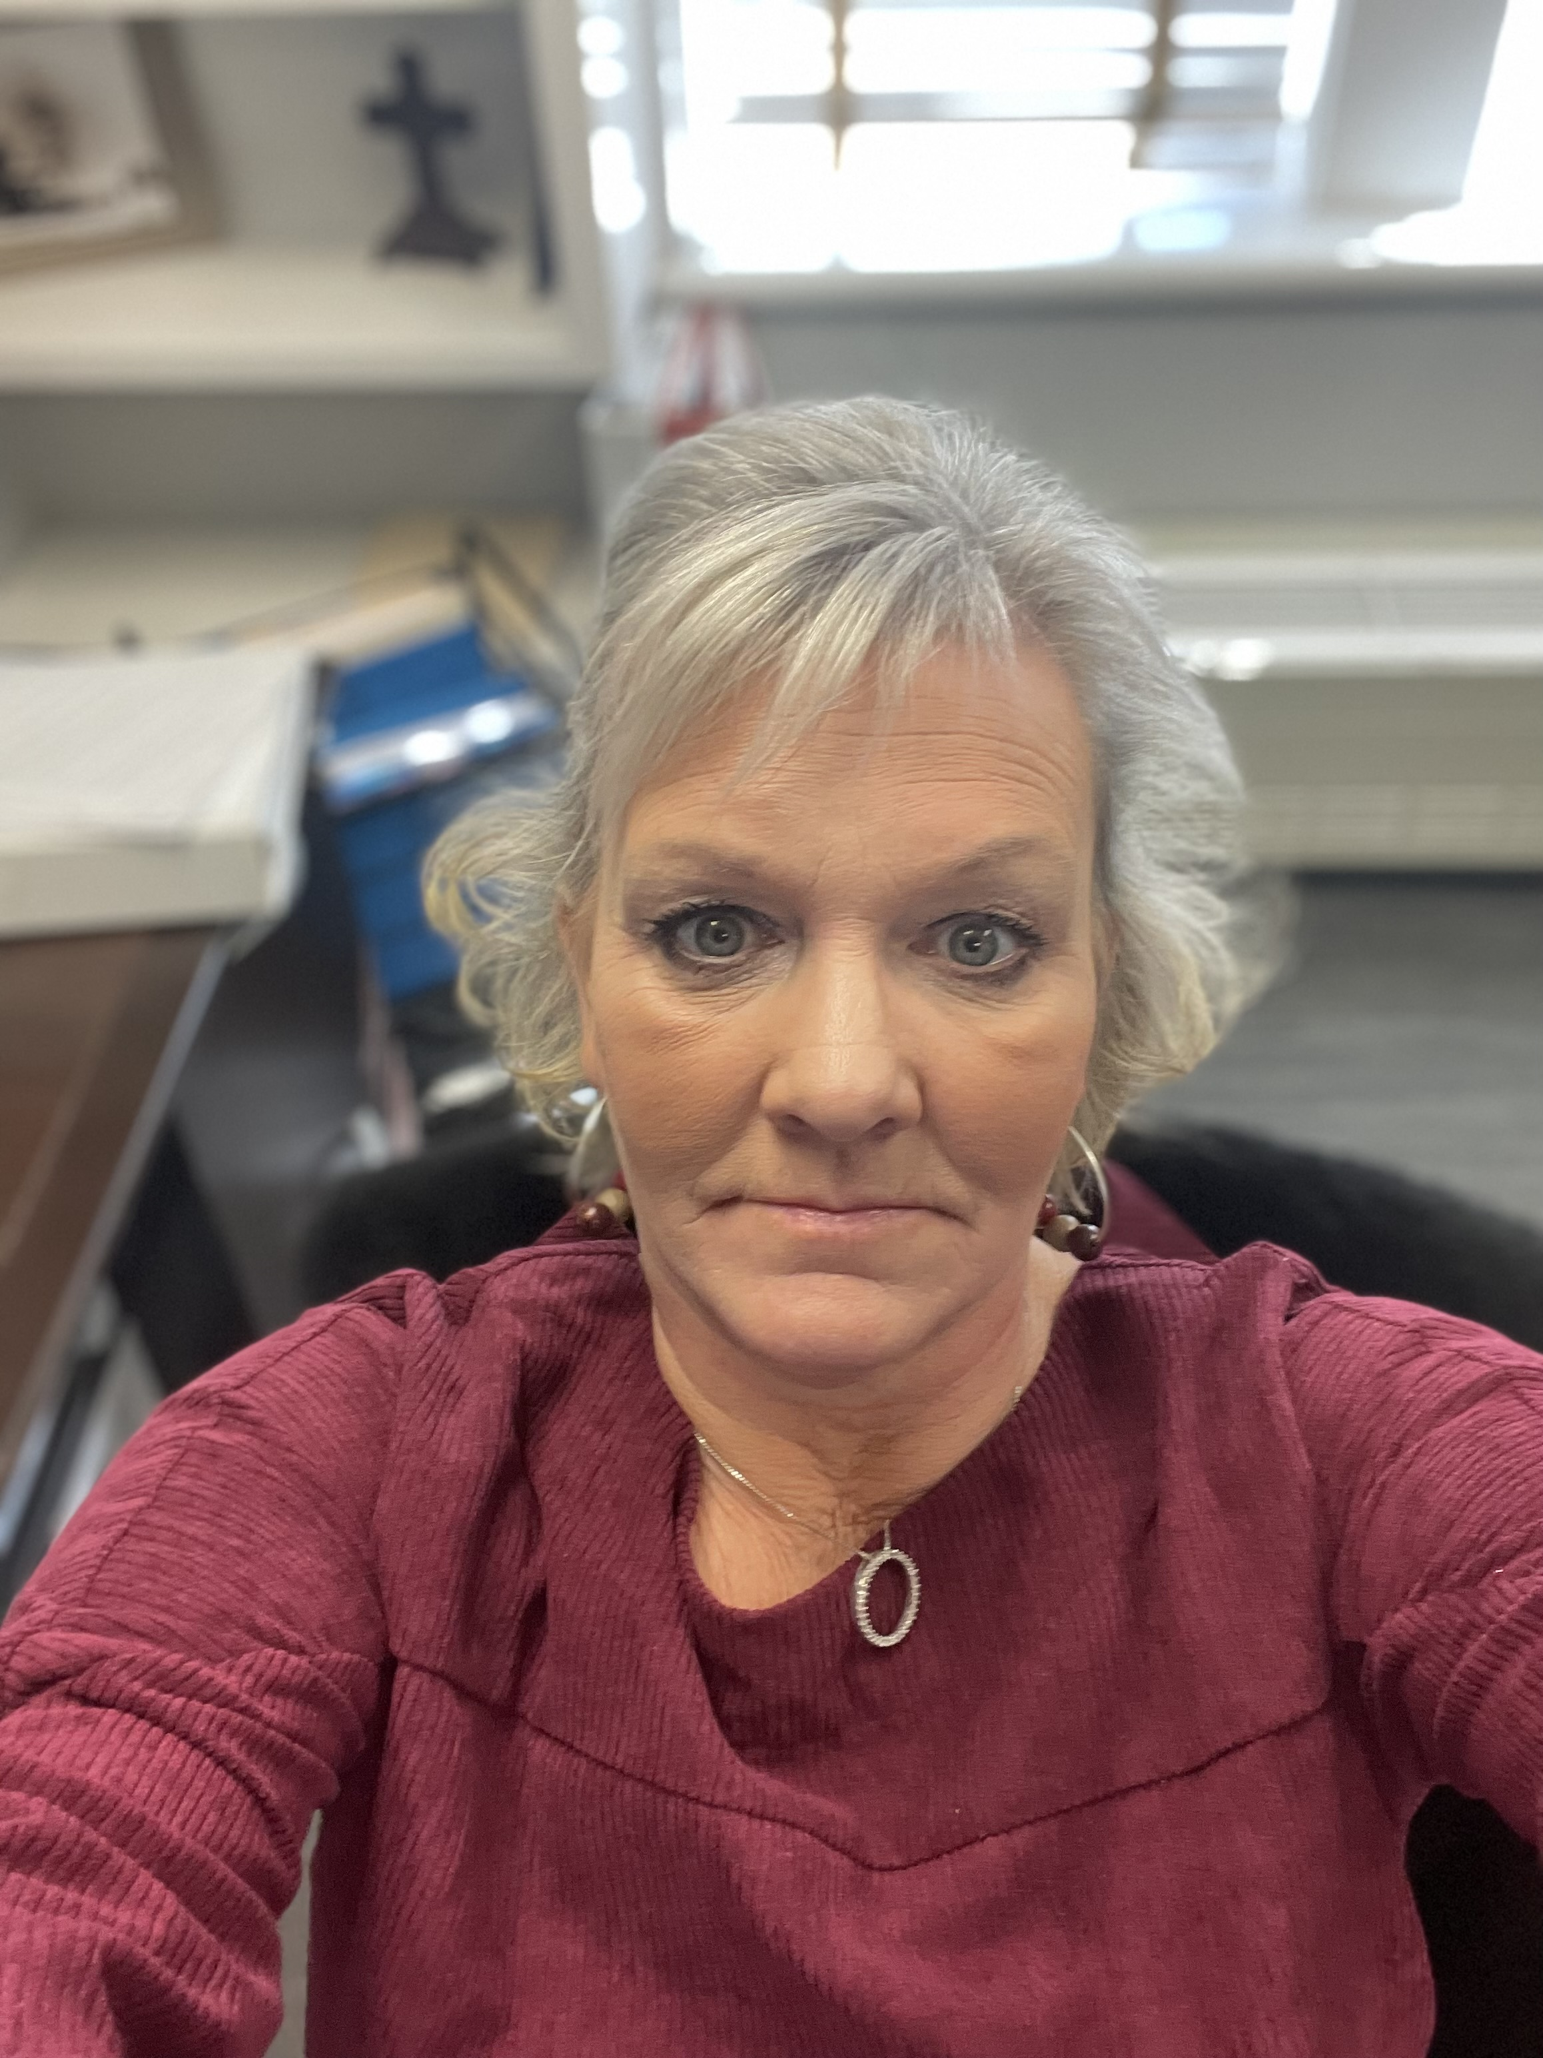





FOREIGN NATIONAL HIRING PANEL
Obrad Budic, Tammy Moore, Rod Kelly, Leanne Fuller, Abbi Brown, and Kristine Ball
August 2, 2023, 2-2:50 p.m., Camellia Room

Slide 2

Foreign National employment
The Basics

Slide 3
TOPICS
Foreign National Employment Flow Chart
Prevailing Wage and H-1B
Tax Compliance
Work Authorization (Form I-9 and E-Verify)
Resources
Q & A

Slide 4
Foreign national employment Flow chart
Hiring Department*
Office of International Programs**
Office of Tax Compliance
Onboarding Center or TES Office
University Human Resources Records
Onboarding Events Initiated***
*Hiring departments considering H1-B sponsorship on behalf of a foreign national for an A&P position must submit a “Request for Determination of Support for Sponsorship” to AUHR prior to contacting OIP to initiate processing actions.
** The Office of International Programs issues documents for F-1 and J-1 students, J-1 scholars, and H1-B sponsorships.
*** Following the completion of the hiring proposal, foreign national employees are assigned the following Onboarding tasks:
Submission of Foreign National Tax Form
Completion of Foreign National Information System (FNIS)

Slide 5
Prevailing Wage And H-1B

Slide 6
Prevailing wage
The Immigration and Nationality Act (INA) requires that the hiring of a foreign worker will not adversely affect the wages and working conditions of U.S. workers who are comparably employed.
To comply with the statute, the Department of Labor’s (DOL) regulations require that the wages offered to a foreign worker must be the prevailing wage rate for the occupational classification in the area of employment.
If the prevailing wage if lower than the offered salary, then we can proceed with an H-1B.
If the prevailing wage is higher than the offered salary, then the department will have to decide to meet the prevailing wage or not proceed with the H-1B.
$ NOTE: The new hire pay level may be a “triggering event” that warrants a “pay alignment review” if:
Pay level leads to a potentially unjustifiable pay compression or inversion relative to another similarly situated employee’s pay level within the same hiring team, unit, department, or division.
If so, contact Bailey Ward, Manager of Compensation Administration at (334) 844-1601
H1-B prevailing wages are processed through our immigration attorney and take up to 14 days
Permanent Residency prevailing wages are processed through the DOL and processing varies from 8-12 months

Slide 7
H-1B
What is an h-1b?
What are the Barriers to an H-1B?
Performs services in a “specialty occupation” requiring
(A) theoretical and practical application of a body of highly specialized knowledge, and
(B) attainment of a bachelor’s or higher degree in the specific specialty (or its equivalent) as a minimum for entry into the occupation in the U.S.
Six-year limit: Initial period of stay up to 3 years; Extensions in up to 3-year increments thereafter
Employer, Job and Location Specific: Employment is limited to the specific employer and employment specified in the H-1B petition, but it is possible to have multiple concurrent H-1B petitioners
Dual intent
212e 2-Year Home Residency Requirement
Proof of 2 years in home country or 212e waiver
Degree
Bachelors or higher
Had to have already obtained degree within major indicated on job posting
If not U.S. degree, must have credential evaluation from OIP approved company
Prevailing Wage too high
Country of Citizenship

Slide 8
How to start the h-1b process faculty positions
1
2
3
Complete a Prevailing Wage Request Form
Submit the Completed Prevailing Wage Request Form
Prevailing Wage Calculation
The Prevailing Wage Request Form can be accessed at:
International Student and Scholar Services>Non-Immigrant Employment
Email the completed form, along with the job description, to:
Shellyn Beltran, H-1B Advisor – snb0051@auburn.edu
The Prevailing Wage will be calculated by an attorney and returned to the department once complete.
Common H-1Bs at Auburn University include:
Postdoctoral Fellows, Lecturers, Assistant Professors, Associate Professors, Professors, and Research Professors
Note:
The position must be a full-time benefits eligible position. Auburn University does not provide sponsorship for part-time positions, or positions are ineligible for benefits.

Slide 9

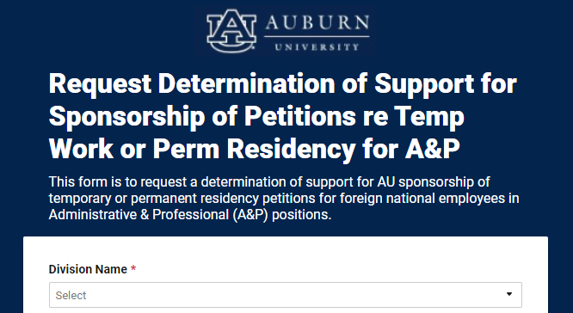
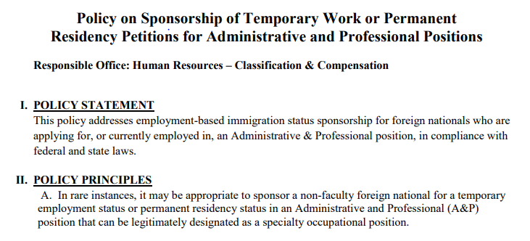
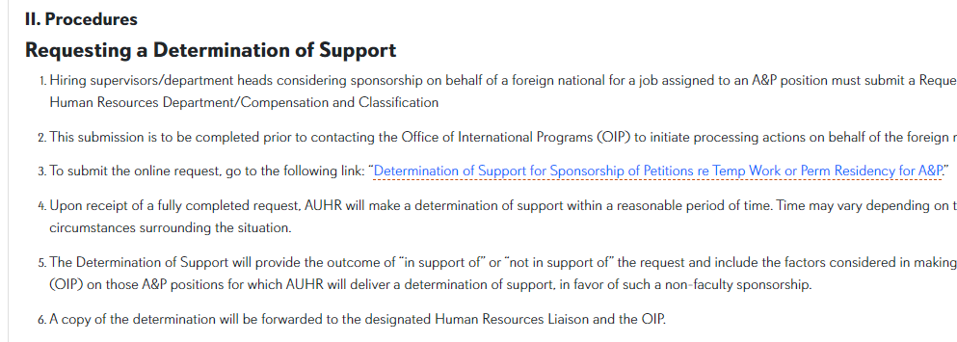
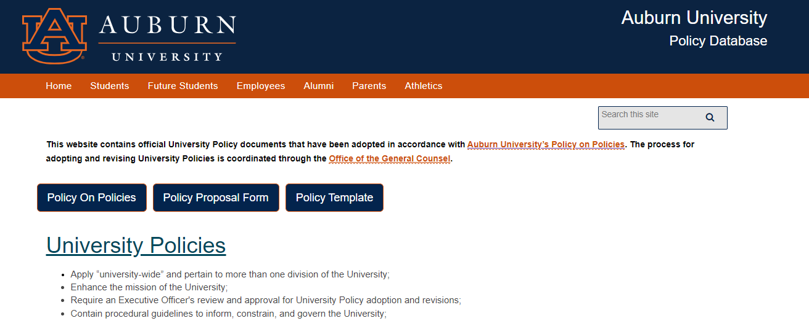
Request for sponsorship determination process a&P positions
1
2
3
Hiring Dept: Submit Request for Determination of Support
UHR Review:
Position Eligibility (SOP)
UHR Review:
Candidate Eligibility
Full-time/benefits eligible only
Highly specialized knowledge in fields of human endeavor, such as architecture, engineering, mathematics, physical sciences, social sciences, medicine and health, education, business specialties, accounting, law, theology, or the arts
Not a specialty occupation if attainment of a general degree, such as business administration or liberal arts, without further specialization, is sufficient to qualify for the position
Support must be received from UHR prior to initiating sponsorship actions with OIP
Submit online request to UHR via Smartsheet link please include:
Resume/CV
Posting Announcement
Job Description
Pay Evaluator© Work History Tab
Foreign national currently and lawfully in the United States
Possess MQs as published on JD
“Specialized studies” must be directly-related specific specialty to the position.
Qualifications have NOT been gained through AU employment
Smartsheet
Submit
Policy
Procedure

Slide 10
Request for sponsorship determination process - Continued A&P positions
4
5
Department
Contacts OIP and Submits Prevailing Wage Request Form
UHR
Prepares Determination Memo
UHR collaborates with the HRL and OIP, as needed
Determination Memo is signed by the Associate VP, Human Resources
Memo sent to HRL, Manager, OIP:
“Supported” or “Not Supported” Sponsorship
To HRL with cc: Manager, OIP
If Sponsorship is “Not Supported”:
Department or foreign national can reach out to International Student & Scholar Services (ISSS) to discuss available options
If sponsorship is supported, email the completed prevailing wage form, along with the job description, to:
Shellyn Beltran, H-1B Advisor snb0051@auburn.edu

Slide 11
Tax Compliance

Slide 12
Tax Compliance Process
1
2
3
Employee completes the Foreign National Tax Form and Document Upload
This form should be used for all new hires, re-hires, or extension/change of status
Employee receives an email from the FNIS system to complete additional information. The information helps to determine:
Tax status
This form should be completed by the employee when they are ready to be hired or have received a change of status and have received all appropriate documents from OIP
Taxes to be charged
Qualification for tax treaty benefits
Legal dates of work authorization
Tax Compliance Office emails the hiring department and the Onboarding Center (or TES Office) the legal dates of employment.
After the employee has received a SSN, Tax Compliance Office sends all appropriate tax forms to the employee through their FNIS account
The system allows the employee to receive an annual 1042-S tax form (if they need it), even after termination.
Tax Compliance Office receives the tax form and uploaded document(s):
This email indicates that the employee has completed all required tax compliance documents and is ready to move to the next step of the process.
The email the employee uses on the form is the email that the tax compliance notifications will be sent
Note: If the employee is changing status to a Lawful Permanent Resident (LPR) or is a new hire LPR, they will complete the Foreign National Tax Form for Lawful/Conditional Permanent Resident status. LPRs will not receive an email to complete FNIS. Dates will be sent to the department and Onboarding at that time.
4
5
Note: For an extension or change of status, the employee must update FNIS, but Tax Compliance will go ahead and send legal dates of work authorization to the department and Onboarding.

Slide 13
Work Authorization
(Form I-9 and E-Verify)

Slide 14
Form I-9 and E-VERIFY Process
1
3
New Hire
2
Employee receives an email from the Onboarding Center (or TES Office) with instructions for completing the onboarding process.
Notifications will come from PeopleAdmin to the email address provided in the employee’s application
Notifications will include: information for completing tax compliance requirements, as well as, instructions on scheduling an appointment to complete section 1 of the Form I-9.
Employee schedules an in-person appointment with the Onboarding Center or TES Office.
Employee must be prepared to bring their original work authorization documentation with them to the appointment.
Employee completes Form I-9
To ensure federal compliance, the Form I-9 and E-Verify process must be successfully completed no later than the third day of employment.
Note: E-Verify actions will not initiate if a new hire has not been issued a number by the Social Security Administration. Section 1 of Form I-9 will be placed ‘on-hold’ until the SSN has been issued.
Work authorization for foreign nationals must be re-verified if there is an end date noted on their work authorization documents.
Email notices are generated from Banner and sent to the employee and supervisor beginning 90 days from expiration date.
The employee must schedule an appointment with the Onboarding Center or TES Office to re-verify their work authorization prior to their work authorization end date.
Note: Tax compliance update requirements should be completed prior to Form I-9 reverification.
Employee should ensure they have completed the tax compliance requirements within FNIS prior to their scheduled appointment.
Reverification

Slide 15
Resources
Human Resources & Onboarding
Office of International Programs
Tax Compliance
Home Page: University Human Resources
Home Page: Onboarding Center
Policy: Sponsorship of Temporary Work or Permanent Residency Petitions for A&P Positions
Policy: Verification of Work Authorization and Identity through Form I-9 and E-Verify
Procedure: Requesting Determination of Support for the Sponsorship of Temporary or Permanent Residency Petitions for A&P Positions
Request Form: Determination of Support for Sponsorship of Petitions for Temp Work or Perm Residency for A&P
Resources: Foreign National Employment
Resources: Form I-9 Acceptable Documents
Homepage: Office of International Programs
Homepage: International Students & Scholars Services
Request Form: Prevailing Wage
Home Page: Tax Compliance Homepage
Form: Foreign National Tax Form and Document Upload
Form: Foreign National Tax Form for Lawful/Conditional Permanent Resident Status

Slide 16
Q & A

Slide 17
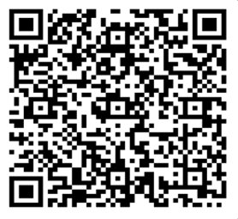
Thank you for attending!
We would love your feedback. Please scan the QR code to fill out a feedback form.

