Slide 1




EPAF’s and banner
April McFarlin, Joy Dowdy, and Michael Loyd
UHR Employee Records
August 2, 2023, 2-2:50 p.m., Terrace Room

Slide 2
Auburn University HR Records

Slide 3

Peopleadmin hiring proposals
Approval document for hiring all Employee Types
Audit
Accuracy of Information Critical
Banner record reflects information contained on Hiring Proposal
Timely and Complete Documentation
Delays affect an employee’s access
Upon completion of work authorization, the job record is completed in Banner 30 days prior to hire as a protocol
Documentation
Personnel File

Slide 4
Official personnel files
Xtender: web-based file system
No paper files maintained – paperless!
Audit
Legal & Open Records Requests
Retention schedule
Public Universities of Alabama Records Disposition Authority
University Policy pending approval

Slide 5
BANNER RESOURCES
HR Banner Resources
EPAF illustrations
Banner field information
Hours Per Pay Calculations
Employee Class Codes
Dates
Other
Training available:
Calendly link – one-on-one or group trainings available
Contact April McFarlin for details

Slide 6



humnres@auburn.edu
MEET THE RECORDS TEAM
April McFarlin
844-1615
mcfaral@auburn.edu
Joy Dowdy
844-1584
mjm0058@auburn.edu
Michael Loyd
844-7609
mbl0084@auburn.edu

Slide 7
QUESTIONS ?

Slide 8
We think YOU are amazing!
We appreciate all you do for Auburn employees.
Let us know how we can serve you.

Slide 9
Auburn University Human Resources 1550 East Glenn Ave. Auburn, AL 36830 334-844-4145

Slide 10
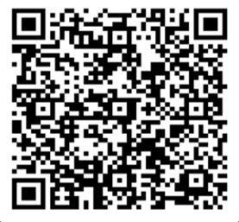
Thank you for attending!
We would love your feedback. Please scan the QR code to fill out a feedback form.

