Slide 1
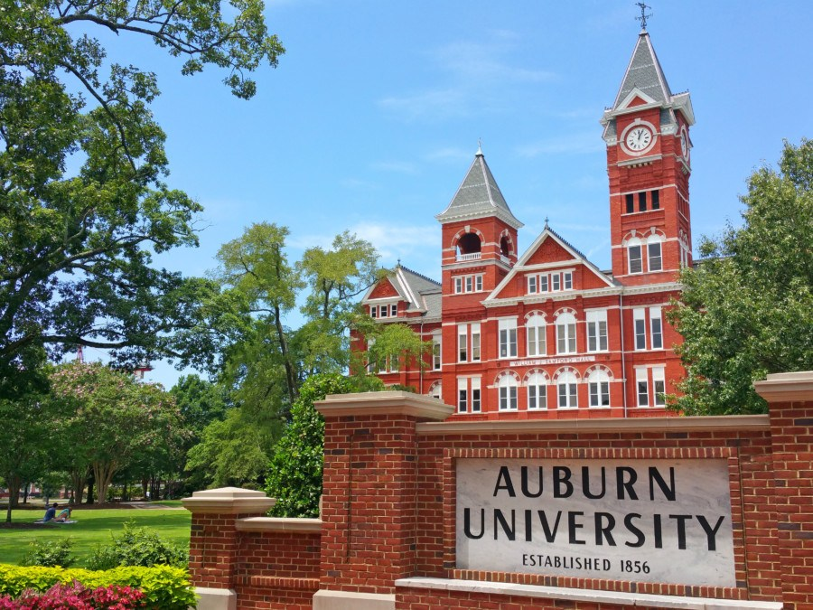
Administrative & Professional Assembly
Affirms its commitment to the principles of fair and equitable treatment and opportunity of all employees

Slide 2
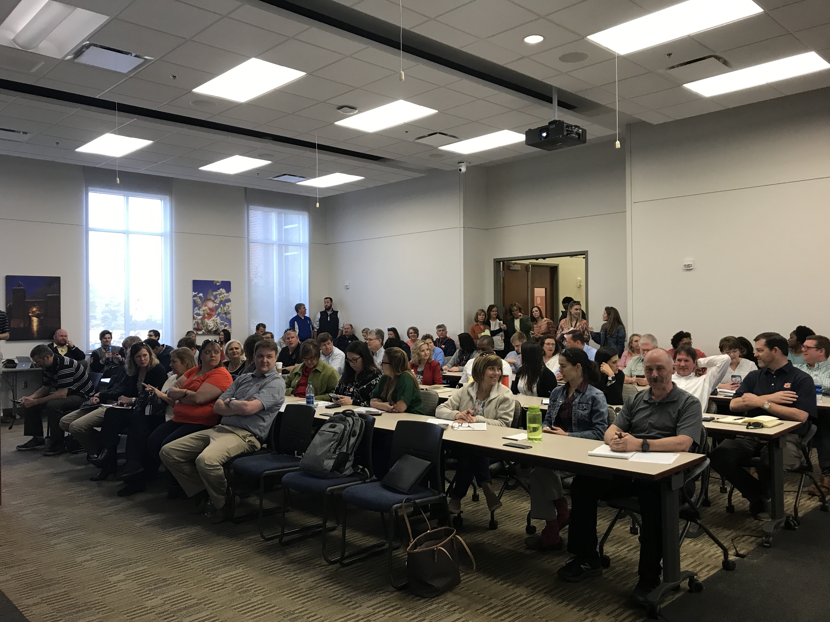
What is the A&P Assembly?
The A&P Assembly is an elected body established at Auburn University by authority of the Board of Trustees. The Assembly advises the President regarding policies, procedures, and general welfare issues affecting A&P employees. These include budget, resource allocation, employee welfare, campus calendars, schedules, and facilities.

Slide 3
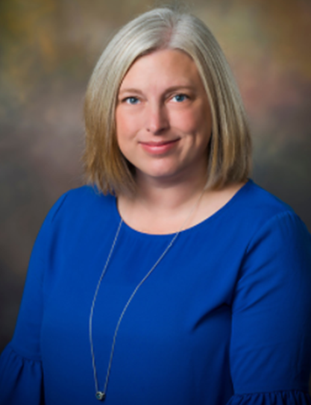
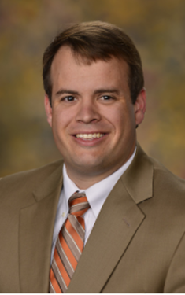
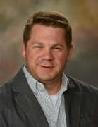
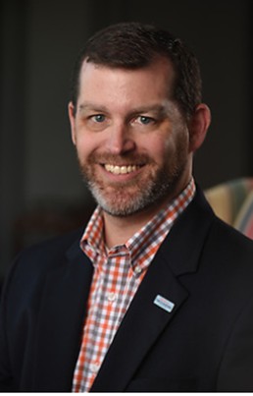
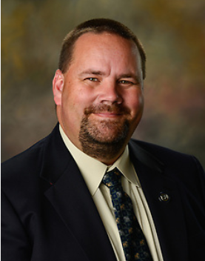
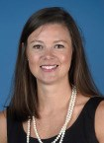
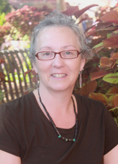
Paige Patterson
Chair
lanfokp@auburn.edu
Clint Lovelace
Chair-Elect
jcl0014@auburn.edu
Mark Bransby
Past-Chair
bransby@auburn.edu
Claire Wilson
Secretary
wilsoc3@auburn.edu
A&P Executive Committee 2020-2021
David Bess
At Large
bessdav@auburn.edu
Mike Stover
At Large
mike.stover@auburn.edu
Anna Thompson
At Large
gueriak@auburn.edu

Slide 4

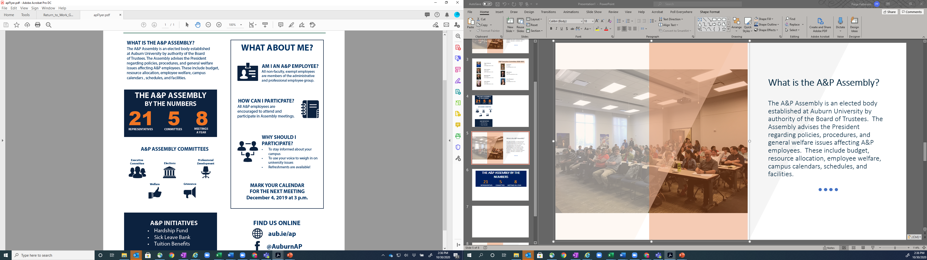
December 2, 2020 at 3pm

