Slide 1
Campus Parking Overview

Slide 2
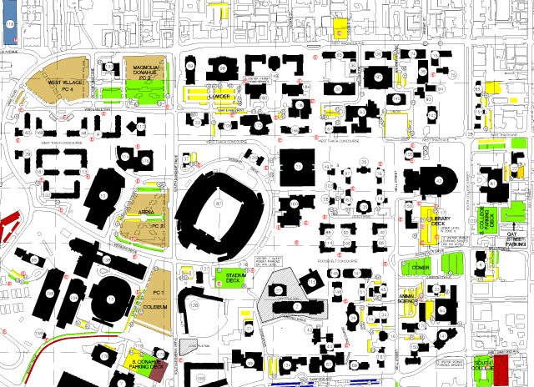
Current Parking
2018
2019
A-Zone
A-Zone
Issued| 3,367
Issued| 3,308
Spaces
Available|1,268
Spaces
Available|1,485
B-Zone
B-Zone
Issued|1,320
Issued|1,736
Spaces
Available| 2,986
Spaces
Available| 3,132
A-zone is designated as yellow and B-zone is designated as green on the map.

Slide 3
Parking Task Force Overview
Eliminate “Hunting License” Practice
- Current method utilized with all zones on-campus.
- Resulting in reducing stress of searching for available parking throughout the day.
Implementation of Zonal Parking
- Eliminate designated A, B, C, and other zones.
- Permits would be lot-specific.
- Requires allocation parking based on faculty/staff assignments derived from HR.
- Specific areas will be available for purchase at
a higher rate however, these will not be oversold.
- Other areas will be oversold by a small percentage and cost less.

Slide 4
Parking Task Force Goal
Implement Positive Changes to Parking
- Ensure all areas of campus are represented on the task force to achieve successful results.
- Utilize the results of the Transportation Demand Study.
- Reduce stress and frustration currently associated with
accessing campus daily.
One overview proposal of how campus could be divided to implement zonal parking.

