Slide 1

Postdoc Benefits
AU Human RESOURCES, GRADUATE SCHOOL, AND RESEARCH

Slide 2
What is Happening?
Effective Oct. 1, 2019, changes are occurring to several benefits that are available to eligible Postdocs at Auburn University.
Why? After reviewing our benefits, along with the benefits offered by other peer and statewide universities, we are updating these benefits to ensure that our total package to Postdocs remains competitive.
With this updated benefits package, AU will continue to attract talented researchers as Postdocs.

Slide 3
What is Staying the Same?
Postdocs can still take advantage of the following benefits:
Health insurance through AU’s existing employee group plan (for full-time Postdocs)
Voluntary benefits (dental, vision, cancer, critical care, supplemental life, and supplemental long-term disability insurances)
Flexible Spending Account (for medical and dependent care)
AU’s voluntary retirement plans (when applicable, Postdocs can still receive the University match)
Employee Education Benefits
Tiger Perks, AU Bookstore discount, and Auburn University Federal Credit Union

Slide 4
What is Changing?
Mandatory retirement
Leave accrual (paid time off)
Some employer-paid insurance plans
    Employer-paid, long-term disability insurance
    Employer-paid, salary continuation plan/short-term disability
    Employer-paid life Insurance

Slide 5
Mandatory Retirement
Postdocs have historically been required to contribute 6 percent or more of their salary to the Teachers’ Retirement System. (TRS)
Several institutions in Alabama do not require this contribution.
The Retirement Systems of Alabama (RSA) has informed AU that Postdocs are not required to participate in the TRS.
Most postdocs will not be at Auburn long enough to vest (10 years)

Slide 6
Mandatory Retirement Changes
Before Oct. 1, 2019 | After Oct. 1, 2019
Postdocs were required to contribute a percentage of their salary (in most cases, 6 percent) to TRS. | New and current postdocs will no longer contribute to TRS. Postdocs who have previously contributed to TRS will have the option of keeping their current contributions in TRS or having them refunded. If the Postdoc is later hired in an eligible position, he or she may, upon completion of two years of full-time participating membership, purchase the previously refunded account.

Slide 7
Leave Accrual (Paid Time Off)
Before Oct. 1, 2019:
Most postdocs received 13.34 hours of annual leave per month, in addition to sick leave.

Slide 8
Leave Accrual Changes
After Oct. 1, 2019:
12-month Postdocs will receive eight hours of paid time off per monthly pay period for combined annual leave and sick leave. (96 hours annually)
9-month Postdocs will receive four hours of paid time off per semimonthly pay period for combined annual leave and sick leave. (72 hours annually)
Postdocs are eligible for AU holiday pay.

Slide 9
More Leave Accrual Changes
After Oct. 1, 2019:
Summer assignments of .50 full-time equivalent (FTE) or more will accrue paid time off per pay period based on the assignment’s FTE.
On Oct. 3, leave balances for current Postdocs will transfer to their paid-time off bank.
The maximum amount of paid time off that can be carried over each year is 192 hours.
Postdocs will be eligible to be paid for up to 173.3 hours of paid time off at termination of employment.

Slide 10

Special Enrollment Period
Current postdocs will have the opportunity to change their benefit elections or purchase benefits during the period of Sept. 2-13.
These changes would become effective on Oct. 1, 2019.
Additional information will be available at aub.ie/pdbenefits

Slide 11
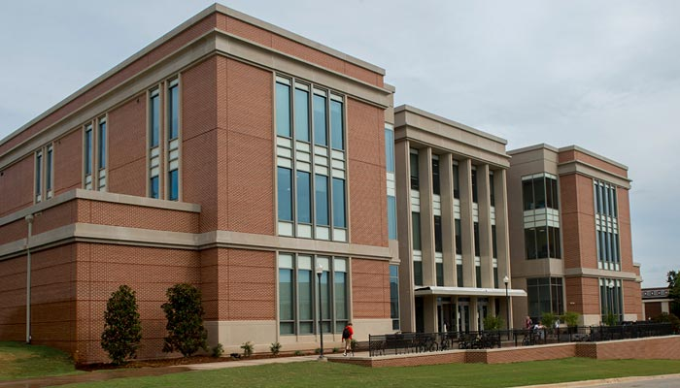
Special Meeting
Current postdocs and mentors can learn more about the changes at a forum which is planned for Sept. 6.
It will be held from 3 p.m.-4 p.m. in Mell Classroom 2250.
The meeting will be held in conjunction with the Graduate School.
Additional information forthcoming from the Graduate School.

Slide 12
Questions or Comments?

