Slide 1
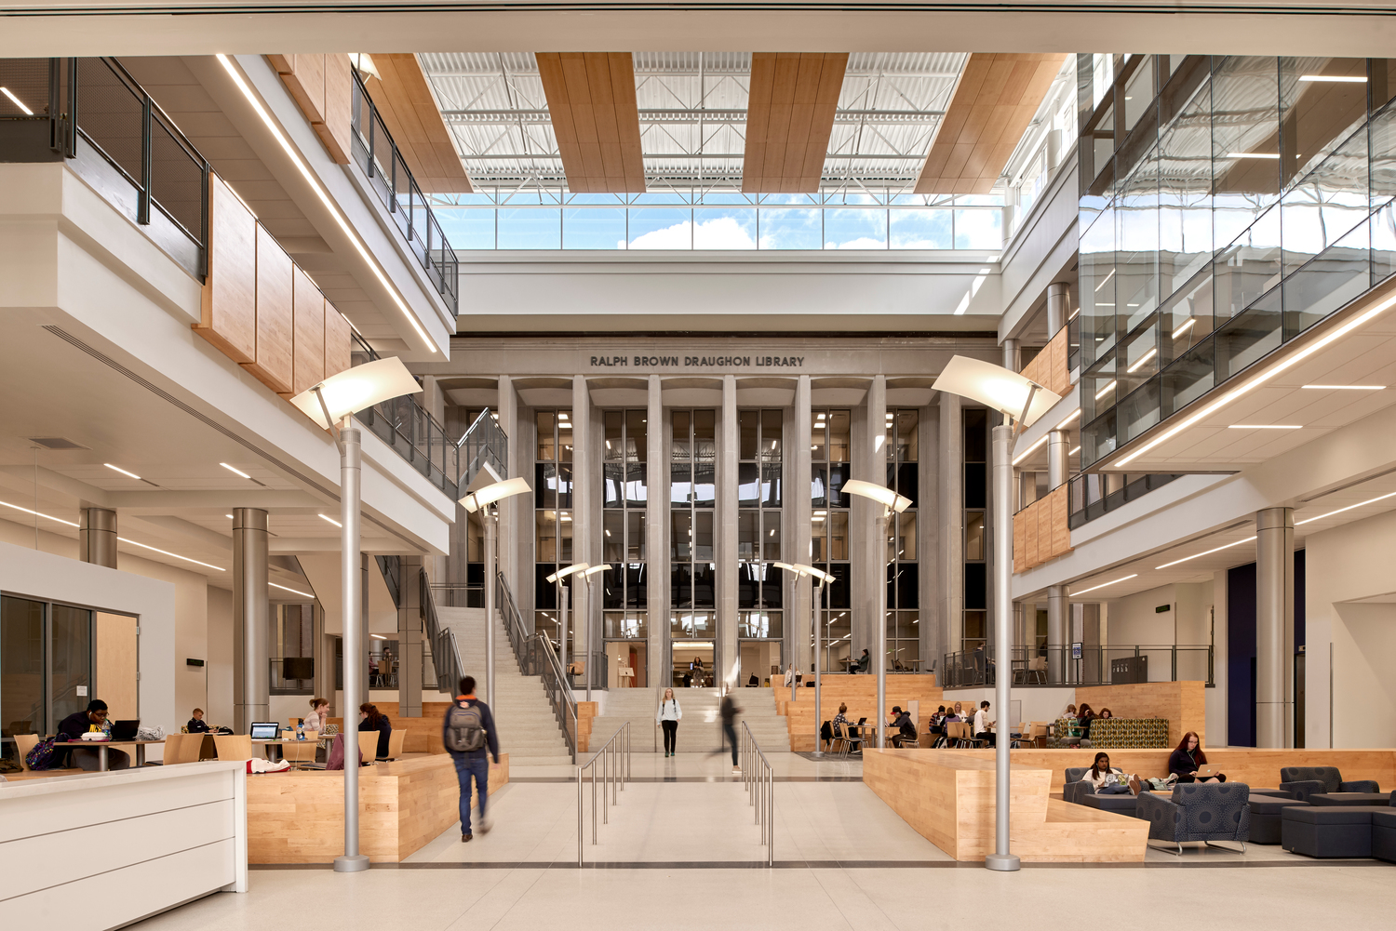
The State of Mell @ RBD 2018
Wiebke Kuhn
Learning Spaces & Faculty Development Coordinator
Notes:
Last time I spoke, the building had not opened yet, now we have over a year of classes in the building

Slide 2
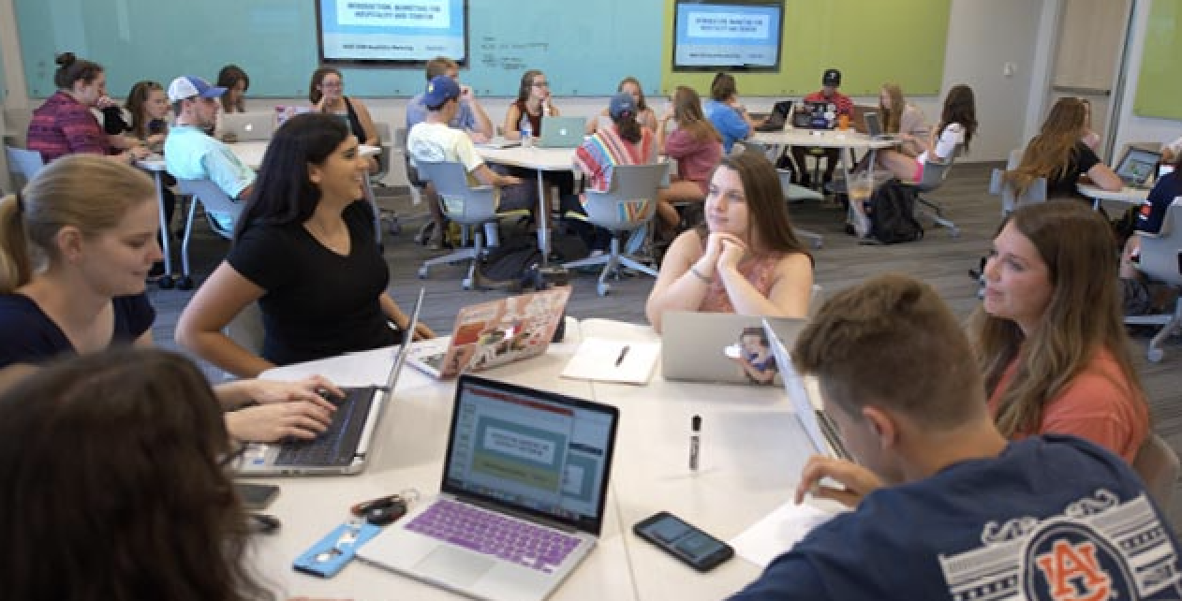
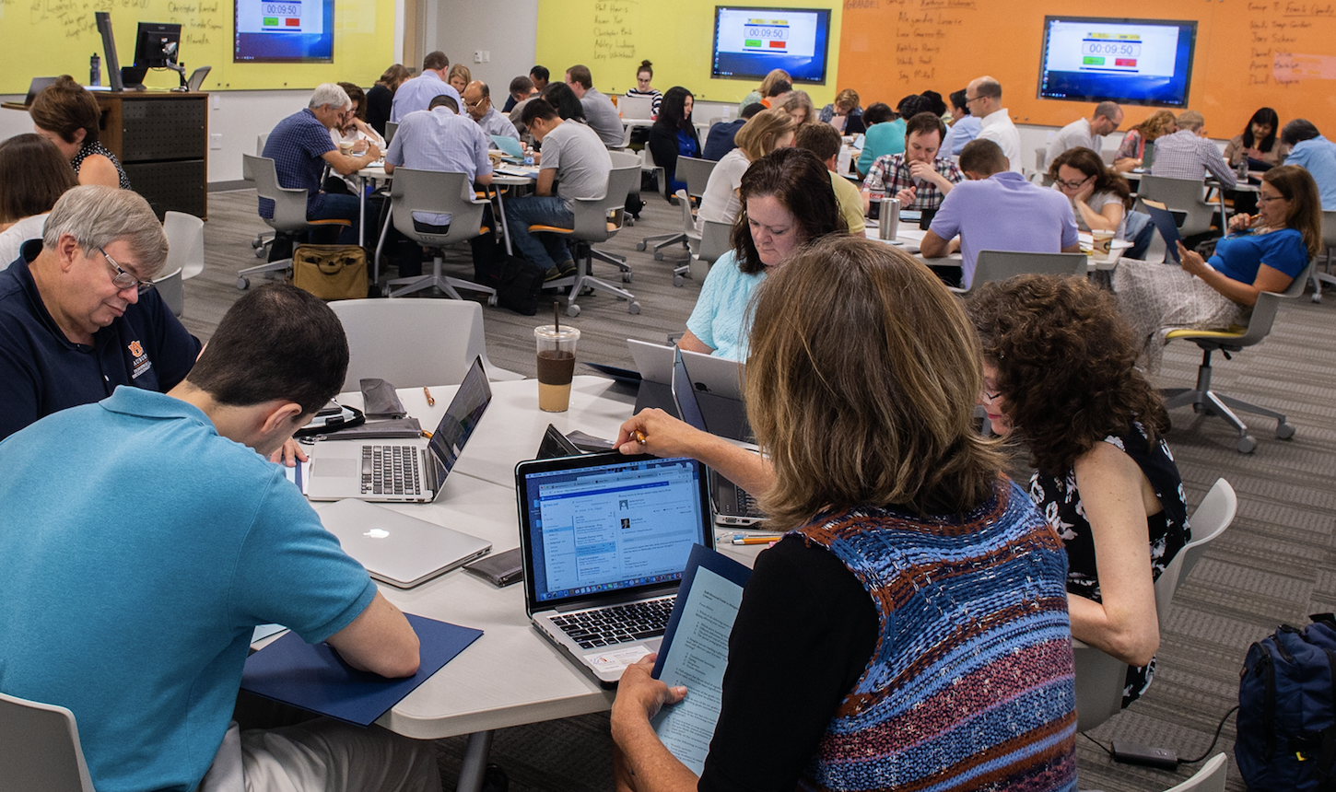
Engaged Active Student Learning
(EASL) Spaces
Evidence suggests that academic performance increases with active learning especially in STEM courses (Freeman et al., 2014)
Auburn has 50 EASL classrooms; 28 in the Mell Classroom Building @ RBD Library
Fall 2018: 43% of Auburn students learning in EASL spaces; 13% in multiple EASL courses
558 faculty and instructional staff trained in EASL space pedagogy to maximize student learning
1,049 faculty, GTAs, & instructional staff
have engaged in Biggio Center teaching and learning professional development since Fall 2017
Faculty Senate, October 23, 2018

Slide 3
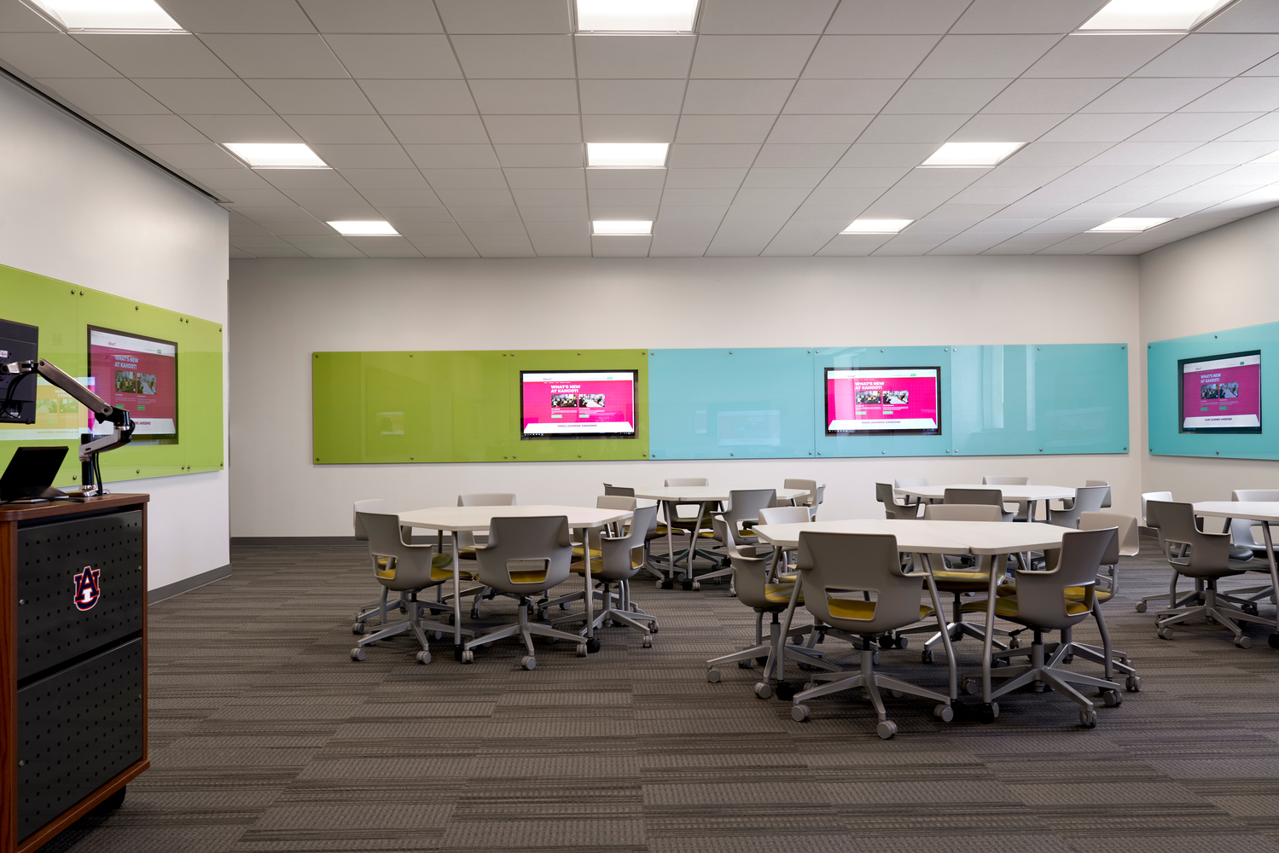
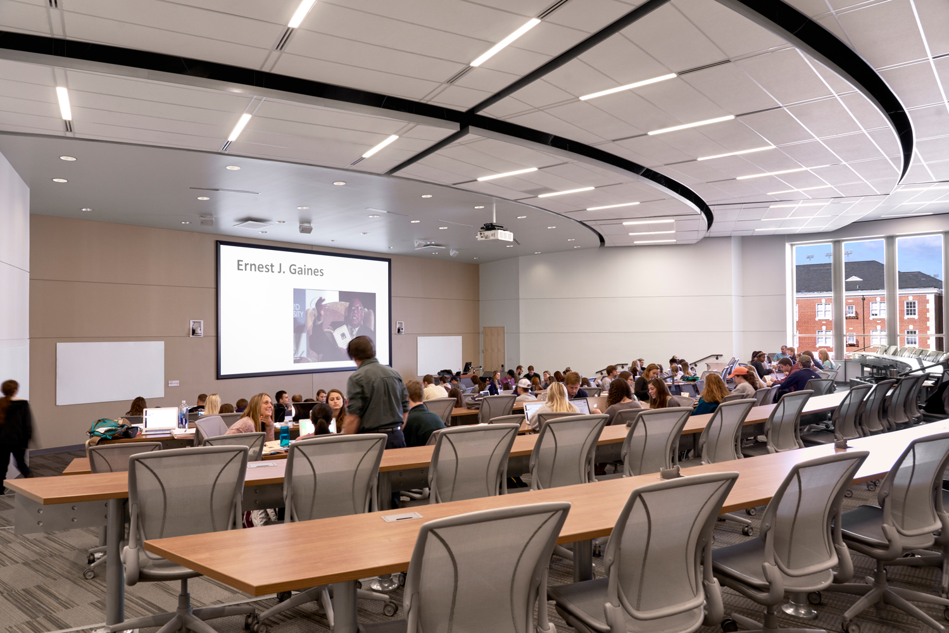
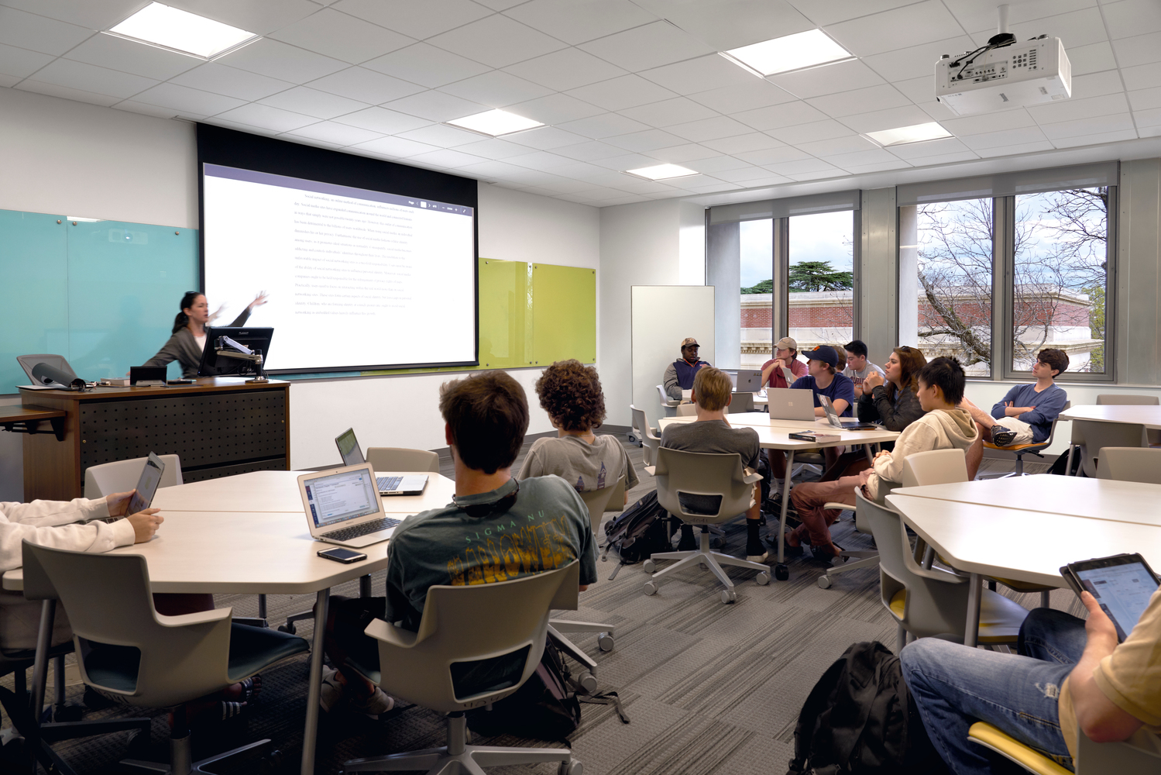
Spaces
2 lecture halls (166 seats)
Full EASL
EASL Lite
40 Study spaces
Panera
Faculty Senate, October 23, 2018

Slide 4
Classes Fall 2017-Spring 2019
First year – Graduate courses
Colleges: 10
Departments: 36
Term | student enrollment |  | courses/ sections
Fall 2017 | 6090 |  | 232
Spring 2018 | 6300 |  | 235
Fall 2018 | 8616 |  | 310
Spring 2019 |  |  | 248
Faculty Senate, October 23, 2018
Notes:
Colleges: Agriculture, CLA, COSAM, CADC, Engineering, Human Sciences, Education, Forestry and Wildlife Science, Business, Honors
Departments: 36 and multiple programs outside of department
STEM sections are increasing – up to over 50 now
First year was so high because of GLOBAL classes – we have not been able to get them back into the building

Slide 5
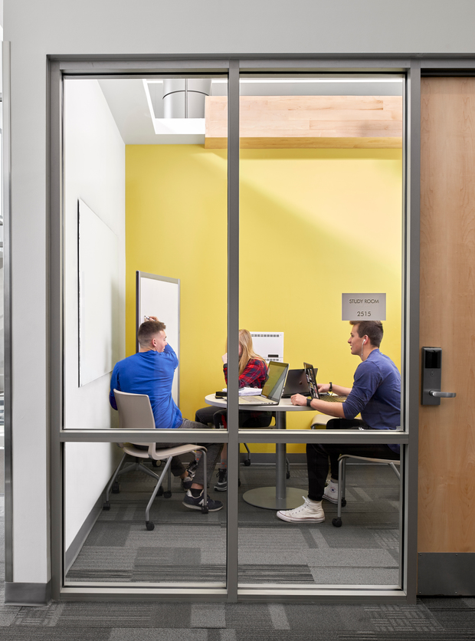
Events
Over 5,000 rooms reserved for various events
  Critical Conversations
  Workshops, conferences
  Summer camps
  Supplemental Instruction
Over 60,000 study room reservations
Faculty Senate, October 23, 2018

Slide 6
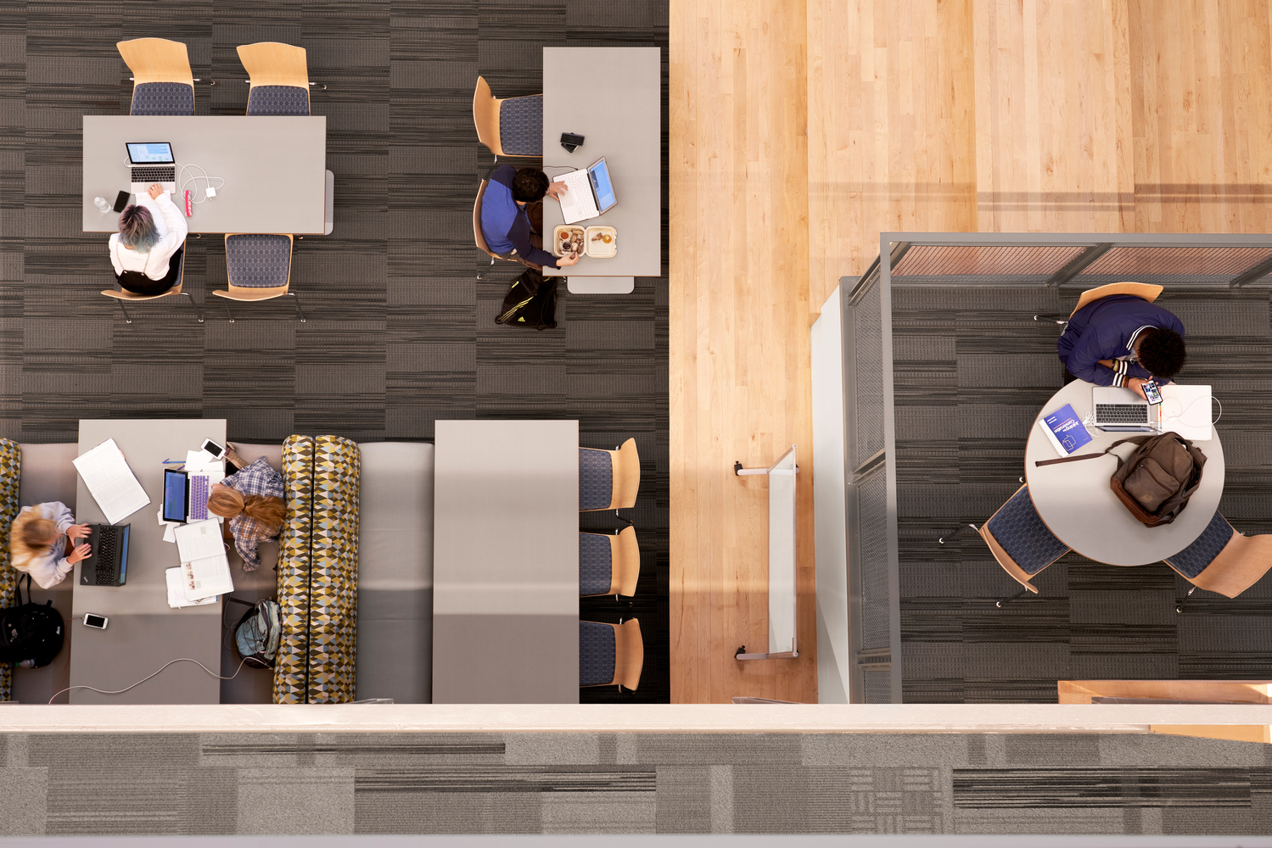
Come Visit!

