Slide 1
Proposed Parking Improvement Plan 2019 - 2024
Notes:
OVERVIEW:
We have heard your concerns regarding the parking situation on campus.
Want to share with you the draft of a plan to improve the parking situation on campus.
The plan consists of several actions that the University intends to take:
Construct new parking spaces. Multiple projects over the next 5 years.
Institute a demand management system for campus parking that would include the establishment of zones on the campus with the cost of parking tied to the location of the zone.
Improve the transit system to make it more efficient and effective.
Raise parking fees so that parking comes closer to paying for itself.

Slide 2
+1,500 Space Increase
39% Increase
Faculty/Staff Parking Inventory
2012 – 3859 Spaces
2019 – 4879 Spaces (26% Increase Since 2012)
2023 (Projected) – 5359 Spaces (39% Increase Since 2012)
Notes:
Before I get into the details of the plan to construct more parking, let me share some past history with you.
Contrary to urban legend, the University has added a significant number of parking spaces on campus.
This slide shows how faculty and staff parking has increased over the past 6-7 years.
Added a net gain over 1,000 faculty and parking spaces since 2020
Some of the University investments that have contributed to faculty and staff parking the past 6-7 years include:
South Quad Parking Deck
South Donahue Parking Deck
South College Street Parking Deck
We plan on adding a net gain of 631 spaces for faculty and staff based the projects that will come on line in 2019 or that we will build by 2023 (in other words, after we build new Faculty and Staff parking and then subtract the spaces lost on campus for various reasons, we will still be ahead by 631spaces over where we are today.
Let me give you some data regarding the cost of parking:
The cost of a new parking spot in a parking garage: approx. $25,000 per space. (South College Parking Deck is $26.5 million and provides 600 spaces = $26,500. )
The cost to lease a space off campus but nearby for faculty and staff: approx. $110/month.

Slide 3
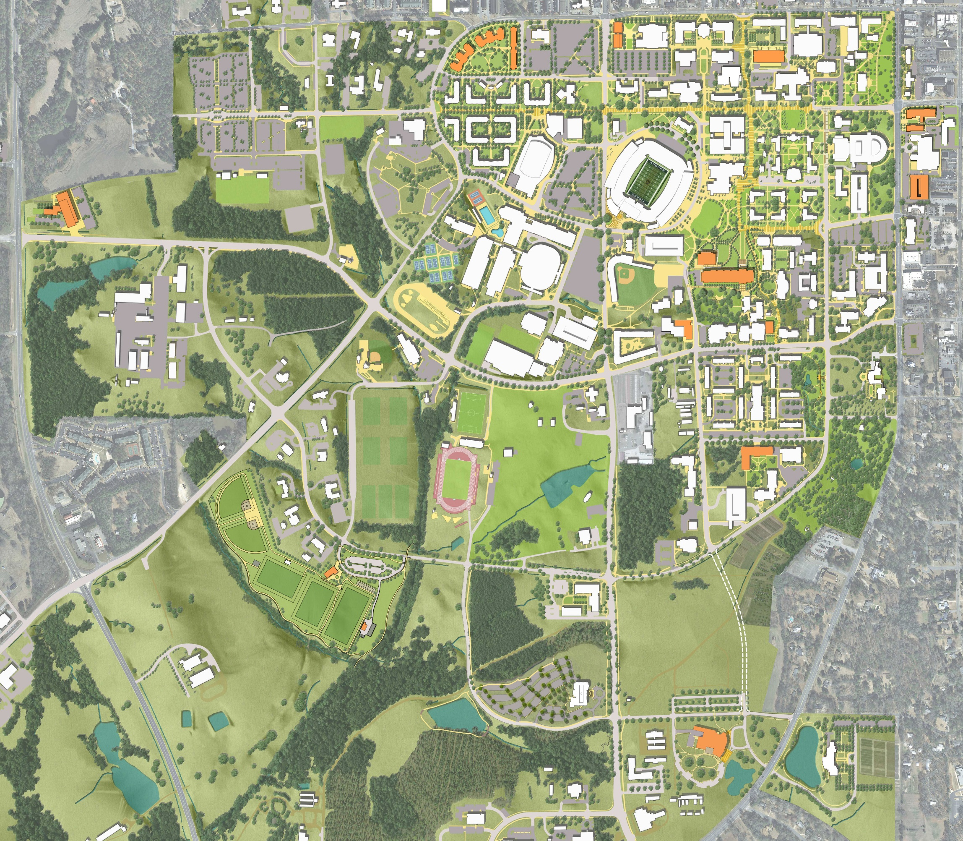
8
Ongoing Projects Increasing Parking For Fall 2019:
Graduate Business Building (+140)
South College Street Parking Deck (+600)
Gogue Performing Arts Center (+455)
Future Parking Project Recommendations:
North & South Surface Lot Expansion at West Campus Parking
Gravel Parking Expansion at Hayfield
Surface lot expansion at Hemlock/Thach (Fire Station)
Relocate Impound Lot to Recapture Surface Parking
Repair Coliseum Parking Lot
Repair Hill Parking Lot
Parking Deck at CDV Extension
Off Campus Faculty Staff Parking
Replace/Expand Library Deck
130 Structured Spaces
Net 72 Addition
Complete 2021 - $0 M
A
1
140 Surface Spaces
Net 140 Addition
Complete 2020 - $1.6 M
300 Surface Spaces
Net 300 Addition
Complete 2019 - $2.7 M
3
4
7
475 Surface Spaces
Net 0 Addition
Complete 2020 - $3.5 M
9
B
Net 85 Addition
Complete 2020 - $1.0 M
750 Structured Spaces
Net 470 Addition
Complete 2021 - $19.5 M
Phase 1:Expansion
350 Structured Spaces
Net 350 Addition
Complete 2022
Phase 2: Replacement
350 Structured Spaces
Net 0 Addition
Complete 2023
5
570 Surface Spaces
Net 0 Addition
Complete 2020 - $2.5 M
6
Legend
2
300 Gravel Spaces
Net 300 Addition
Complete 2019 - $0.5 M
XX
Current Projects
Faculty/Staff
Commuters/Events
Residents
Parking Overview:
Parking Constructed – 3600 Spaces
Net Increase from Parking Projects – 2551 Spaces
Anticipated Loss from Other Capital Projects – 900 Spaces
Total Increase of Parking (2018 – 2023) – 1651 Spaces
Faculty/Staff – 631 Spaces
Commuter/Events – 619 Spaces
Resident Students – 385 Spaces
Other – 16 Spaces
Estimated Cost - $71.50 M
XX
XX
C
XX
XX
Notes:
This slide is the plan to increase parking on campus for all three major parking constituent groups:
Faculty and Staff
Commuter Students and Event Parking
Resident Students
It shows the location of the proposed parking improvements, the target parking group each project will help, and the net change in parking spaces.
These include both new parking garages and surface parking.
Overall, the plan proposes that the University invest over $71 million in parking improvements.
It focuses faculty and staff parking improvements on the Northeast Quadrant of campus, where the shortfall for faculty and staff is greatest. This is not an easy task since there is little to no space to build new parking in that area of campus. Nonetheless, the plan:
Includes some off campus parking in conjunction with a private developer
Includes the replacement and expansion of the library parking deck.
A key driver in the plan is student housing. The University plans on replacing the Hill Residence Hall complex and the Cambridge Residence Hall over the next five years.
Overall this plan would construct over 2,500 new surface and structured parking spaces.

Slide 4
14,944
+3,946 Space Increase
36% Increase
Other
10,998
Resident Students
Commuter Students
Faculty/Staff
Notes:
This slide provides a summary of how this plan will impact the overall parking situation for all of the parking constituent groups.
This slide represents the net increase of parking spaces from 2012 to the end of the plan in 2023.
As you can see we have tried to take a reasonably balanced approach to achieve improvements for all the parking constituents across campus.

Slide 5
A
Graduate Business Building
South College Street Parking Deck
Gogue Performing Arts
Expansion of West Campus Parking
Hayfields Gravel
ACLC + Central Dining
Rane Culinary Science Center
Off Campus Faculty & Staff
Phase 1 Housing + CDV Parking Deck
Surface Parking Hemlock/Thach
Relocate Impound Lot
Repair Coliseum Parking Lot
Repair Surface Parking at Hill
College of Education
Library Parking Replace & Expand
Phase 2 Housing (North Village)
+140
B
+600 (239 Faculty/Staff)
C
+455
1
+300
2
+300
-110
0
-93
0
8
-71/-58
+130
7
-280
+750
0
3
0
+140
4
0
+85
5
0
0
6
0
0
-76
0
0
Phase 1
Phase 2
9
+350
-550
0
2019
2020
2021
2022
2023
2024
Net Additional Parking Spaces 0 0 47 1102 822 822 746 971 1171 1171 1171 1301 1301 1301 1301 1301 1301 1301 1651 1651 1651
Notes:
This slide shows the execution schedule. The grey bars are key University capital projects. The orange bars are the construction timelines for the parking projects.
None of this have been approved by the Board of Trustees, so it is only a proposal until they do.
As stated earlier, a key driver to the schedule is the construction of 1800 bed of housing to replace the Hill at the Old CDV housing site and in the West Village Parking lot.
We have not finalized which of those two areas will be the first phase of housing to be constructed.
The initial parking improvement would be to construct some surface parking this summer. If we build the housing at CDV first, we would begin design of a new parking deck at the CDV Parking lot as soon as we got Board of Trustees approval.
At the bottom, you can see a summary of the net additional parking spaces on campus resulting from this plan.
Overall we would add a net 1,635 parking spaces.

Slide 6
 | Parking Construction Program Recommendations
No. | Description | Constituent | Parking Constructed | Net Parking Increase | Project Cost
 | FY 2018
A | Graduate Business Building | Faculty/Staff | 140 | 140 | $ 0.2 M
B | South College Street Parking Deck | Faculty/Staff | 600 | 239 | $ 15.9 M
C | Gogue Performing Arts Center | Commuter Students | 455 | 455 | $ 1.6 M
FY 2018 Subtotal |  |  |  |  | $ 17.70 M
 | FY 2019
1 | West Campus Expansion | Resident Students | 300 | 300 | $ 2.70 M
2 | Hayfields Gravel | Commuter Students | 300 | 300 | $ 0.50 M
--- | Signage Replacements/Gates | All | --- | --- | $ 0.50 M
FY 2019 Subtotal |  |  |  |  | $ 3.70 M
 | FY 2020
3 | Hemlock/Thach Surface Parking (Fire Station) | Commuter Students | 140 | 140 | $ 1.60 M
4 | Relocate Impound Lot | Resident Students | 85 | 85 | $ 1.00 M
5 | Reconstruct/Repair Coliseum Lot | Commuter Students | 0 | 0 | $3.50 M
6 | Reconstruct/Repair Hill Parking Lot | Resident Students | 0 | 0 | $2.50 M
FY 2020 Subtotal |  |  |  |  | $ 6.10 M
 | FY 2021
7 | CDV Extension Parking Deck | Commuter Students | 750 | 470 | $ 19.50 M
8 | Off Campus Faculty and Staff Parking | Faculty/Staff | 130 | 72 | $ 0.00 M
FY 2021 Subtotal |  |  |  |  | $ 19.50 M
 | FY 2022
9 | Library Parking Deck Replacement | Faculty/Staff | 700 | 350 | $24.50 M
 | FY 2022 Subtotal |  |  |  | $24.50 M
Totals |  |  | 3600 | 2551 | $ 71.50 M
Notes:
This table shows the proposed projects, the spaces constructed, the net parking increase, and the cost.

Slide 7
Plan Recommendations
Parking
Increase Parking Inventory To Offset Future Capital Project Impacts And University Growth
Extend parking enforcement to 6:00 PM
Implement location-based parking zoning system
Permit prices increased for high demand lots/decks
Install cameras/gated in reserved faculty/staff lots/decks
Locate pay by space visitor parking within reserved facilities
Create new departmental zoning separate from service vehicle parking
Limit and charge for departments to store vehicles in core of campus
Close loop-holes for users that currently don’t pay to park
East Glenn Administrative Complex
Campus Safety and Security/Auburn Police
Airport
ARTF
Field Laboratories (Swine Unit, Beef Teaching, Turfgrass, Plan Sciences, etc.)
North Auburn (Fisheries, Poultry, etc.)
Unzoned Locations (Hemlock Dr., Hayfield, Recreation Field Expansion, etc.)
Transit
Consolidation of low ridership routes/stops. Reallocate those resources to higher ridership routes
Extend service hours to 8:00 PM on the high-ridership routes
Install bus pullouts, turn-arounds, covered bus shelter, and crosswalks to facilitate a transition to Hub and Spoke system
Explore partnerships with City and Apartment complexes
Notes:
As stated at the outset, this plan would also implement other changes to the parking and transit system to include:
Extending Parking enforcement hours
The creation of location based parking zoning system.
Create parking for departmental vehicles.
Ensure that all AU employees pay for parking.
Make improvements to the Tiger Transit system
Consolidate routes
Extend service hours on high ridership routes
Install bus infrastructure
City-Apartment partnerships?

