Slide 1
Office of Academic Assessment Update
Megan Rodgers Good, PhD
Director of Academic Assessment

Slide 2
Overview
Academic Assessment at Auburn
Resources Available
Purpose of Assessment

Slide 3
Assessment Cycle
Student Learning Outcomes
Align Outcomes to Curriculum
Systematic Measurement of Outcomes
Report, Interpret, and Communicate Results
Purposeful Reflection of Results/ Plans for Change

Slide 4
Academic Assessment
General Education Assessment
Academic Degree Program Assessment

Slide 5
General Education Assessment
Core Curriculum General Education Committee is:
  Piloting standardized ETS (HEIghten) Assessments
  Creating alternative assessment strategies for other student learning outcomes not measured by these assessments
No assessment reports are due in Fall 2016

Slide 6
Academic Assessment
General Education Assessment
Academic Degree Program Assessment

Slide 7
What is an academic degree program?
Undergraduate programs (e.g., Psychology, B.S.)
Graduate programs (e.g., Chemistry, Ph.D.)
Certificates (e.g., Construction Management, Certificate)
  Both undergraduate and graduate certificates

Slide 8
Academic Degree Program Assessment at AU
Systematic Formative Feedback on the quality of assessment
Report Submission
Peer Rating
Feedback Reports
April 18 – July 1
Mid-July
October 1

Slide 9
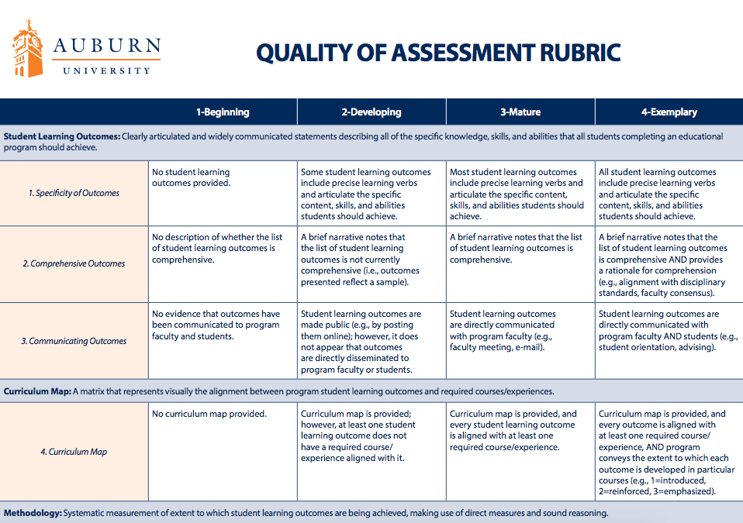

Slide 10
Feedback Reports – Disseminated on Sept. 13
Each academic degree program received quantitative and qualitative feedback on the quality of their assessment process
Each report will recommend next steps for strengthening the quality of assessment within the program

Slide 11
On average, between “Developing” and “Mature” on the Quality of Assessment Rubric (2.4)

Slide 12
Resources Available
Quality of Assessment Rubric
  Articulates assessment quality for Auburn University
Assessment workshops
  Offered twice a week October 1 – November 10
  Customizable workshops available
One on one consultations
Program Student Learning Focus Groups
Website: auburn.edu/academicassessment
Email: assess1@auburn.edu

Slide 13
Purpose of Assessment
Tell a Story About Student Learning
Accountability
Make Evidence-Based Program Innovations
Notes:
Mention that sacs does make us do assessment, but if we do it for the right reason, the assessment will take care of itself

Slide 14
Questions?

