Slide 1


University Faculty Senate Presentation
January 17, 2017
Steven Taylor, Ph.D.
Professor of Biosystems Engineering
Associate Dean for Research
College of Engineering
Lorraine Wolf, Ph.D.
Director of Undergraduate Research
Professor of Geosciences
College of Sciences and Mathematics
Jennifer Kerpelman, Ph.D.
Professor of Human Development and Family Studies
Associate Dean for Research and Graduate Studies
College of Human Sciences
Notes:
We are members of the This is Research Steering Committee. We are here to tell you about the 2017 Symposia.

Slide 2

This is Research 2017
Student Symposium April 13; Awards April 20
Faculty Symposium September 22 (tentative)
Notes:
As we did in 2016, This is Research in 2017 will feature a student symposium this April and a faculty symposium in September. The student symposium is April 13 (events run from approximately 8:30 am to 6:00 pm). The Awards Ceremony is the evening of April 20 in the early evening. The Faculty Symposium is tentatively scheduled for September 22 (events run from approximately 8:30 to 6:00); We may again hold a cluster hire reception during the afternoon of September 21.

Slide 3
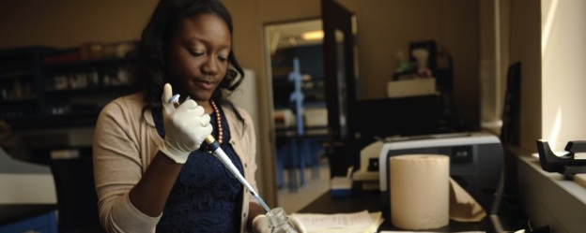
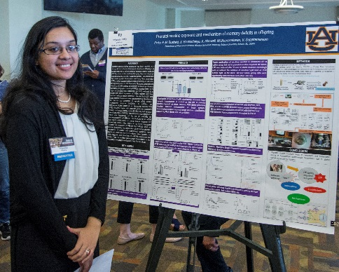
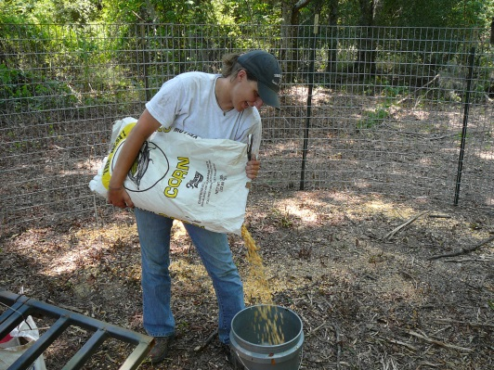
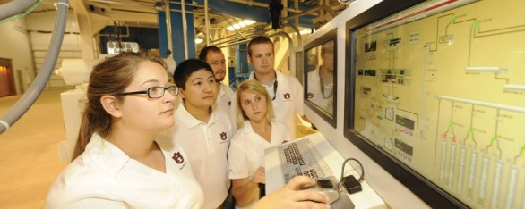
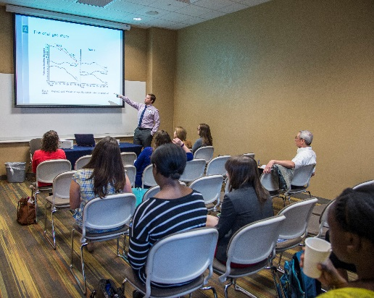
Auburn University
This is Research 2017
Student Symposium
Abstract Submission: January 11 - February 17
Graduate and Undergraduate Students welcome
Oral and Poster Presentations: Abstracts accepted January 11-February 17, 2017
Judging and Awards
Visibility of student research to internal and external audiences
Held in the STUDENT CENTER
Notes:
For students, the purpose of This is Research is to provide professional experience presenting research and interacting with various audiences (other students, faculty, potential employers). Students also compete for awards that can add to their accomplishments on their resumes/CVs. Last year, over 300 students made presentations.
The 2017 Student Symposium will feature undergraduate and graduate students presenting their research via oral papers, posters and creative scholarship presentations.
Middle and high school students will be invited to some of the presentations
Employers with an interest in hiring professionals with research experience also will be invited to attend
The Symposium and Awards Ceremony will all take place in the Student Center
Registration is now open. Please encourage students (and ask faculty to encourage students) to submit abstracts prior to the February 17 deadline
PLEASE GO TO THE THIS IS RESEARCH WEBSITE (WILL SHOW LINK AT THE END OF THIS PRESENTATION) FOR MORE INFORMATION ON THE STUDENT SYMPOSIUM, THE REGISTRATION FORM, AND THE AWARDS FOR UNDERGRADUATE AND GRADUATE STUDENTS.

Slide 4

Judges Needed!
Our biggest challenge each year is recruiting enough judges for the student symposium.
Having enough judges is one of the most important ways to support our students.
We ask that senators encourage your faculty to sign up to judge student presentations. An online sign-up link will be sent soon.
Notes:
We will be reaching out for help in the recruitment of judges. As senators for your departments, we ask you to help us encourage your faculty to participate. Serving as a judge is the best way faculty can support students participating in the symposium. We try to have 3 judges per presentation and last year we had over 300 presentations.

Slide 5
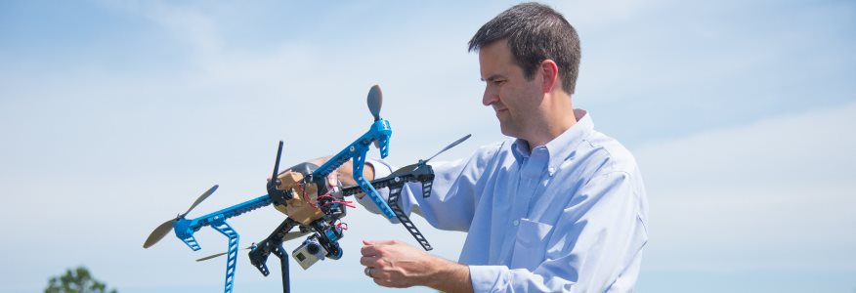
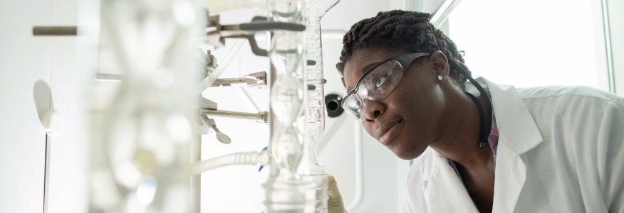
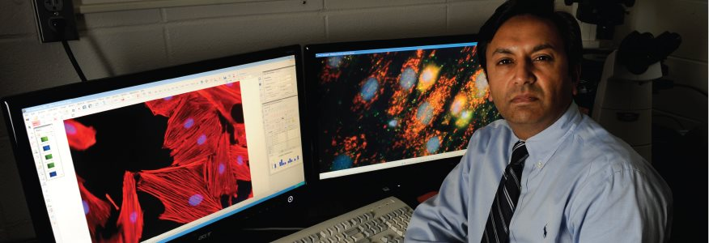

Auburn University
This is Research 2017
Faculty Symposium September 22* 2017
*tentative
Visibility and Connection
  Lightning Sessions
  Auburn Talks
  Interactive Poster Session
  Recognition of Cluster Hires
  Highlighting Research Resources on Campus
  Visibility of research to internal and external audiences
LOCATION TBD
Notes:
The new format for This is Research used in 2015 and 2016 went well – our post event survey suggested we should do something similar in 2017. In September 2017 we will learn about the work of some of our most successful researchers, and we will recognize the work of some of our newer scholars. We strongly encourage faculty, students, staff and administrators to attend the symposium, and we will increase our efforts to attract external audiences.

Slide 6
Auburn University
This is Research 2017
Student Symposium: April 13
Faculty Symposium: September 22*
Questions?
Dr. Steven Taylor
This is Research 2017 Steering Committee, Chair
Contact: taylost@auburn.edu
Dr. Lorraine Wolf
Undergraduate Research Director
This is Research 2017 Steering Committee
Contact: wolflor@auburn.edu
Dr. Jennifer Kerpelman
This is Research 2017 Steering Committee, Past Chair
Contact: jkerpelman@auburn.edu

