Slide 1

Spirit of Sustainability Awards
Purpose
Sustainability Compass
Eligibility
Ceremony and Recognition
Nomination Process and Deadline
Selection Committee Composition
Notes:
The Auburn University Spirit of Sustainability Awards program exists to recognize individuals or groups that exemplify the Auburn spirit by making significant contributions toward sustainability on campus or in a community at any point along the Sustainability Compass.

Slide 2


Notes:
The Auburn University Spirit of Sustainability Awards program exists to recognize individuals or groups of exemplify the Auburn spirit by making significant contributions toward sustainability on campus or in a community at any point along the Sustainability Compass.

Slide 3


Notes:
Sustainability Compass: Nature, Economy, Society, Wellbeing.
Nature undertakings exemplify how we can restore, protect, and live in accord with the laws of Nature.
Economic achievements contribute to a prosperous economy that is viable, fair, and inclusive.
Societal work cultivates connectedness, caring, equity, and engagement. Efforts for Wellbeing nurture individual health, fulfillment, happiness, and wellbeing

Slide 4
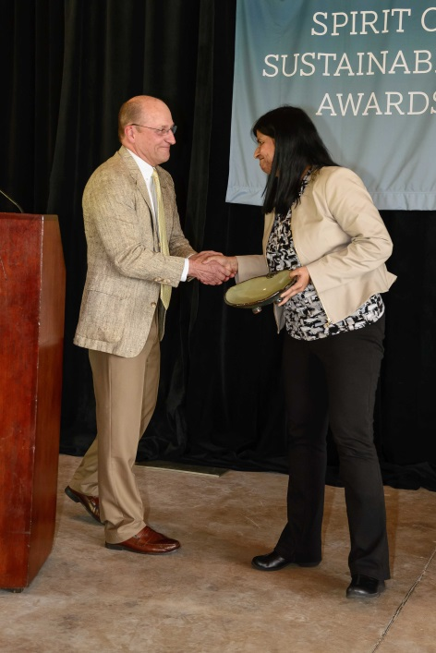
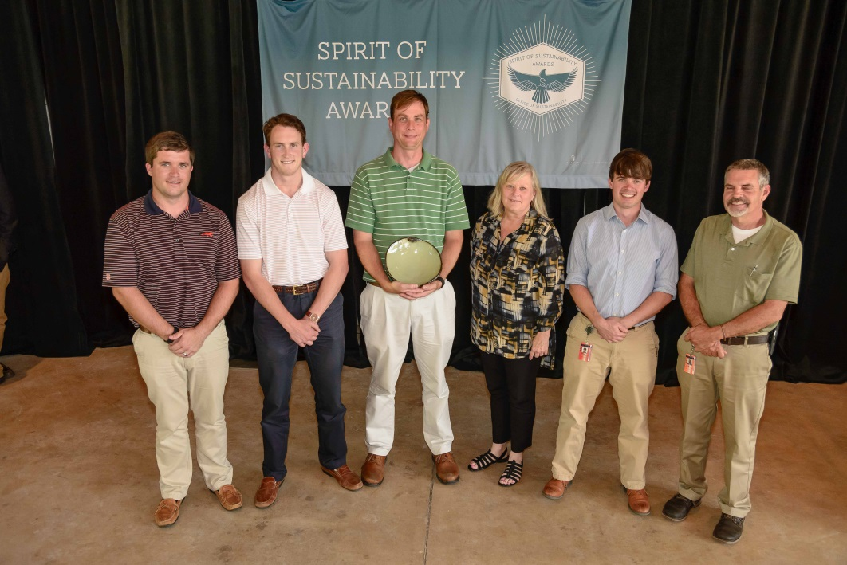
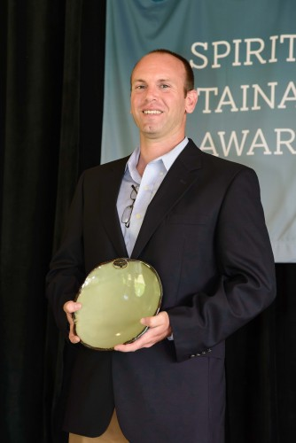
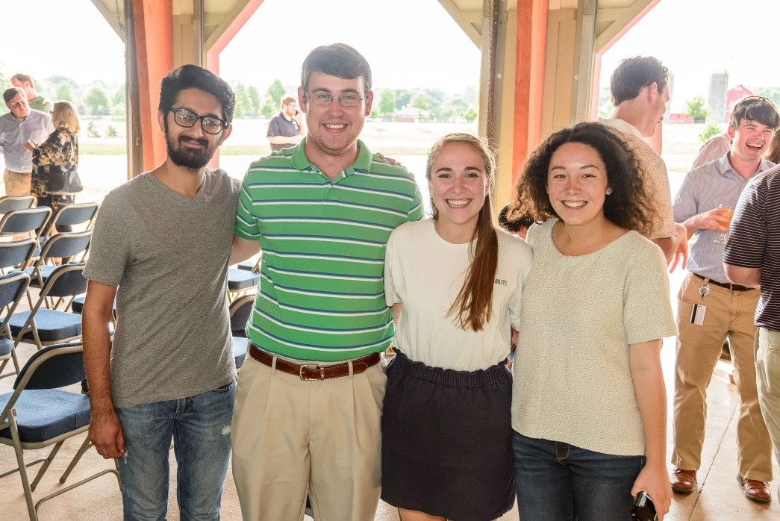
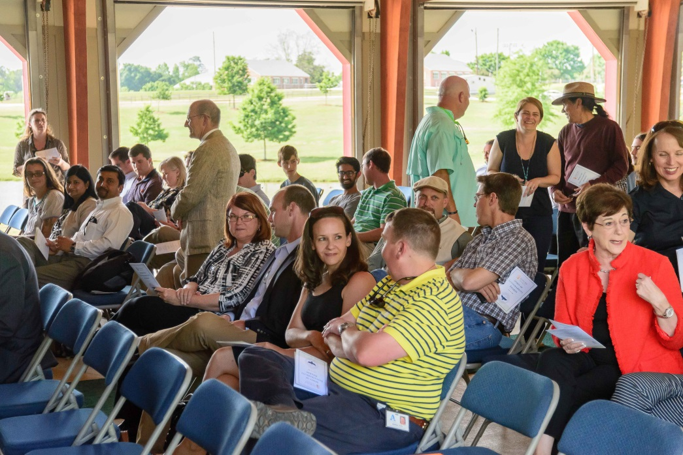
Sweta Byahut
Energy Management Group
Dan Ballard
Rachael Gamlin
Awards Ceremony 2016
Notes:
Awards are given to: Faculty Sweta Byahut), staff (Energy Management Group), alumni (Dan Ballard), and students (Rachael Gamlin).
Individuals and Groups
Faculty: Dan Bennett, Lindy Biggs, Charlene LeBleu, Sushil Bhavnani, Amanda Gale, Michael Hein, Christopher McNulty, Eve Brantley, Dennis DeVries, Sweta Byahut, Wayde Morse

Slide 5

On-field recognition at Green Game 2016

Slide 6
Nomination Process
Online application
  Overview
  Motivation and Commitment
  Impact
  Engagement
  Self-nominations welcome
DEADLINE: January 31st 2017
Notes:
Recognize those that exemplify the Auburn spirit by making significant contributions toward sustainability on campus or in a community at any point along the Sustainability Compass.

Slide 7
Judging Committee
Committee:
  Director of Academic Sustainability Programs
  Faculty member
  Student
  Staff
  Alumni
Visit the awards website to see past recipients and nominate someone today.
Notes:
Recognize those that exemplify the Auburn spirit by making significant contributions toward sustainability on campus or in a community at any point along the Sustainability Compass.
Nanette Chadwick
Wayde Morse
Matthew Preisser
Glen Loughridge
Carolina Ruiz

Slide 8
Notes:
The Auburn University Spirit of Sustainability Awards program exists to recognize individuals or groups of exemplify the Auburn spirit by making significant contributions toward sustainability on campus or in a community at any point along the Sustainability Compass.

