Slide 1
MELL CLASSROOM BUILDING @ RBD
UNIVERSITY SENATE
APRIL 18, 2017

Slide 2
MELL CLASSROOM BUILDING @ RBD
IMPORTANT DATES
August 18, 2017
Mell Classroom Building Opens
September 15, 2017
Formal Opening by the BOT

Slide 3
WHY IS THE MELL BUILDING IMPORTANT?
Advances Auburn’s teaching and learning by promoting Engaged Active Student Learning (EASL) environments.
Symbolizes Auburn’s investment in teaching and learning innovation.
Fosters students’ diverse skill sets and supports learning outcomes.
Replaces older campus classroom spaces.
Models classrooms utilized in professional schools.
Integrates learning with resources available in RBD Library.

Slide 4
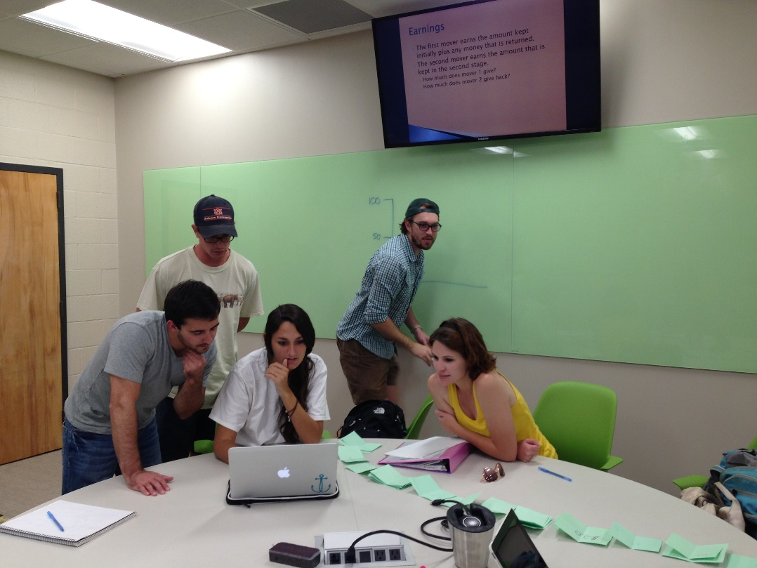
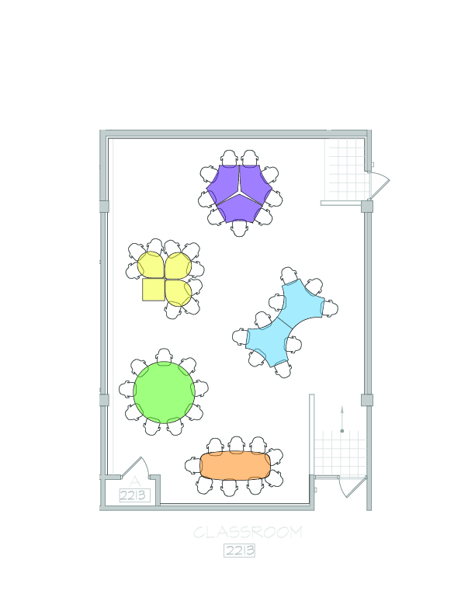
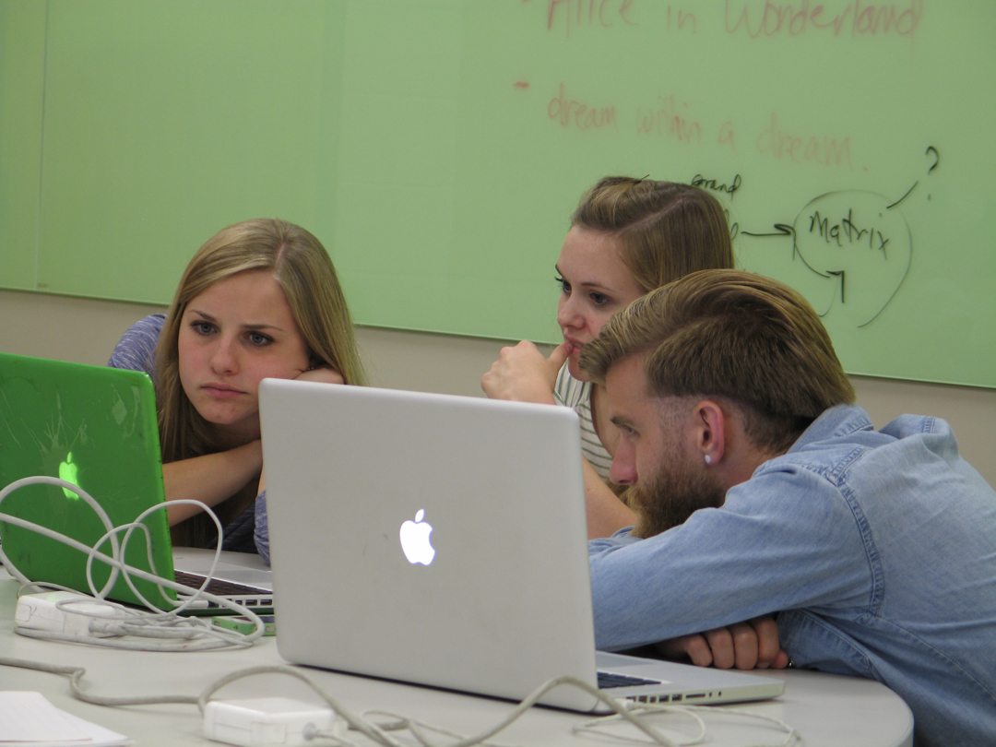
WHAT WILL LEARNING LOOK LIKE INSIDE MELL?
Auburn began piloting EASL approaches in 2011 with the development of
Haley Center 2213 and Science Center Classroom 118.

Slide 5
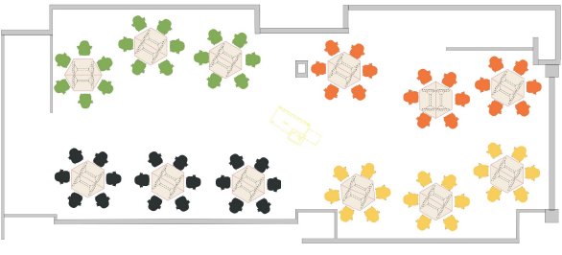
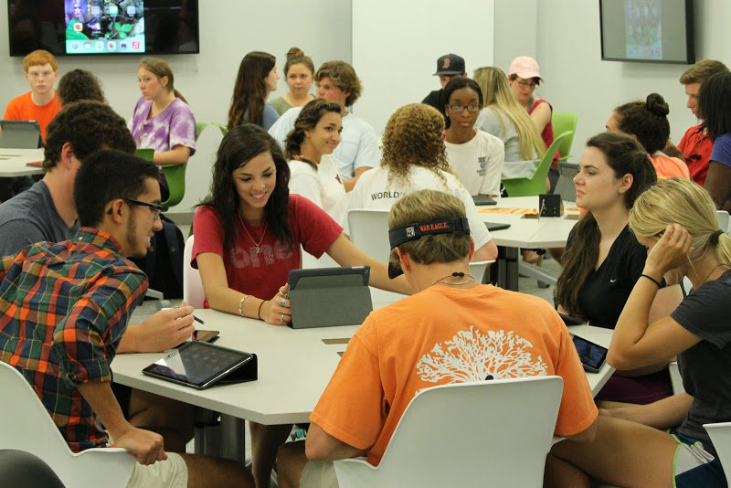
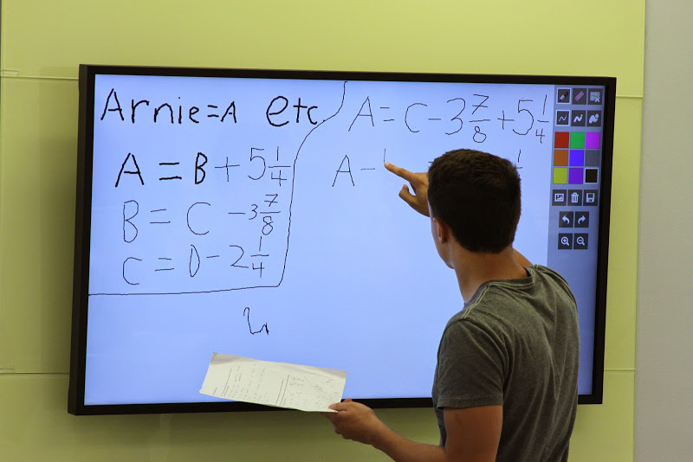
WHAT WILL LEARNING LOOK LIKE INSIDE MELL?

Slide 6


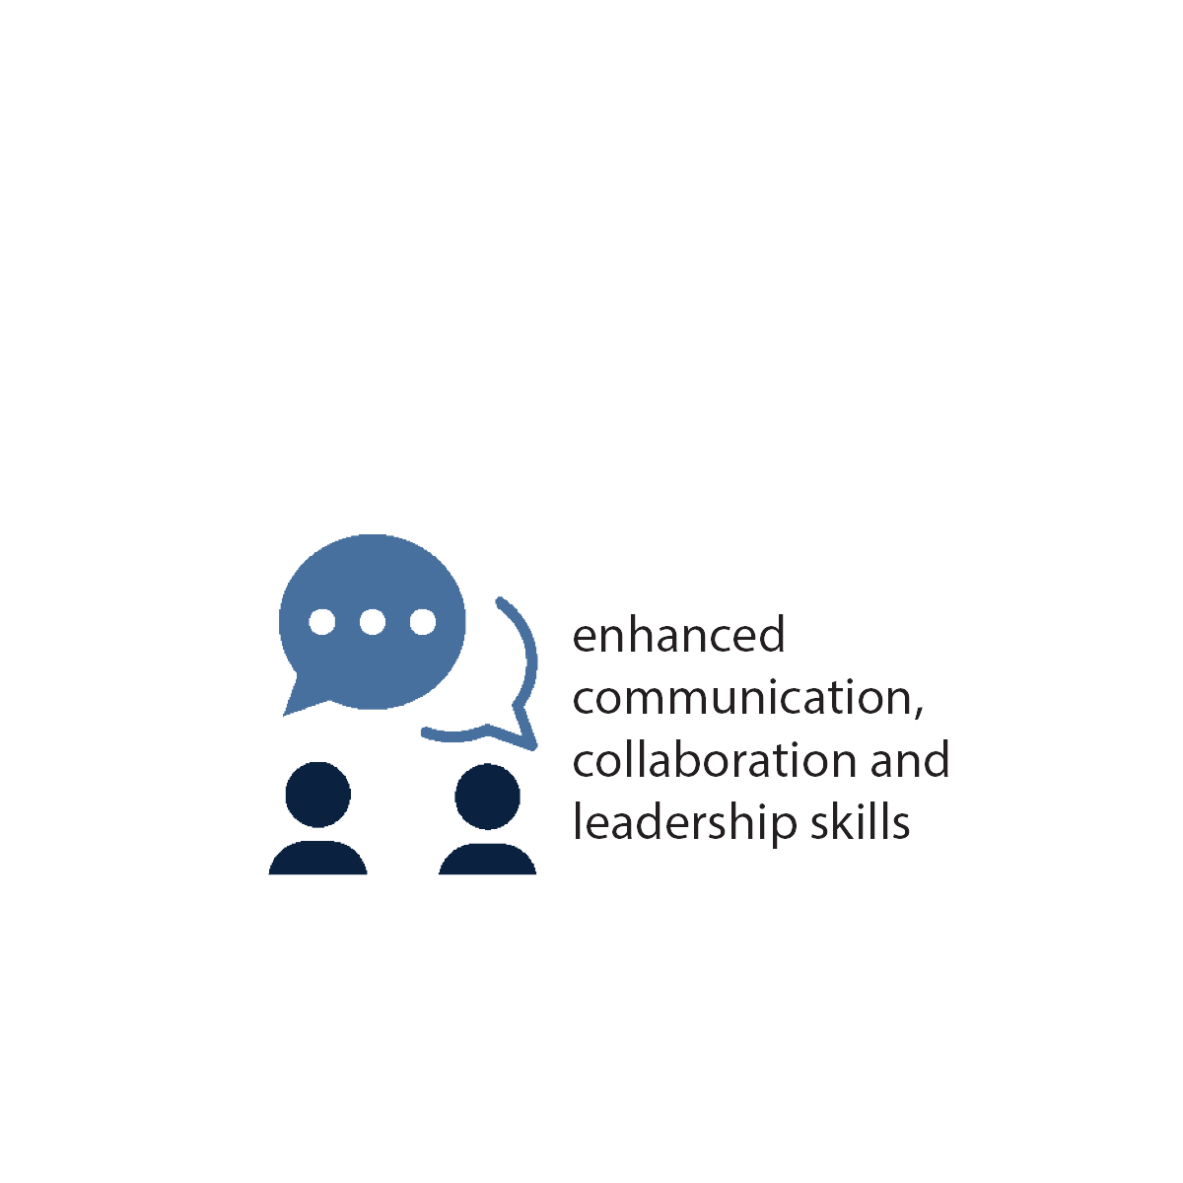
WHAT WILL LEARNING LOOK LIKE INSIDE MELL?
Classrooms will employ active learning strategies ranging from simple (i.e. short writing assignments, self-assessments) to complex (i.e. active review sessions and inquiry learning).
Examples of Active Learning:
Structured exercises
Challenging discussions
Team projects
Peer critiques
Internships
Independent study
Cooperative job programs
Teach peers

Slide 7
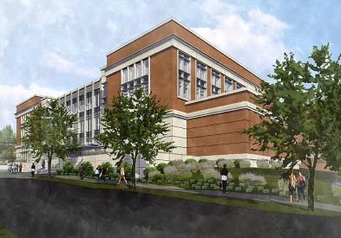
UNIQUE MELL FEATURES
INFORMAL LEARNING
SPACES
29 EASL CLASSROOMS
DINING VENUES
REVITALIZED
RBD SPACE
2 LECTURE HALLS
DIGITAL SIGNAGE TO DISPLAY STUDENT WORK
69,000 SQUARE FEET

Slide 8
UNITS TEACHING IN MELL (CURRENTLY)
64 individual classes scheduled / 102 individual sections:
College of Agriculture
College of Human Sciences
College of Liberal Arts
College of Science and Mathematics
Samuel Ginn College of Engineering
University Programs

Slide 9
HOW ARE WE PREPARING FACULTY?
Multiple years of redesigning courses to support student learning in EASL spaces.
Pre-term workshops, tutorials, reminders on using EASL spaces effectively.
Learning Consultants available to come to class to help faculty with technology.
Web site with instructions and support information (auburn.edu/easl).

Slide 10
HOW ARE WE PREPARING STUDENTS?
Welcome Week tutorials on using EASL spaces effectively and how to prepare for these classes.
Learning Consultants available to help students figure out technology.
Classroom spaces become informal learning spaces outside of scheduled classes.
Web site with instructions and tutorials.

Slide 11
CONTACT INFORMATION
Wiebke Kuhn
Learning Spaces and Faculty Development Coordinator
kuhnwi1@auburn.edu
334-750-3360
Biggio Center, Foy 136

