Slide 1
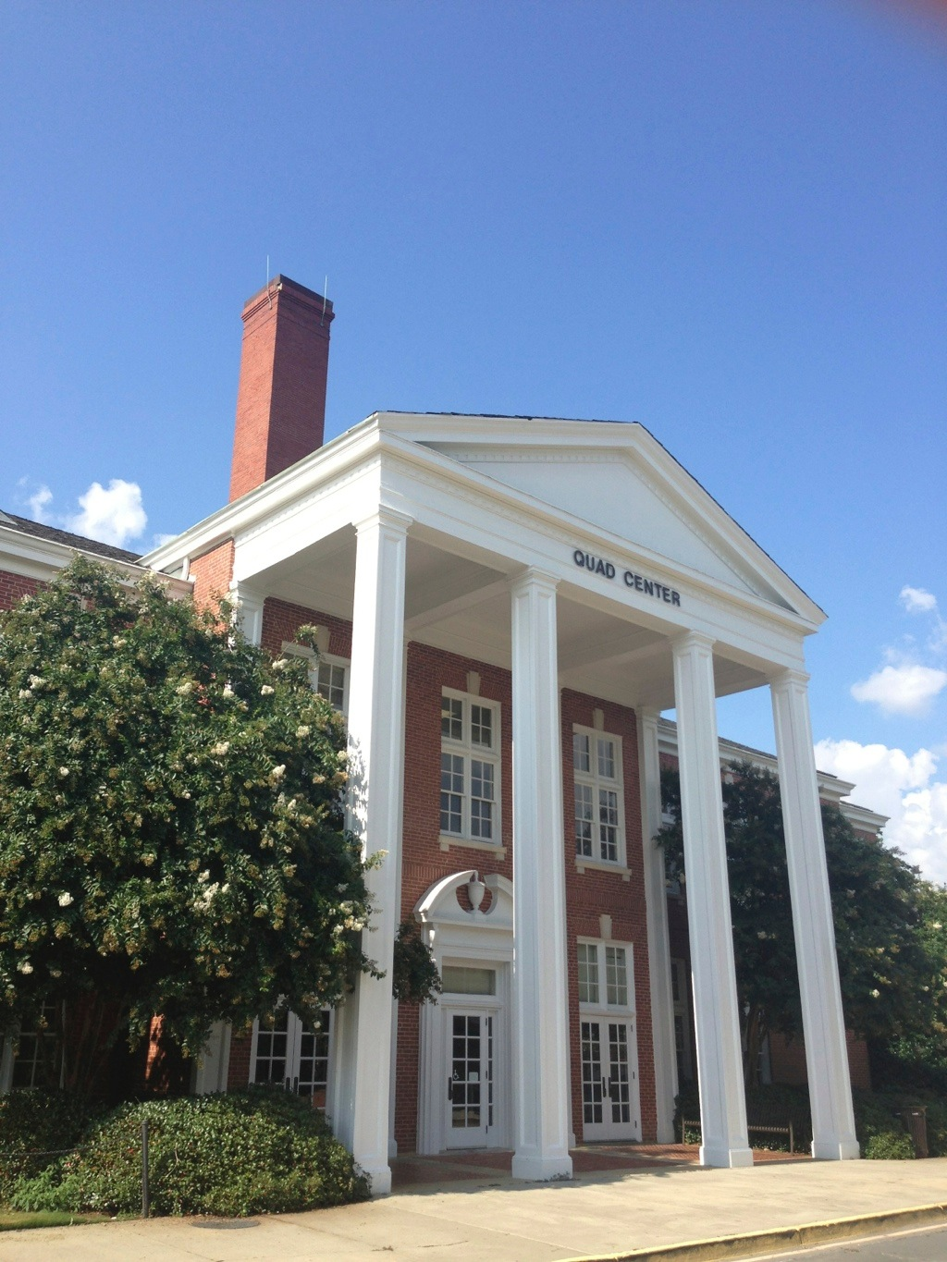
The Office of the Ombudsperson
General Faculty Meeting
March 10, 2015
C. Kevin Coonrod
Ombudsperson
Quad Center, Suite 005
(334) 844-7170

Slide 2
independence
neutrality
confidentiality
INFORMALITY

Slide 3
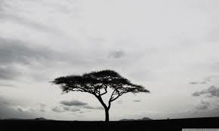
Independent
Solitary trees, if they grow at all, grow strong
~ winston Churchill

Slide 4
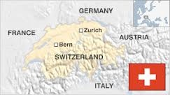
Neutral

Slide 5
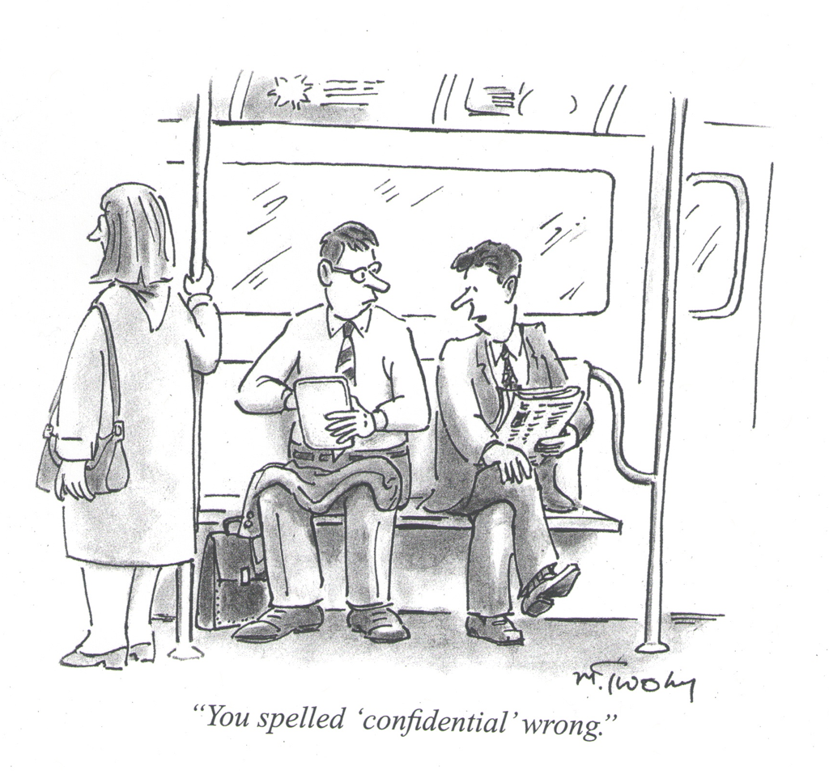
Confidential

Slide 6
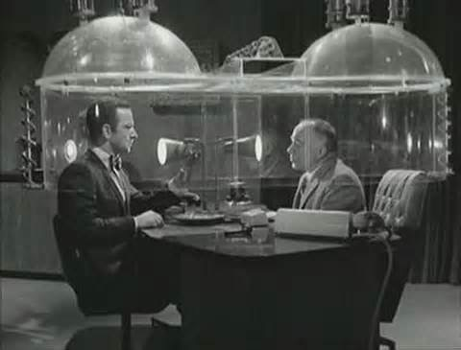
Sound Mitigation System

Slide 7
Informal

Slide 8
FUNCTIONS OF THE OMBUDSPERSON
CONFLICT RESOLUTION
POLICY ADVICE
TREND REPORTS

Slide 9
CONFLICT RESOLUTION

Slide 10
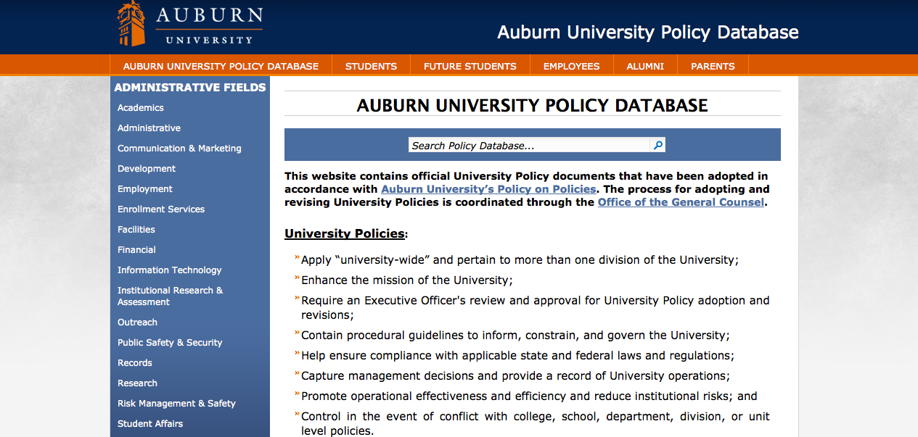
Policy Advice

Slide 11
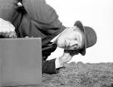
trend reports

Slide 12
THE OMBUDSPERSON DOES NOT:
ADJUDICATE
SET POLICY
GIVE LEGAL ADVICE
SERVE AS AN AGENT OF NOTICE FOR AUBURN UNIVERSITY
PARTICIPATE IN GRIEVANCES OR OTHER FORMAL PROCESSES
OFFER THERAPY
ADVOCATE FOR ANY PARTY TO A CONFLICT

Slide 13
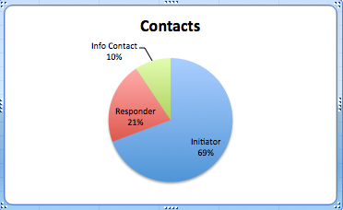
Ombudsperson Report
2013/2014 Annual Summary
Office Visitors: 183
Initiators: 140
Responders: 43
Informational: 19

Slide 14
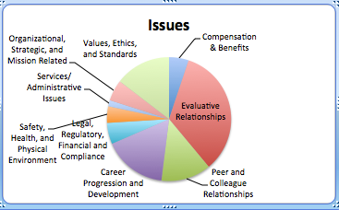
Issues
Evaluative: 86
Career Progression: 42
Values & Ethics: 37
Peer & Colleague: 33
Strategic/Mission: 14
Legal/Compliance: 13

Slide 15
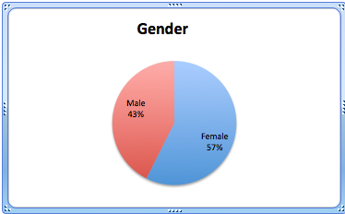
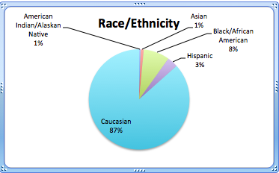
Demographics

Slide 16
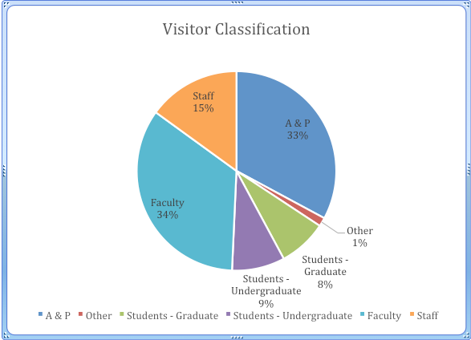
Visitor Classifications

Slide 17
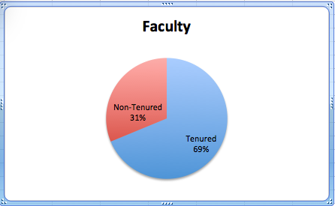
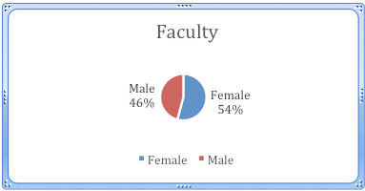
Faculty - 48
Tenured: 33
Non-Tenured: 15
Female: 26
Male: 22

Slide 18
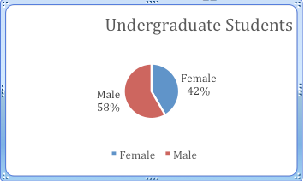
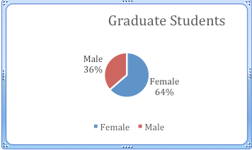
Students - 23
Undergraduate: 12
Male: 7
Female 5
Graduate: 11
Female: 7
Male: 4

Slide 19
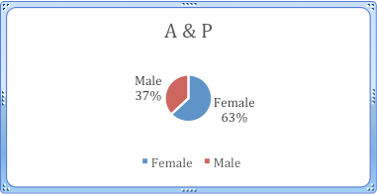
A & P - 46
Female: 29
Male: 17

Slide 20
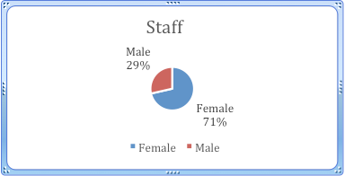
Staff - 21
Female 15
Male: 6

Slide 21
Other - 2
Parents
External Individuals
External Entities

Slide 22
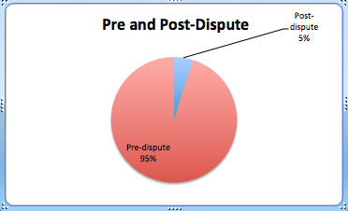
Pre and Post-Dispute

Slide 23
7 Common Themes

Slide 24
Ombudsperson Response
Consultation & Problem Solving: 121
Referral to Policy or Office: 83
Look into Issue: 24
Mediation: 21
Unit Consultation:15
Upward Feedback: 17
Inquiry on Behalf: 17
Notify on Behalf: 2
Total Response: 300

Slide 25
upcoming seminars
SPRING 2015
working with high conflict people
bullying and mobbing
FALL 2015
active listening and underlying interests
Cooperative NEGOTIATION Strategy

Slide 26
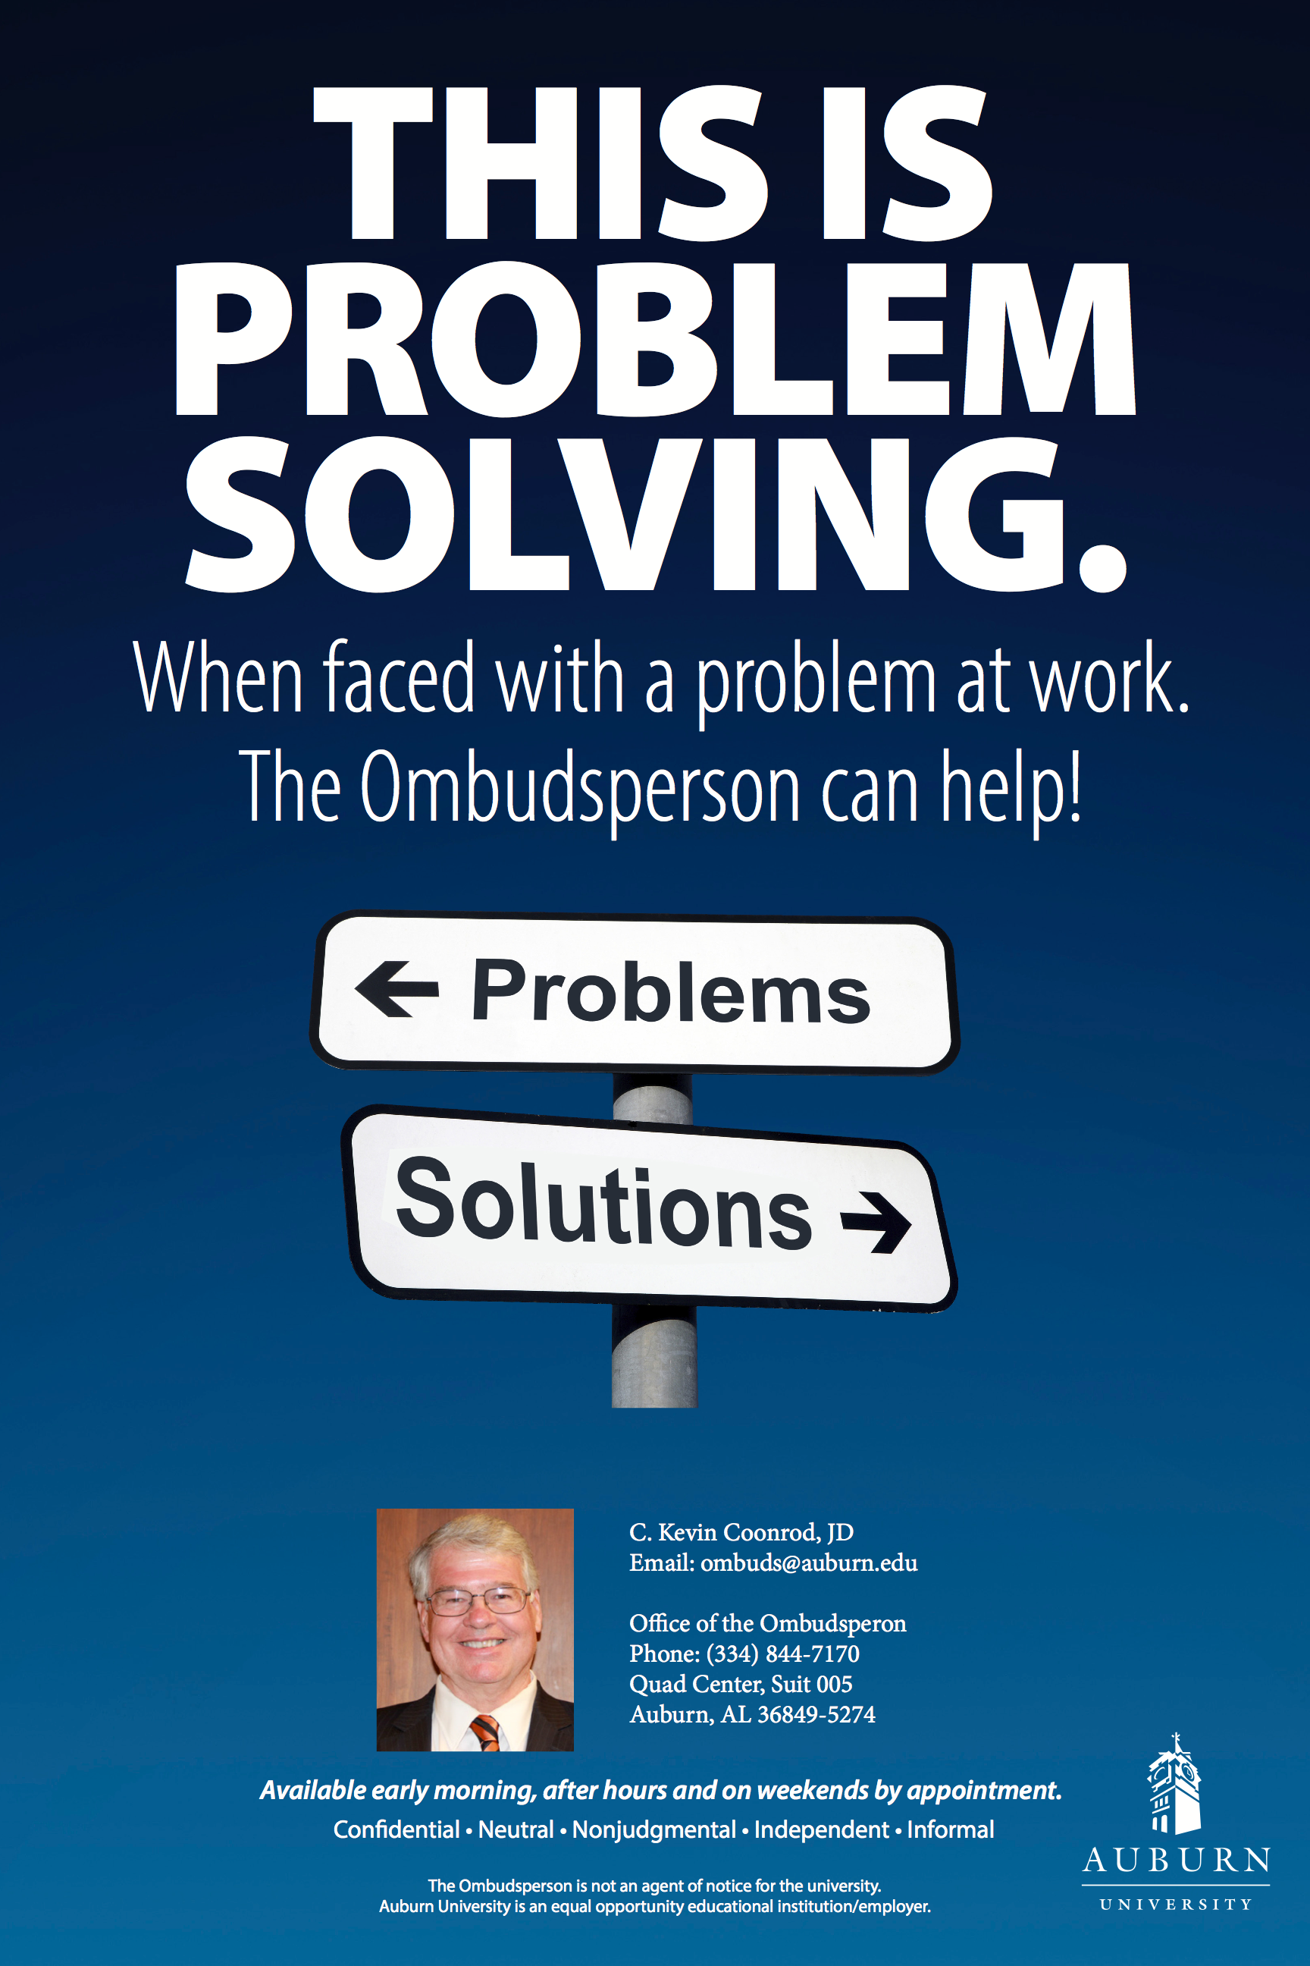

Slide 27
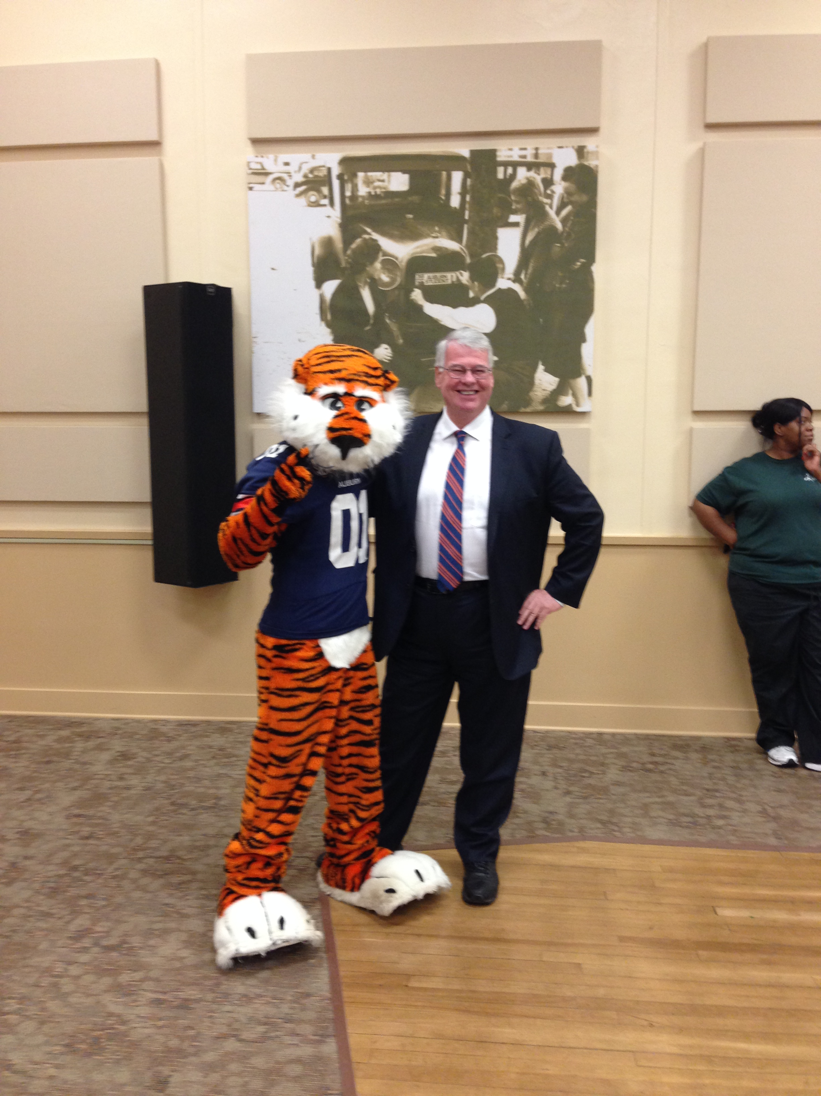

Slide 28
The Office of the Ombudsperson
C. Kevin Coonrod
Quad Center, Suite 005
Auburn University
ombuds@auburn.edu

