Slide 1
Report from the Committee on Intercollegiate Athletics (CIA)
Mary K Boudreaux, DVM, PhD
Chair of the CIA
Faculty Athletics Representative
CIA – Charge, Composition, Subcommittees
Student Athlete Eligibility – Progress Towards Degree requirements
Graduation Success Rate (GSR) – data released in Fall 2014
Academic Progress Rate (APR) – data released in Spring 2014
Accolades – Rhodes Scholar Finalists
Marshall Scholar
1A FAR Academic Excellence Award
NCAA Postgraduate Scholarships
SEC Academic Honor Roll
Auburn University Student Athletes 2014 Statistics
SEC FAR members
Visit NCAA.org

Slide 2
Charge of the Committee on Intercollegiate Athletics
The Committee on Intercollegiate Athletics shall:
recommend to the President the policies for the operation of the Intercollegiate
Athletics program at Auburn University,
(2) monitor for the President all aspects of the Intercollegiate Athletics Program at
Auburn University for compliance with University policies, and with NCAA and SEC
legislation.
(3) assist the President and the Director of Athletics on any aspect of the
Intercollegiate Athletics Program for which advice or assistance is requested.
The Committee on Intercollegiate Athletics shall meet once per quarter and
additionally as called by the President of Auburn University.

Slide 3
Composition of the Committee on Intercollegiate Athletics
Mary K Boudreaux, Pathobiology, Chair
Barbara Struempler, CES Family and Consumer Sciences, Vice-Chair
Tina Loraas, Accounting
Daowei Zhang, Forestry and Wildlife Sciences
Daniel Svyantek, Psychology
Ann Beth Presley, Consumer and Design Sciences
Brian Connelly, Management-Business
Don Large, Executive Vice-President
Bobby Woodard, Assoc Provost and Vice President for Student Affairs
C. Wayne Alderman, Dean of Enrollment Services
Kevin Robinson, Executive Director of Internal Auditing
Ashley Hamberlin, A & P Chair
Michael Freeman, Staff Council Chair
Logan Powell, SGA President
Ex-Officio Members
Jay Gogue, President
Timothy Boosinger, Provost
Jay Jacobs, Athletics Director
David Benedict, Chief Operating Officer, Athletics
Rich McGlynn, Senior Associate Athletics Director

Slide 4
Subcommittees of the Committee on Intercollegiate Athletics
Academic Standards Subcommittee—Daniel Svyantek, Chair
Awards Subcommittee—Brian Connelly, Chair
Compliance Subcommittee—Mary K Boudreaux, Chair
Drug Education/Testing Advisory Group—Randall Clark, Chair
Equity, Welfare, and Sportsmanship —Ann Beth Presley, Chair
Priority and Seating Subcommittee—Brian Connelly, Chair
Athletics Department Seminar Series – Barbara Struempler, Chair

Slide 5
New NCAA Division I Initial-Eligibility Academic Requirements
For college-bound student-athletes enrolling full time at an NCAA
Division I college or university on or after August 1, 2016, there are
three possible academic outcomes:
Full qualifier = competition, athletics aid (scholarship), and practice
the first year.
2. Academic redshirt = athletics aid the first year, practice in first
regular academic term (semester or quarter).
3. Nonqualifier = no athletics aid, practice or competition the first year.

Slide 6
A Full Qualifier in 2016:
Must complete 10 core courses before seventh semester of
high school (e.g., senior year).
Of the 10 core courses completed, seven must be in the
area of English, math, or science.
These 10 core courses become “locked in” for the purpose
of core-course GPA calculation.
A repeat of one of the “locked in” courses will not be used
if taken after the seventh semester begins.
Meet the sliding scale of core-course grade-point average
(minimum 2.300) and SAT/ACT sum score
Graduate from high school.

Slide 7
More information on initial eligibility requirements
can be found at these links:
http://www.ncaapublications.com/productdownloads/CBSA15.pdf
http://2point3.ncaa.org/

Slide 8
Student Athlete Eligibility 40-60-80 Rule
Once in college, student-athletes must make steady progress toward
degrees. Student-athletes must complete coursework
required for a degree in the following time frame:
40 percent by the end of their second year,
60 percent by the end of their third year,
80 percent by the end of their fourth year.
Student-athletes are allowed five years to graduate while receiving
athletically related financial aid.
All student-athletes must earn a minimum of six hours each term to be
eligible the next semester.
From NCAA.org

Slide 9
Graduation Success Rate (GSR)
The NCAA developed the Division I Graduation Success Rate in response to
college and university presidents who wanted graduation data that more accurately
reflect the mobility among all college students today.
The rate measures graduation rates at Division I institutions and includes
student-athletes transferring into the institutions.
It differs from the rate mandated by the federal government, which does not
count incoming transfer student-athletes and counts student-athletes who
transfer out as not having graduated, regardless of whether they actually did.
The Graduation Success Rate also allows institutions to exclude from the computation
student-athletes who leave their institutions before graduation, so long as they would
have been academically eligible to compete had they remained.
From NCAA.org

Slide 10
Federal Graduation Rate (FGR) vs. Graduation Success Rate (GSR)
•FGR assesses only first-time full-time freshmen in a given cohort and only counts
them as academic successes if they graduate from their institution of initial
enrollment within a six-year period. It makes no accommodation for transfers into
or out of an institution.
The rate is very limited because it ignores the large number of transfer students in
higher education, but it is still the only rate that allows a direct comparison between
student-athletes and the general student body.
•GSR begins with the federal cohort, and adds transfer students, mid-year enrollees,
and non-scholarship students (in specified cases) to the sample. Student-athletes
who leave an institution while in good academic standing before exhausting athletics
eligibility are removed from the cohort of their initial institution.
This rate provides a more complete and accurate look at actual student-athlete
success by taking into account the full variety of participants in Division I athletics
and tracking their academic outcomes.
From NCAA.org

Slide 11
Comparison of Graduation-Success Rates and Federal
Graduation-Rate Cohorts (2004-2007 Entering Classes)
Federal Rate GSR
Enrolled (Under Federal Definition) 84,374 84,374
Enrolled as Frosh in January 0 2,702
Two-Year College Transfers 0 9,432
Four-Year College Transfers 0 8,071
Non-Scholarship Athletes
(Only at Schools Not Offering Aid) 0 12,443
Total Enrolled 84,374 117,022 (+38.7%)
Allowable Exclusions
(Death, Military, Church Mission, etc.) 321 415
Left Eligible 0 21,556
Participants No Longer Sponsored By 0 1,414
Institution
Total Denominator 84,053 93,637 (+11.4%)
Both the GSR and FR evaluate a six-year graduation rate (% of students graduating
by end of their sixth year – or before the 7th Fall)
From NCAA.org

Slide 12
M &W Golf = 56%/100%
Gymnastics = 92%
M & W Basketball = 62%/100%
Equestrian = 86%
Baseball = 58%
M & W Track/XC = 60%/81%
M & W Tennis = 100%/100%
Football = 68%
Soccer = 91%
Volleyball = 80%
M & W Swimming = 72%/92%
Softball = 95%

Slide 13
Graduation Success Rate by Sport 2004 – 2007 cohorts (n = 347)
Men’s Sports GSR FR Women’s Sports GSR FR
Baseball 58 38 Basketball 100 67
Basketball 62 47 C/C Track 81 79
CC/Track 60 44 Equestrian 86 75
Football 68 58 Golf 100 71
Golf 56 71 Gymnastics 92 79
Swimming 72 55 Soccer 91 80
Tennis 100 100 Softball 95 81
Swimming 92 71
Tennis 100 44
Volleyball 80 43
Graduation Rates All Students (%) 2004 – 2007/6 cohorts (FED Rate)
Division I (n = 3,009,403) Auburn (n = 15,995) AU Student Athletes (n = 368)
Men 61 Men 64 Men 52
Women 66 Women 70 Women 72
Combined 64 Combined 67 Combined 62

Slide 14
Student Athletes Graduation Rates (GSR %) 2004 – 2007
Division I (n = 93,637) Auburn (n = 347)
Men 77 Men 66
Women 89 Women 91
Combined 83 Combined 78

Slide 15
Academic Progress Rate (APR)
While eligibility requirements make the individual student-athlete
accountable, the Academic Progress Rate (APR) creates a level of
institutional responsibility.
The Academic Progress Rate is a Division I metric developed to track
the academic achievement of teams each academic term.
Each student-athlete receiving athletically related financial aid earns
one retention point for staying in school and one eligibility point for
being academically eligible.
A team’s total points are divided by points possible and then
multiplied by one thousand to equal the team’s APR.
From NCAA.org

Slide 16
Academic Progress Rate Calculation Example
A Division I Football Bowl Subdivision team awards the full complement of 85
grants-in-aid. If 80 student-athletes remain in school and academically eligible,
3 remain in school but are academically ineligible and 2 drop out academically
ineligible, the team earns 163 of 170 possible points for that term.
Divide 163 by 170 and multiply by 1,000 - team’s APR that term is 959.
The NCAA calculates the rate as a rolling, four-year figure that takes into account all
the points student-athletes could earn for remaining in school and academically
eligible during that period. Teams that do not earn an APR above specific benchmarks
face penalties ranging from scholarship reductions to more severe sanctions.
Teams that score below 925 and have a student-athlete who both failed academically
and left school (0 for 2) can lose scholarships (up to 10 percent of their scholarships
each year) under the immediate (contemporaneous) penalty structure.
From NCAA.org

Slide 17
The APR penalty structure was significantly revamped in 2011, effective with the 2012-13 academic year.
After sitting at a 900 APR for the first five years of the
program, the penalty benchmark slowly increased
over the next several years.
Teams were required to earn a 900 four-year APR
in 2012-13 and 2013-14.
The benchmark was raised to 930 for 2014-15 and beyond.
From NCAA.org

Slide 18
Penalty Structure for multi-year APR of less than 930
Level 1 – Practice penalties (4 hours/day/week of practice in season resulting in 16
hours per week rather than 20 and 5 days per week rather than 6, to be replaced
with academic activities.
Level 2 – Adds out of season practice restrictions (4 hours per week), cancellation of
nontraditional season or spring football and for sports without a nontraditional
season, a 10% reduction in contests and length of season.
Level 3 – Menu of options including financial penalties, restricted NCAA membership,
coaching suspensions for a designated number of contests and/or recruiting,
restricted access to practice for incoming student-athletes that fall below
predetermined academic standards and multi-year postseason competition bans.
Teams will be subject to Level 3 penalties until APR improves. The Committee on
Academic Performance has the discretion to apply appropriate penalties once
teams have fallen below the benchmark for three consecutive years.
From NCAA.org

Slide 19
Minimum APR changed from 925 to 930 for Division I postseason competition
Postseason Multiyear APR for Two most recent years average
Competition for Postseason Eligibility APR for Postseason Eligibility
Year
2012 – 2013 Four year APR of 900 OR Two most recent years average
at or above 930
2013 – 2014 Four year APR of 900 OR Two most recent years average
at or above 930
2014 – 2015 Four year APR of 930 OR Two most recent years average
at or above 940
2015 – 2016 Four year APR of 930 NA
and beyond

Slide 20
Sport | APR Multi-Year (4 year) Rate Posted Spring 2014
Baseball | 957
Football | 965
Men's Basketball | 940
Men's Cross Country | 1000
Men's Golf | 1000
Men's Swimming | 961
Men's Tennis | 966
Men's Track, Indoor | 987
Men's Track, Outdoor | 987
Softball | 983
Women's Basketball | 990
Women's Cross Country | 987
Women's Golf | 983
Women's Gymnastics | 991
Women's Soccer | 992
Women's Swimming | 978
Women's Tennis | 993
Women's Track, Indoor | 987
Women's Track, Outdoor | 987
Women's Volleyball | 975
From NCAA.org

Slide 21
Accolades
Rhodes Scholars
In 2009 Jordan Anderson, swimming and diving captain, was awarded a
Rhodes Scholarship.
In 2010 Erica Meissner, swimming and diving team captain, and gymnast Krissy Voss
were Rhodes Scholar finalists.
In 2011 Dan Mazzaferro, swimming and diving captain, was a Rhodes Scholar finalist.
In 2012 and 2013 Ashton Richardson, football, was a Rhodes Scholar Finalist.
In 2014 Tofey Leon, swimming and diving captain, was a Rhodes Scholar finalist.
Special thanks to Paul Harris
From NCAA.org

Slide 22
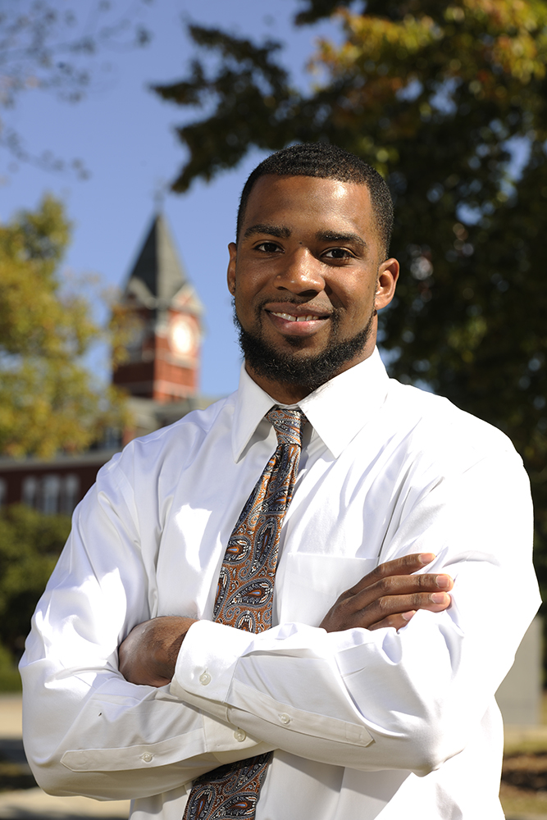
Marshall Scholar
Ashton Richardson
Auburn graduate
Veterinary student at Texas A&M
The Marshall Scholarship program was established in 1953 by an act of British
Parliament in honor of U.S. Secretary of State George C. Marshall as an expression of
Britain's gratitude for economic assistance received through the Marshall Plan after
World War II. The program is overseen by the Marshall Aid Commemoration Commission.
The 40 winners are chosen from the approximately 900 students endorsed annually for
the scholarship by their respective universities.

Slide 23
1A FAR Academic Excellence Award
Student-Athlete Major Sport
Elizabeth Briasco Nutrition-Dietetics Cross Country/Track and Field
Jacqueline Kasler Animal Sciences Pre-Vet Tennis
Spencer Kerns Chemistry Pre-Med Swimming and Diving
Jason Miller Biomedical Sciences Pre-Med Cross Country/Track and Field
Marcus Popenfoose Interdisciplinary Studies Track and Field
Stephanie Rucci Human Resources Equestrian
Jennifer Waxman Political Science Equestrian
Criteria for the award:
Awarded a BS in the previous year (9-1-2013 to 8-31-2014)
Cumulative GPA of 3.8 or above upon graduation
3. Participated in at least 2 years of intercollegiate athletics at a Football Bowl
Subdivision (FBS) institution in a sport sponsored by an FBS conference.

Slide 24
NCAA Postgraduate Scholarship winners in 2014
Spencer Kerns – Swimming & Diving
Tofey Leon – Swimming & Diving
Stephanie Rucci – Equestrian
The NCAA Postgraduate Scholarship is considered one of the highest
academic honors a student-athlete can receive.
The award measures success beyond the playing field, encompassing
academic accomplishments, campus involvement, community service,
volunteer activities and demonstrated leadership.
174 NCAA senior athletes across all sports and divisions are chosen
each year and receive a $7,500 grant to pursue post-graduate education.

Slide 25
Criteria for SEC Academic Honor Roll
A student-athlete must have a grade point average of 3.00 or above for
either the preceding academic year (two semesters or three quarters) or have a
cumulative grade point average of 3.00 or above at the nominating institution.
(2) If a student-athlete attends summer school, his/her grade point average during
the summer academic term must be included in the calculation used to determine
eligibility for the Academic Honor Roll.
(3) Student-athletes eligible for the Honor Roll include those receiving an athletics
scholarship, recipients of an athletics award (i.e., letter winner), and non-scholarship
student-athletes who have been on a varsity team for two seasons.
(4) Prior to being nominated, a student-athlete must have successfully completed
24 semester or 36 quarter hours of non-remedial academic credit toward a
baccalaureate degree at the nominating institution.
(5) The student-athlete must have been a member of a varsity team for the sport’s
entire NCAA Championship segment.

Slide 26
Auburn Student-Athletes SEC Academic Honor Roll
The 2014 Winter SEC Academic Honor Roll
2013 Spring, Summer and Fall terms
26 Equestrian, 3 W. Basketball, 10 Gymnastics,
13 M. Swimming, 10 W. Swimming
A total of 108 student-athletes were named to the 2014 Spring SEC
Academic Honor Roll, the highest in the conference.
The 2014 Spring SEC Academic Honor Roll
2013 Summer, 2013 Fall and 2014 Spring terms
14 Baseball, 11 M. Golf, 7 W. Golf, 9 Softball, 5 M. Tennis,
10 W. Tennis, 21 M. Track and Field, 31 W. Track and Field
The 2014 Fall SEC Academic Honor Roll
2014 Spring, Summer and Fall terms
31 Football, 12 Soccer, 6 Volleyball

Slide 27
Athletics Department—Academic Report—Fall of 2014
Number of Student-Athletes: 521
Incoming Freshmen/Incoming Transfer Students: 74
Student-Athletes with an Existing Auburn University Cumulative GPA: 447
Number of Student-Athletes with a 4.00 Cumulative GPA 51 (11.41%)
Mean Cumulative GPA of Student-Athletes 3.09
Median Cumulative GPA of Student-Athletes 3.05
Auburn University Cumulative Grade Point Average—Comparative Information
2014 2013 2012
Student-Athletes, Cumulative GPA of 3.0 or Higher 55.03% 53.86% 51.49%
Student-Athletes, Cumulative GPA of 2.50-2.99 27.29% 25.11% 23.22%
Student-Athletes, Cumulative GPA of 2.00-2.50 17.23% 19.74% 24.14%
Student-Athletes, Cumulative GPA less than 2.0 0.45% 1.29% 1.15%
Student-Athletes on Track to Graduate with Honors 36.02% 33.48% 28.51%
Data provided by Dr. Gary Waters, Sr. Assoc. Athletics Director, Student Athlete Support Services

Slide 28
Auburn University Student Athletes Fall Semester 2014
Average Team GPA for Semester 3.06
Average Team Cumulative GPA 3.14
Average Individual Student Athlete GPA for Semester 3.00
Average Individual Student Athlete Cumulative GPA 3.09
Total Student Athletes with 3.00+ 289 (60.12%)
Top Team GPA for the Semester Soccer 3.32
Top Team Cumulative GPA Volleyball 3.43
Team with most 3.00+ GPAs Football 50 (41.67%)
Team with Highest % 3.00+ GPAs Men’s Golf 88.89%
Data provided by Dr. Gary Waters, Sr. Assoc. Athletics Director, Student Athlete Support Services

Slide 29
Enrollment of Student-Athletes by College/School
College/School Number of Student-Athletes—% of Total
Agriculture 9 (1.73%)
Architecture, Design, & Construction 13 (2.50%)
Harbert/Business 124 (23.80%)
Education 92 (17.66%)
Ginn/Engineering 29 (5.57%)
Forestry & Wildlife Sciences 1 (0.19%)
Human Sciences 14 (2.69%)
Liberal Arts 162 (31.09%)
Nursing 9 (1.73%)
Pharmacy 1 (0.19%)
Science & Mathematics 53 (10.17%)
Veterinary Medicine 1 (0.19%)
Inter-Disciplinary Studies 12 (2.30%)
Data provided by Dr. Gary Waters, Sr. Assoc. Athletics Director, Student Athlete Support Services

Slide 30
Most Popular Academic Majors of Student-Athletes within
the College of Business, the College of Education, and the College of Liberal Arts
College/Academic Major Number of Student-Athletes—% of Total
Business
Pre-Business 68—13.05%
Finance 15—2.88%
Marketing 10—1.92%
Education
Fitness, Conditioning, & Performance 21—4.03%
Physical Activity & Health 21—4.03%
Pre-Exercise Science 12—2.30%
Exercise Science 11—2.11%
Liberal Arts
Public Administration 52—9.98%
Psychology 17—3.26%
Pre-Liberal Arts—Undecided 13—2.50%
Sociology 12—2.30%
Data provided by Dr. Gary Waters, Sr. Assoc. Athletics Director, Student Athlete Support Services

Slide 31
Auburn University Football Team—Academic Report
The Gus Malzahn Era at Auburn University —
During the last two years, the academic performance of the student-athletes on the
football team is at an all-time high.
This is reflected in very high APR scores and a record number of student-athletes
graduating from Auburn University.
During the last three years, the single-year APR scores for the football team have been among the highest in the nation and among the highest in the SEC.
On December 13, 2014:
15 current members of the football team graduated.
14 student-athletes earned undergraduate degrees
1 student-athlete earned a Masters Degree during the Fall Semester of 2014
Auburn University Football Team—Outback Bowl on January 1, 2015:
There were a total of 21 student-athletes playing with degree in hand.
This number was #2 in the entire country.
The #1 team in the country played with 22 graduates.
Data provided by Dr. Gary Waters, Sr. Assoc. Athletics Director, Student Athlete Support Services

Slide 32
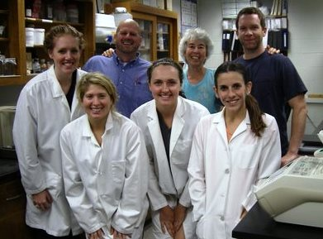
Hemostasis Laboratory
Summer 2013 – 3 student-athletes and 1 veterinary student working in the lab.
Maddie Barnes – Soccer; Melena Smith – Equestrian; Erica Kolakowski – Track/XC

Slide 33
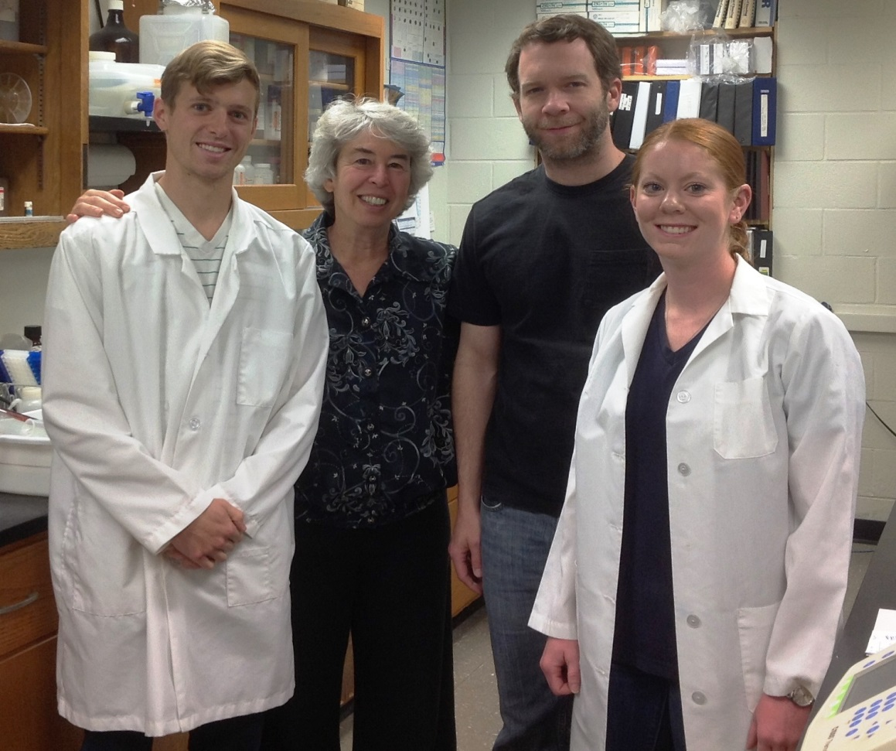
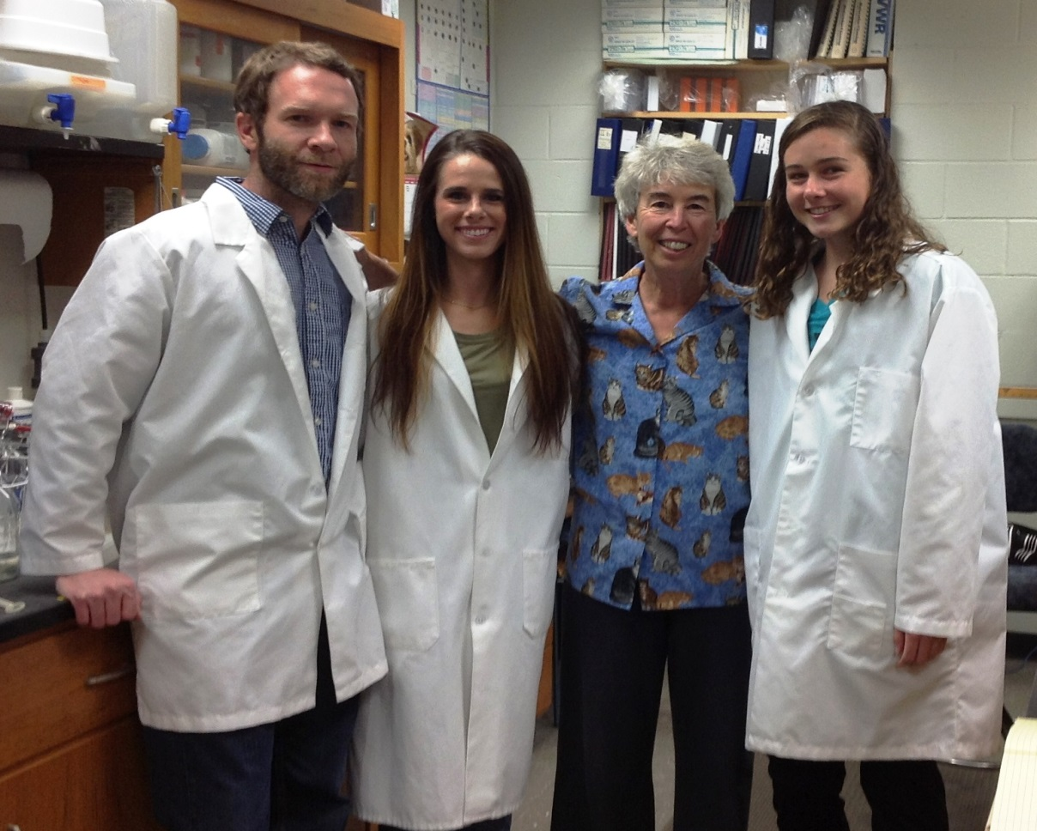
Hemostasis Laboratory
Spring Semester 2014 Jason Miller – Track/XC; Caitlin Moran – Equestrian
Fall Semester 2014 Hannah Loseke – Equestrian; Kristin Sheehan – Track/XC

Slide 34
SEC Faculty Athletics Representatives
Provosts 1 Vanderbilt
Associate Deans 3 Alabama, University of Mississippi, S. Carolina
Department Heads/Chairs 3 Arkansas, Florida, Mississippi State
Professors 7 Auburn, Georgia, LSU, Kentucky,
Tennessee, Missouri, Texas A&M
Engineering 1
Kinesiology 1
Sports Management 1
Law 3
English 1
Ag Economics 1
Economics 1
Educational Leadership 1
Psychology 1
Veterinary Medicine 1
Management 1
Physics 1

Slide 35
Kevin Whitaker, University of Alabama, Assoc Dean for Academic Programs, Assoc Professor of
Aerospace Engineering and Mechanics
Sharon Hunt, University of Arkansas, Depart Head, Depart of Health Science, Kinesiology,
Recreation and Dance
Michael Sagas , University of Florida, Prof and Chair, Depart of Tourism, Recreation, and Sport Management
David Shipley, University of Georgia, Former Law School Dean, Professor of Law
Joseph Fink, University of Kentucky, Prof of Pharmacy Law and Policy (Pharmacy degree and Law degree)
Bill Demastes, Louisiana State University, Alumni Professor of English
Ron Rychlak, University of Mississippi, Associate Dean for Academic Affairs and Professor of Law
Steve Turner, Mississippi State, Department Head and Professor, Department of Agricultural Economics
Zach Kelehear, University of South Carolina, Professor of Educational Leadership and Policies
Don Bruce, University of Tennessee, Professor, Center for Business and Economic Research
Susan Wente, Vanderbilt, Provost and Vice Chancellor for Academic Affairs
Tom Adair, Texas A&M, Professor, Department of Physics and Astronomy
Lori Franz , University of Missouri, Professor, Management, Trulaske College of Business

Slide 36
Auburn student-athletes not only become well-educated, they also develop excellent time management skills and a sense of community that is unique to Auburn University.
Their success relies on the cooperation of faculty, counselors, coaches, sport administrators, and the students themselves.
Student athletes cannot succeed without being both academically
and athletically prepared.
For the faculty and staff who have helped and continue to help inspire our students to be the best that they can be, in the classroom and on the playing field (court, track, pool, horse):
THANK YOU!

