Slide 1
Key FINDINGS from THE 2013-2014 COACHE Faculty Job Satisfaction Survey
University Senate
August 26, 2014

Slide 2
COACHE ALIGNMENT WITH THE STRATEGIC PLAN
Strategic Goal #4: The University will increase productivity by supporting faculty vitality and ongoing faculty development.
Utilized the Collaborative on Academic Careers in Higher Education administered by the Harvard Graduate School of Education
Designed to better understand the academic working lives of faculty and improve their job satisfaction and performance where possible.
2005-2006
Administered to pre-tenure faculty
2008-2009
2010-2011
Administered to tenured faculty
2013-2014
Administered to pre-tenure, tenured, and full-time non-tenure track faculty
Administered to pre-tenure faculty
Survey utilizes 20 benchmarks
COACHE aggregates responses to questions that are related to develop a benchmark score;
Benchmarks provide an overall sense of how faculty feel about a particular aspect of their work/life.

Slide 3
COACHE RESULTS: RESPONDENTS
 | Population | Responders | Response Rate
Overall | 1,015 | 526 | 52%
Tenured | 818 | 401 | 49%
Pre-Tenure | 197 | 125 | 63%
Full | 430 | 201 | 47%
Associate | 391 | 205 | 52%
Men | 680 | 312 | 46%
Women | 335 | 214 | 64%
Faculty of Color | 223 | 108 | 48%
Compared results of Auburn faculty against faculty at 5 peer institutions similar in size and scope as well as all 98 participating institutions.

Slide 4
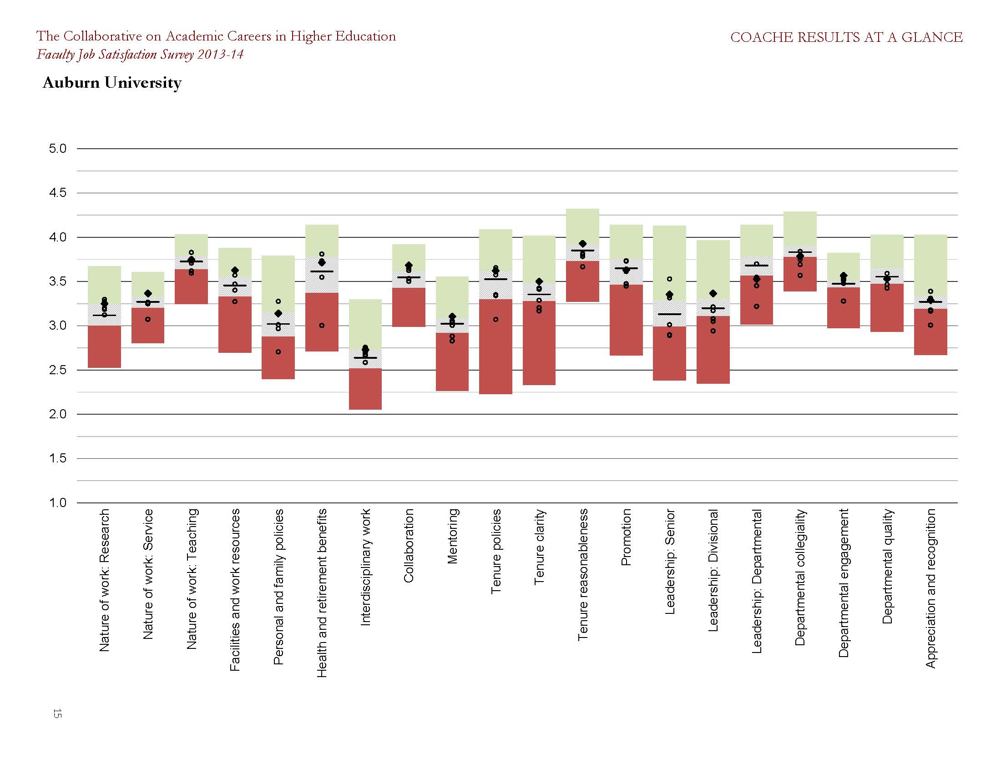
COACHE RESULTS: STRATEGIC PLAN ALIGNMENT

Slide 5
COACHE RESULTS: Selected Research Items
Satisfied with . . . | Professor | Associate | Assistant
Time spent on research | 69% | 48% | 54%
Expectations for external funding | 32% | 33% | 36%
Influence on focus of research | 87% | 86% | 91%
Support for obtaining grants | 24% | 26% | 33%
Course release for research | 27% | 27% | 37%

Slide 6
COACHE RESULTS: Selected Personal & Family Policies
Satisfied with . . . | Professor | Associate | Assistant
Tuition waiver/remission | 36% | 37% | 26%
Family medical/parental leave | 35% | 32% | 30%
Flexible workload/modified duties | 35% | 36% | 33%
Spousal/partner hiring program | 6% | 3% | 6%
Childcare | 3% | 2% | 6%

Slide 7
COACHE RESULTS: Selected Departmental Quality items
Satisfied with . . . | Professor | Associate | Assistant
Intellectual vitality, tenured | 62% | 59% | 57%
Intellectual vitality, pre-tenure | 73% | 74% | 80%
Teaching effectiveness, tenured | 64% | 66% | 62%
Teaching effectiveness, pre-tenure | 67% | 67% | 74%
Scholarly productivity, tenured | 53% | 49% | 50%
Scholarly productivity, pre-tenure | 67% | 68% | 73%

Slide 8
COACHE RESULTS: Global Satisfaction Items
As a place to work . . . | Professor | Associate | Assistant
My department | 64% | 63% | 70%
My institution | 68% | 65% | 69%

Slide 9
COACHE RESULTS: AREAS OF RELATIVE CONCERN
Bottom 30% of the 98-member cohort and ranked #5 or #6 among the selected peer group:
Benchmark: Research
Support for obtaining grants (pre-award)
Benchmark: Personal and family policies
Benchmark: Leadership
Benchmark: Departmental Quality
Benchmark: Appreciation and recognition
Spousal/partner hiring program
Head/Chair: Fairness in evaluating work
Department addresses sub-standard tenured faculty performance
School/college is valued by President/Provost

Slide 10
COACHE RESULTS: NEXT STEPS
COACHE Recommendations:
Evaluate the need for policies related to Spousal/Partner Hiring and Flexible Workload/Modified Duties
Assess the need for campus childcare
Address the need for increased faculty appreciation and recognition
Assess the need for enhanced training for department heads and chairs
Develop enhanced support to sustain increased research productivity
Create a Commission on the Academic Careers of Women at Auburn University
Expanded COACHE committee to become Strategic Priority #2 Implementation Committee:
Jared Russell, Department of Kinesiology, Chair
Drew Clark, OIRA
Bob Holm, Office of Sponsored Programs
Julie Huff, Office of the Provost
Calvin Johnson, College of Veterinary Medicine
Jennifer Johnson, School of Communication and Journalism/NTT Faculty
Iryna Johnson, OIRA
Hulya Kirkici, College of Engineering
Margaret Marshall, Office of University Writing
Chippewa Thomas, Office of University Outreach

