Slide 1
Auburn University Parking Services
2015-2016 Parking Changes
Don Andrae
Parking Services
Auburn University
            March 17, 2015

Slide 2
License Plate Recognition
No permits will be issued for A, B, C, all PC zone and all R zone registrations. You will be registering the license plate information for the vehicle and assigned a zone where you will be able to park.
Important to notify the Parking Services Office of changes in vehicles or changes in license plate information.
How it works!
$20 charge for the registration of more than two vehicles
New rule concerning pulling through or backing into spaces

Slide 3
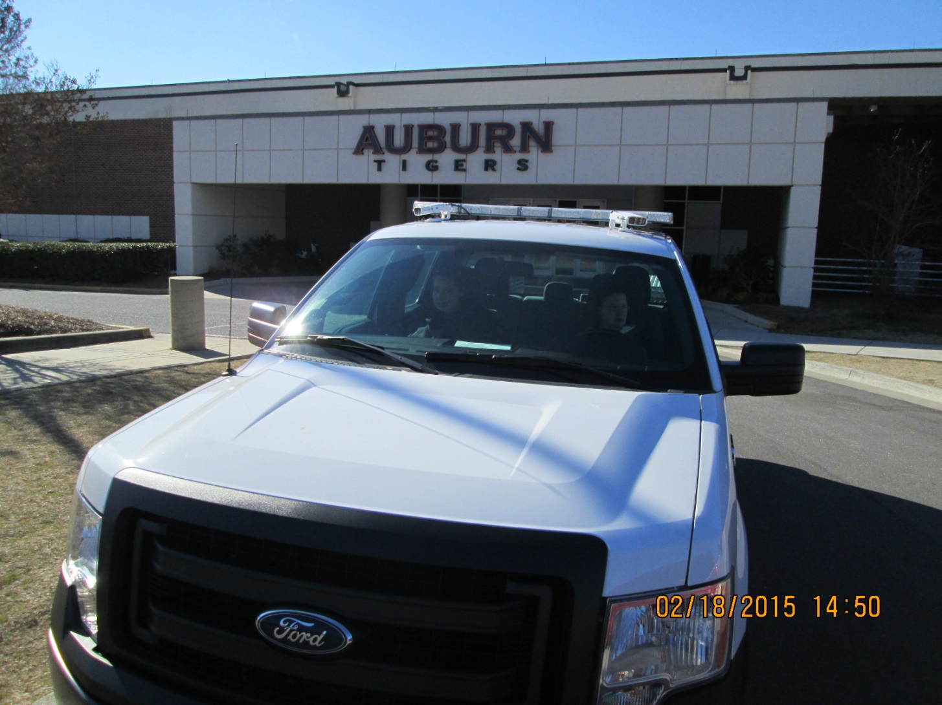

Slide 4
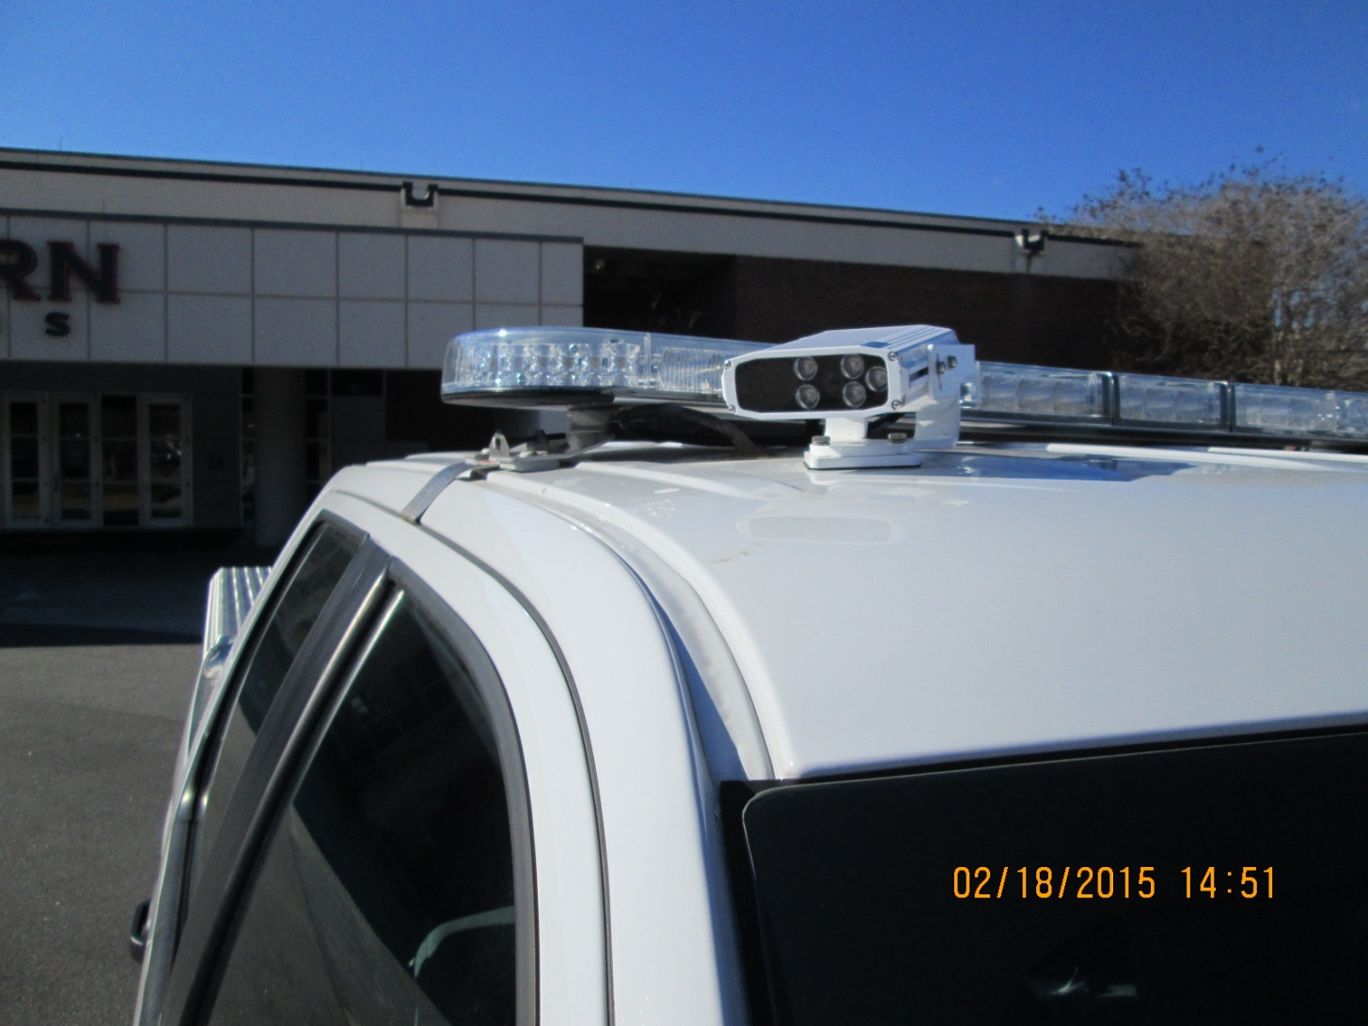

Slide 5
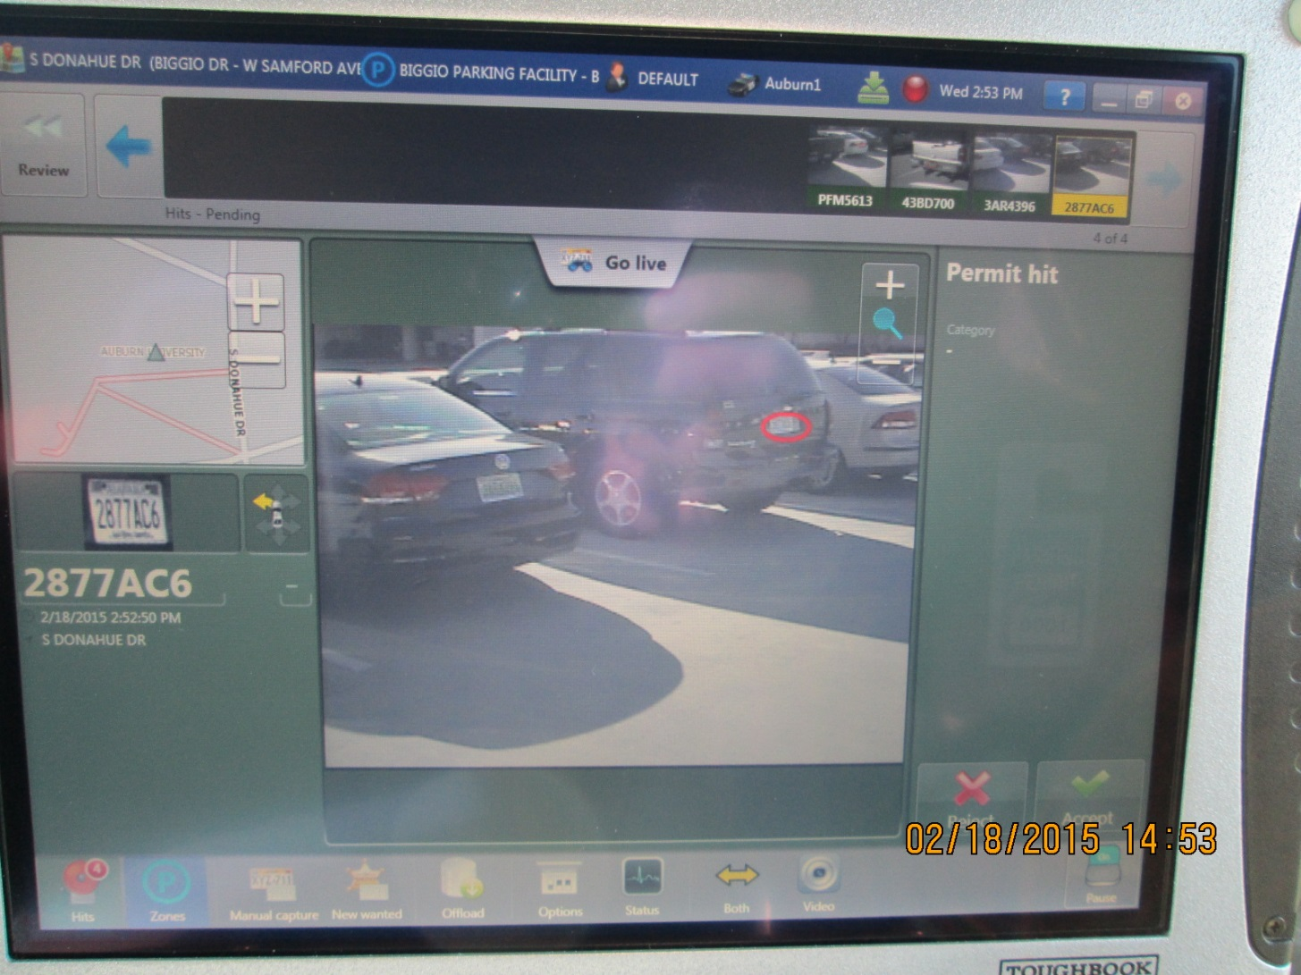

Slide 6
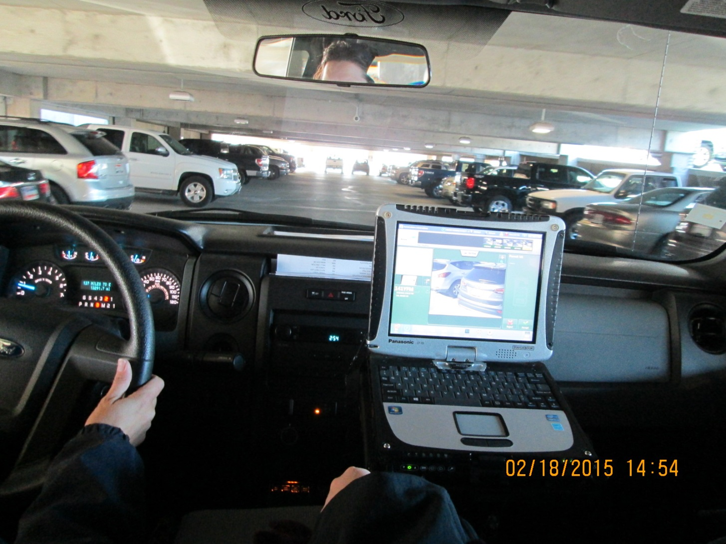

Slide 7
Mell Street Closing
Mell Street from Thach Avenue to Library Drive will be closed starting in July and will remain closed for 18 months.
Because of the anticipated pedestrian traffic in that area, it may remain closed
Tiger Transit will run all buses on Mell from Roosevelt to Samford, which will increase the north and south bound traffic in that area.
Notes:
Rules and regulations available in hard-copy and on Parking Services website

Slide 8
New Parking Zones
Visitor/Guest parking on the fourth level of the Stadium Deck, Lowder Lot, Library Deck, College Street Lot, South Quad Parking Deck and Greene Hall by the CVM.
The row of spaces facing north in the small lot behind AU Public Safety will be changed to B zone.
The remaining spaces in the small lot behind AU Public Safety will be changed to RW zone.
The row of spaces facing Heisman Drive in the Arena Lot will be changed to B zone.
The parallel spaces on the east side of Biggio Drive will be reinstituted and zoned C.
All of the parking west of Hemlock will be changed from either RO or C to be all RO/C.
The parking areas in front of and in back of CDV will be changed to C zone.
Notes:
Rules and regulations available in hard-copy and on Parking Services website

Slide 9
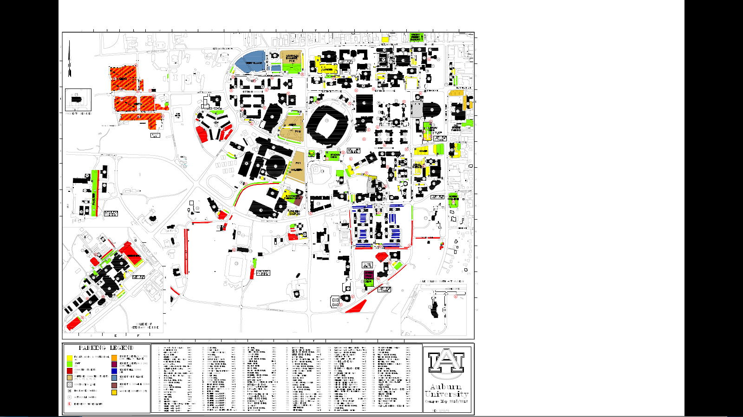
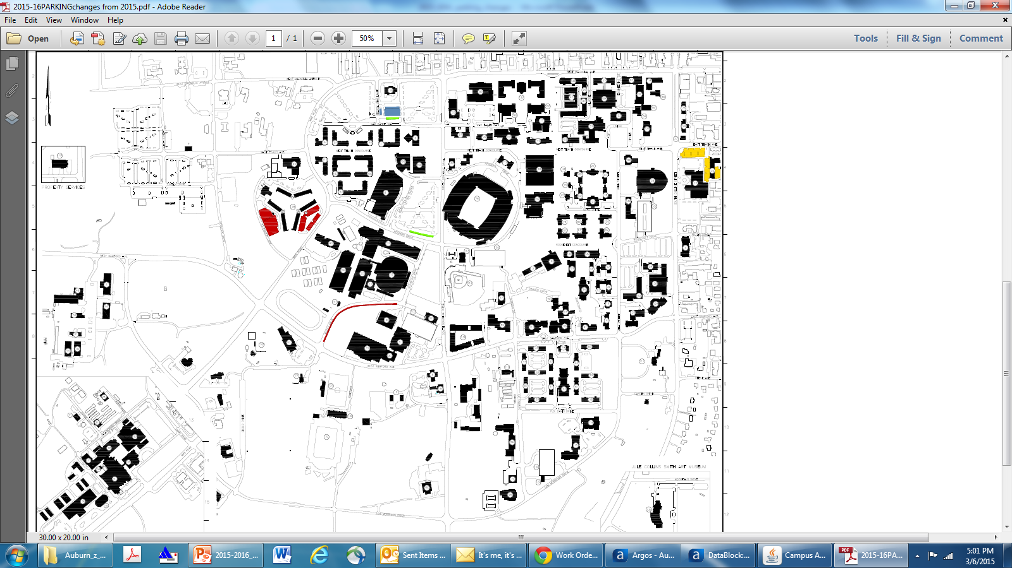

Slide 10
Data about 2014-2015 Rule Changes
Data regarding the changes in ticket fee structure and appeal process
Tickets Issued (August – January)
2013-2014 – 9,783 tickets $481,340
2014-2015 – 10,618 $201,990
Appeals (August – January)
2013-2014 – Total – 521
Approved – 72
Adjusted – 194
Denied – 255
2014-2015 – Total – 712
Approved – 39
Adjusted – 221
Denied – 366
Not Heard – 86
Number of appellants with 3 appeals – 8
Permit holders/tickets statistics
2013-2014 – 20,006
1 ticket – 7,662
2 tickets – 2,867
3 tickets – 1,231
4 or more tickets – 607
2014-2015 – 18,974
1 ticket – 5,318
2 tickets – 1,742
3 tickets – 654
4 or more tickets – 284
Permit registration with more than 2 vehicles registered – 540
Permit registration with more than 3 vehicles registered – 127
Notes:
Rules and regulations available in hard-copy and on Parking Services website

Slide 11
Non Conventional Vehicle Registration
NON-CONVENTIONAL VEHICLES
A non-conventional vehicle is defined as any motorized vehicle, gas or electric powered, that is used to transport people, equipment or other goods. EXAMPLE: Golf carts, ATVs or low-speed vehicles.
All non-conventional vehicles operated on the Auburn University campus must be registered and display a permit issued by the Parking Services Office. The vehicle model, color and serial number, must be presented when registering the vehicle. The permit must be renewed each year and displayed on the non-conventional vehicle. The cost of the permit is $20.
When parking, a non-conventional vehicle must not impede pedestrian or vehicular traffic. Parking of non-conventional vehicles is limited to designated cart parking areas and hard paved surfaces that do not block building entrances. They may not park in a designated parking space, in the roadway or in any tow-away zone as described by the Traffic and Parking Regulations.
Any non-conventional vehicle that does not either display a current permit or is parked illegally is subject to being ticketed and/or towed at the owners expense. Fines for ticketing non-conventional vehicles are the same as described for conventional vehicles on campus and will be assessed to the department for which the vehicle is registered.
Non-conventional vehicles shall be used on the Auburn University campus only for authorized University business with registration limited to University departments, contractors, or vendors. Registration and use of personal non-conventional vehicles to individual students, faculty, or staff is expressly prohibited.
All users of non-conventional vehicles must possess a U.S. driver’s license, be at least 18 years of age, have knowledge and comply with the State of Alabama motor vehicles laws, and successfully complete the Golf/Utility Cart and Low Speed Vehicle Safety course through Risk Management and Safety. It is the responsibility of the department to ensure drivers meet these requirements before operating a non-conventional vehicle.
Notes:
Rules and regulations available in hard-copy and on Parking Services website

Slide 12
Gotcha Bike Program
New bicycle sharing program for faculty, staff and students. No cost to the person who uses the bicycle.
Notes:
Rules and regulations available in hard-copy and on Parking Services website

Slide 13
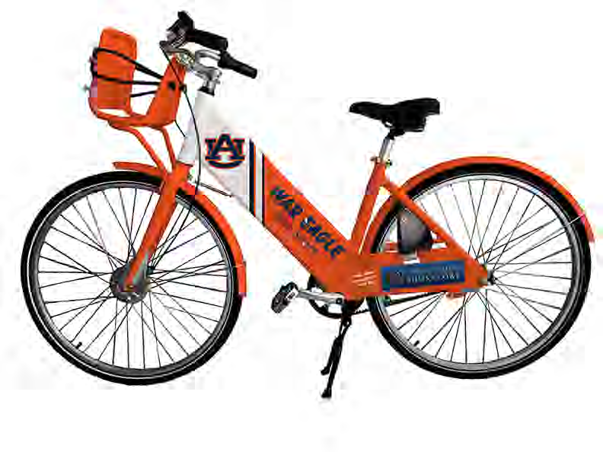
AU Bike Share

Slide 14
Contact Information
Don Andrae – Manager of Parking Services
Telephone #: 334/844-4143
Email: dza0015@auburn.edu

