Slide 1

Facilities Update for
Fall Faculty Meeting
October 29, 2013

Slide 2
Topics
  Current/Upcoming Projects
  Campus Master Plan
  Capital Projects Program

Slide 3
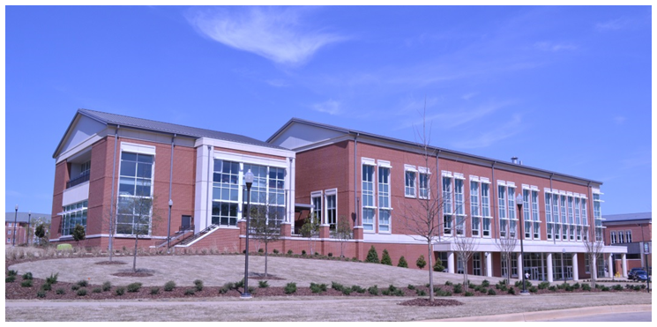
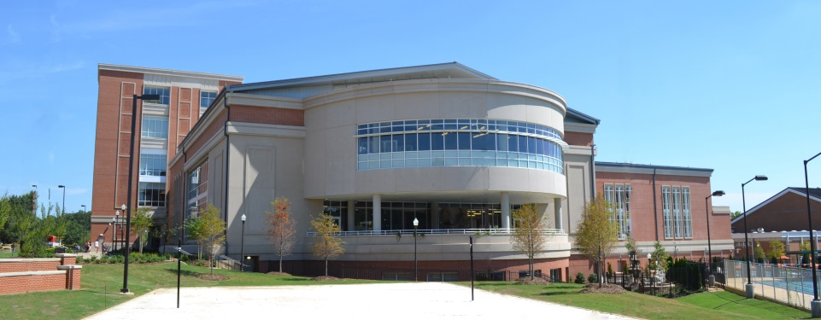
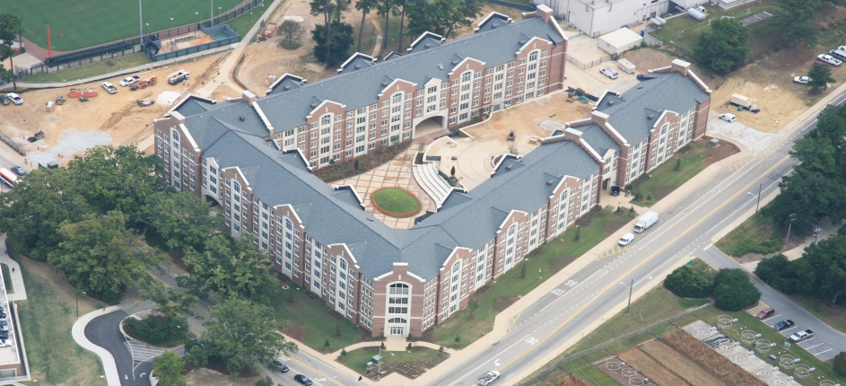
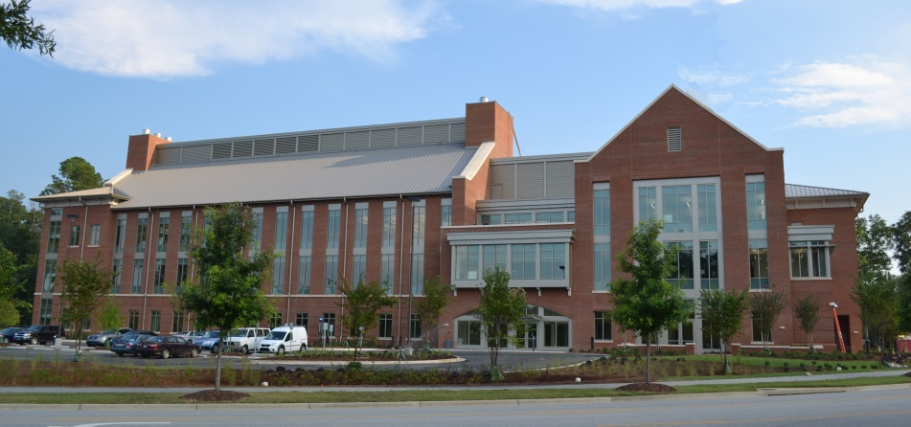

Projects Completed In 2013
Kinesiology Facility ($16M)
Student Wellness Center ($53M)
West Samford Residence Hall ($51M)
CASIC Facility ($19.6M)

Slide 4
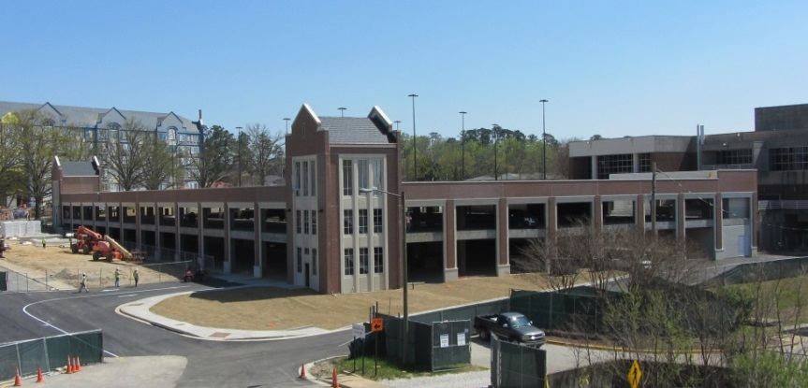
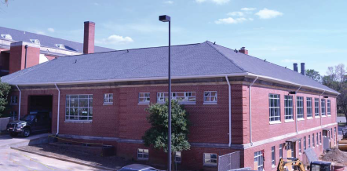
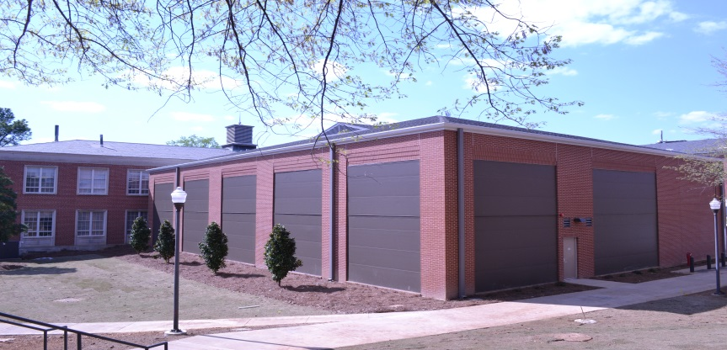
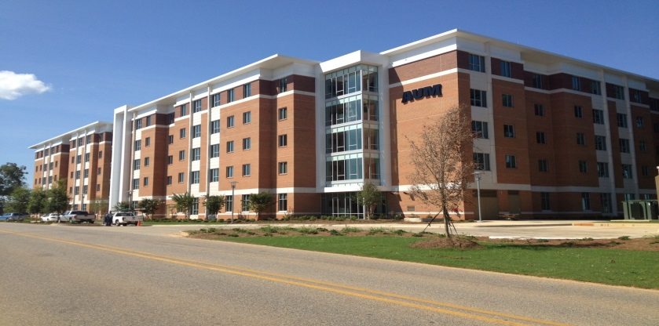
Projects Completed In 2013
Biggio Drive Parking Facility ($8M)
Biological Engineering Research Lab ($5M)
BioDiversity Learning Center ($2.7M)
AUM Residence Hall ($28M)

Slide 5
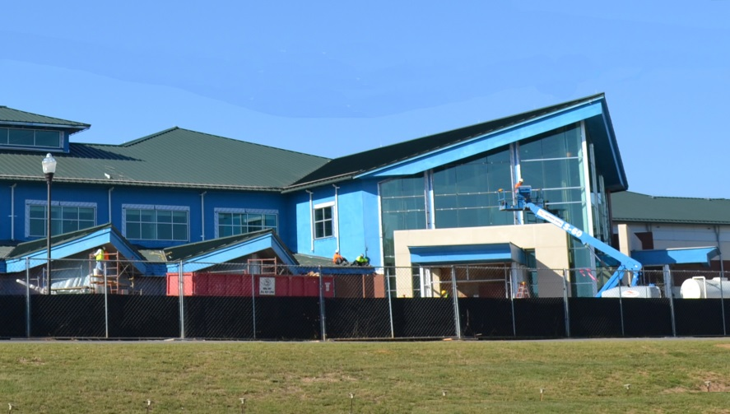
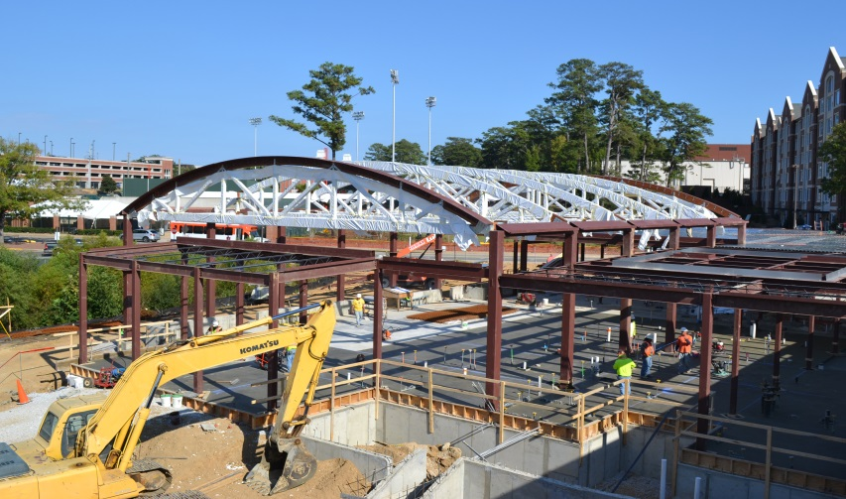

Projects To Be Completed In 2014
Small Animal Teaching Hospital Phase II ($47M)
Wellness Kitchen ($5M)
Other Projects:

Slide 6
Campus Master Plan
Developed with an open, inclusive, engaged process.
Stakeholder Meeting Count
 | Space Model Development | Master Plan Update | TOTAL
Senior Leadership | 15 | 12 | 27
Committees | 3 | 11 | 14
Academic Units | 17 | 33 | 50
Non-Academic Units | 13 | 20 | 33
Advisory Groups | 11 | 5 | 16
Space Planning Groups | 18 |  | 18
Government |  | 2 | 2
Open Forums |  | 6 | 6
TOTAL | 77 | 89 | 166

Slide 7
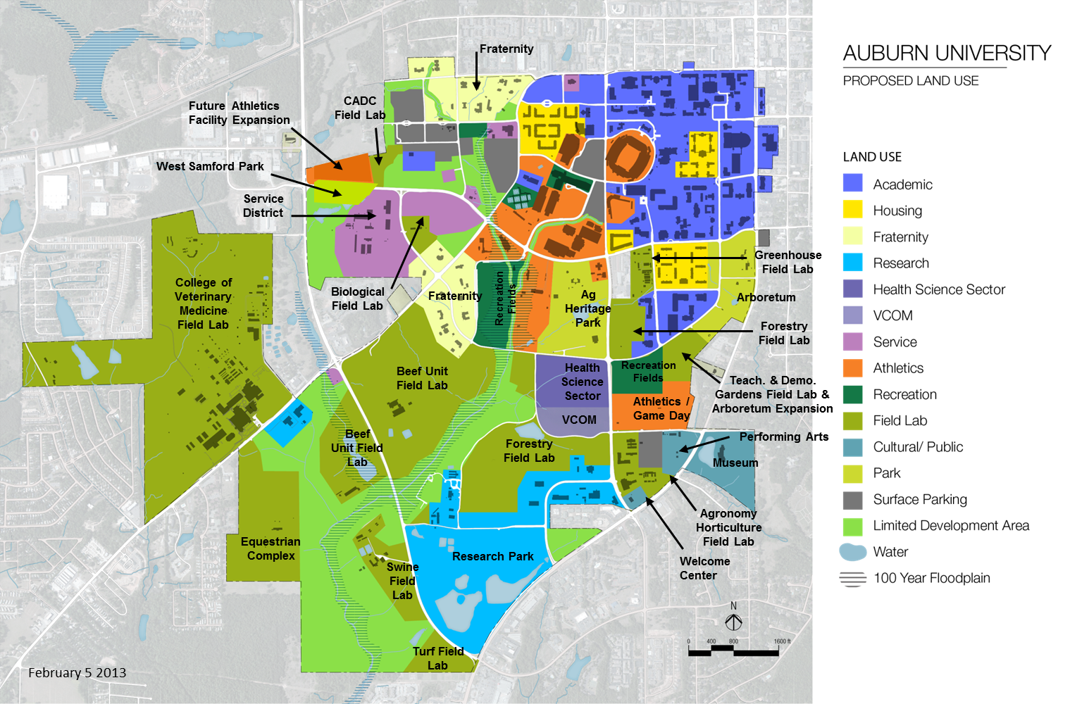
Campus Master Plan
Requesting Approval by the Board of Trustees November 2013

Slide 8
Campus Master Plan
Campus Master Plan Key Findings:
  Greatest Academic Space Deficit by Type:
    Instructional Laboratory Space: 176,000 SF
    COSAM: Greatest Lab Space Deficit: 59,000 SF
  Instructional Classrooms:
    The issue is quality and size, not quantity.
  College/School Operating with Greatest Space Deficit:
    School of Nursing: Has only 21% of Required Space

Slide 9
Evolution of the Capital Projects Program
2010-2012
“Replace Or Renovate Older Academic Buildings In The Core Of Campus.”
Campus
Master Plan
Strategic Plan
Affordability
2013-2020
“Enhance Student Success.”

Slide 10
Capital Projects Program
Project List

Slide 11
Capital Projects Program
Project List

Slide 12
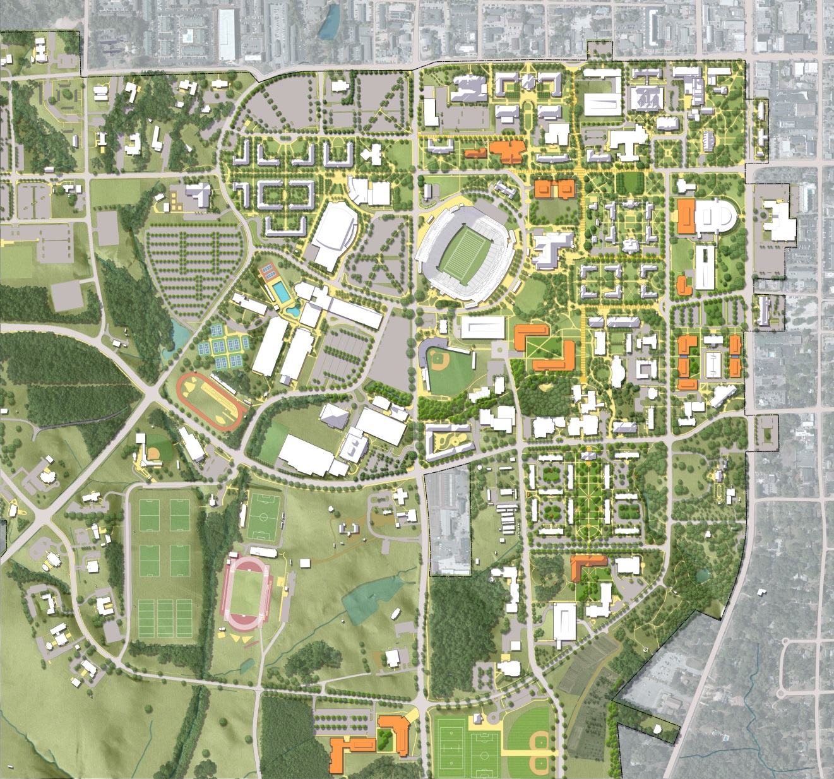
Campus Master Plan
Building Site Locations

Slide 13
Questions?

Slide 14
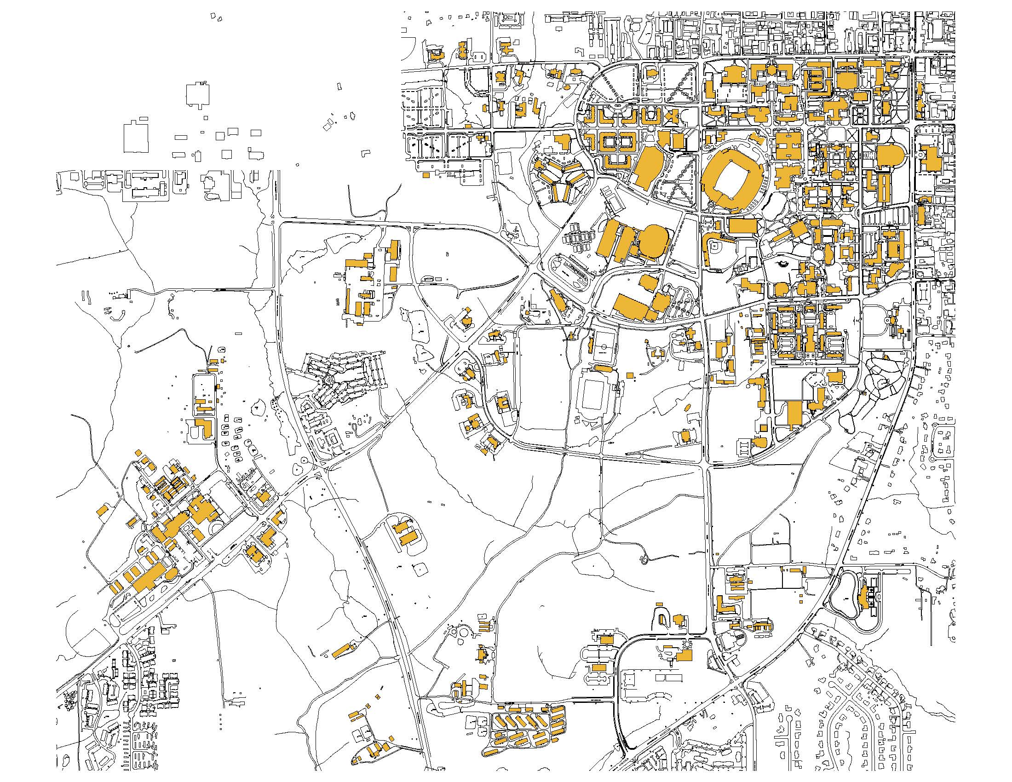
Auburn University Map

Slide 15
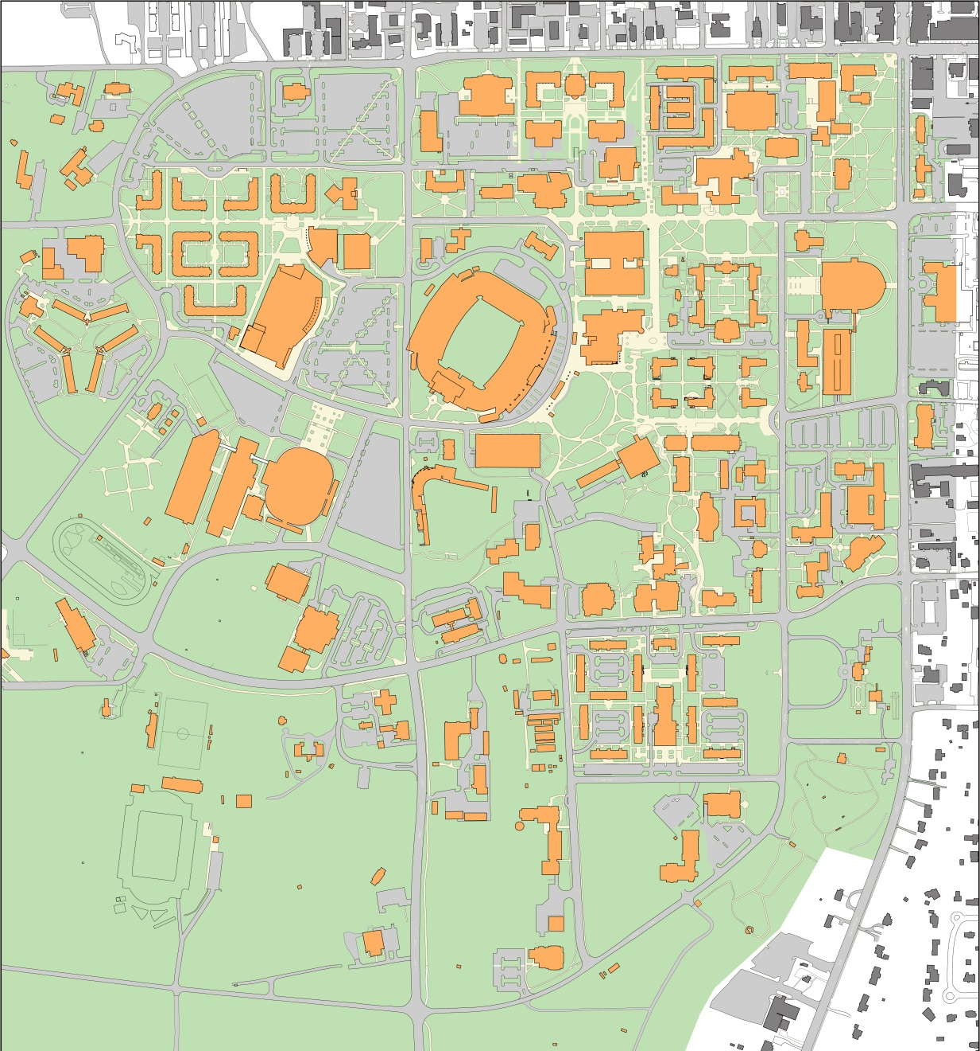
Auburn University
Core of Campus Map

