Slide 1

presented by:
Joan Hicken
January 14, 2014

Slide 2
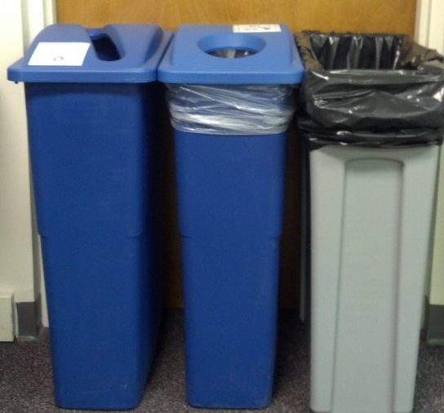
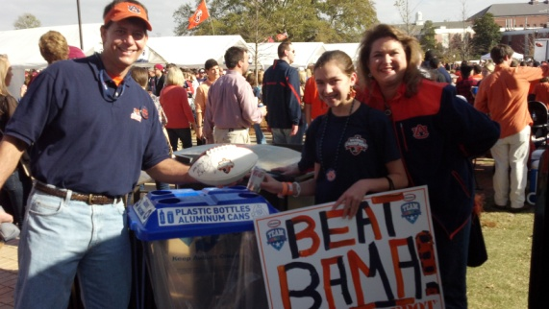
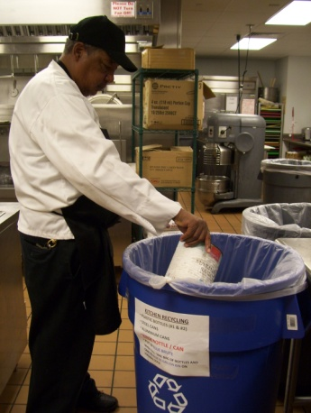
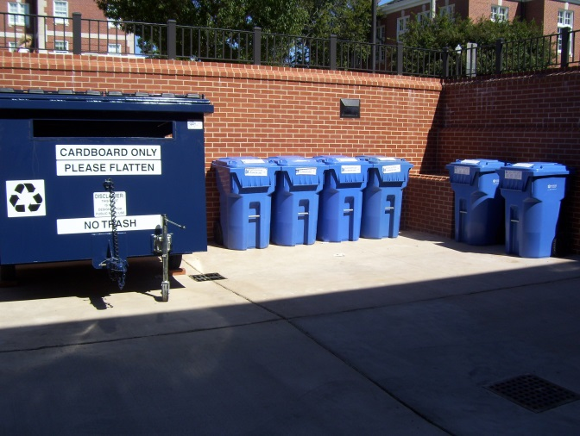

Recycling Programs

Slide 3
Campus Building Recycling Program
Campus Community
Custodial Collection
Waste
Reduction
and
Recycling
Operations
Recycling Facility

Slide 4
Campus Building Recycling Program
Recycling sorted into three (3) categories:
1. Mixed Paper
2. Containers
- Plastic Bottles #1 & #2
- Aluminum Cans & Steel Cans
3. Cardboard

Slide 5
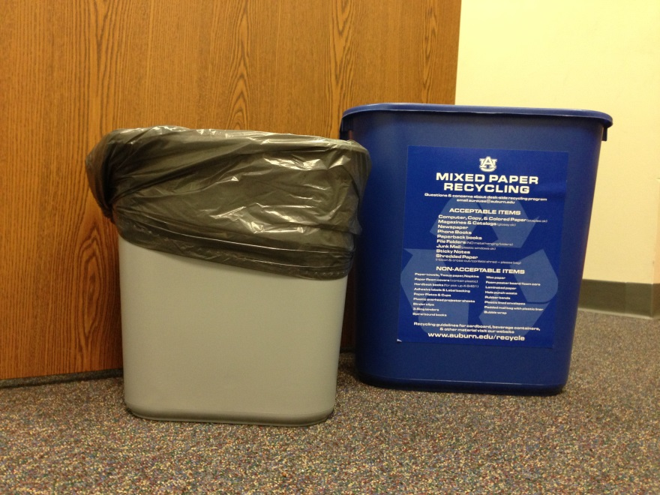
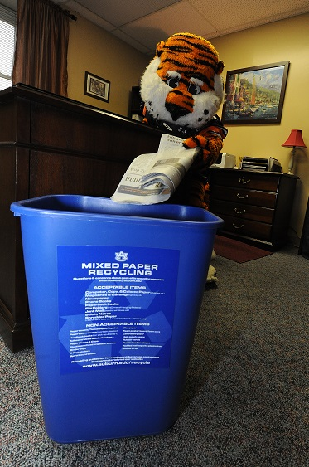
Campus Building Recycling Program
Mixed Paper

Slide 6
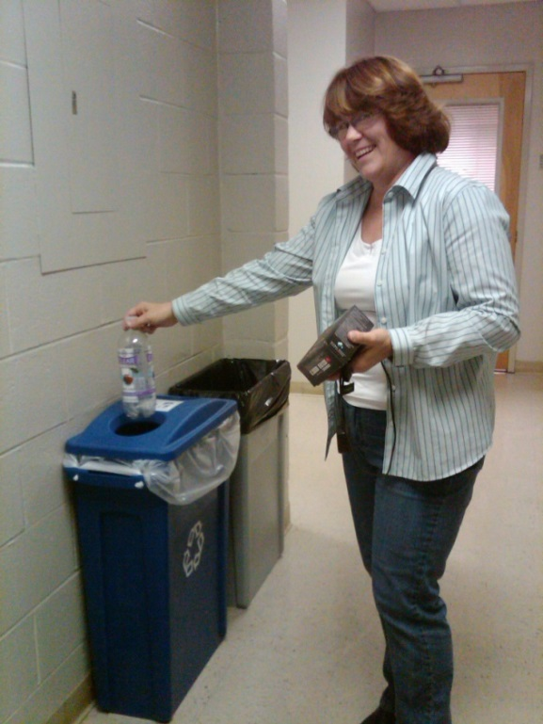
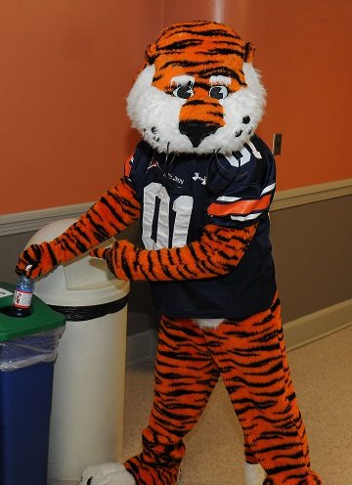


Campus Building Recycling Program
Containers - Plastic Bottles, Aluminum Cans, Steel Cans

Slide 7
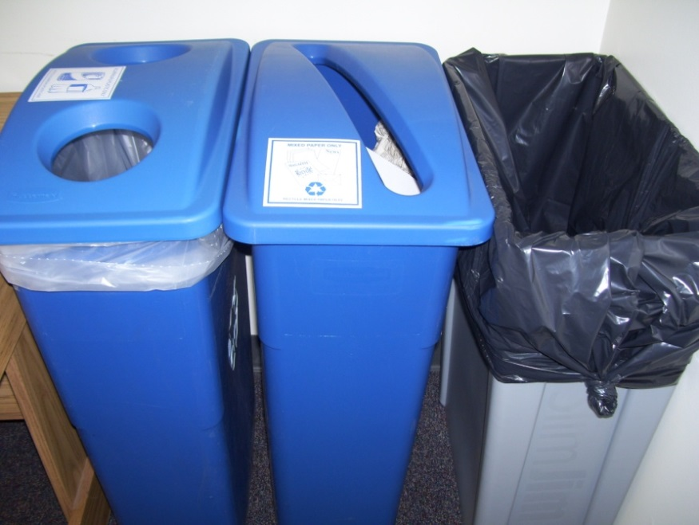
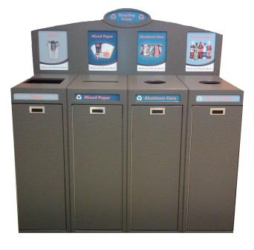
Campus Building Recycling Program
Common Area Bins

Slide 8
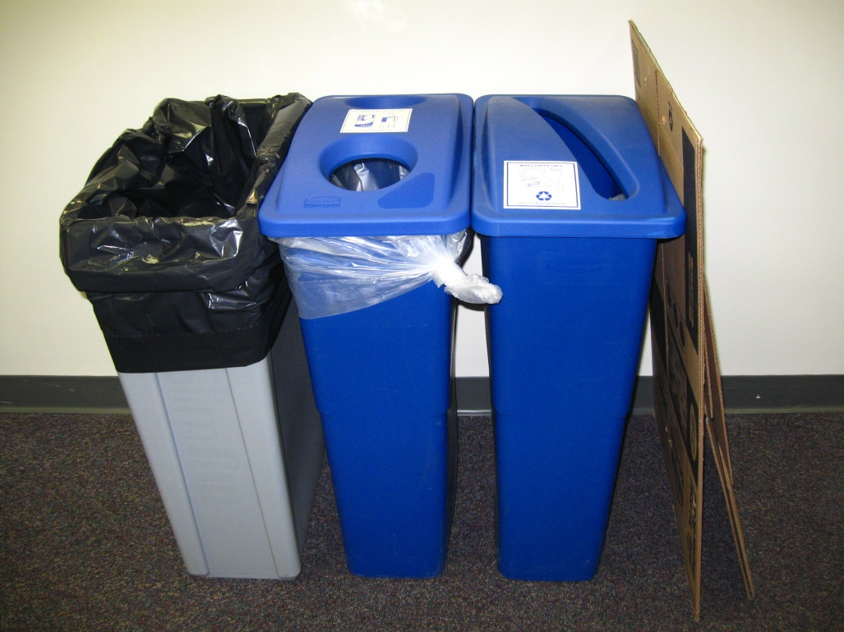
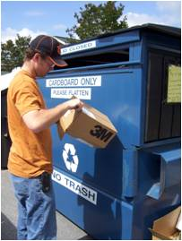
Campus Building Recycling Program
Cardboard

Slide 9
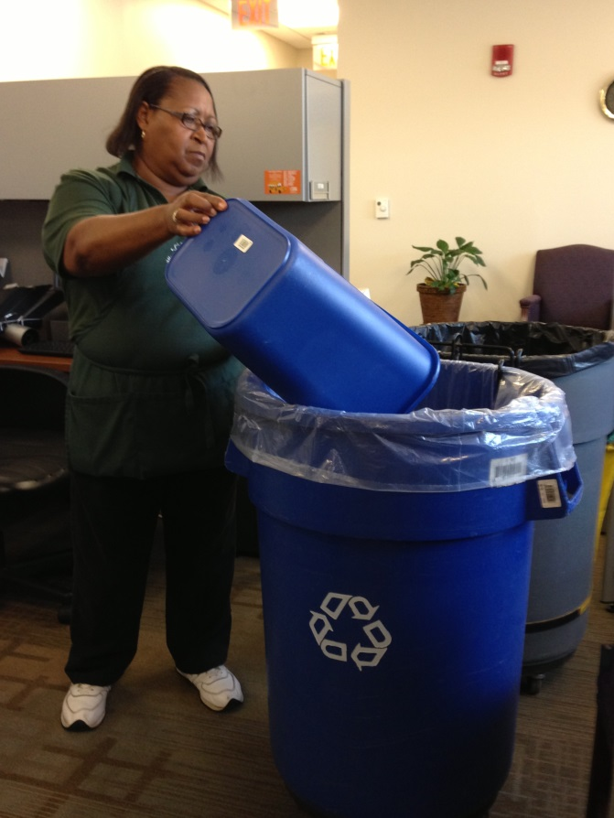
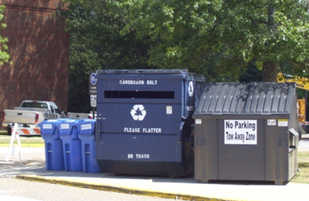
Campus Building Recycling Program
Custodial Collection

Slide 10
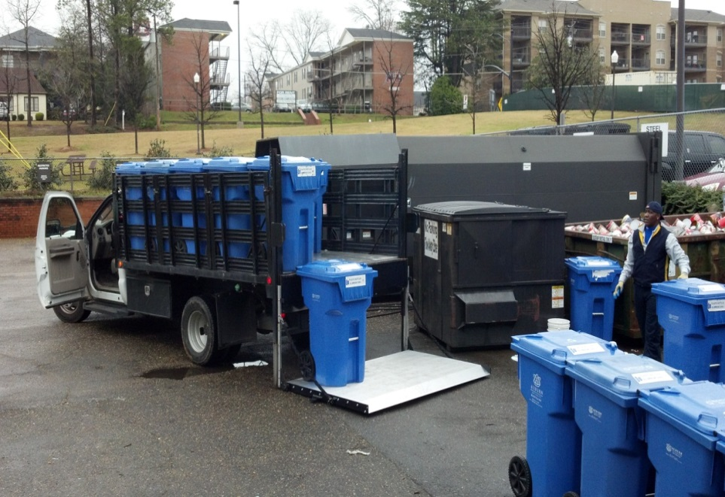
Campus Building Recycling Program
Waste Reduction and Recycling Operations

Slide 11
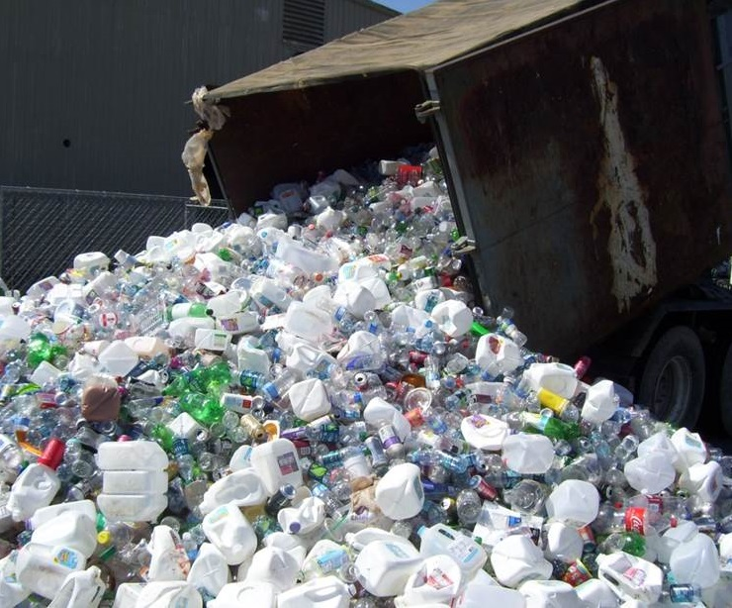
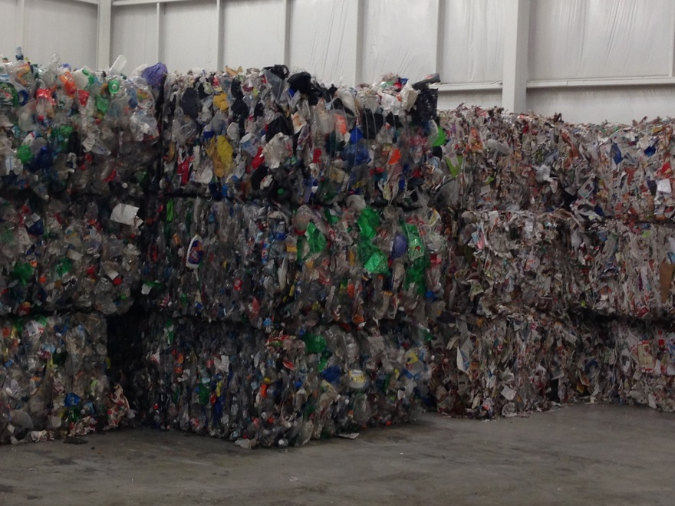
Campus Building Recycling Program
Recycling Facility

Slide 12
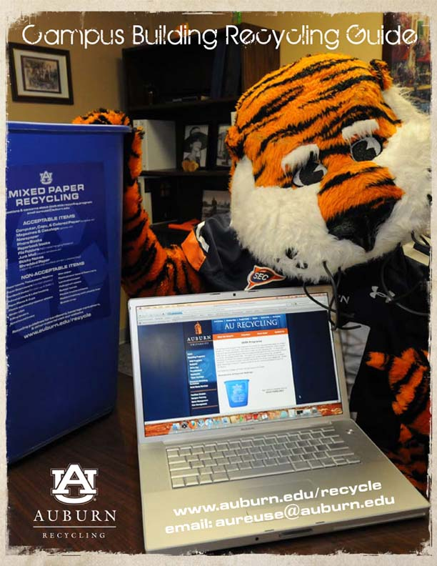
Campus Building Recycling Program
Guide

Slide 13
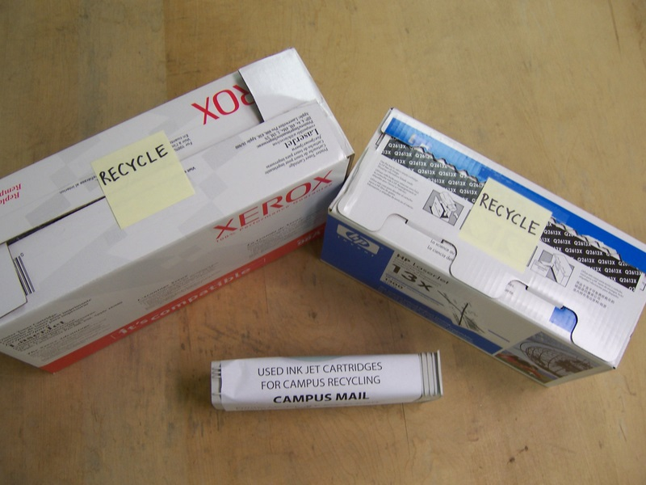
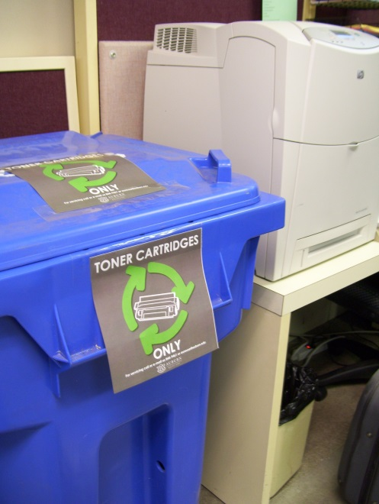
Campus Building Recycling Program
Toner & Ink Cartridge Recycling

Slide 14
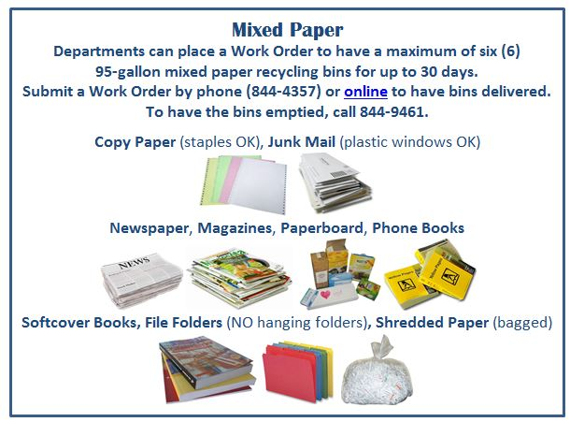
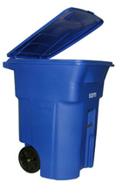
Campus Building Recycling Program
Office Clean-outs

Slide 15
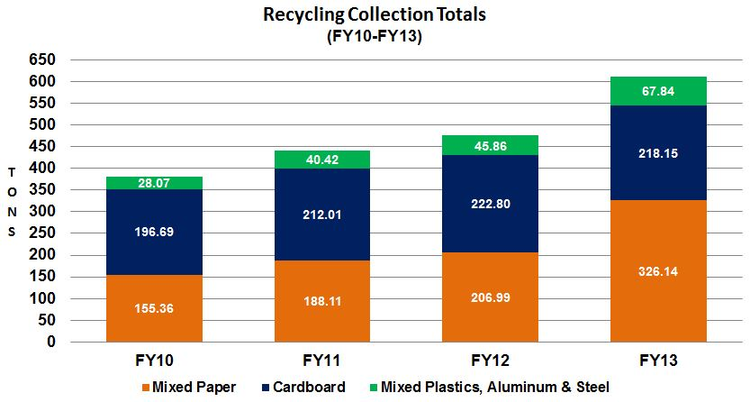
Campus Building Recycling Program
Recycling Collection Totals

Slide 16
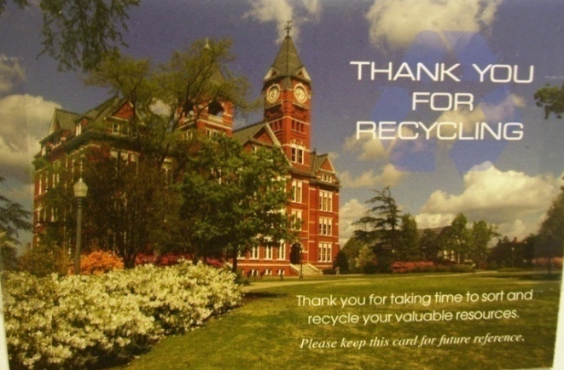

Slide 17



Waste Reduction and Recycling Department
Contact Information
www.auburn.edu/recycle
aureuse@auburn.edu
(334) 844-9461
www.facebook.com/auburnuniversityrecycles
https://twitter.com/AU_Recycles

