Slide 1
Strengthening the Auburn Brand: Coordinating Marketing Messages
Notes:
Why should we coordinate brand messaging? Why now?
Competition for high-ability students, donor contributions, alumni involvement, and qualified faculty is greater than ever before. By coordinating our messages, the reputation of Auburn University becomes more clear and strong. A unified message will have greater recall among our audiences than many scattered messages.

Slide 2
Background and Timeline
Image research study by SimpsonScarborough
Brand steering committee
Messaging recommendations
Identify key partners for central communications:
Enrollment Management
Development
Develop creative messaging platform – ongoing
Final testing phase – current stage
Implementation – Summer 2013
Brand inspiration book/ambassadors program
Completed 2012
Complete
Current

Slide 3
Branding Objectives
Follow recommendations and make decisions informed by SimpsonScarborough research.
Showcase Auburn’s strengths, qualities, and values in an authentic manner.
Set the stage for the comprehensive campaign by showing Auburn’s impact on the state, nation, and world.
Select features based on leadership and vision, which donors desire to see.
Provide units joining with a flexible and simple messaging platform.
Notes:
Key recommendations:
Within the creative, make bold, not boastful, statements.
To attract students from beyond the region, the University must be seen as an academic powerhouse as well as a “spirit,” “values” or “family” powerhouse.
Bundle strengths, especially in academics and research – to tell a larger “more than the sum of their parts” story.
Leverage success stories of alumni.

Slide 4
Partners: Common Branding Theme
Admissions and Recruitment
Development: comprehensive campaign
NCAA spot and general reputation advertising
Athletics
Student Affairs
Human Resources
Alumni Affairs
Office of the Provost and Colleges

Slide 5
Message Platform
This is Auburn.

Slide 6
Plug in Words and Phrases
Future Momentum Vision Promise Success
Forever Commitment Family Tradition Honor
Prestige Value Real Choice Modern Life
Smart Progress Power Home Knowledge
Opportunity Pride Distinction A Perfect Match
Motivation Investment Growth Discovery

Slide 7
Six Messaging Chapters
National Gravitas
Academic Muscle
Research Wow
Outcomes/Return-on-Investment
Family/Spirit
Outreach
Notes:
National Gravitas
Message: Auburn is a top national public university with rankings to back up the claim.
Academic Muscle
Message: Many of Auburn’s academic programs have stellar rankings and accolades that allow students to excel in their chosen fields and learn from the best.
Research Wow
Message: Auburn is making a difference in providing solutions to some of the world’s most pressing problems.
Outcomes (ROI)
Message: An Auburn University education, student experience and mentoring provide the skills and strategies to turn career dreams into realities.
Family/Spirit
Message: The strong traditions and school spirit create a bond among those who attend Auburn, considering all students and alumni to be members of the Auburn Family and appropriately greeted with the phrase “War Eagle.”
Outreach
Message: As a prominent part of our land-grant mission, Auburn is committed to sharing knowledge and providing volunteer hours to benefit humanity locally and worldwide.

Slide 8
General Reputation Examples
This is Auburn.

Slide 9
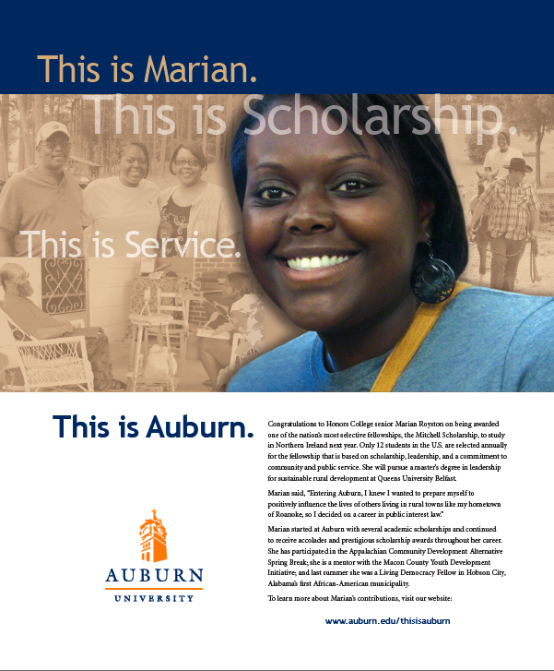
Integrated approach:
Web story and video
11,465 views
Notes:
Test advertisement for Spring issue of Auburn Magazine. Used to test recall and messaging with online survey.

Slide 10
Reach for Auburn Messages
This Week at AU Students 25,000 weekly
Commons Alumni 120,000 monthly
Auburn Homepage All audiences 2.5 million monthly
Facebook All audiences 271,482 likes
Twitter All audiences 34,877 followers
WireEagle All audiences 7,274 subscribers
YouTube Channel All audiences 2,343 subscribers 1.42 million views

Slide 11
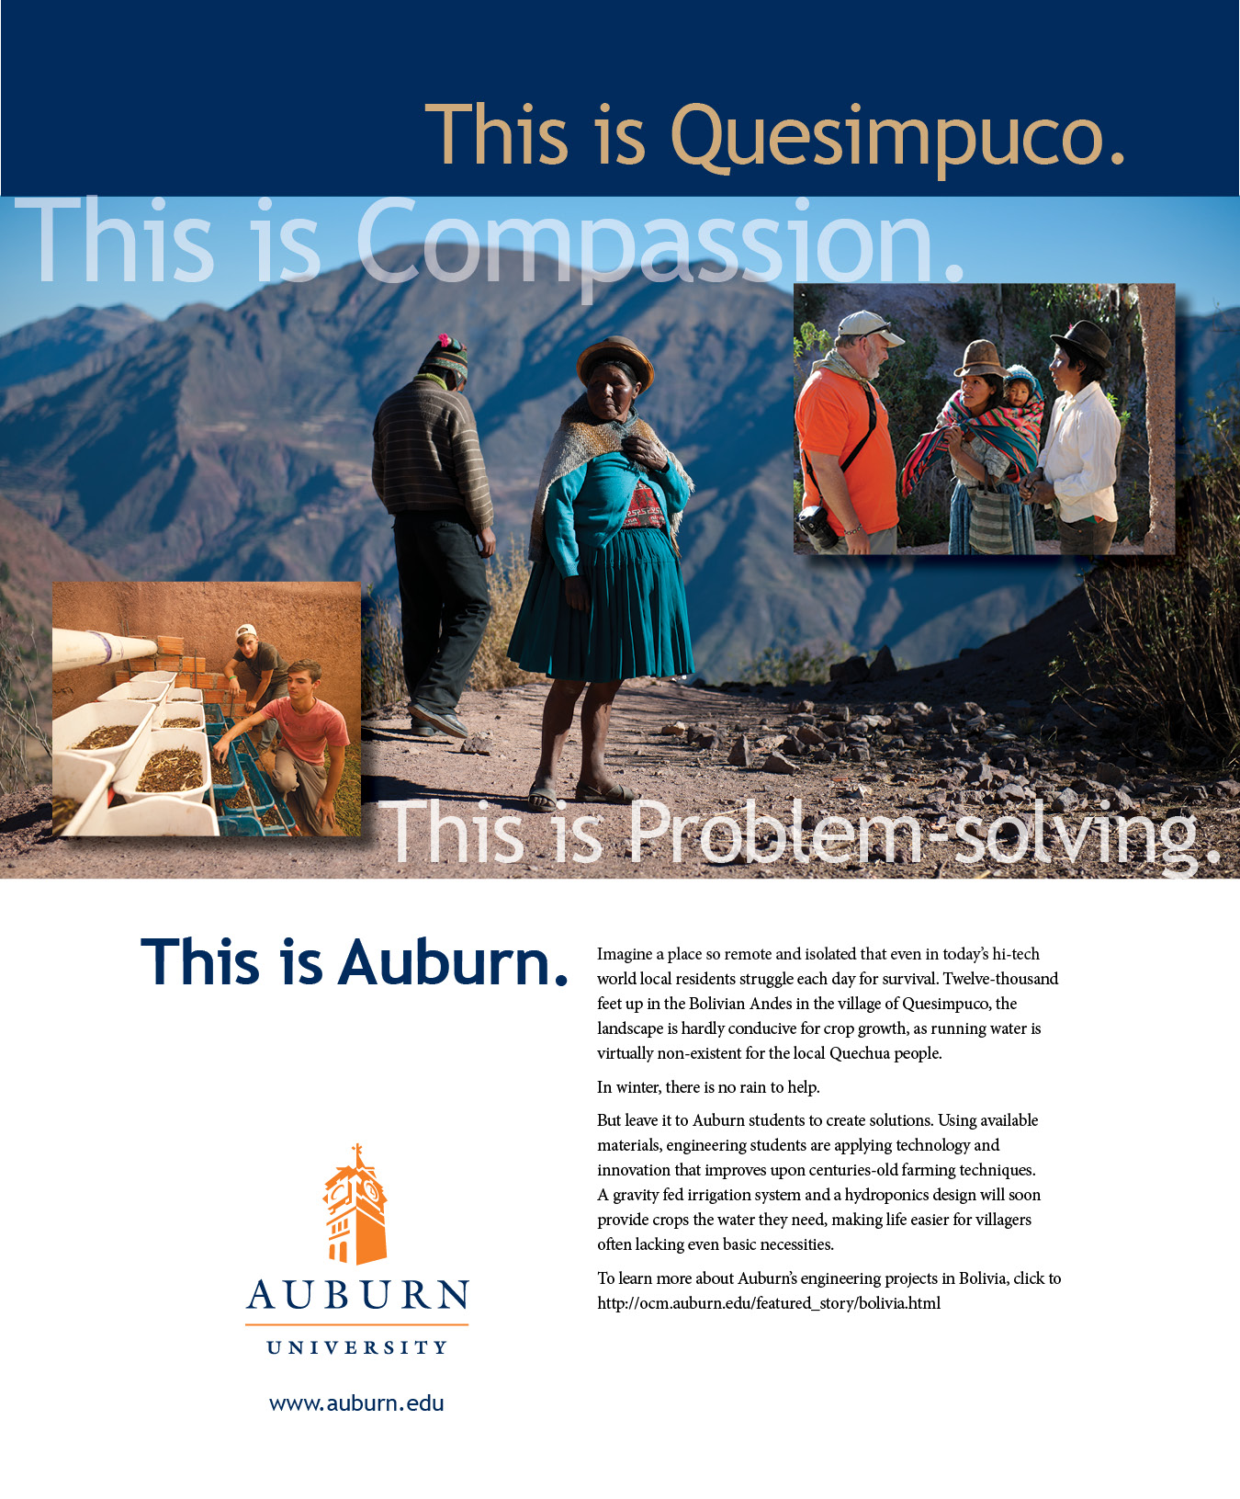
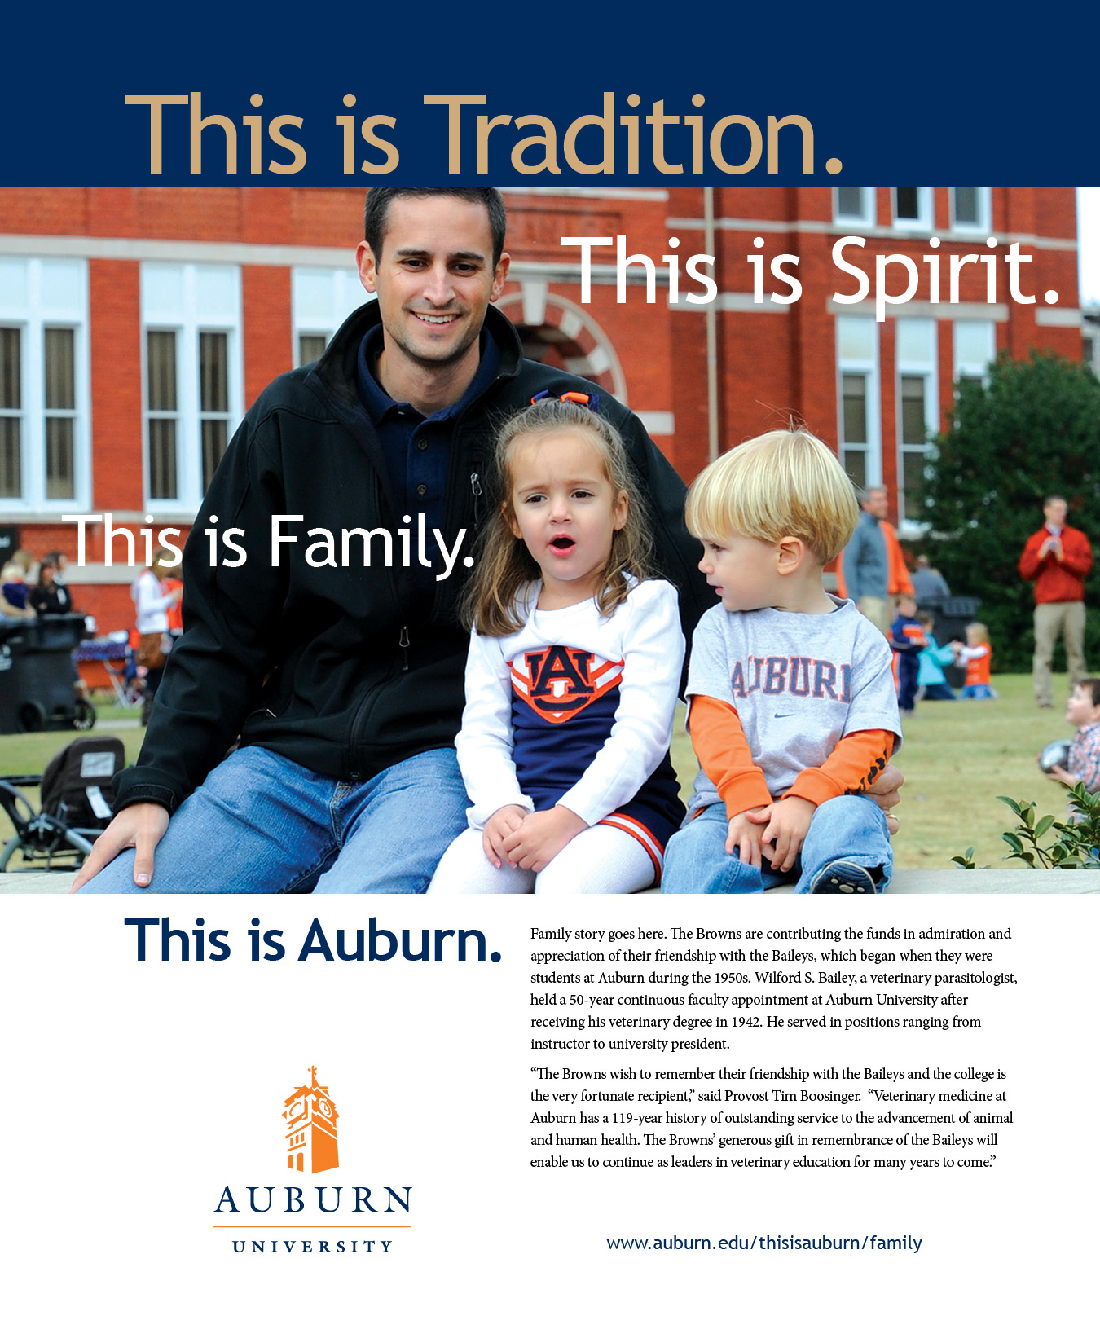
Notes:
Family, tradition, and the values of the Auburn Creed remain an important message to many of our key audiences.

Slide 12

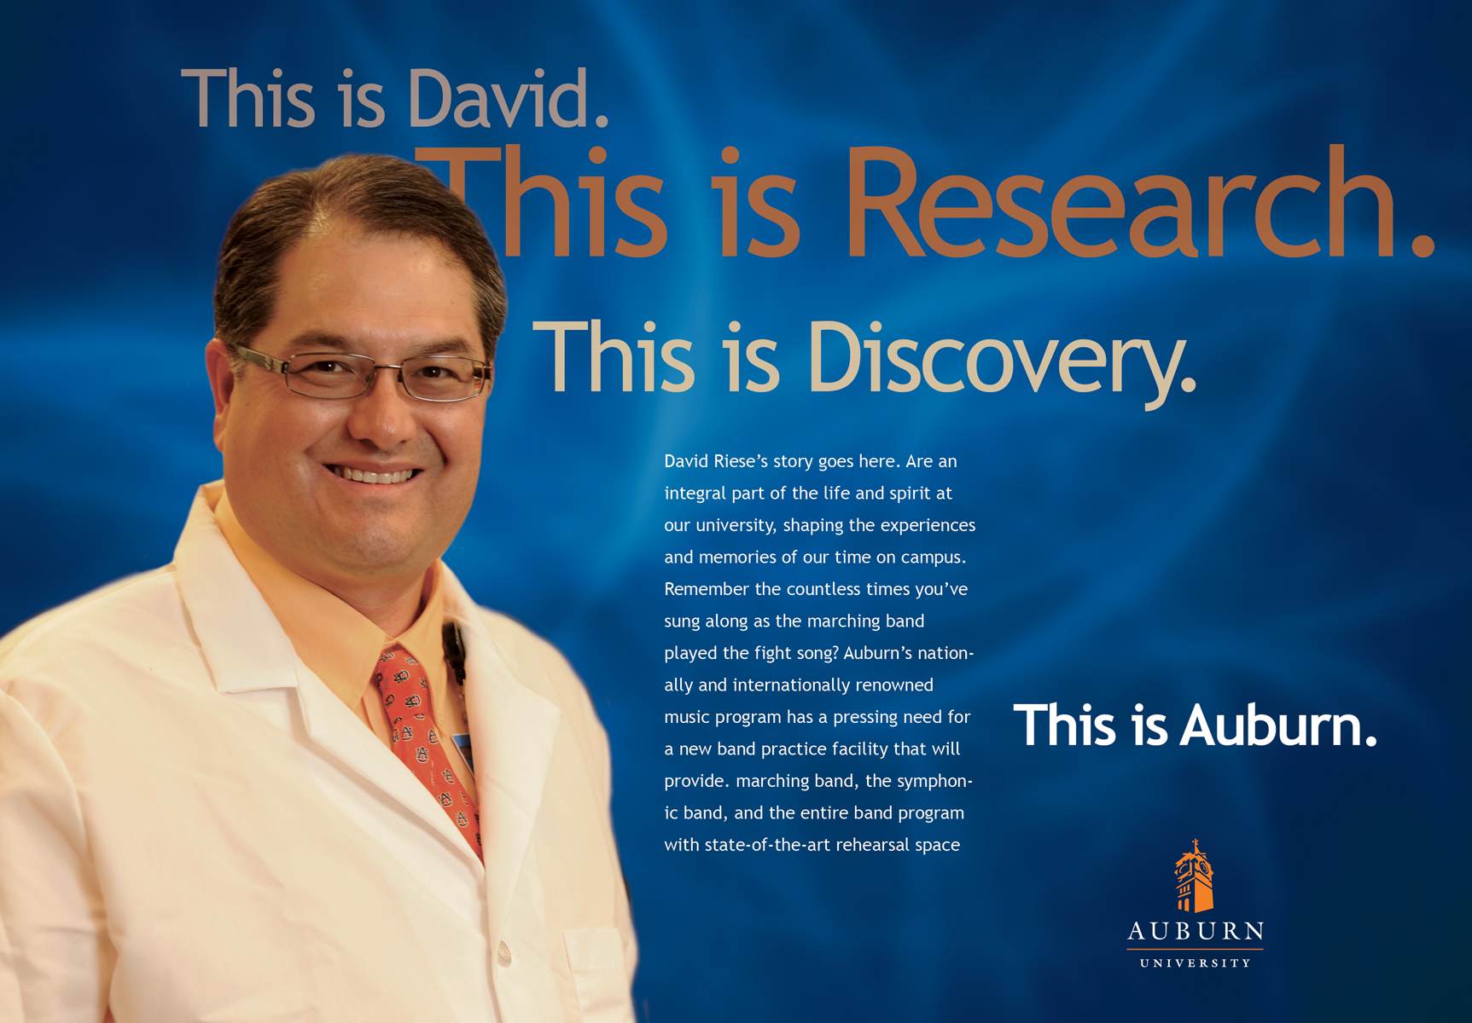
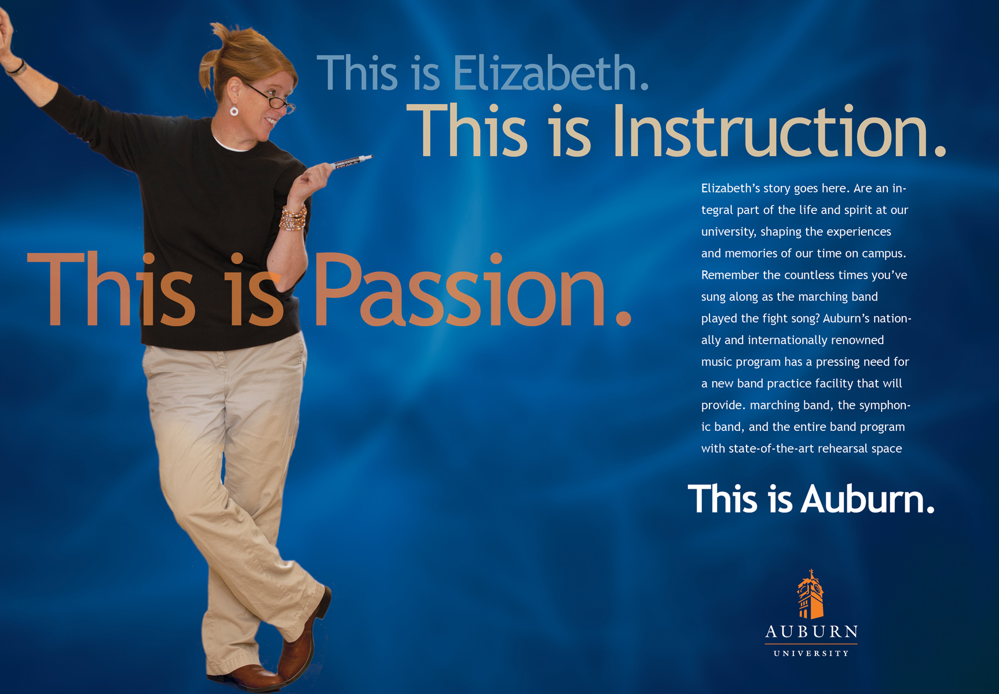
Notes:
Mock ups of Chronicle of Higher Ed campaign. Will development with Human Resources.

Slide 13
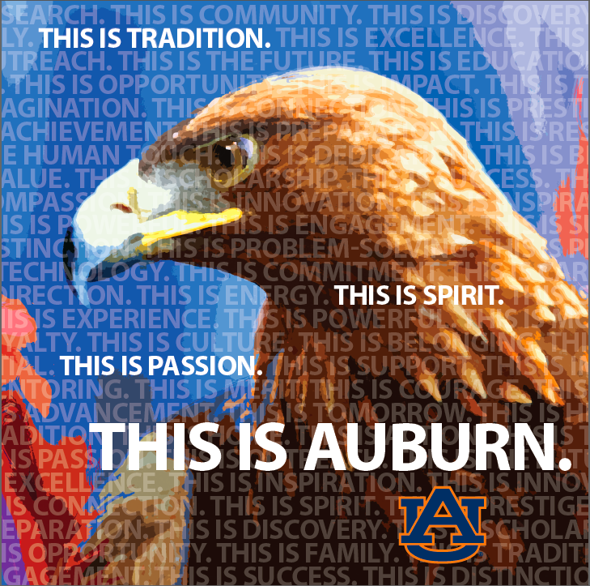

Slide 14


Slide 15
Recruitment Examples
This is Auburn.

Slide 16
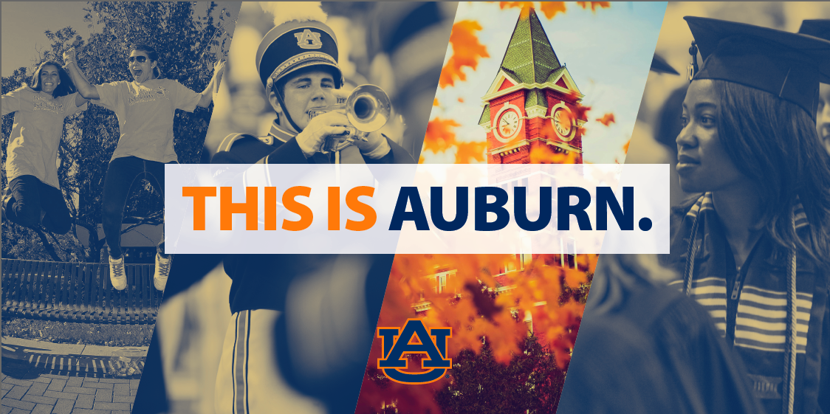

Slide 17


Slide 18
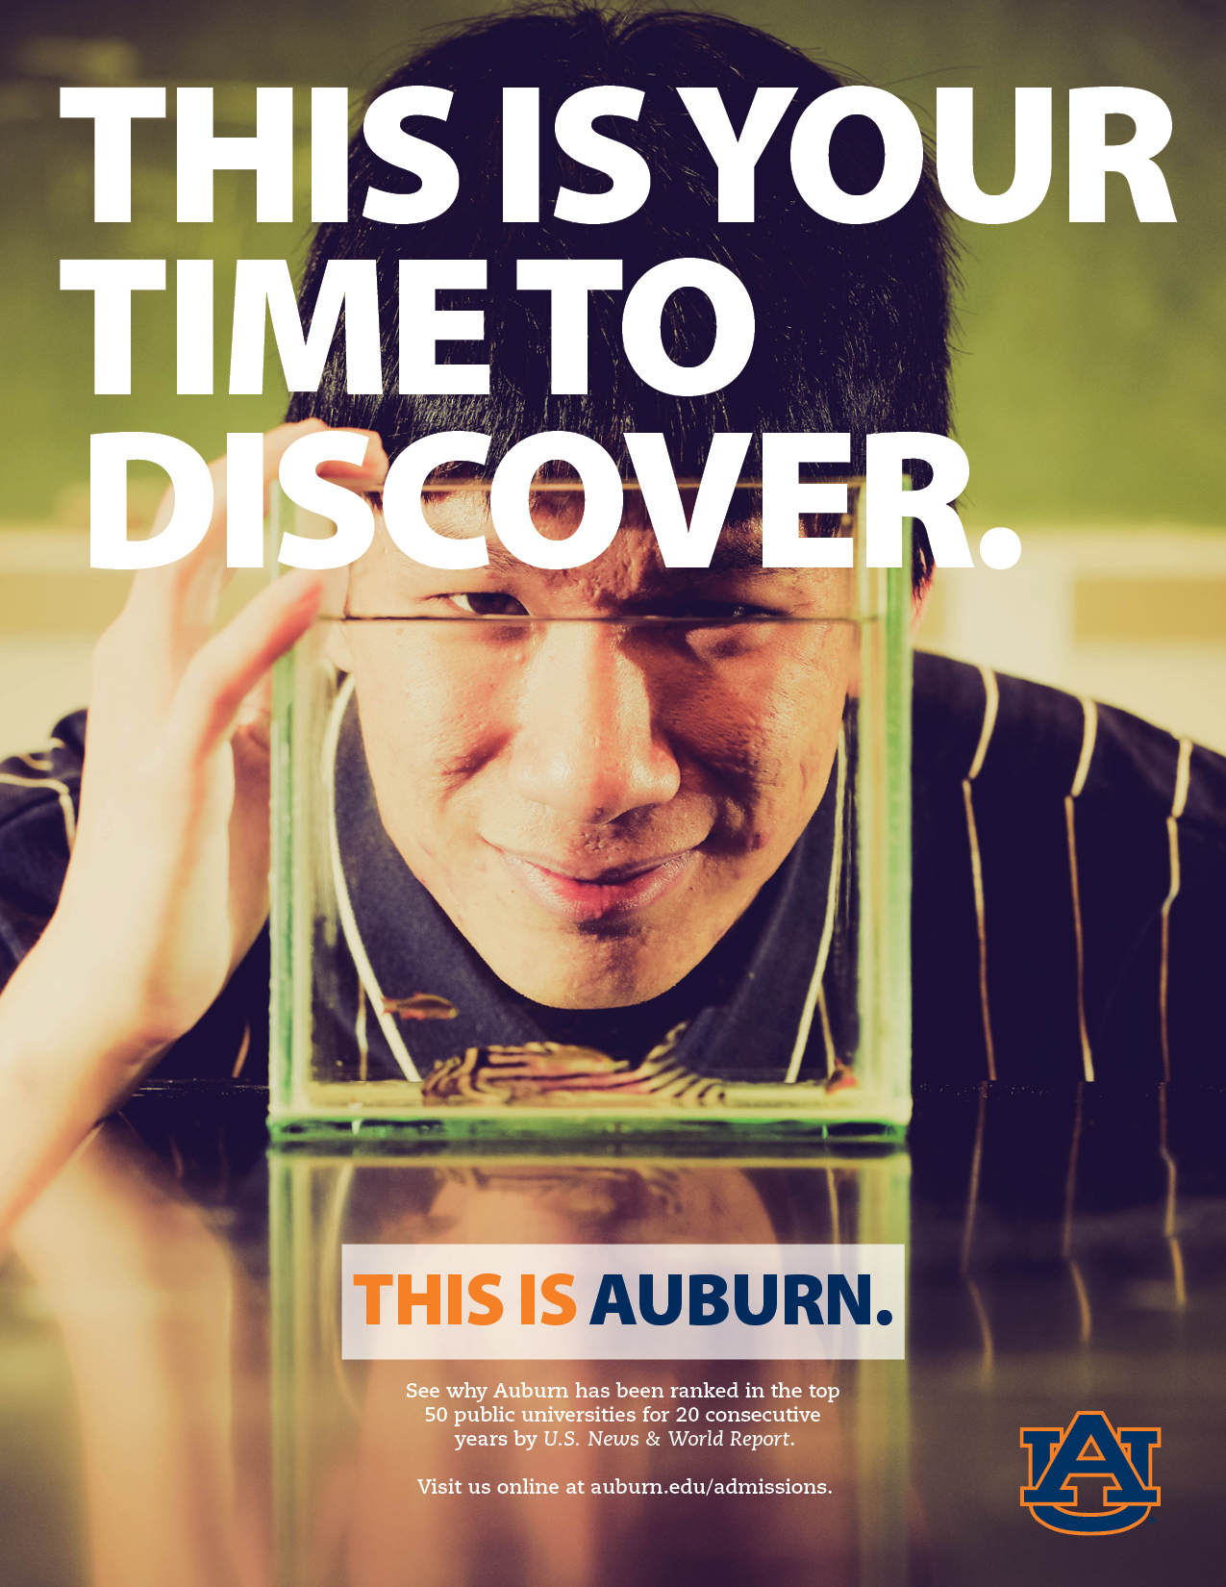

Slide 19


Slide 20


Slide 21
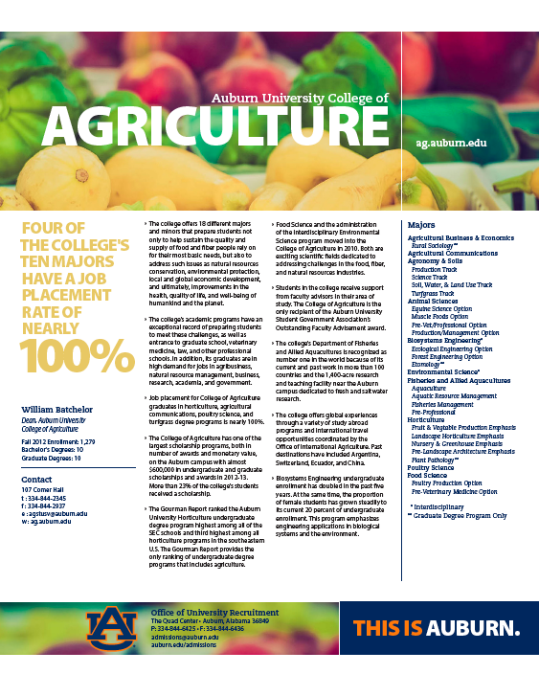

Slide 22
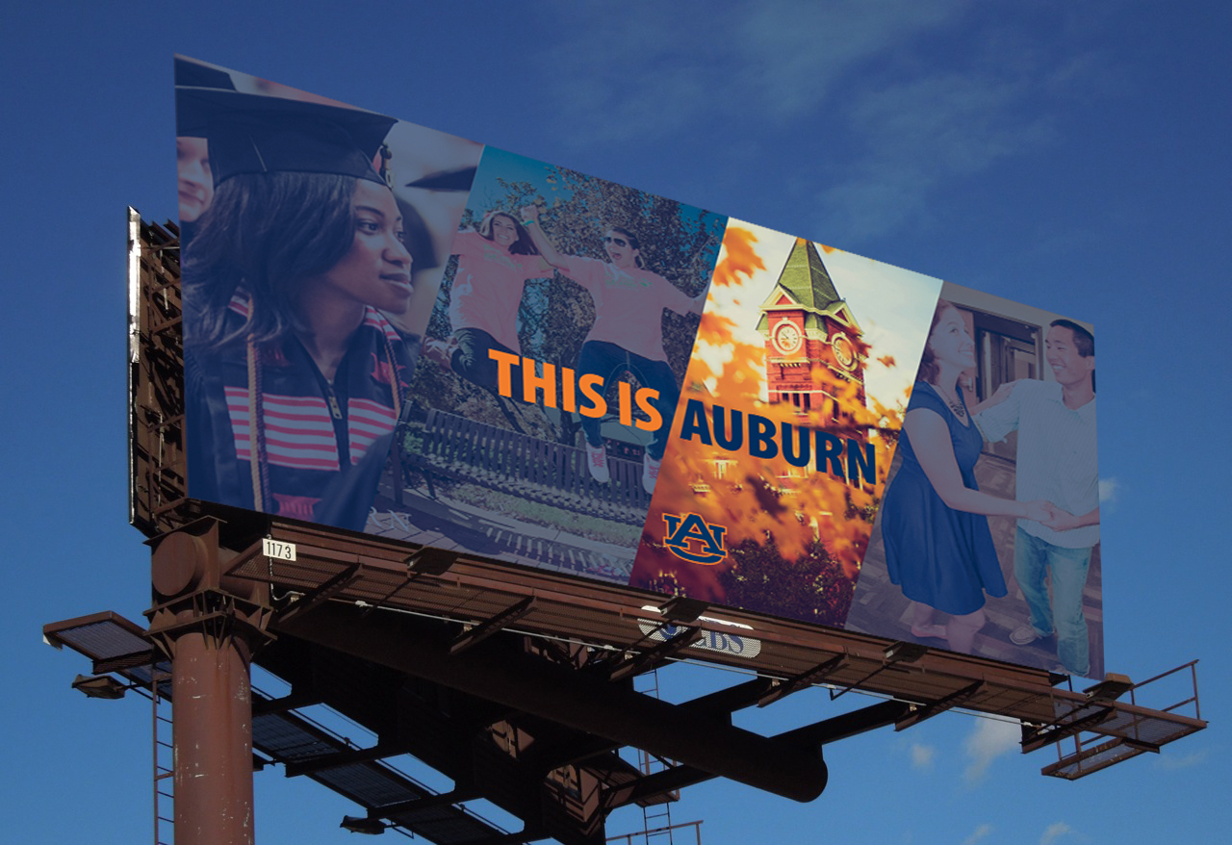
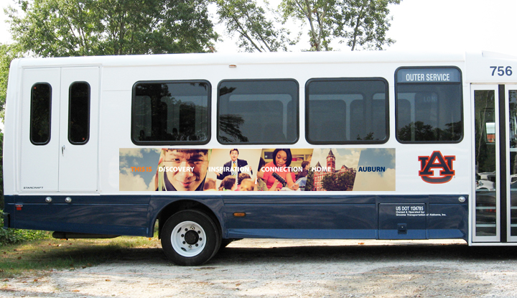

Slide 23
Development Example
This is Auburn.

Slide 24
Creating a Complementary Campaign Brand
Identify a coordinated tagline for campaign.
Continue to identify and promote the best of the Auburn Family – faculty, students, and alumni.

Slide 25
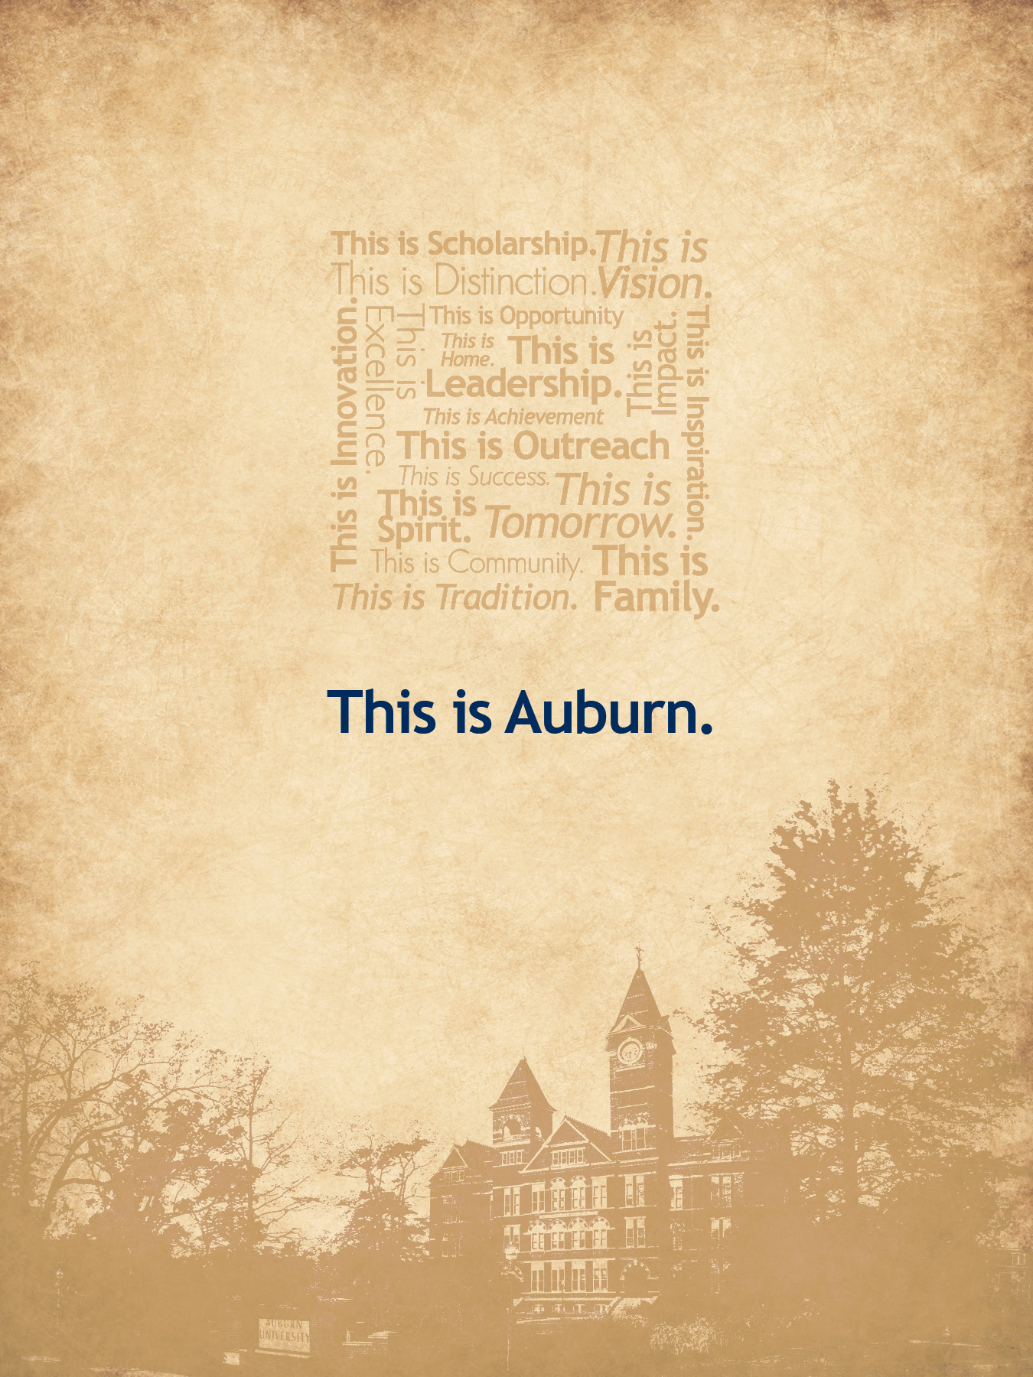

Slide 26
This is Auburn. auburn.edu/thisisauburn #thisisauburn thisis@auburn.edu

