Slide 1
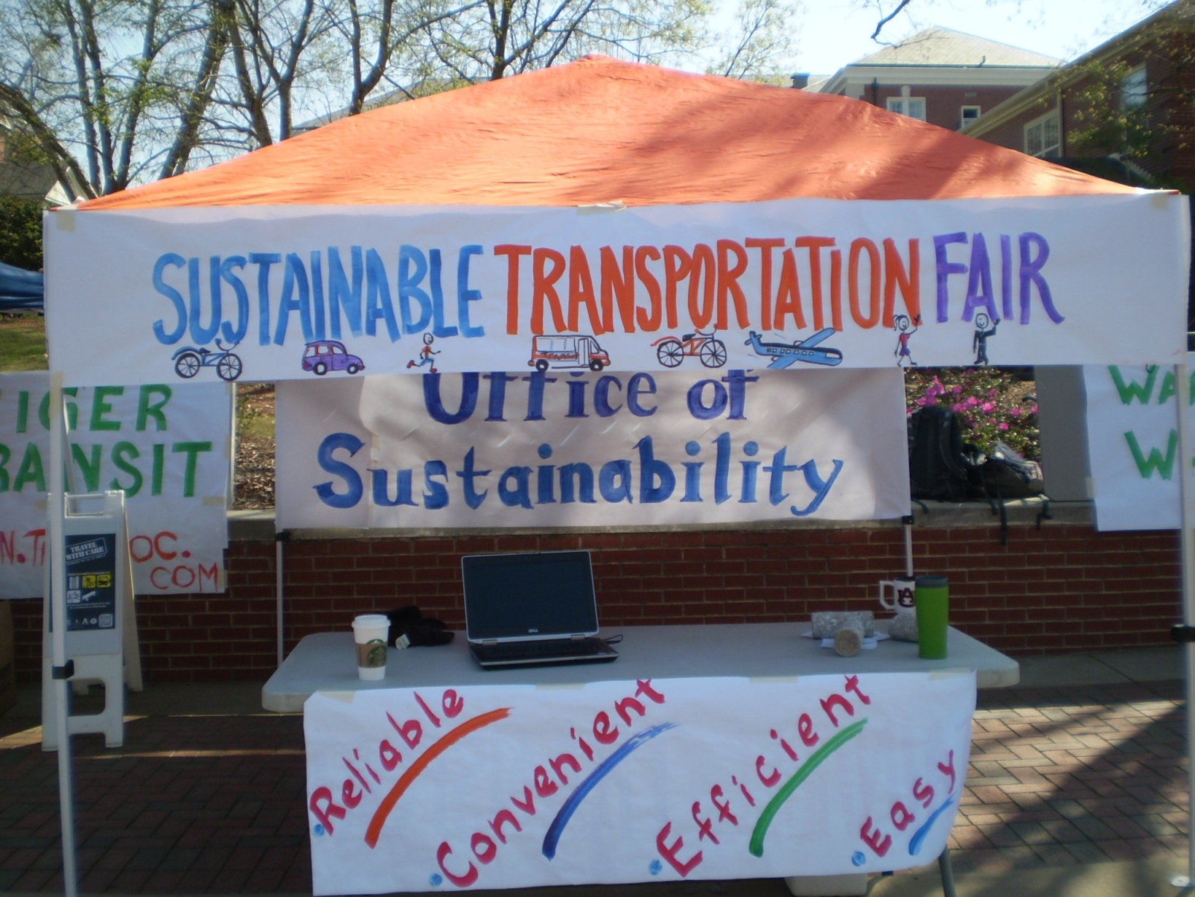
Office of Sustainability Update

Slide 2
Outline
Auburn’s Commitment to Sustainability
Office of Sustainability
Structure
Role
Messaging
What we are doing (and how it might involve you)
Our opportunity

Slide 3
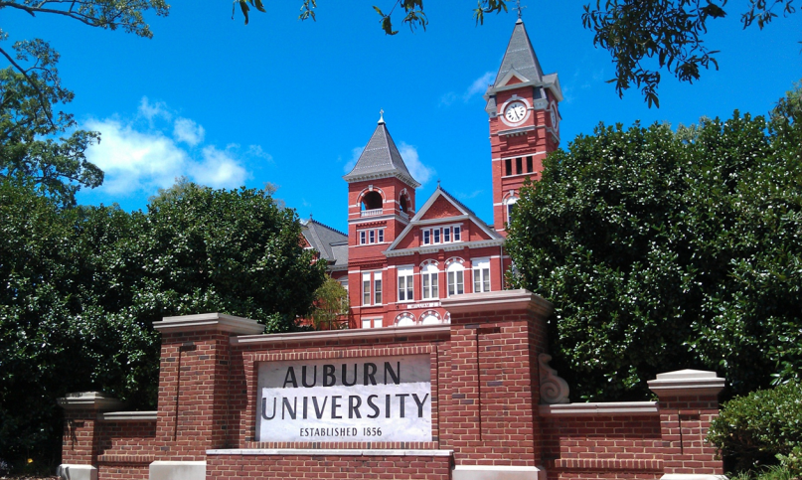
Auburn’s Commitment to Sustainability:
Auburn University Strategic Plan
“…we recognize the importance of sustainability as crucial for this century, and we are integrating this theme into our work”

Slide 4
Auburn’s Commitment to Sustainability:
Auburn University Sustainability Policy
“Auburn University is committed to integrating sustainability into all aspects of the University including: operations, instruction, research, and outreach activities. Auburn University considers sustainability a core value and strives for excellence in sustainability through continuous assessment and improvement .”

Slide 5


Planet
Prosperity
People
Office of SustainAbility
Academic Sustainability Programs
Dr. Nanette Chadwick, Director
Campus Sustainability Operations
Mike Kensler, Director
Matt Williams, Program Manager
Jen Morse, Communications and Outreach
Interns

Slide 6
Planet
Prosperity
People
Office of SustainAbility
Mission
Cultivate an ethic and practice of Sustainability at Auburn
Send graduates out into the world as Sustainability Practitioners
Approach
Possibility, Aspiration, Future-focused:
solving problems in the context of the future we aspire to create
Collaboration, Engagement, Empowerment, Advocacy
Leadership as Social Architecture

Slide 7
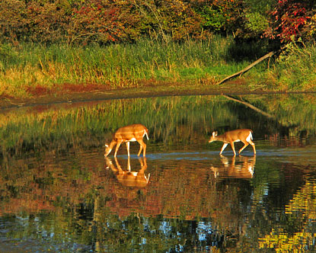
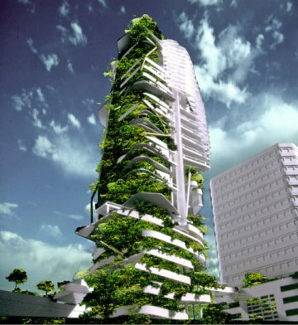



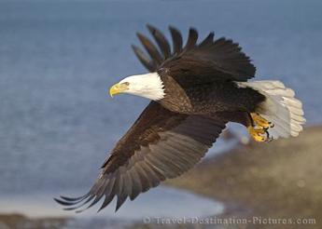

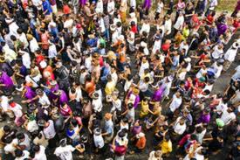

Slide 8
Sustainability
“Meeting human needs in a fair, just, and equitable way
that enables future generations to meet their own needs,
while protecting and maintaining healthy ecosystems in perpetuity.”

Slide 9
Sustainability
“Leave the world better than you found it,
take no more than you need,
try not to harm life or the environment,
make amends if you do.”
Paul Hawken

Slide 10
Sustainability
“The "greatest good for the greatest number" ….
Our duty to the whole, including the unborn generations, bids us to restrain an unprincipled present-day minority from wasting the heritage of these unborn generations."
Theodore Roosevelt, 1916

Slide 11
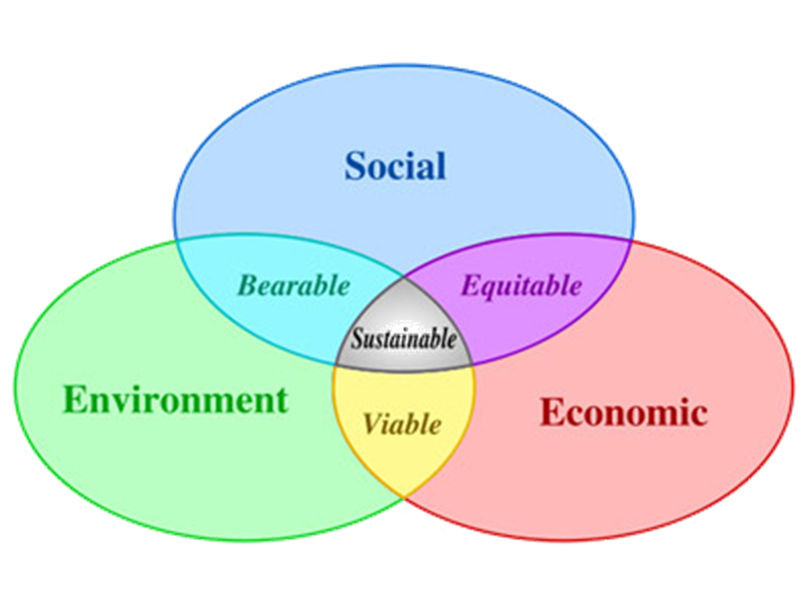
The Three Integrated Spheres of Sustainability

Slide 12

Sustainability
Economic Systems
Human–Social Systems
Ecological Systems

Slide 13
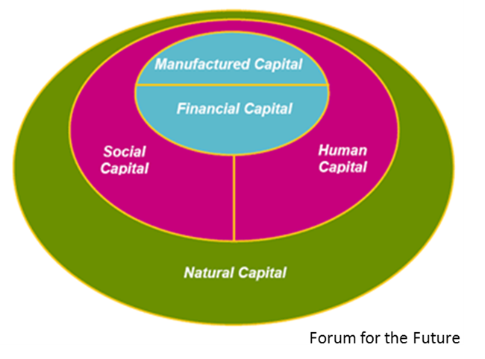
Sustainability

Slide 14
Compass of Sustainability
Nature
Wellbeing
Economy
Society
Herman Daly, Alan AtKisson

Slide 15

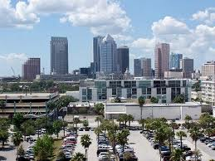
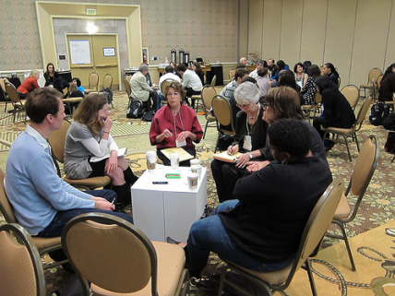

4 Basic System Conditions for Sustainability
Live within Earth’s physical and biological limits
Maintain a vital, prosperous, inclusive economy
Cultivate social connectedness, caring, equity, and engagement
Make individual opportunity, fulfillment, and happiness possible.
Robert Steele

Slide 16
Sustainability: Why does it matter?
Ecological: The 6th…
Social: Every 15 seconds…
Wellbeing: 15% of college students…
Economic: 15,000 / .005% / 6%
120,000,000 / 40% / 0.3%

Slide 17
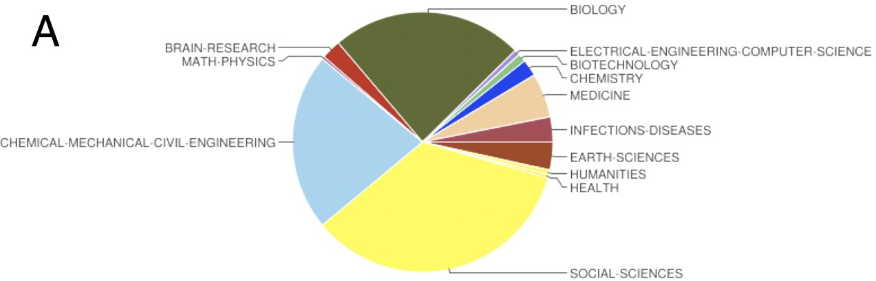
The Science of Sustainability
Bettencourt & Kaur, 2011

Slide 18
“Laws and institutions must go hand in hand with the progress of the human mind.”
Thomas Jefferson

Slide 19
Learning Organizations:
“…organizations where people continually expand their capacity to create the results they truly desire…
and where people are continually learning to see the whole together.”
Peter Senge

Slide 20
Office of Sustainability
What are we up to?
How will it affect you?

Slide 21
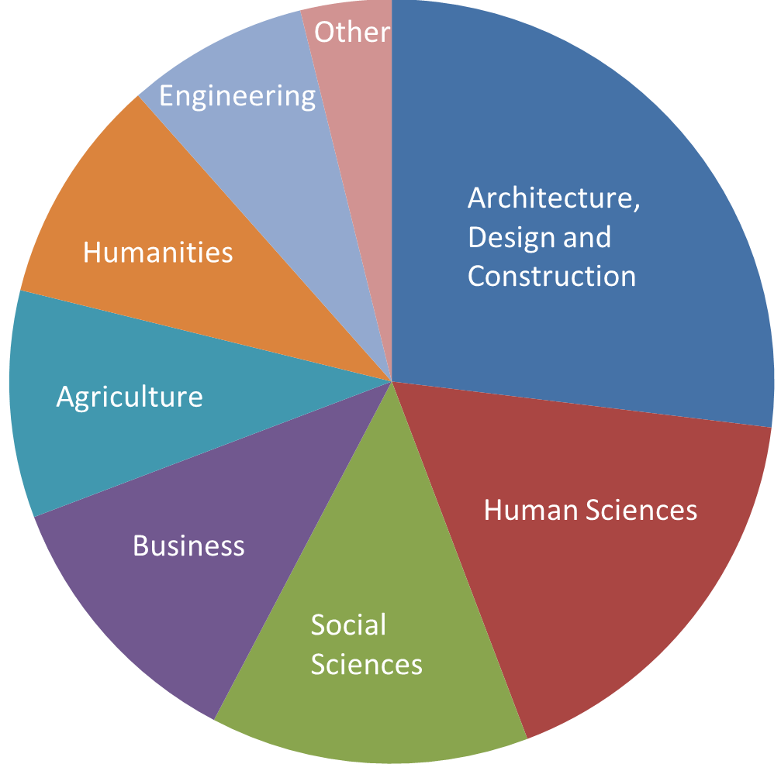
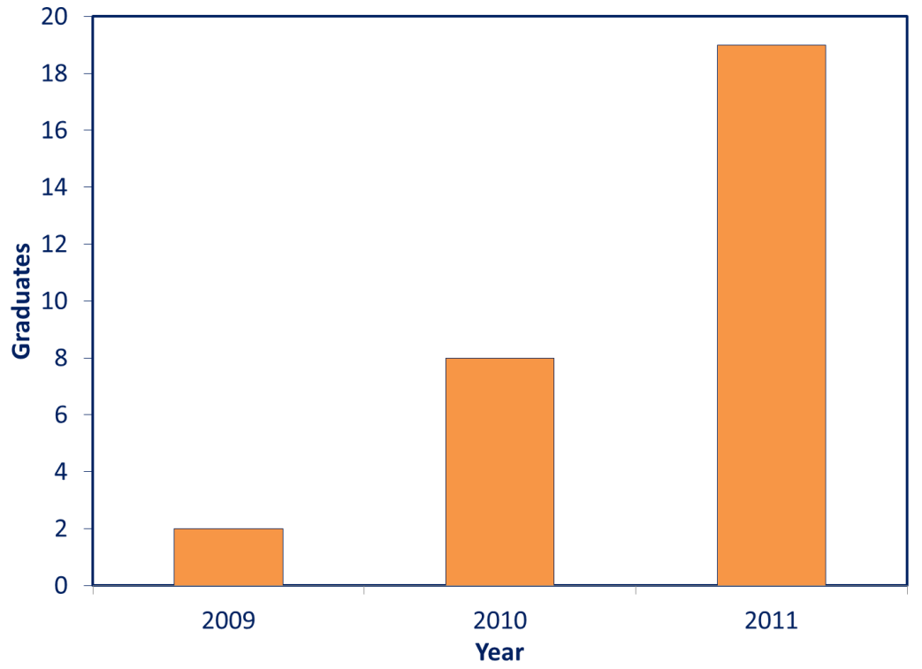
Minor in Sustainability Studies
Began in 2008
Rapid growth over past 3 years
Interdisciplinary: Students from 34 majors in 9 Colleges at Auburn

Slide 22
Minor in Sustainability Studies
Wide diversity of student majors:
Agricultural Economics, Animal Science, Architecture, Building Science, Business, Design (Apparel, Graphic, Industrial, Interior), Economics, Education, Engineering (Biosystems, Chemical, Civil, Mechanical), Environmental Science, French, Geography, History, Horticulture, Hotel & Restaurant Management, Interdisciplinary Studies, Marine Biology, Marketing, Nutrition, Philosophy, Political Science, Pre-Med, Psychology, Public Administration, Radio/Telecommunications/Film, Sociology
Popular elective courses in the minor:
Global Consumer Culture
Ecotourism
Bioenergy and the Environment
Physical Geography
Landscape and Culture
Religion and the Environment
Environmental History
Environmental Ethics
Add your course as an elective:
http://www.auburn.edu/projects/sustainability/website/student_resources/student_minor.php
Planet
Prosperity
People

Slide 23
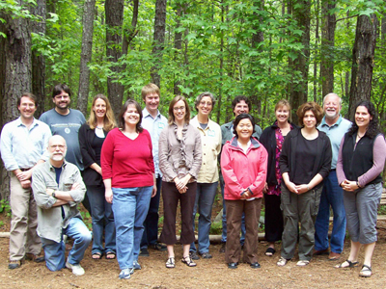
Sustainability in the Curriculum
5th Annual Faculty Training Workshop: May 9-10, 2012
Participants: 20 faculty from 12 departments in 7 colleges across campus
Website: http://www.auburn.edu/projects/sustainability/website/staff_faculty_resources/workshops.php
Learn how to incorporate
sustainability into your courses!
Contact:
Dr. Nanette Chadwick
Director of Academic
Sustainability Programs
Email: chadwna@auburn.edu
Phone: 844-8184

Slide 24
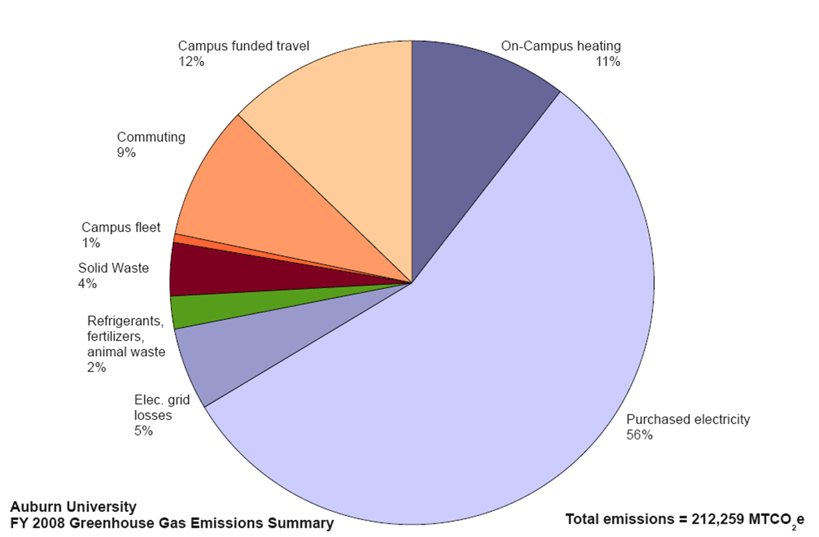
Climate Action Plan

Slide 25
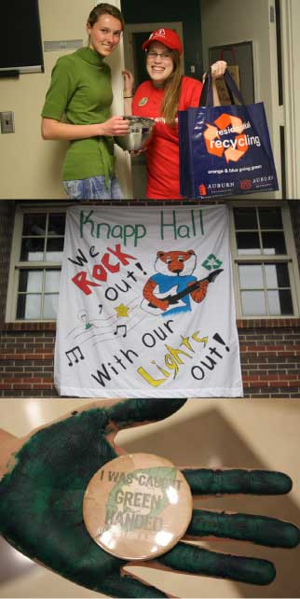

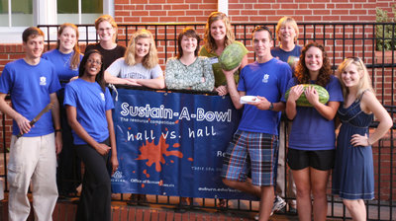
Sustain-A-Bowl in Residential Community
Notes:
The Residential Life “Eco-Rep” program began in fall 2009 and resulted from the cooperation between the Office of Sustainability and Housing and Residence Life.
The Eco-Reps are Housing and Residence Life staff who are involved in peer-to-peer sustainability education throughout the year.
Organize sustainability themed area events.
Encourage residents and other Housing staff to live more sustainably.
Educate residents about sustainability.
Liaise with the Office of Sustainability.
Be the Res Life Eco-Reps for Sustain-A-Bowl, the annual residential conservation competition
http://www.auburn.edu/projects/sustainability/website/student_resources/eco_reps.php

Slide 26
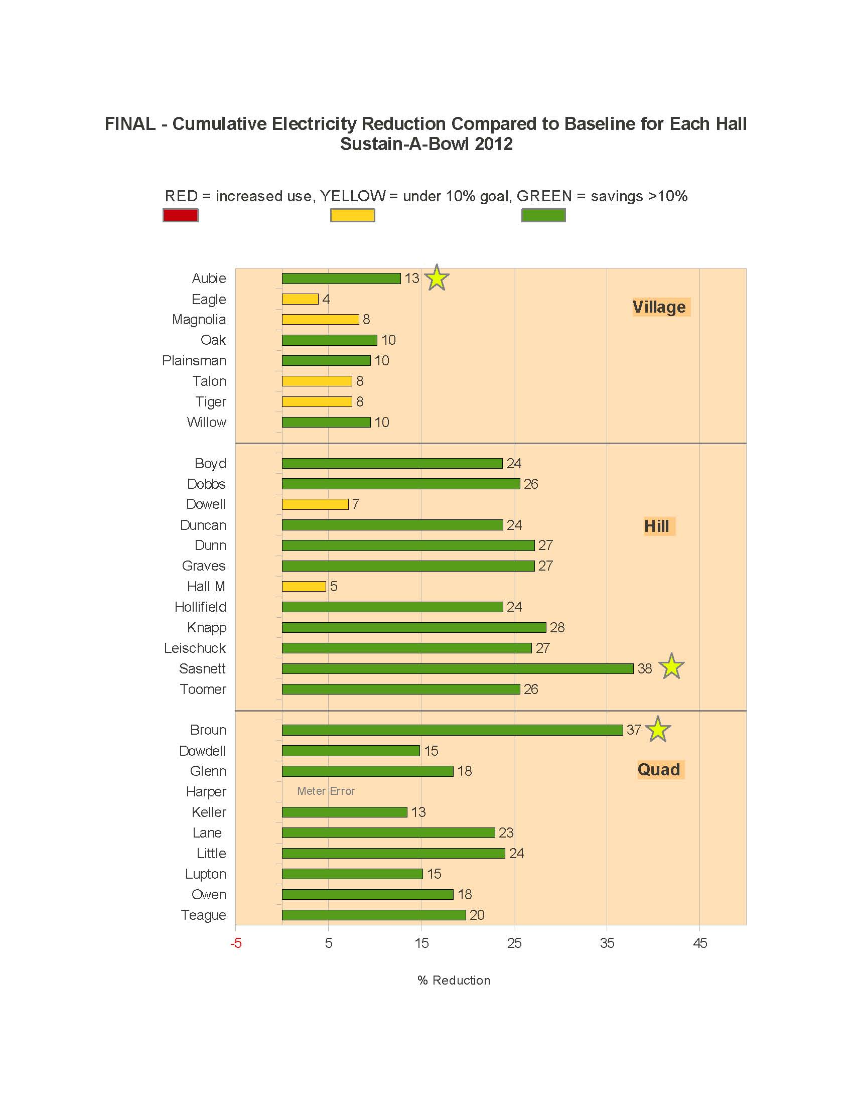

Slide 27
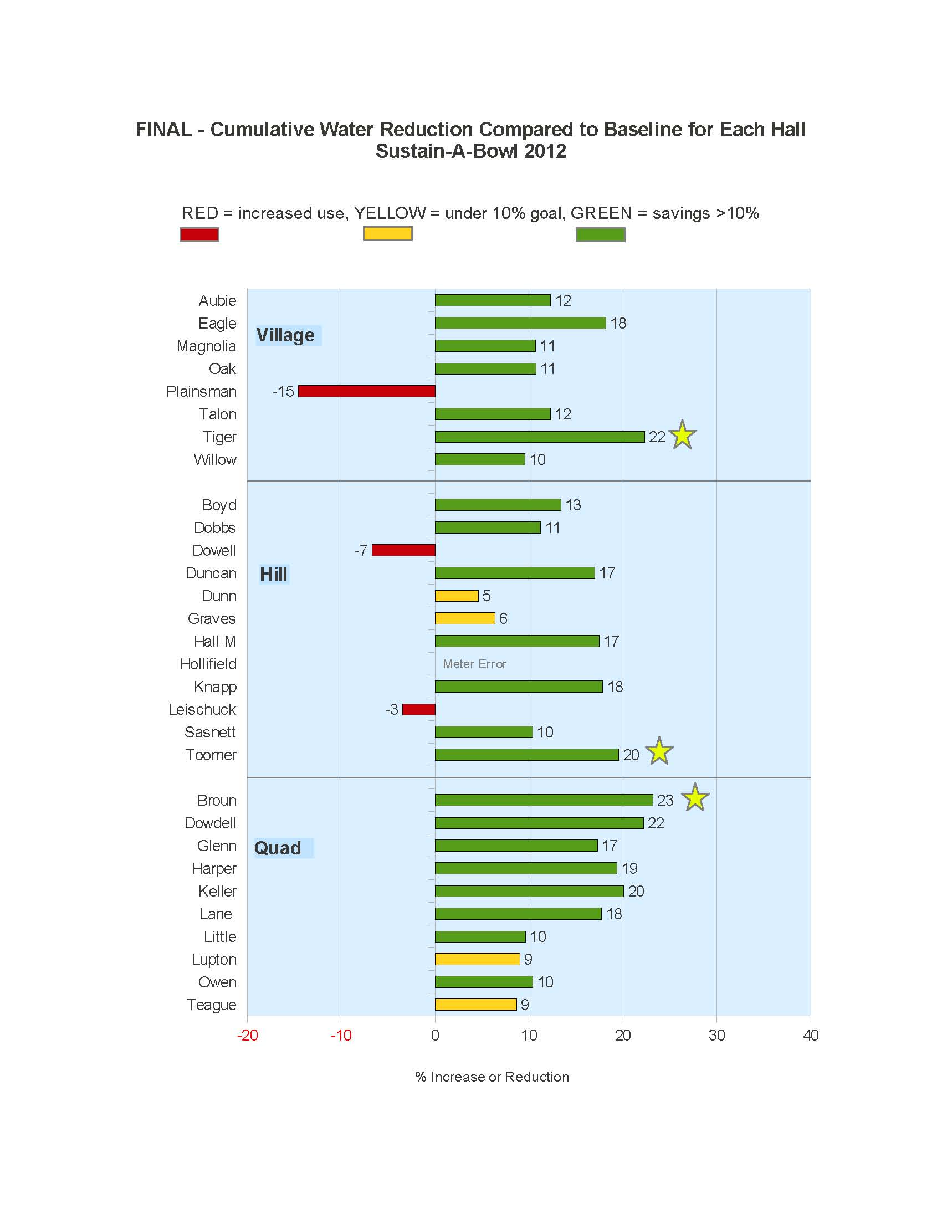

Slide 28
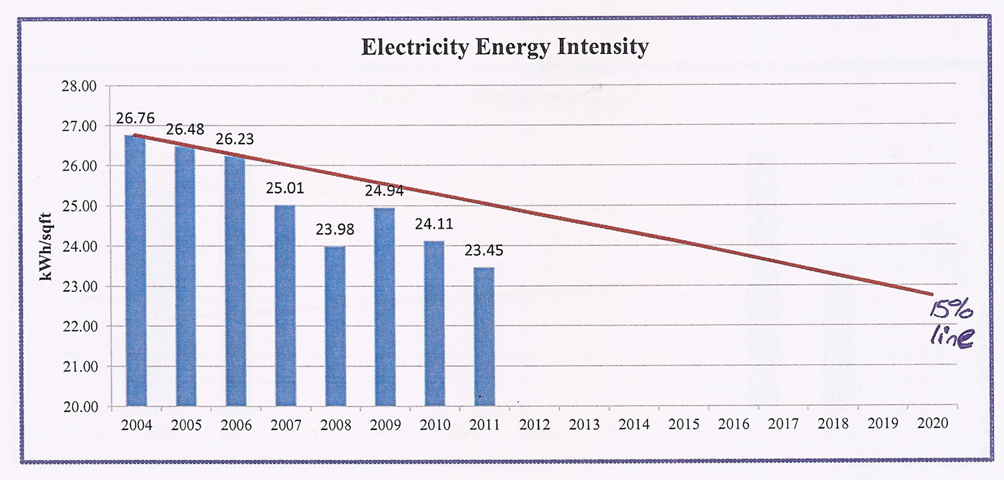
Energy Reduction
5% reduction in purchased electricity
By 2020
From 2010 baseline

Slide 29
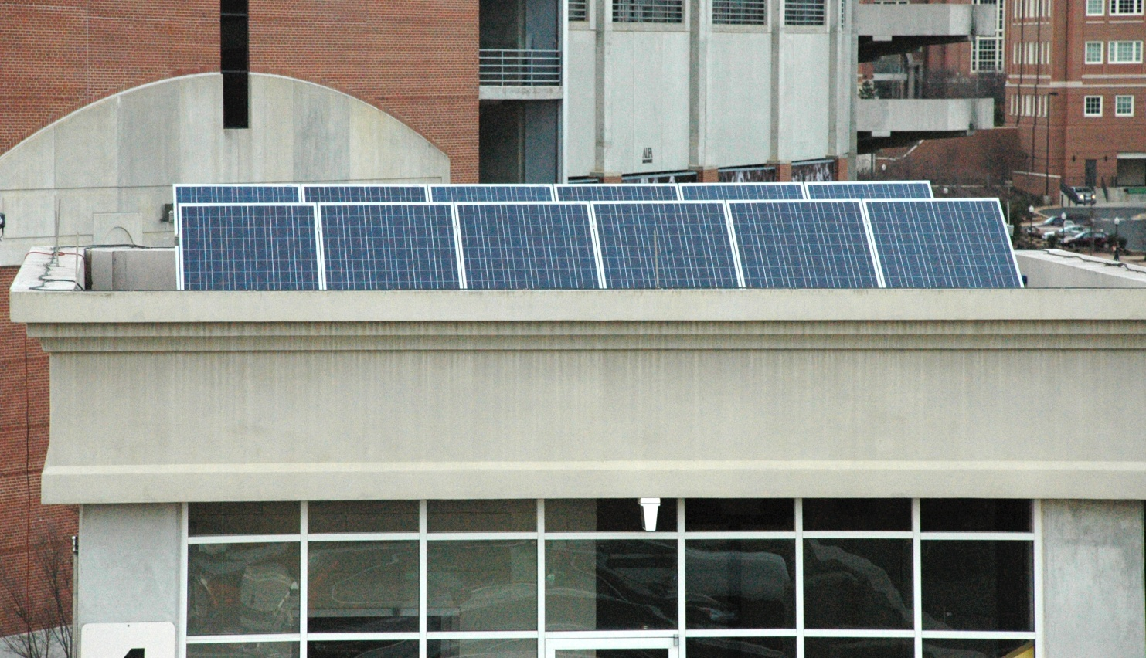
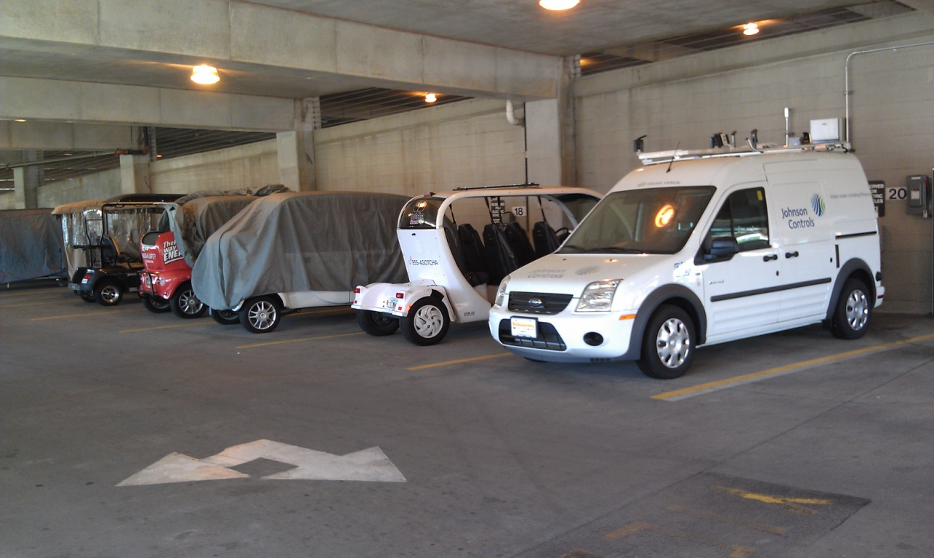
Prototype Projects

Slide 30
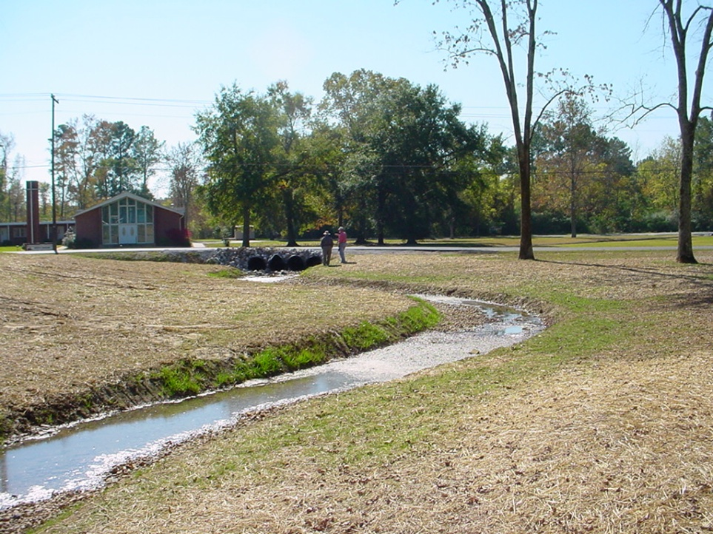
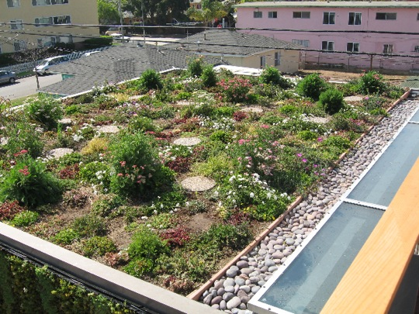
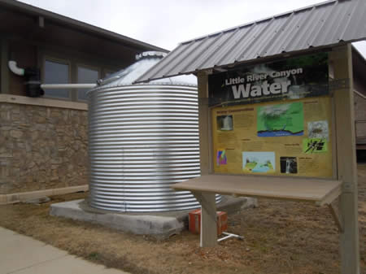
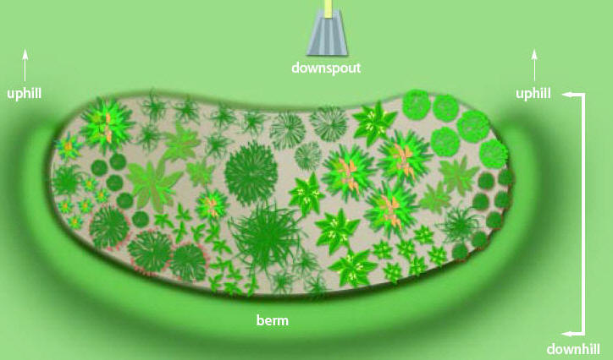
Prototype Projects

Slide 31
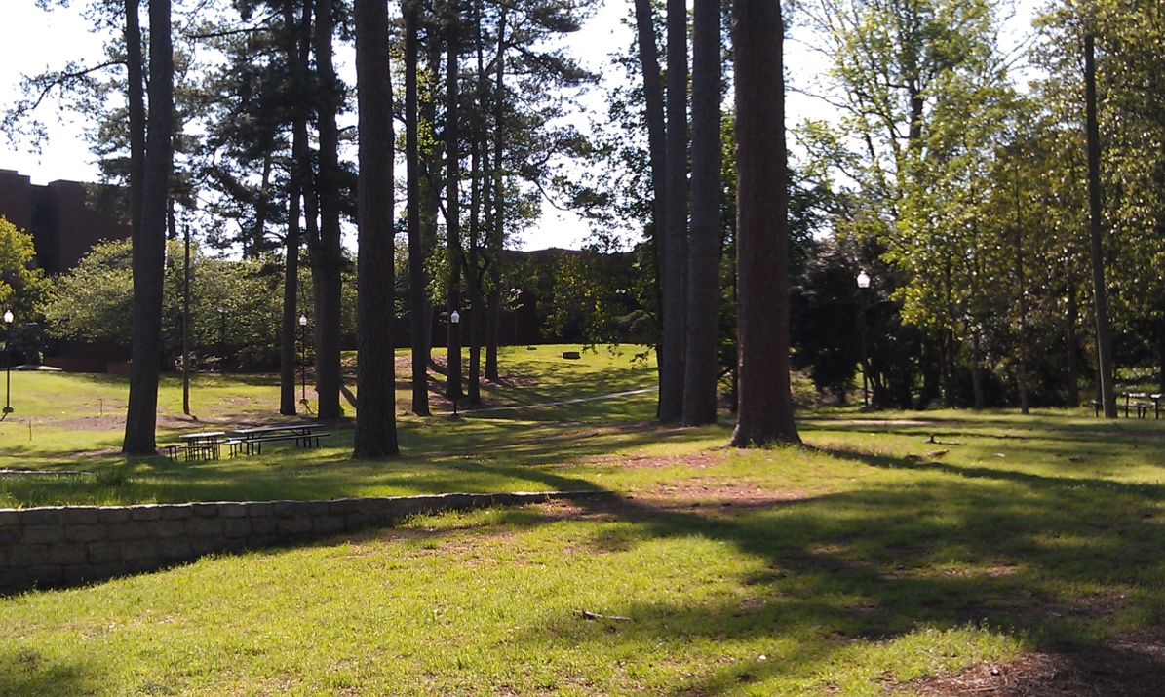
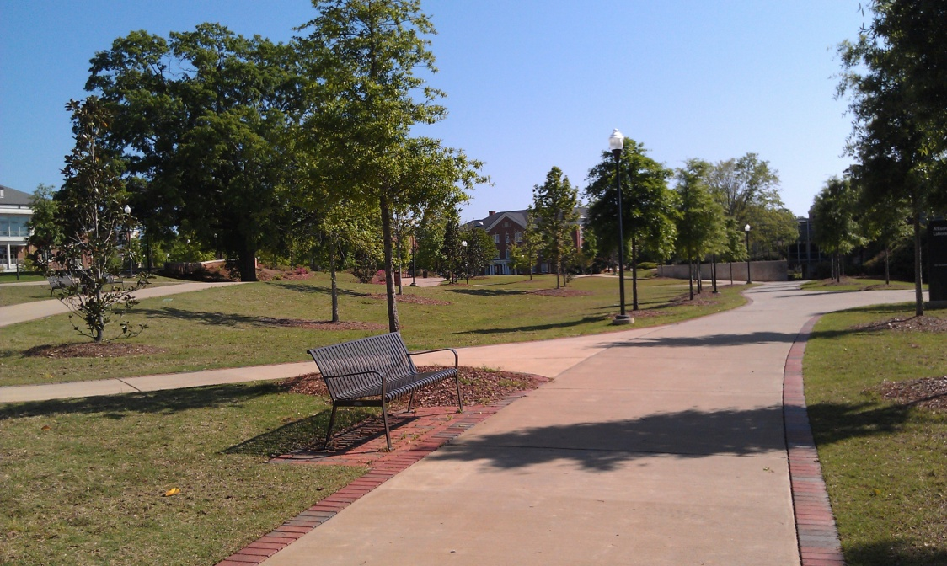
Sustainable Landscape Forum

Slide 32

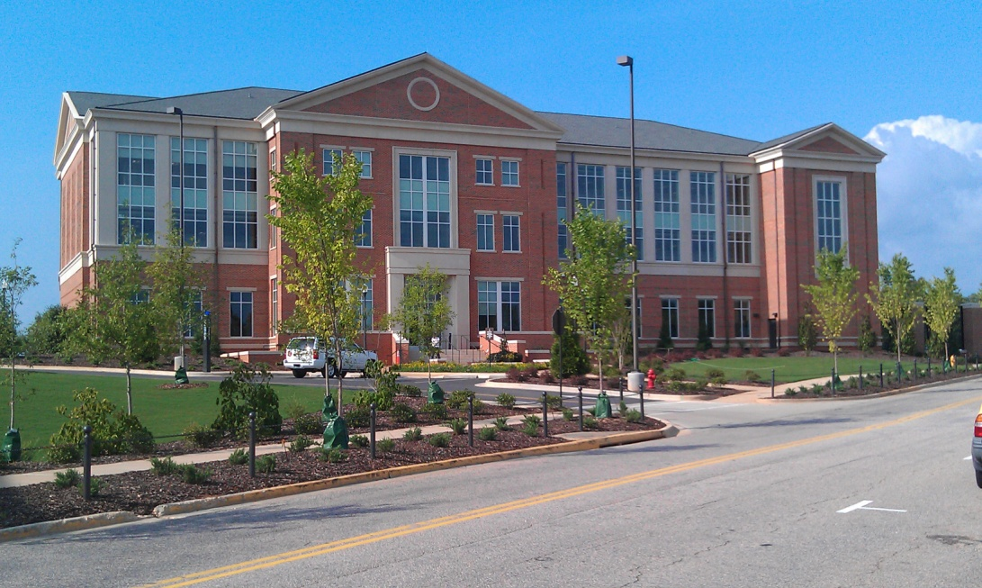
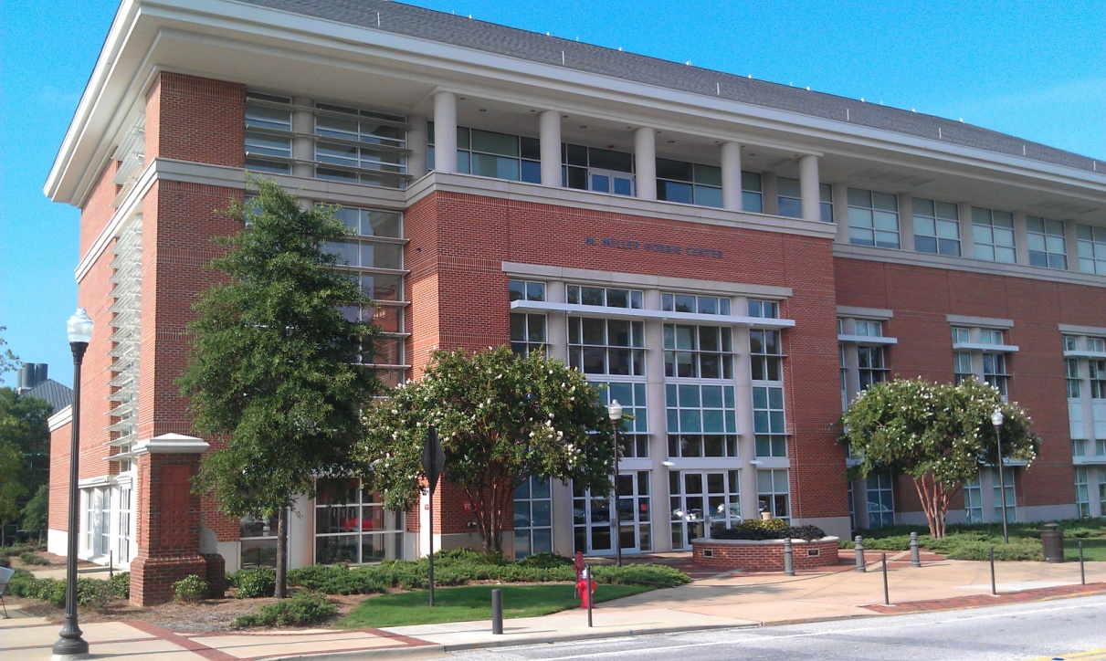

Leadership in Energy & Environmental Design

Slide 33
Sustainable Office Certification Program
S.O.A.R.
Sustainable Offices Achieving Recognition
Energy
Water
Purchasing
Waste
Recycling
Transportation
Innovation

Slide 34

Sustainability Awards Program

Slide 35


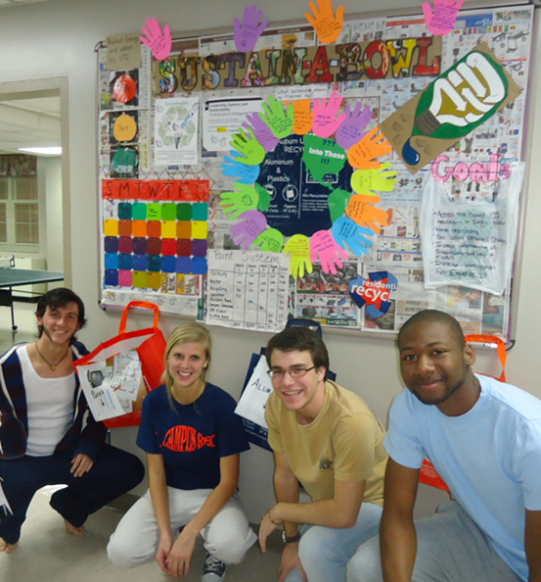
Sustainability in Action

Slide 36
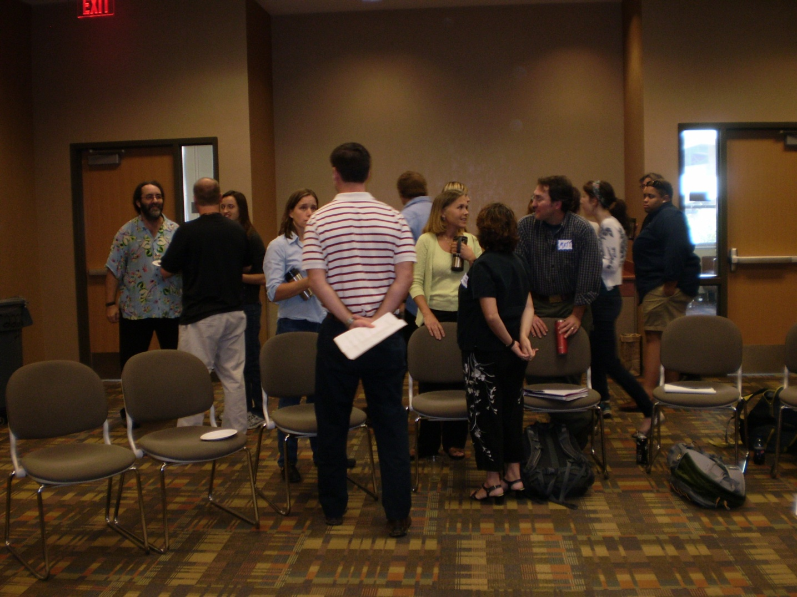
Campus Conversations

Slide 37

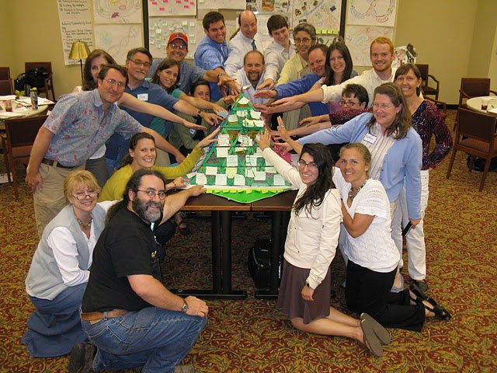
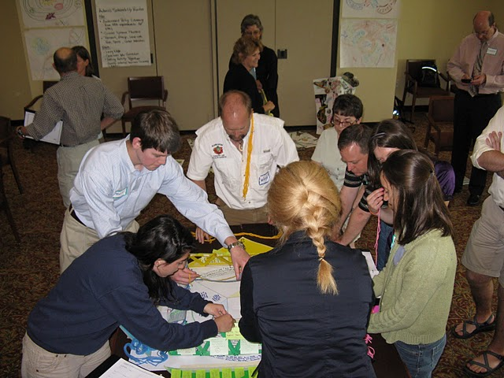

Sustainability Training
Notes:
Broader sustainability commitments, transforming the culture at Auburn and engaging students, faculty and staff.
Pictures are from an ISIS Academy sustainability workshop conducted with students, faculty, and staff in affiliation with The AtKisson Group and Systainability Asia. (it is spelled with a “y”. ed.)

Slide 38


Sustainability Tracking, Assessment, and Rating System

Slide 39

Categories within STARS
Education & Research
Co-Curricular Education; Curriculum; Research
Operations
Buildings; Climate; Dining Services; Energy; Grounds; Purchasing; Transportation; Waste; Water
Planning, Administration & Engagement
Coordination & Planning; Diversity and Affordability; Human Resources; Investment; Public Engagement
Innovation
Notes:
You get credits for certain accomplishments.
There are guidelines on how to measure the items.
Your overall score is an average of the three areas: Ed and Research, Operations, and Planning and Admin, and Engagement
Dining Services- what could be rated there? Ideas?
Brainstorm List-
Then share what else is there.
This is what Colleges and Universities are doing at a national level.
Now we will take a look at Auburn

Slide 40
Long Term Sustainability Goals
“Auburn will establish specific goals for sustainability based on national metrics.”
Auburn University Strategic Plan

Slide 41
STARS Assessment
Sustainability Goals
Current Conditions
Desired Future
Campus Sustainability Action Plan

Slide 42
Auburn’s Commitment to Sustainability:
Auburn University Sustainability Policy
“Auburn University’s goal is to be acknowledged as a national leader in sustainability teaching, research, outreach, and practice.”

Slide 43
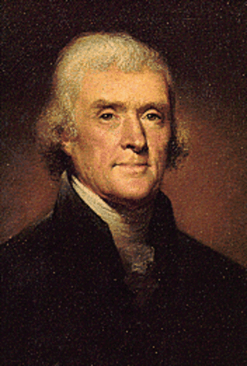

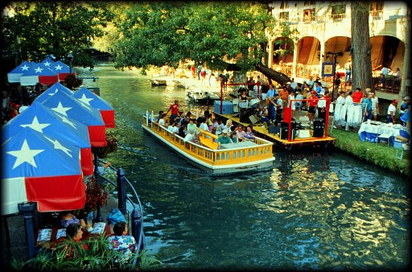

Think Long Term,
and Create the Future:
Reimagine, Reconsider, Aspire
“In every deliberation we must consider the impact on the seventh generation... even if it requires having skin as thick as the bark of a pine.”
Great Law of the Iroquois

