Slide 1

DEIB, Title IX, & Sex-Based Misconduct
Office of AA/EEO & Title IX

Slide 2



WARNING
Some of the content can be traumatic or triggering.
If you find the content offensive, such as the video examples, please remember this training discussion today is taken serious by Auburn University and it is not intended to upset anyone but meant to educate everyone on what to do and what not to do, such as some of the examples in the videos.
Please be respectful of each other’s feelings. We don’t know what we have all experienced in life so be supportive and don’t judge others.
Notes:
As a reminder, this presentation is a safe space and topics of sex, domestic violence, and stalking will come up. This content is meant to be engaging and informative and not intended to upset anyone. Please be respectful of your peers as this will be an interactive presentation.

Slide 3

TRAINING OUTLINE
DIVERSITY, EQUITY, INCLUSION, & BELONGING
TITLE IX / PROHIBITED CONDUCT
BYSTANDER INTERVENTION
REPORTING/RESOURCES
RETALIATION
SUPPORTIVE / INTERIM MEASURES
PROCESS
SANCTIONS
PRESERVATION OF EVIDENCE AND MEDICAL SUPPORT

Slide 4

· Diversity·Equity·Inclusion·Belonging·
· SEX · · AGE· · DISABILITY ·
· GENETIC INFO · · RELIGION ·
· NATIONAL ORIGIN · · RACE·
· COLOR · ·VETERAN STATUS ·
Notes:
What does diversity mean to you? A variety of people with differences such as the ones you mentioned. Yes. And these qualifications listed are considered protected statuses. Our office investigates allegations of discrimination and harassment based on protected statuses.

Slide 5

DISCRIMINATION AND HARASSMENT
Discrimination – Conduct directed at a specific individual or a group of identifiable individuals that subjects the individual or group to treatment that adversely affects their education or employment because of their Protected Status.
Harassment – Verbal and/or physical conduct that is severe or pervasive, that is based on an individual’s Protected Status, and that unreasonably interferes with the individual’s work or academic activities, or that creates an environment that a reasonable person would consider intimidating, hostile, or offensive.
Notes:
These definitions are taken straight out of Auburn’s Policy against Discrimination and Harassment.

Slide 6
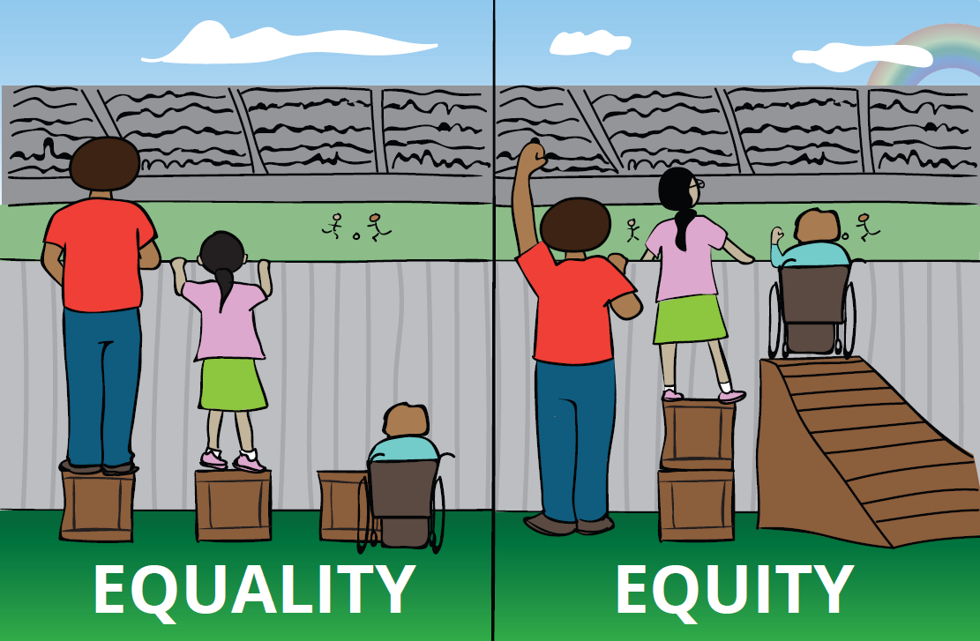
· Diversity·Equity·Inclusion·Belonging·
Equality=Sameness
Equality tries to promote fairness by providing everyone with the same thing
But…it only works if everyone starts from the same place (like the same height)
Equity=Fairness
Equity is about providing everyone with access to the same opportunities
Our differences and personal history sometimes create barriers but ensuring equity first allows us to then enjoy equality
Notes:
What do you think of when we talk about “equity”?

Slide 7
· Diversity·Equity·Inclusion·Belonging·
Inclusion: Including or of being included within a group or structure
Belonging: Belonging is the feeling of security and support when there is a sense of acceptance, inclusion, and identity for a member of a certain group
Think about your own team.
Notes:
Think about the purpose of athletics, sports. You want to win, yes, but what else? Is it also about being a team, working together to a common goal? Inclusion and belonging is about growth. Can you all play the same position? No! Do you all have the same skills? No. You need diversity, but you also need to have inclusion and belonging.

Slide 8




Engaged
Respected
Valued
Welcomed
The Bare Minimum is not discriminating , not harassing, and overall, just not doing anything.
Notes:
What's the purpose of athletics and sports? To win. Yes, but what else? What will help you win? To grow and develop! Yes. Can you grow and develop with all of the same players on your team playing the same positions from the same backgrounds? No. So you need diversity!
Diversity brings unique perspectives and strengths that can enhance your team's performance. But diversity alone isn't enough. To truly benefit from a diverse team, we must ensure everyone feels welcomed, valued, respected, and engaged.
Welcomed: Think about how you felt when you first joined a team or a group of people. Did someone greet you, show you around, and make you feel like you belonged? That’s what it means to be welcomed. It's about creating an environment where everyone feels like they’re part of the team from day one.
Valued: Every player brings something unique to the team. Recognizing and appreciating each person’s contributions makes them feel valued. It’s not just about the star player; it's about acknowledging the effort and skills of everyone, whether they're on the field or supporting from the sidelines.
Respected: Respect is fundamental in any team. It's about listening to each other, valuing different opinions, and treating everyone with dignity. When we respect each other, we build trust and create a stronger, more cohesive team.
Engaged: Engagement means being involved and enthusiastic. Encourage each other to participate, share ideas, and take initiative. When everyone is engaged, the team thrives because everyone is contributing their best.
So, to grow and develop, we need to create a team culture where everyone feels welcomed, valued, respected, and engaged. That’s how we not only win games but also build a legacy of excellence and unity.

Slide 9

TITLE IX
FEDERAL LAW PROHIBITING DISCRIMINATION BASED ON SEX IN AN EDUCATIONAL SETTING (PROGRAMS AND ACTIVITIES)
ATHLETICS
CLASSROOM
EMPLOYMENT
FINANCIAL AID
ENROLLMENT

Slide 10
TITLE IX / SEX-BASED MISCONDUCT
SEXUAL HARASSMENT
INTIMATE PARTNER VIOLENCE (DATING / DOMESTIC VIOLENCE)
STALKING
NON-CONSENSUAL SEXUAL CONTACT / INTERCOURSE (SEXUAL ASSAULT)
SEXUAL EXPLOITATION
OTHER FORMS OF DISCRIMINATION
BULLYING AND HAZING

Slide 11
CAN YOU VIOLATE TITLE IX OR BE RESPONSIBLE FOR SEX-BASED MISCONDUCT:
On campus?
&
Off campus?

Slide 12
SEXUAL HARASSMENT (UNWELCOME CONDUCT)
Unwelcome conduct determined by a reasonable person to be so severe, pervasive, and objectively offensive that it effectively denies a person equal access to the University’s education programs and activities.
Unwelcome sexual advances
Requests for sexual favors
Unwanted touching / rubbing of a sexual nature
Comments about physical appearance
Sexual gestures or images
Sexual “jokes”
Notes:
What are other examples of unwelcome conduct that could be considered sexual harassment?

Slide 13
STALKING
Engaging in a course of conduct directed at a specific person that would cause a reasonable person to fear for the person’s safety or the safety of others; or suffer substantial emotional distress.
Following someone
Showing up un-invited
Watching someone
Constant messages
Making comments perceived as threatening
Notes:
Other examples of stalking include:

Slide 14

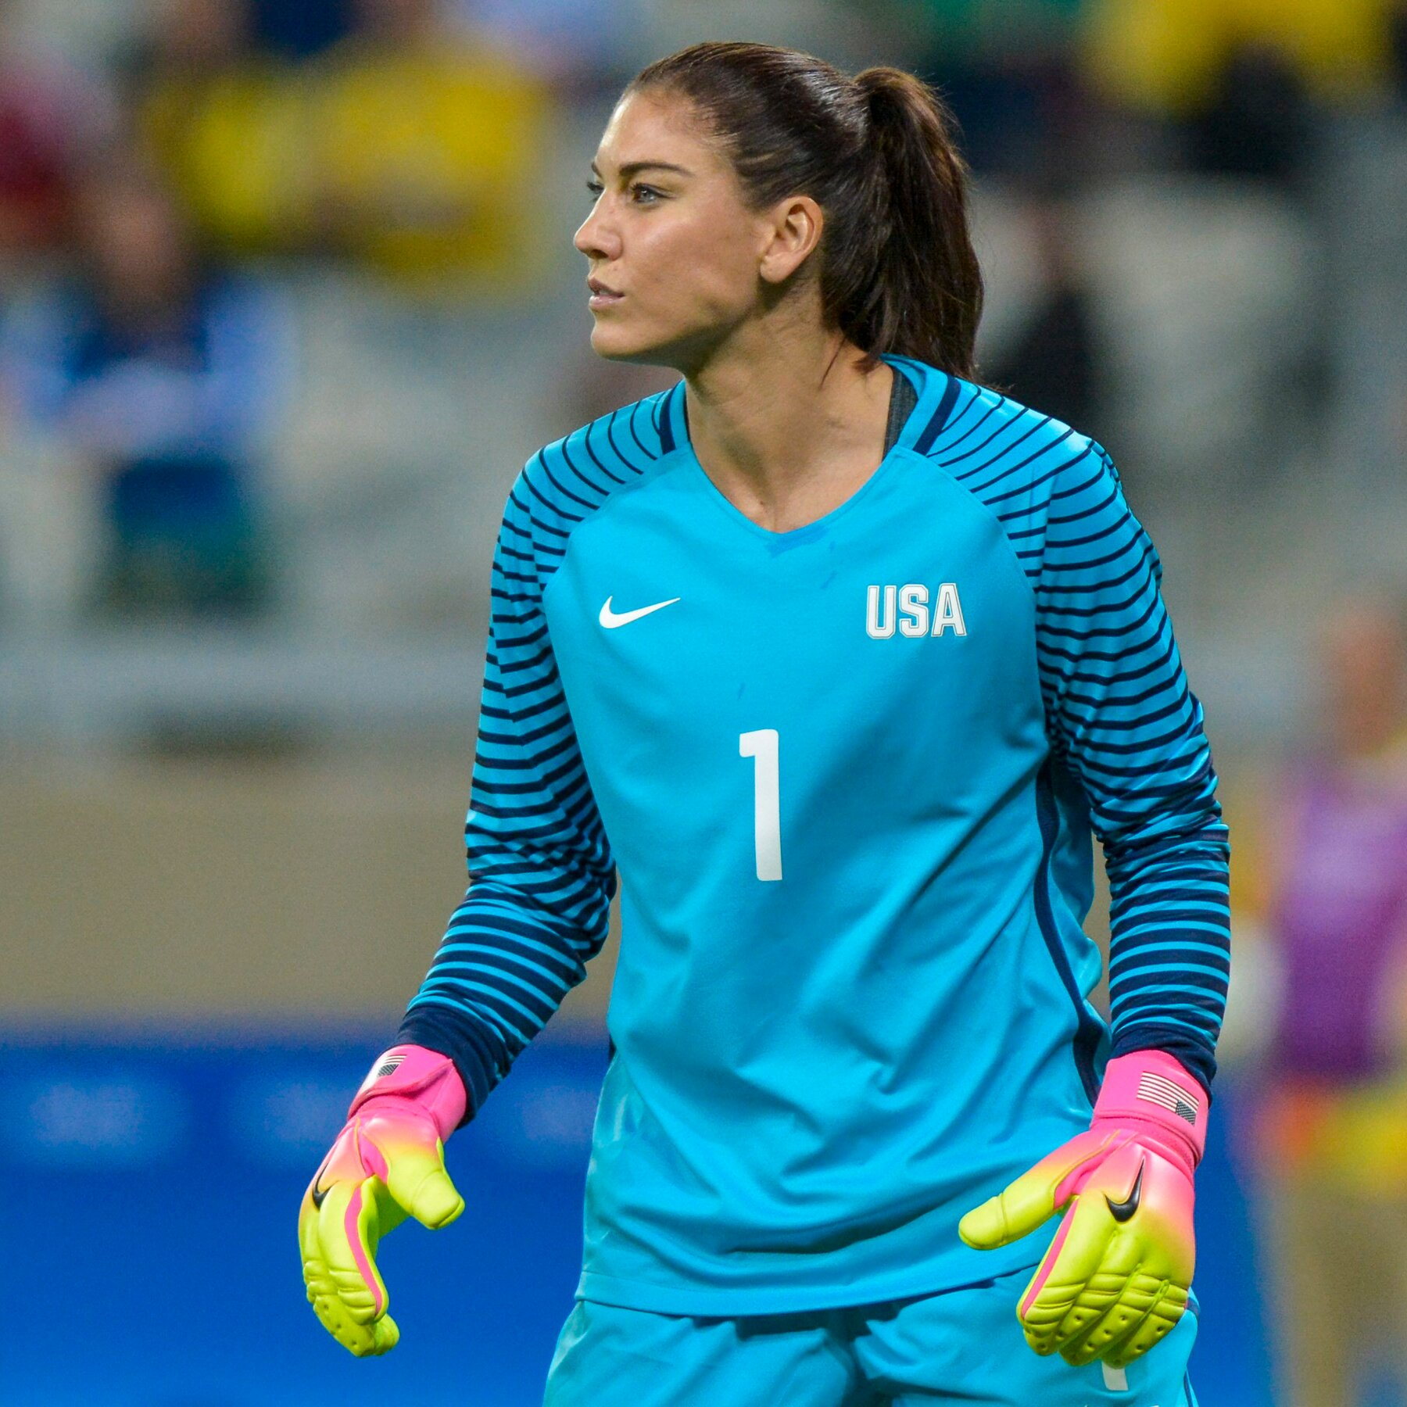


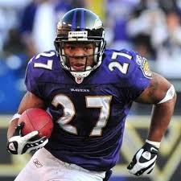

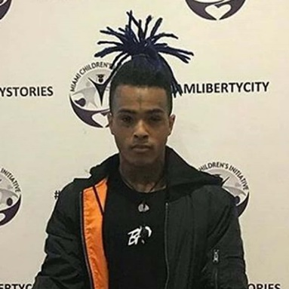



Hope Solo
Ray Rice
Trevor Bauer
INTIMATE PARTNER VIOLENCE
(DATING/DOMESTIC VIOLENCE)
Notes:
Who can name anyone on this screen?........................ These celebrities have all been alleged to have committed intimate partner violence which is violence committed against a romantic or intimate partner or a spouse. As you see, these individuals display diversity in age, race, sex, profession and their victims display an array of diverse traits as well. Intimate partner violence could happen to any of us, but we can make sure that we are engaging in healthy relationships practices and watching out for warning signs of unhealthy relationships.

Slide 15
SIGNS OF UNHEALTHY RELATIONSHIPS
Physical Abuse
Verbal Abuse
Extreme Jealousy
Isolation
Controlling
Electronic
(pushing, shoving, grabbing, hitting)
(name calling, put downs, insults, threats)
(upset about you having friends of the same sex as them)
(prevent you from doing any activities with friends/family)
(deciding when and where you can do anything)
(access to cell, email, social media to monitor)

Slide 16
HOW DO YOU KNOW IF YOU HAVE CONSENT?
NON-VERBAL
VERBAL
Body Language!
Are they leaning in vs pulling away?
Are they smiling vs is their face blank or uncomfortable?
Are they kissing you back vs staying still or frozen?
Consent Can Be SEXY!
“Do you want to show me your bedroom?”
“Show me where you want me to touch you?”
“Do you want to help me take my clothes off?”

Slide 17

CONSENT IS SIMPLE AS TEA!
https://youtu.be/fGoWLWS4-kU

Slide 18
SEXUAL EXPLOITATION
Sharing or posting images of private sexual activity and/or nude pictures of someone without consent
Causing or attempting to cause someone to get incapacitated for sexual purposes
Watching sexual activity or someone nude without consent
Exposing someone to an STD
Sextortion

Slide 19
RETALIATION
PROHIBITED
INITIMIDATION
THREATING
MAKING FUN OF PERSON
MAKING A FALSE COMPLAINT

Slide 20
BYSTANDER INTERVENTION
If you see something wrong, you can make a difference with bystander intervention. Don’t sit back and do nothing, intervene and help prevent something from happening.
DIRECT
DELEGATE
DISTRACT

Slide 21
REPORTING
Auburn Police Department
AA/EEO & Title IX Office:
TITLE IX COORDINATOR, Kelley Taylor, email: taylokg@auburn.edu
call: 334.844.4794
walk-in 317 Foy Hall
Online-Reporting Form aub.ie/report
Confidential Resources:
Student Counseling & Psychological Services - 2086 Student Center - phone:334.844.5123
Safe Harbor (advocates for students and employees) - 1206 Student Center – phone: 24/7 crisis # 334.844.safe (7233)
(non-emergency: 334.501.3100)
Address: 141 N Ross Street, Auburn, Al
Counseling & Sport Psychology – Athletics Complex – phone 334.844.5123

Slide 22
INCIDENT REPORTED, OBSERVED,
OR SUSPECTED
If it is an emergency, call 911.
Employees (including coaches) are required to report (make a referral to Title IX office)
Reason for the report is to offer you support (not forced to participate)

Slide 23
NON-CONFIDENTIAL / PRIVATE RESOURCES
Office of Affirmative Action / Equal Employment Opportunity & Title IX
Office of Human Resources
Office of Provost
Office of Student Affairs
Campus Safety and Security

Slide 24
ON CAMPUS CONFIDENTIAL RESOURCES
Safe Harbor (334.844.7233)
Counseling & Sport Psychology (334.844.5123)
Student Counseling & Psychological Services (334.844.5123)
Ombudsperson (334.844.7170)

Slide 25
SUPPORTIVE / INTERIM MEASURES
NO CONTACT DIRECTIVES
SAFETY PLANNING
SCHEDULE CHANGES (ACADEMIC OR WORK)
ON CAMPUS HOUSING CHANGES
RESTRICTIONS
EMERGENCY REMOVAL / SUSPENSIONS

Slide 26
PROCESS
hearing
determination
determination
investigation
informal / formal
assessment
appeal

Slide 27
SANCTIONS
WARNING
TRAINING
PERMANENT NO CONTACT
PROBATION
PERMANENT RESTRICTION
SUSPENSION
EXPULSION

Slide 28
PRESERVATION OF EVIDENCE
MEDICAL EXAM RIGHT AWAY
DON’T SHOWER
DON’T THROWING AWAY ITEMS (CONDOMS)
DON’T WASH CLOTHES OR SHEETS
SAVE ELECTRONIC EVIDENCE
TEXT
SOCIAL MEDIA
EMAIL MESSAGES
REPORT IT!

Slide 29
QUESTIONS?
Office of AA/EEO & Title IX (317 Foy Hall)
titleix@auburn.edu

Slide 30
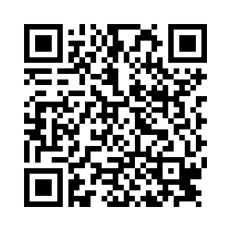
SCAN FOR CREDIT

