Slide 1

Title IX & Sex-Based Misconduct
Office of AA/EEO & Title IX

Slide 2



WARNING
    Some of the content can be traumatic or triggering.
    If you find the content offensive, such as the video examples, please remember this training discussion today is taken serious by Auburn University and it is not intended to upset anyone but meant to educate everyone on what to do and what not to do, such as some of the examples in the videos.
    Please be respectful of each other’s feelings. We don’t know what we have all experienced in life so be supportive and don’t judge others.
Notes:
As a reminder, this presentation is a safe space and topics of sex, domestic violence, and stalking will come up. This content is meant to be engaging and informative and not intended to upset anyone. Please be respectful of your peers as this will be an interactive presentation.

Slide 3

TRAINING OUTLINE
TITLE IX / PROHIBITED CONDUCT
BYSTANDER INTERVENTION
REPORTING/RESOURCES
RETALIATION
SUPPORTIVE / INTERIM MEASURES
PROCESS
SANCTIONS
PRESERVATION OF EVIDENCE AND MEDICAL SUPPORT

Slide 4

TITLE IX
FEDERAL LAW PROHIBITING DISCRIMINATION BASED ON SEX IN AN EDUCATIONAL SETTING (PROGRAMS AND ACTIVITIES)
  ATHLETICS
  CLASSROOM
  EMPLOYMENT
  FINANCIAL AID
  ENROLLMENT

Slide 5
TITLE IX / SEX-BASED MISCONDUCT
SEXUAL HARASSMENT
INTIMATE PARTNER VIOLENCE (DATING / DOMESTIC VIOLENCE)
STALKING
NON-CONSENSUAL SEXUAL CONTACT / INTERCOURSE (SEXUAL ASSAULT)
SEXUAL EXPLOITATION
OTHER FORMS OF DISCRIMINATION
BULLYING AND HAZING

Slide 6
CAN YOU VIOLATE TITLE IX OR BE RESPONSIBLE FOR SEX-BASED MISCONDUCT:
On campus?
&
Off campus?

Slide 7
SEXUAL HARASSMENT (UNWELCOME CONDUCT)
Unwelcome conduct determined by a reasonable person to be so severe, pervasive, and objectively offensive that it effectively denies a person equal access to the University’s education programs and activities.
Unwelcome sexual advances
Requests for sexual favors
Unwanted touching / rubbing of a sexual nature
Comments about physical appearance
Sexual gestures or images
Sexual “jokes”
Notes:
What are other examples of unwelcome conduct that could be considered sexual harassment?

Slide 8
STALKING
Engaging in a course of conduct directed at a specific person that would cause a reasonable person to fear for the person’s safety or the safety of others; or suffer substantial emotional distress.
Following someone
Showing up un-invited
Watching someone
Constant messages
Making comments perceived as threatening
Notes:
Other examples of stalking include:

Slide 9

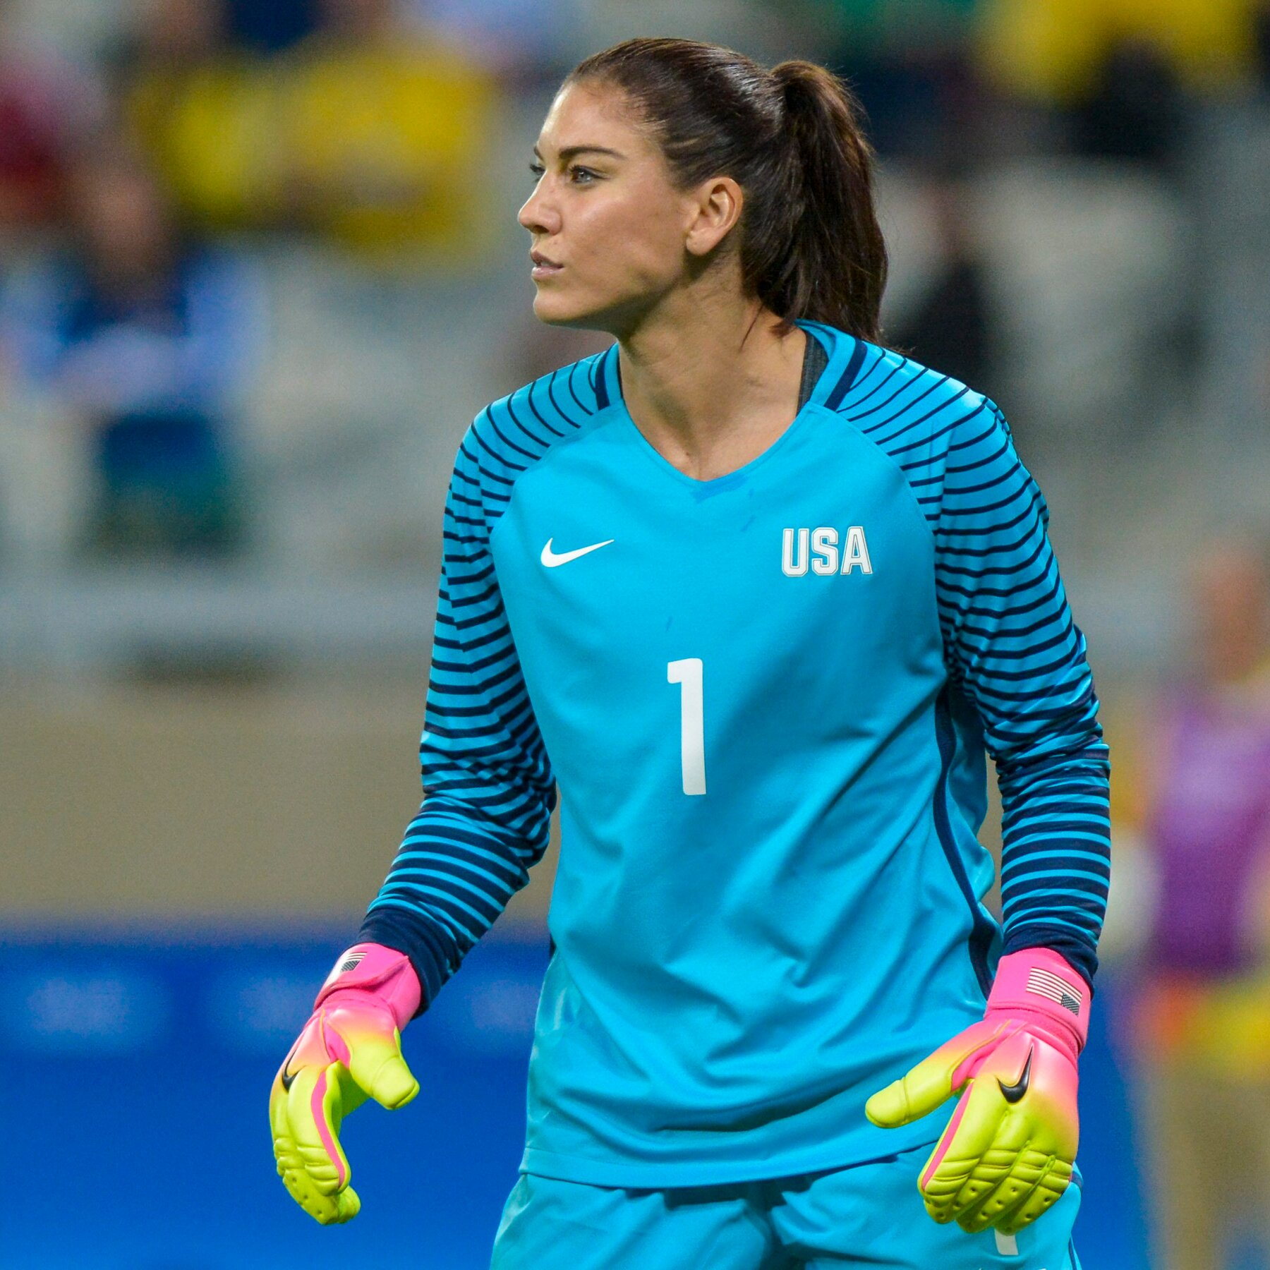
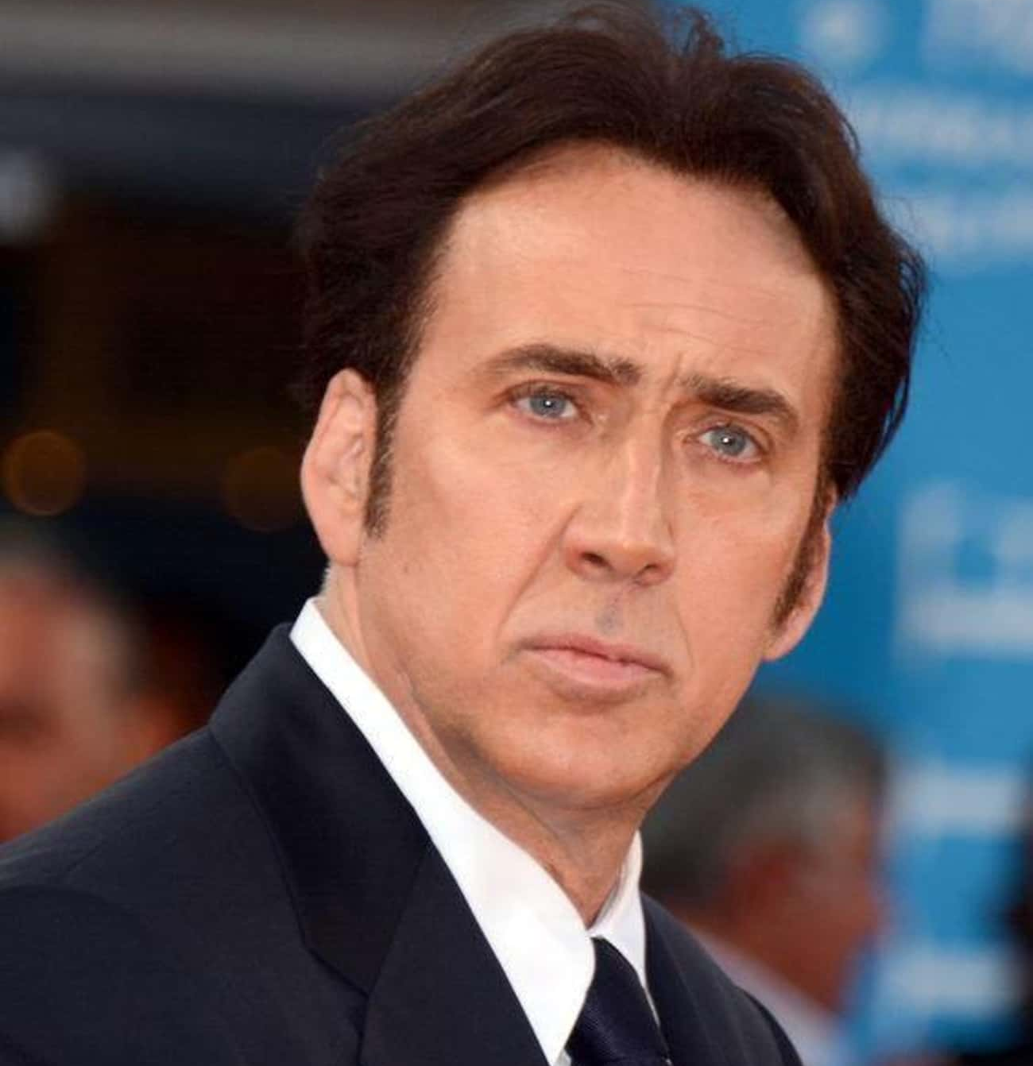

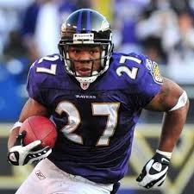

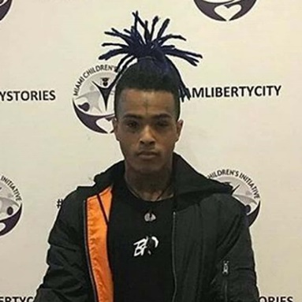



Hope Solo
Ray Rice
Trevor Bauer
INTIMATE PARTNER VIOLENCE
(DATING/DOMESTIC VIOLENCE)
Notes:
Who can name anyone on this screen?........................ These celebrities have all been alleged to have committed intimate partner violence which is violence committed against a romantic or intimate partner or a spouse. As you see, these individuals display diversity in age, race, sex, profession and their victims display an array of diverse traits as well. Intimate partner violence could happen to any of us, but we can make sure that we are engaging in healthy relationships practices and watching out for warning signs of unhealthy relationships.

Slide 10
SIGNS OF UNHEALTHY RELATIONSHIPS
Physical Abuse
Verbal Abuse
Extreme Jealousy
Isolation
Controlling
Electronic
(pushing, shoving, grabbing, hitting)
(name calling, put downs, insults, threats)
(upset about you having friends of the same sex as them)
(prevent you from doing any activities with friends/family)
(deciding when and where you can do anything)
(access to cell, email, social media to monitor)

Slide 11
HOW DO YOU KNOW IF
YOU HAVE CONSENT?
NON-VERBAL
VERBAL
Body Language!
  Are they leaning in vs pulling away?
  Are they smiling vs is their face blank or uncomfortable?
  Are they kissing you back vs staying still or frozen?
Consent Can Be SEXY!
  “Do you want to show me your bedroom?”
  “Show me where you want me to touch you?”
  “Do you want to help me take my clothes off?”

Slide 12


CONSENT IS SIMPLE AS TEA!
https://youtu.be/fGoWLWS4-kU

Slide 13
SEXUAL EXPLOITATION
Sharing or posting images of private sexual activity and/or nude pictures of someone without consent
Causing or attempting to cause someone to get incapacitated for sexual purposes
Watching sexual activity or someone nude without consent
Exposing someone to an STD
Sextortion

Slide 14
RETALIATION
PROHIBITED
  INITIMIDATION
  THREATING
  MAKING FUN OF PERSON
  MAKING A FALSE COMPLAINT

Slide 15
BYSTANDER INTERVENTION
If you see something wrong, you can make a difference with bystander intervention. Don’t sit back and do nothing, intervene and help prevent something from happening.
DIRECT
DELEGATE
DISTRACT

Slide 16
REPORTING
Auburn Police Department
AA/EEO & Title IX Office:
TITLE IX COORDINATOR, Kelley Taylor, email: taylokg@auburn.edu
call: 334-844-4794
walk-in 317 Foy Hall
Online-Reporting Form www.auburn.edu/titleix
Confidential Resources:
Student Counseling & Psychological Services - 2086 Student Center - phone:334-844-5123
Safe Harbor (advocates for students and employees) - 1206 Student Center – phone: 24/7 crisis # 334-844-safe (7233)
(non-emergency: 334-501-3100)
Address: 141 N Ross Street, Auburn, Al

Slide 17
INCIDENT REPORTED, OBSERVED,
OR SUSPECTED
If it is an emergency, call 911.
Employees are required to report (make a referral to Title IX office) (unless designated as Confidential Employees by law or Policy)
Reason for the report is to offer you support (not forced to participate)

Slide 18
ON CAMPUS CONFIDENTIAL RESOURCES
Safe Harbor (334-844-7233)
Counseling & Sport Psychology (334-844-5123)
Student Counseling & Psychological Services (334-844-5123)
Ombudsperson (334-844-7170)

Slide 19
NON-CONFIDENTIAL / PRIVATE RESOURCES
Office of Affirmative Action / Equal Employment Opportunity & Title IX
Office of Human Resources
Office of Provost
Office of Student Affairs
Campus Safety and Security

Slide 20
SUPPORTIVE / INTERIM MEASURES
NO CONTACT DIRECTIVES
SAFETY PLANNING
SCHEDULE CHANGES (ACADEMIC OR WORK)
ON CAMPUS HOUSING CHANGES
RESTRICTIONS
EMERGENCY REMOVAL / SUSPENSIONS

Slide 21
PROCESS
hearing
determination
determination
investigation
informal / formal
assessment
appeal

Slide 22
SANCTIONS
WARNING
TRAINING
PERMANENT NO CONTACT
PROBATION
PERMANENT RESTRICTION
SUSPENSION
EXPULSION

Slide 23
PRESERVATION OF EVIDENCE
MEDICAL EXAM RIGHT AWAY
DON’T SHOWER
DON’T THROWING AWAY ITEMS (CONDOMS)
DON’T WASH CLOTHES OR SHEETS
SAVE ELECTRONIC EVIDENCE
TEXT
SOCIAL MEDIA
EMAIL MESSAGES
REPORT IT!

Slide 24
Consensual Relationships Policy – Romantic, Intimate, or Sexual Relationships
Faculty/Student Relationships
Staff/Student Relationships
Staff/Subordinate Relationships
In the Instructional Context
  NOT permitted and a policy violation
  Supervision of the student
    In class
    TA
    Research
Outside the Instructional Context
  Proceed with caution
  Context? Same unit?
  Conflicts of Interest
Prohibited where staff member has authority or control over the student
“Authority or control” is broadly construed
Violations may result in disciplinary action
Supervisors cannot be in an intimate relationship with a subordinate
  Reassign the supervisor to remove supervisory duties (supervisor, manage, evaluate, other employment decisions)
  Management Control Plan
  Stays in effect even if relationship ends

Slide 25
QUESTIONS?
Office of AA/EEO & Title IX (317 Foy Hall)
titleix@auburn.edu

