Slide 1

How Pre-service Teachers Reflective: Practice From An International Teaching Experience Impacts Their Own Perspectives Of A Diverse Learning Experiences
Kristina DeWitt, Ph. D.
Liberty University
Notes:
Title of Article: Island Experiences: Training Pre-Service Teachers Abroad
Kristina DeWitt, Ph.D.
Liberty University

Slide 2
Background
Teacher preparation program
UG candidates
Optional practicum (substitution for a local placement)

Slide 3
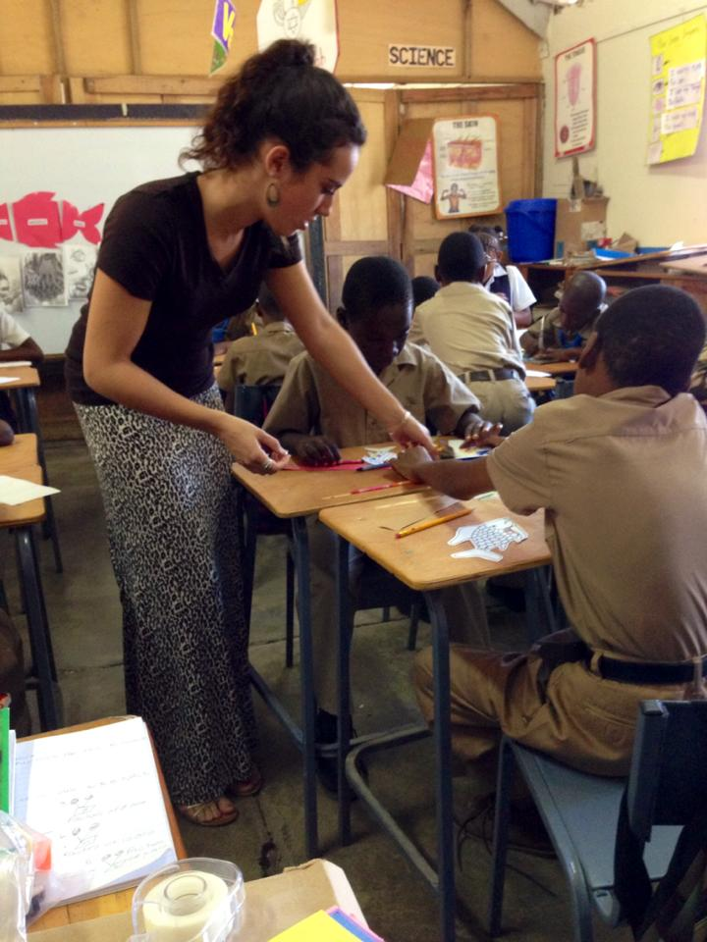

What We Will Discuss
Monitor, evaluate & modify processes
Collaboration
Reflection and Extended thinking

Slide 4


Our Global Impact How To Monitor, Evaluate & Modify Processes
Dispositions
Monitor and adjust
Thinking on your feet
Flexibility
Changing the lesson to meet the needs of the students
Peer review
Adjusting to culture
Classroom environment
Teaching roles
Testing procedures
Classroom management

Slide 5
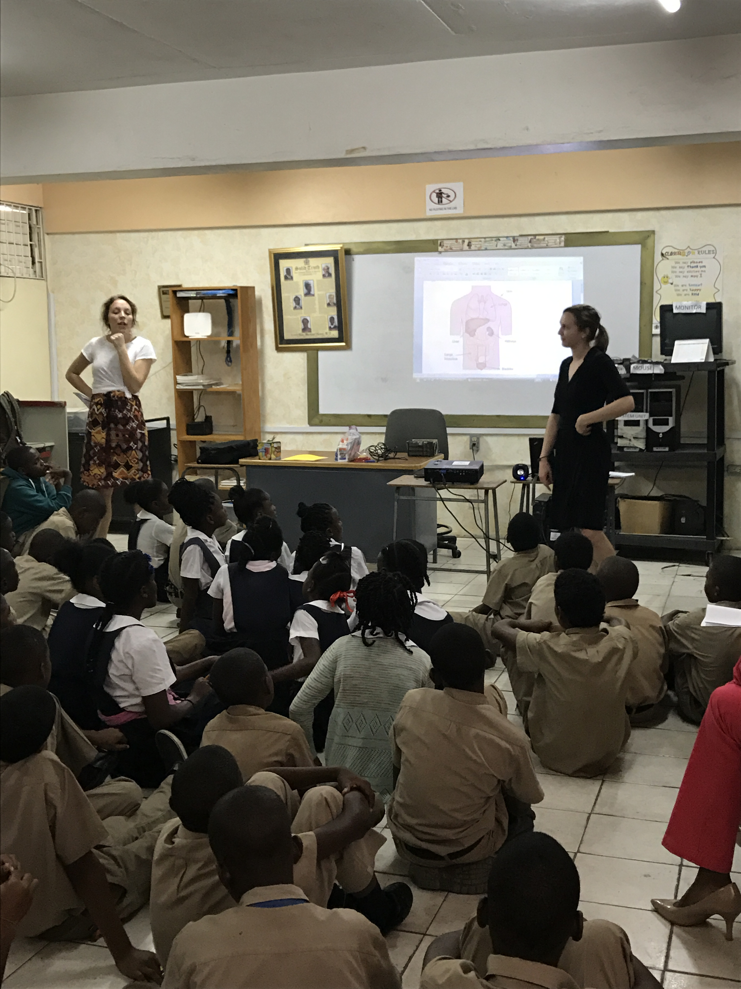
Collaboration
Peer collaboration
Dialogue journaling, planning
Reflecting, time managing
Professor feedback/interaction
Professional development
Education, Culture, Government

Slide 6

Reflection
“Turning a subject over in the mind and giving it serious and consecutive consideration…involves active, persistent and careful consideration.”
Dewey (1933)
Reflection
Takes many shapes for preservice teachers
videos, journals
observations
tasks and duties
Blogs
Personal discussion

Slide 7
Two Types of Reflection
Unproductive
mainly descriptive without very much analysis, usually listing ideas rather than connecting ideas.
Productive
to promote effective learning and involves questioning assumptions and seeing things in many ways.

Slide 8

Reflecting in Multi-Genres
Dialogue journals
Blogs
Video conferencing
Table to table discussion
WhatsApp
Honor’s Thesis

Slide 9
Impact for Preservice Teachers
Urban education training and teaching
Cultural perspective
Collaboration defined

Slide 10

Contact Information
Dr. Kristina DeWitt
kdewitt@liberty.edu
Thanks to Mrs. Ann Gooden for continued support.

Slide 11
References
Davis, E.A. (2006). Characterizing Productive Reflection Among Preservice Elementary Teachers. Teaching and Teacher Education, 22, 281-301.
Dewey, J. (1933). How we think, A Restatement of the Relation of Reflective Thinking. Boston: Heath and Company.
Garmon, M. A. (2001). The benefits of dialogue journals: What prospective teachers say. Teacher Education Quarterly, 31(3), 73-97.
Hoover, L. (1994). Reflective writing as a window on preservice teachers’ though processes. Teaching and Teacher Education, 10(1), 83093.
Lee, I. (2004). Using dialogue journals as a multi-purpose tool for of dialogue journals for preservice teachers: How effective is it? Teacher Education Quarterly, 28(4), 37-50.
Johnston, B. (2000). Investigating dialogue journal in language teacher education: The teacher educator as learner. In K. E. Johnston (Ed.). Teacher Education (pp. 157-173). Alexandria, VA: Teaching English to Speakers of Other Languages.
Staton, J. (1988). ERIC/RCS Report: Dialogue journals. Language Arts, 65, 198-201.

