Slide 1

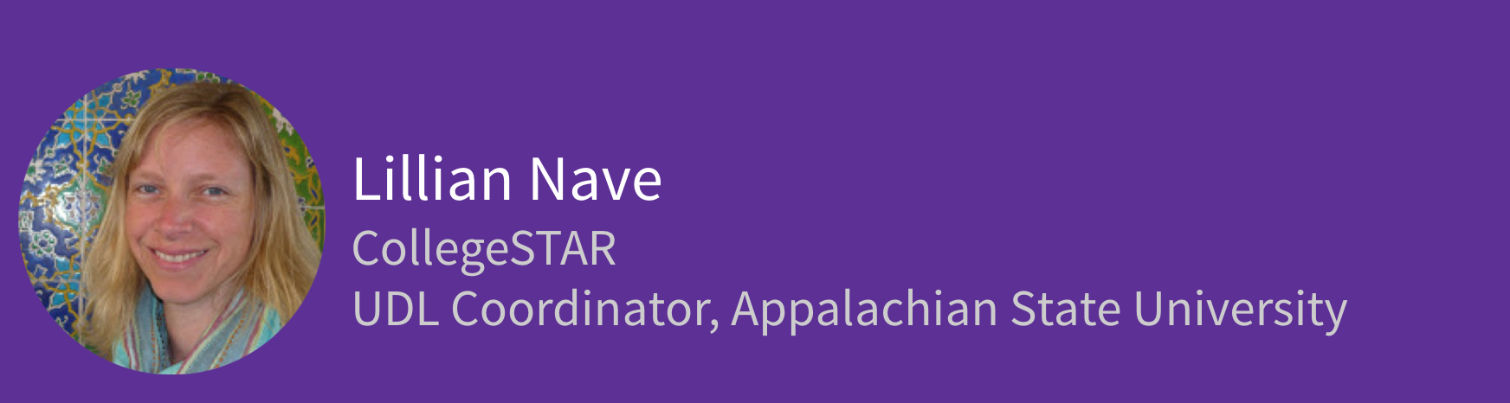

Slide 2
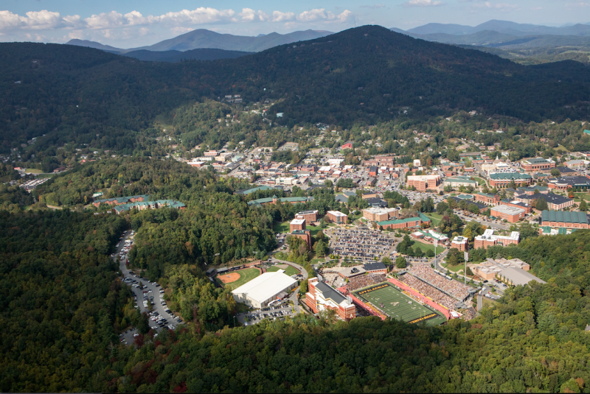
How Art Taught Us to Know and See Each Other: The Boone-Kabul Project

Slide 3

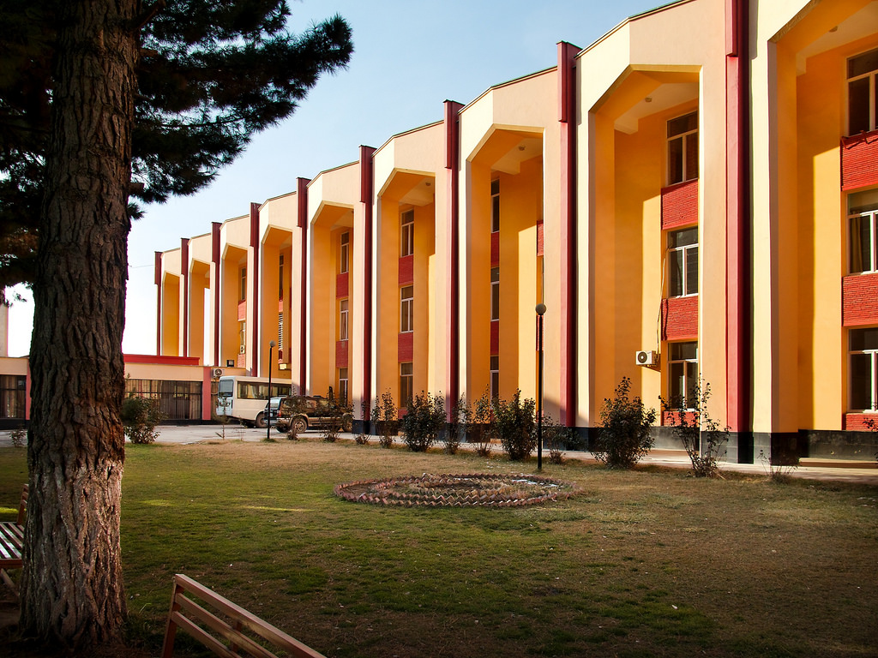
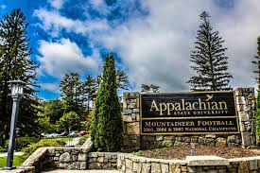
Mountains of
Opportunities

Slide 4
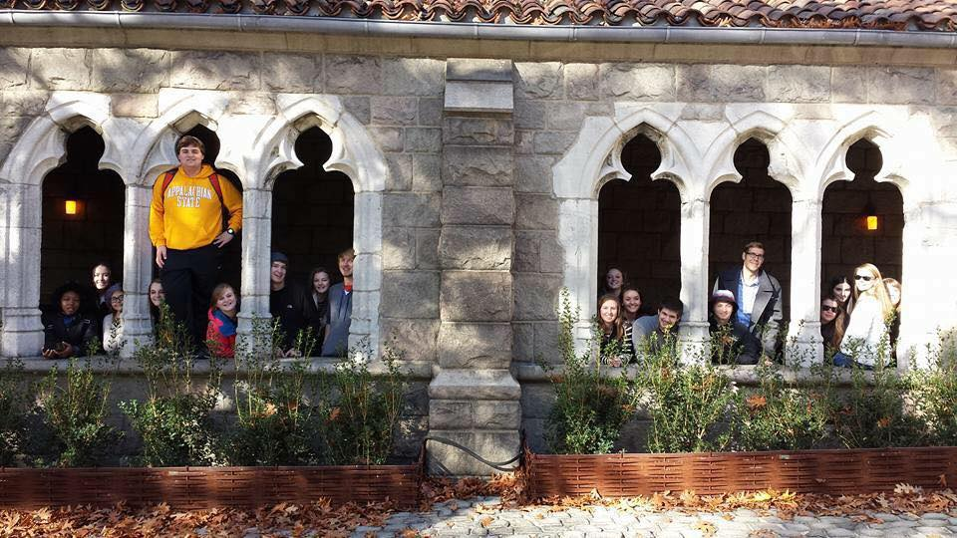
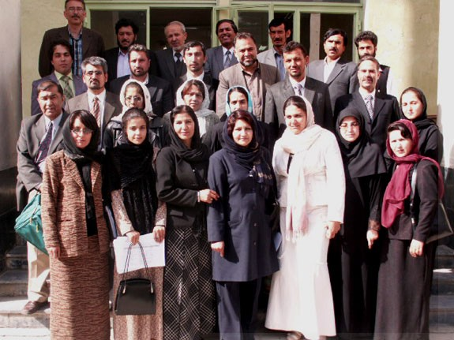
A history… and a future… of educators
Notes:
Students in Lillian Nave Goudas’s First Year Seminar course Art, Religion & Society at Appalachian State University.
The students in Afghanistan attend Kabul Education University, the premiere teachers’ college in Afghanistan. Professor Khalid’s students will be teaching the next generation of Afghani students. We believe that the collaboration between our two institutions is particularly appropriate considering Appalachian’s long history as North Carolina’s premiere institution for future educators.

Slide 5
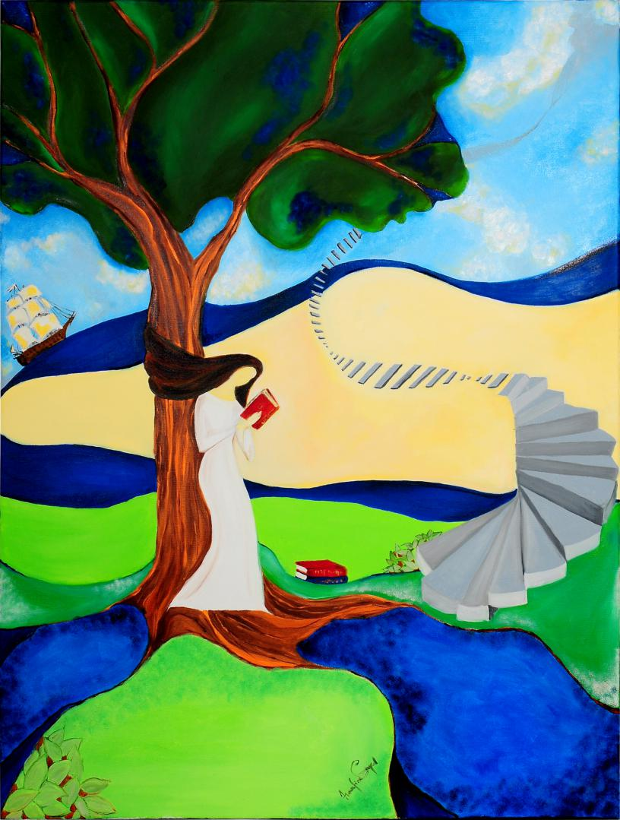
Why Art? Why this project?
Art is a transformational entity that can build bridges across cultures.
AIM of project: In-depth discussion of artistic works by Afghan and American students working together will reduce cultural stereotyping and poor media image-making and lead the students to a shared understanding and a deep connection as humans that transcends national, political, religious and cultural boundaries.
The Invisible Muslima (Sayed, 2013)

Slide 6

A chance encounter in an elevator...
Notes:
The project came into being after a chance encounter with a junior faculty member from Kabul Education University at the Lilly Conference on College and University Teaching in Greensboro in February of 2013. In a few conversations, both Professor Abdul Habib Khalid and I noted the perceptions that our students had of each other’s culture were inaccurate and we were both deeply pained by this revelation.

Slide 7

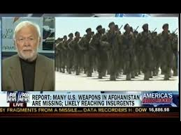
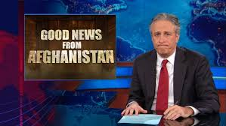
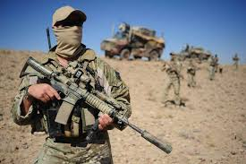

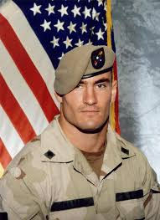
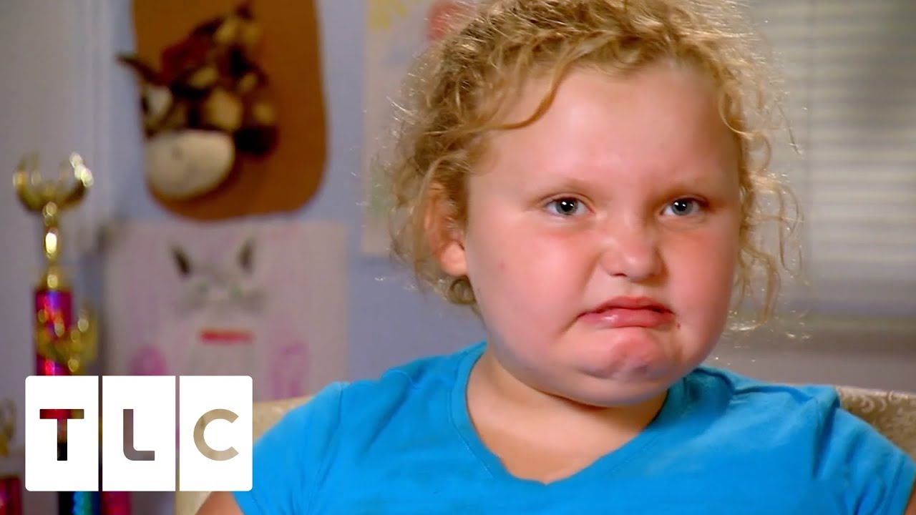
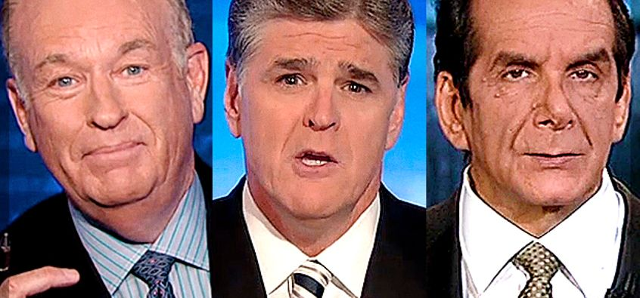
Notes:
Students in Afghanistan know Americans from two main sources-our military presence and our exported media. Students in America know very little about the average Afghani student or citizen, but rather hear of Afghanistan in terms military efforts and sensational news stories. After clearing up some of our own misconceptions, we were determined to do the same thing for our students

Slide 8
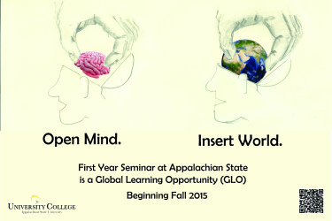
Academic/Cognitive Learning Objectives
(big picture)
Students Will:
-determine how perceptions are shaped about other cultures and analyze how these perceptions change
-examine how art is multivalent and is particularly able to carry many nuanced messages that allow for in-depth discussion
-analyze how art and its interpretation is shaped by various cultural and religious backgrounds

Slide 9

Academic/Cognitive Learning Goals:
(these are the things students will have done
upon completion of the project)
Students Will:
gain written and oral skills in communicating effectively with students of another culture
gain valuable experience in demonstrated complexity of understanding, problem analysis, and critical thinking
apply what they have learned in class to “real world” situations
Be able to explain how art can be used to influence civic discourse

Slide 10

Social Goals
Students will:
increase their communication skills, interpersonal development, and ability to work well with others
reduce stereotypes and facilitate cultural understanding.
increase their sense of social responsibility and citizenship skills
better understand their commitment to the global community and their agency in it.

Slide 11

Institutional Goals
Students will:
-develop competency in global knowledge
-cultivate their own intercultural competencies
-increase their understanding as a global citizen

Slide 12
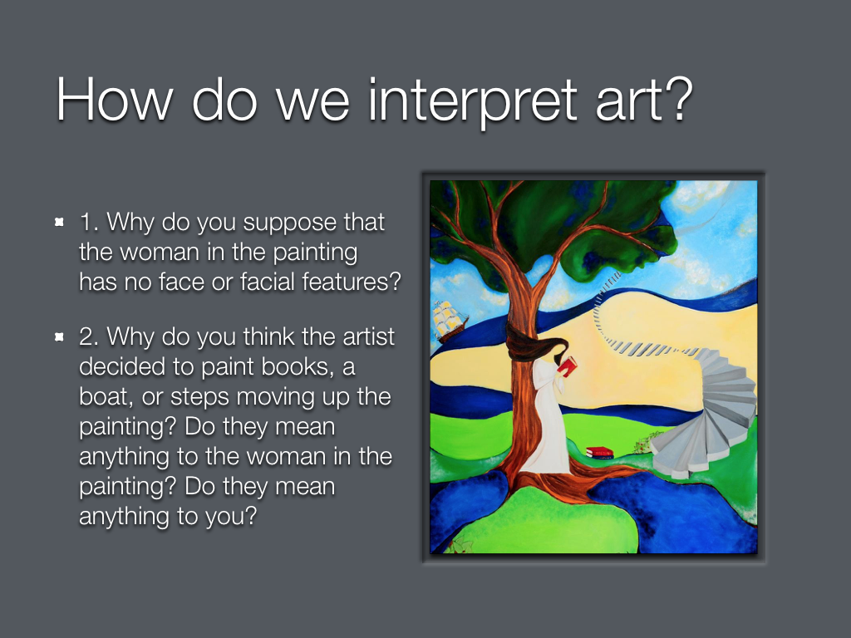

Slide 13
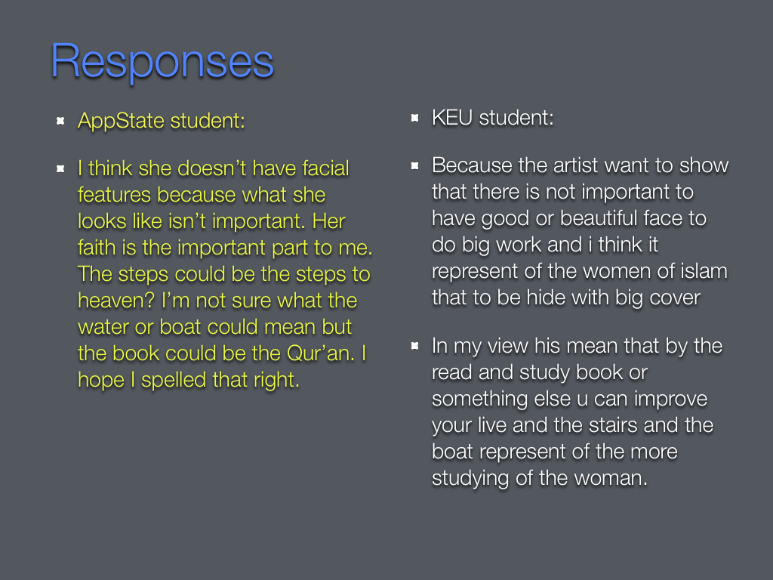

Slide 14
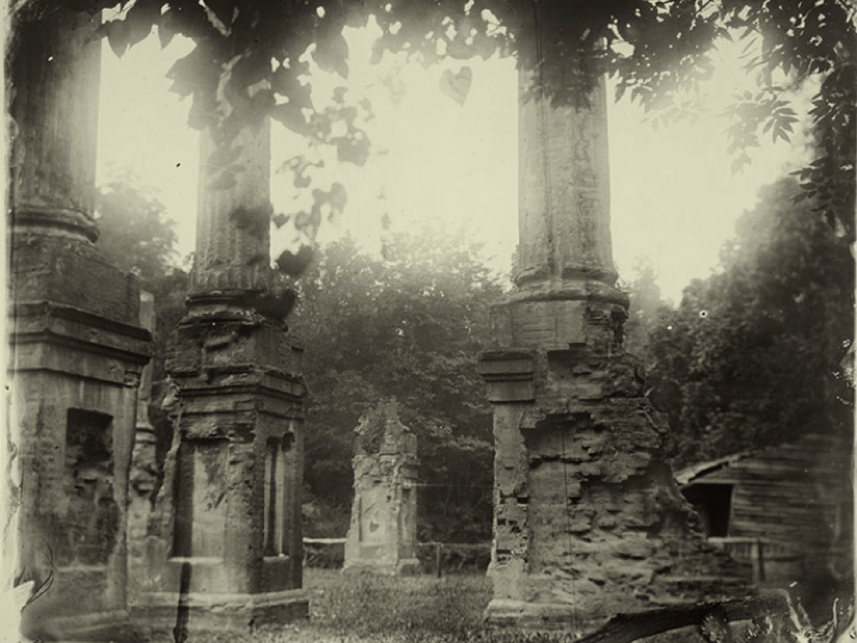

Slide 15
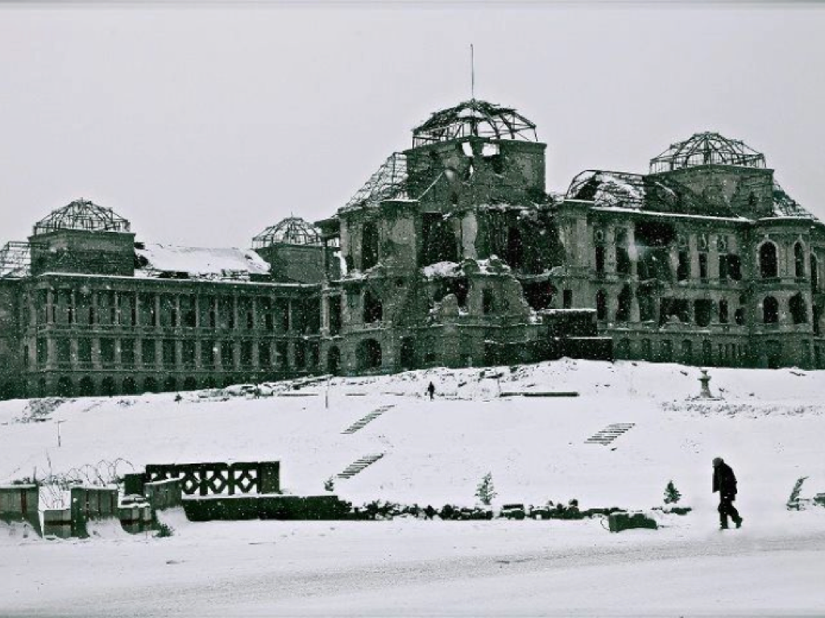

Slide 16
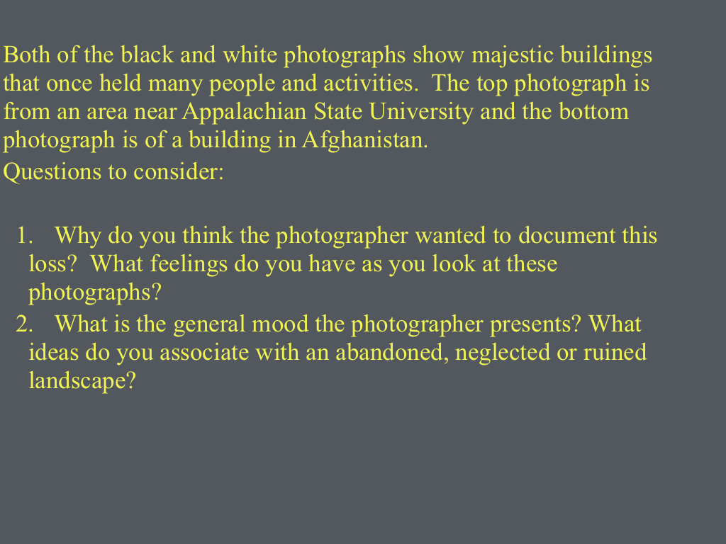

Slide 17
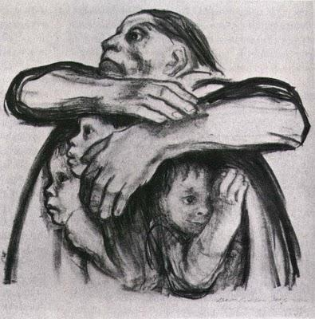
What is the role of the mother in this work of art? How is she depicted? What do you believe is the role of the mother in the family and in the culture? Tell your partner about something important your mother has taught you.
Seed Crops should not be Milled. (Kollwitz, 1941)

Slide 18
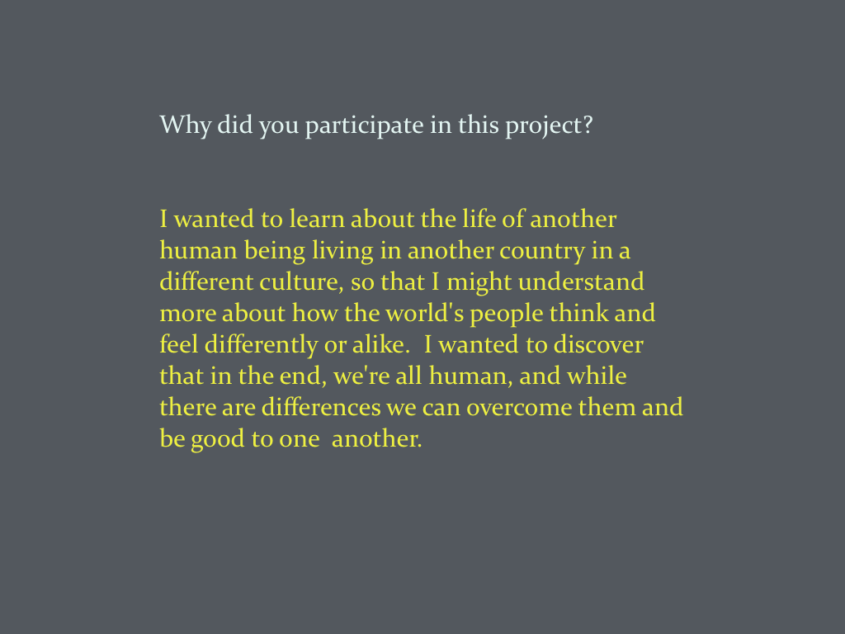

Slide 19
Students from both countries commented on the role of the mother as protector, guardian, care-giver and instructor of moral and religious teachings to her children.
The day a child is born, so is a mother. A good mother has been historically expected to contribute her whole life to her family. Mothers have been the glue that holds a family together because it is up to them to provide the loving care and support needed by growing children. The nurturing a mother provides is unparalleled and a vital part of a child's care. The important thing that my mother taught me is “before saying something, carefully think about what you want to say.”

Slide 20
Cultural Differences
I believe the role of a mother in her family is to support her family, and she has the right to make the important decisions in her family, but I think her role is different in our culture. Mothers should stay at home raising her children and do house chores but some educated mothers send their children in kindergarten, so in this case, children can not get their mother’s real love and might be stubborn. When children are with their mothers they feel themselves safe and sound.
Mothers are responsible for raising children and in today’s society that role seems less important because more mothers have to work now. As a result of more mothers working, more children are being placed in daycare. It is becoming increasingly hard to make a living in the United States, and I’m not saying daycare is wrong, but it has been proven that direct care from children’s mothers is much more beneficial to that child. The mother teaches children all the morals and values while the father reinforces those teachings, or at least that is how my parents are.

Slide 21
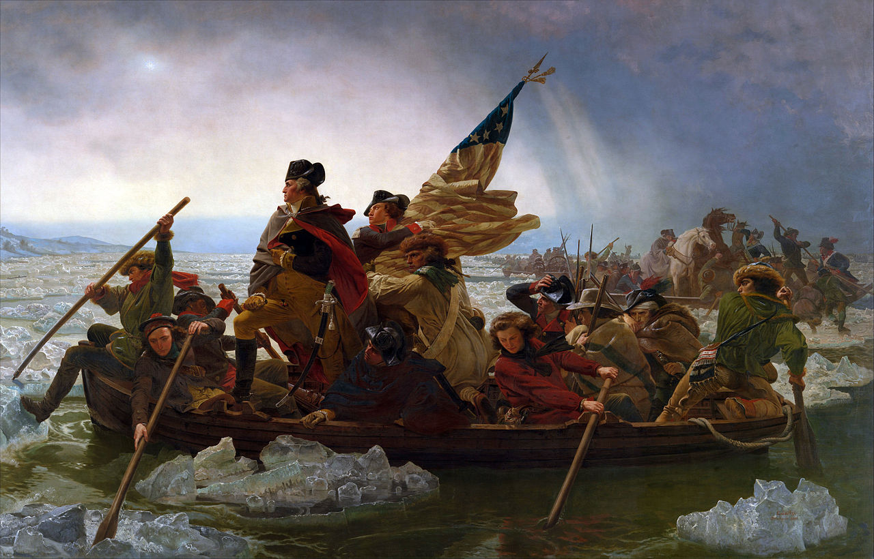
Washington Crossing the Delaware. (Leutze, 1851)
In this painting, what important leadership characteristics does the artist want to convey about George Washington to the viewer? How does he show George Washington to be heroic or a good leader here? What do you believe are important characteristics for a good leader in your own country? How would you describe an ideal leader for your land? Who are your heros?
Notes:
A little background information was provided this time to help all students understand the painting and the significance of the event. The painting shows a determined George Washington, the first President of the United States, determinedly crossing the Delaware river in order to attack the invading British forces and represents a major turning point in the war for American independence. Ever since its creation in 1851, many years after the battle was fought and won by Washington, this painting has symbolized his good leadership in the quest for freedom. Below are the guiding questions students were given to broach a discussion on what qualities are necessary in a good leader.

Slide 22
George Washington is portrayed as being heroic. His stance and poise all suggest that he is some type of leader. He is in the front of the boat and standing. He is portrayed as being a courageous and strong individual. -American Student
In my own country, I believe a leader must simply put the people first. They should be selfless in their actions, and act out of the best interest of the people. The leader should be honest, brave, fair, wise, and strong, along with other characteristics. I honestly don’t have any heroes in the American government, not now or in the past. The only heros in my life are my parents and family, for they go the extra mile to help me in any and everything that I do. I can not say the same for the American government. -Afghan Student

Slide 23
George Washington is portrayed as being heroic. His stance and poise all suggest that he is some type of leader. He is in the front of the boat and standing. He is portrayed as being a courageous and strong individual. -American Student
In my own country, I believe a leader must simply put the people first. They should be selfless in their actions, and act out of the best interest of the people. The leader should be honest, brave, fair, wise, and strong, along with other characteristics. I honestly don’t have any heroes in the American government, not now or in the past. The only heros in my life are my parents and family, for they go the extra mile to help me in any and everything that I do. I can not say the same for the American government. -Afghan Student

Slide 24
Results:
I found it challenging at the beginning, therefore I hesitated to participate at the first stage. But, I thought let’s give it a try. Once I participated, I learned some basic technology skills as google doc, Skype conversation and Facebook for academic purposes. I also felt proud to share about my country and people.

Slide 25
Results:
I learned a lot about community and what it means to be a community within our actual class since we discussed world issues within our class, but we discussed world issues also with students in Kabul, sometimes one-on-one through Facebook messaging, which was really interesting, because you got a really personal perspective. You got to hear from all sorts of points of views from students in Kabul.

Slide 26
Results:
Being a part of the Boone-Kabul experience was a very profound experience for me. It allowed me to relate to other people despite cultural differences. It was very easy to talk to them. I found I could implement this group project well in my own lessons when I become a teacher. Overall, I thought it was a great experience.

Slide 27
Results:
The Boone-Kabul cultural exchange program was an eye opening experience for me. I learned a lot from that program. I really didn’t know how my American peers were thinking about the world. I learned how unawareness causes misunderstanding and cultural stereotypes. I wish this noble and unique initiative conducted by our two brilliant Professors Ms. Lillian Nave and Mr. Abdul Habib Khalid, continue for years to come. I strongly suggest Kabul Education University and Appalachian State University students actively take part in the programs that come. It is a fruitful effort to bring two nations together to understand and embrace each other. I found new American friends who widened my horizons by sharing their feelings and thoughts. I feel proud of being part of such a wonderful program.

Slide 28
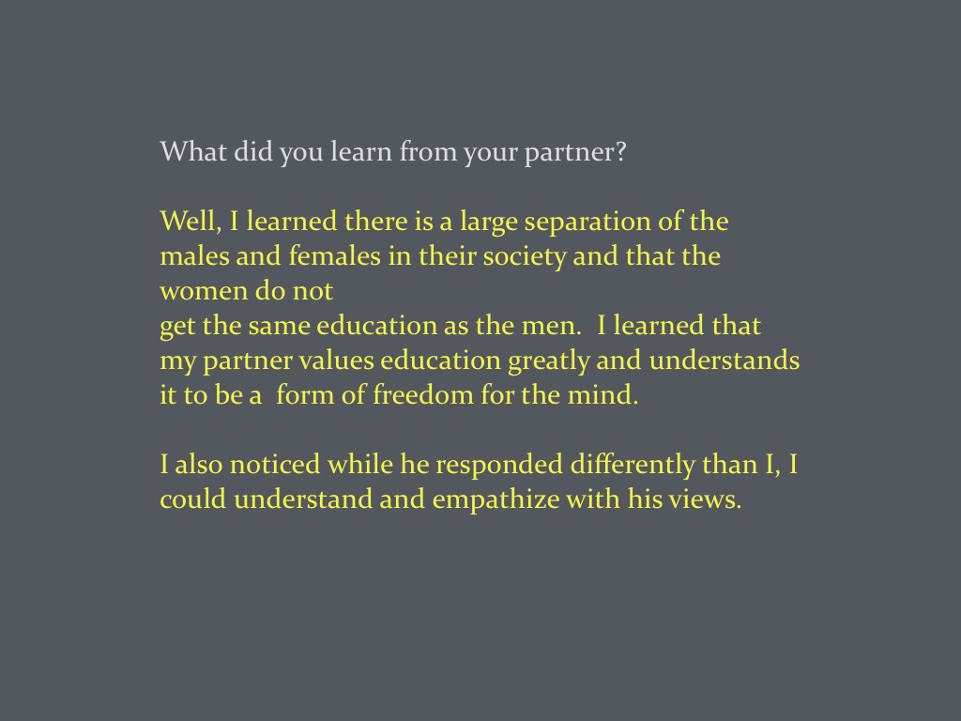

Slide 29
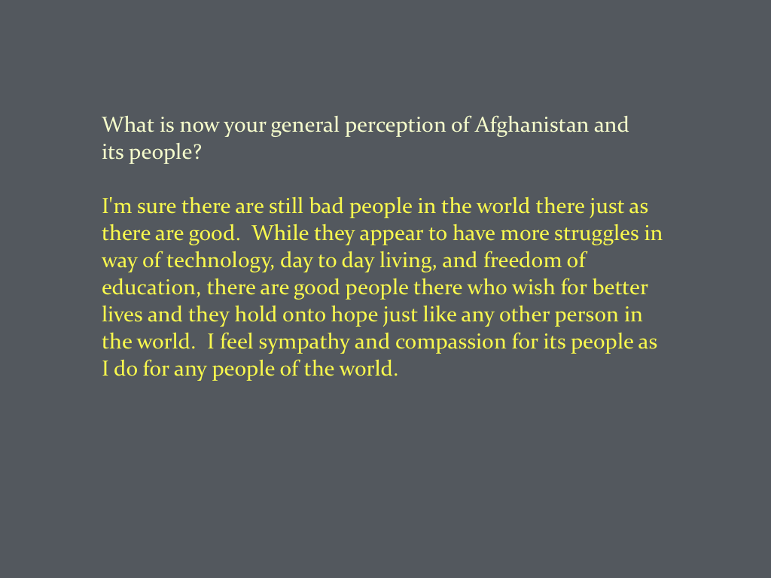

Slide 30
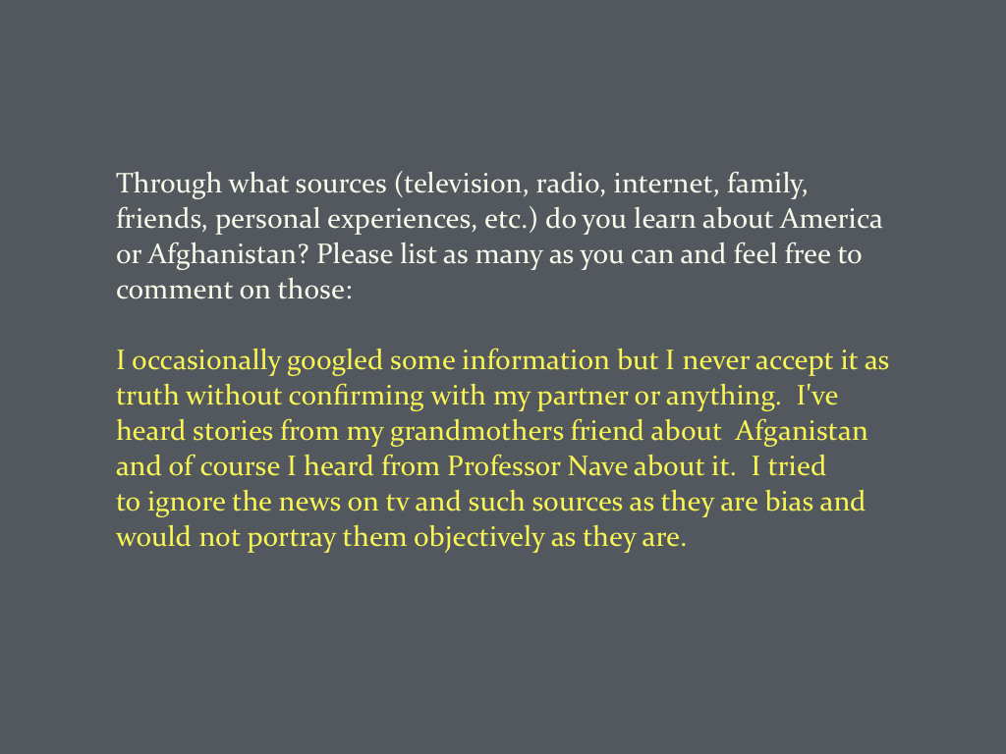

Slide 31
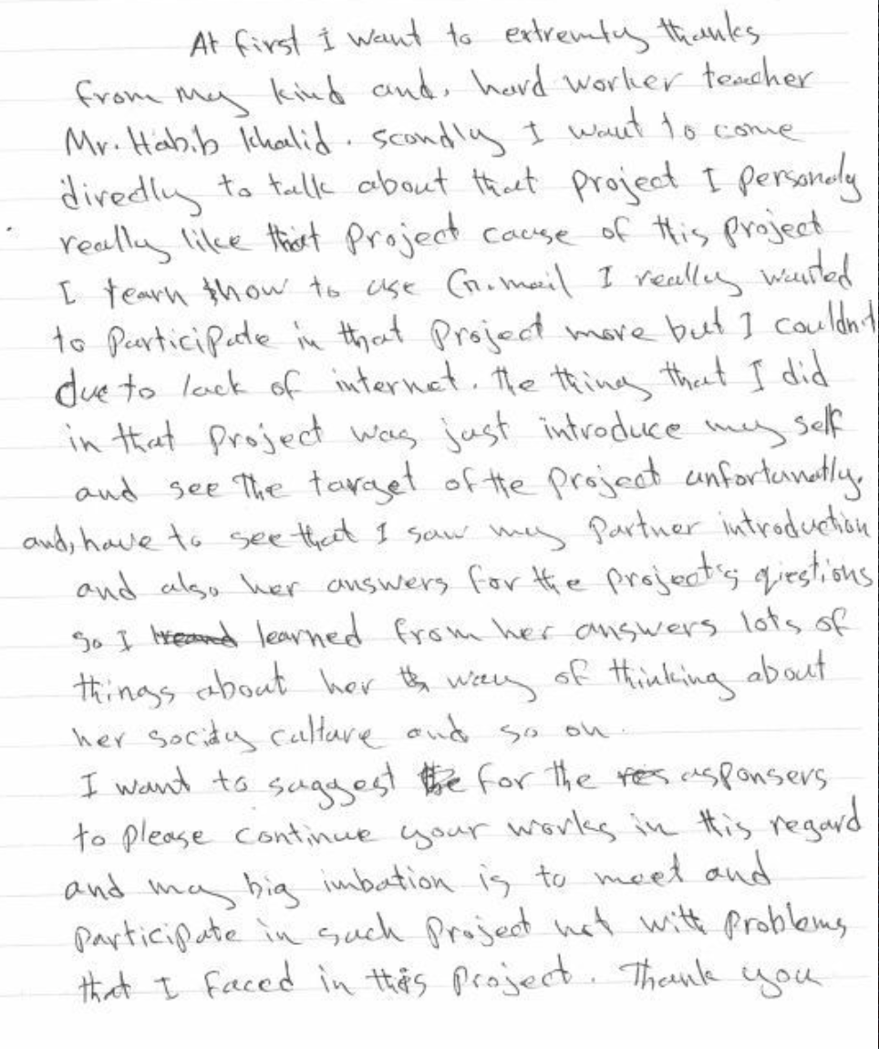
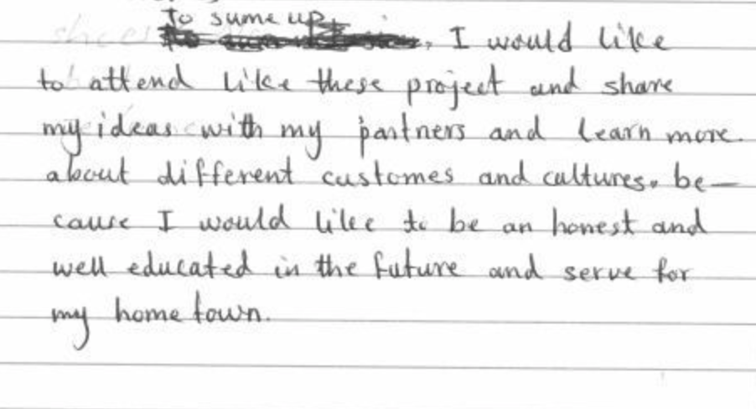

Slide 32
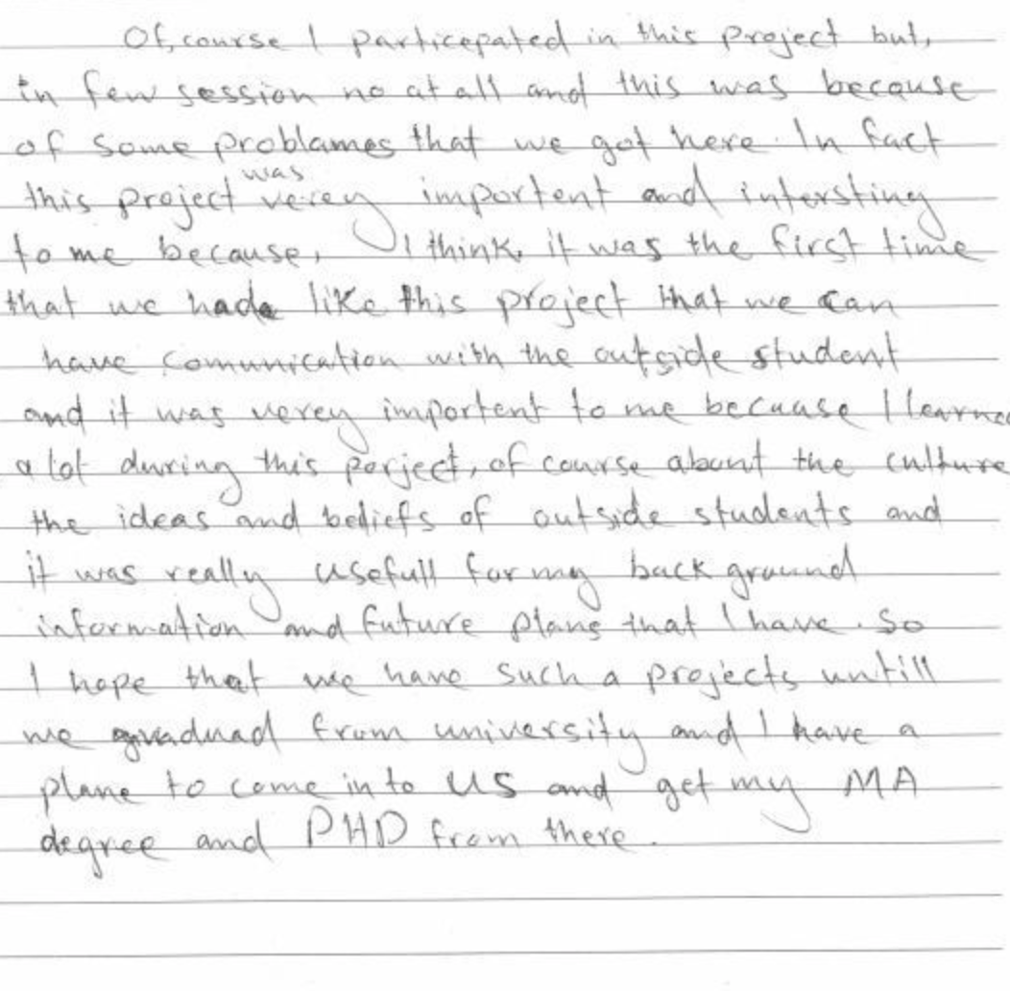
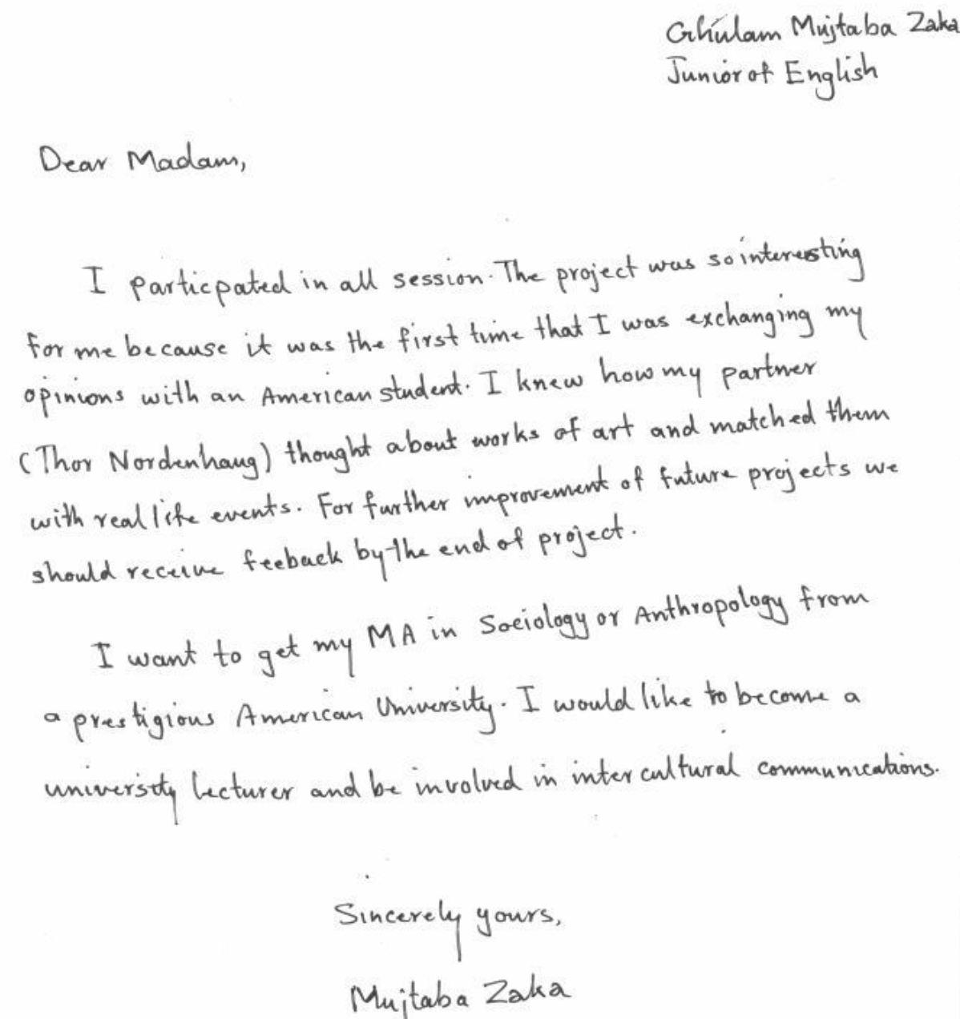

Slide 33
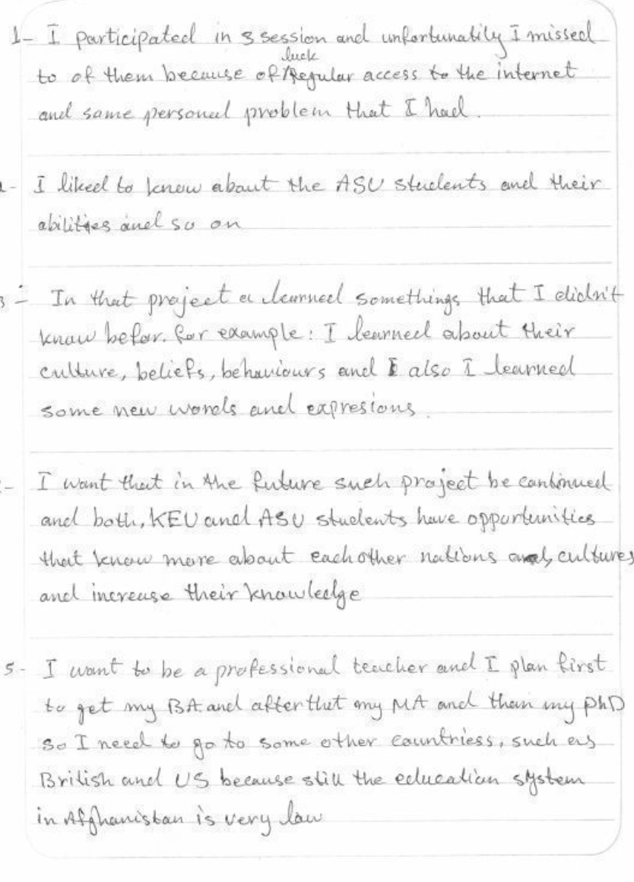
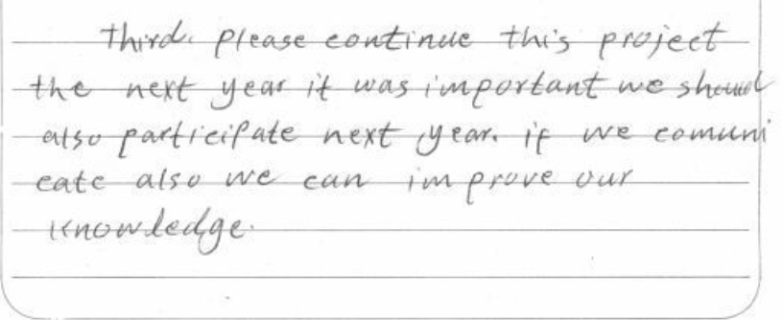

Slide 34
