Slide 1

Engaging ALL Students
...Not just the ones you wish were in your class
Lillian Nave
CollegeSTAR
UDL Coordinator, Appalachian State University

Slide 2
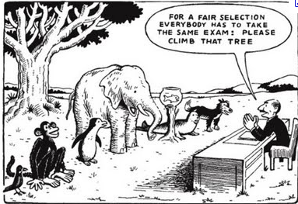

Slide 3
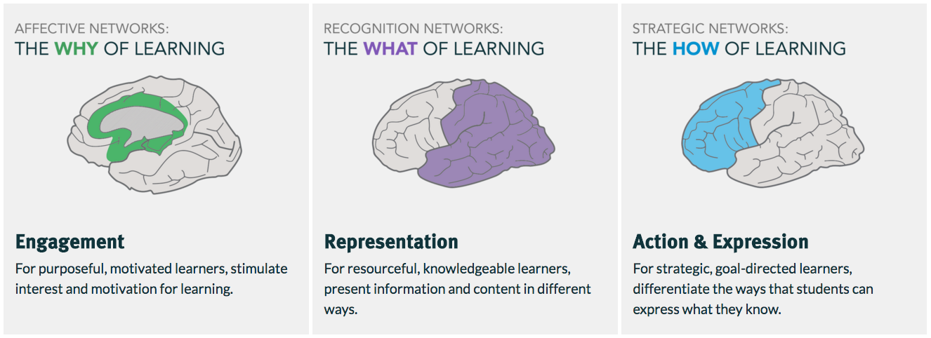
Basic Principles of UDL
How do we motivate our students to learn?
How does information get in our students’ heads?
How do students show their understanding of their learning?

Slide 4


Slide 5


Slide 6
Engage
Motivate!

Slide 7
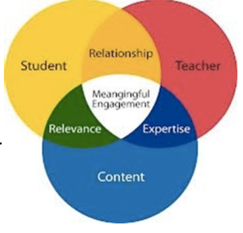
How do we motivate our students?
Help students make connections with the material and the wider world.
Why was this so interesting for YOU in the first place? Tell your story!

Slide 8
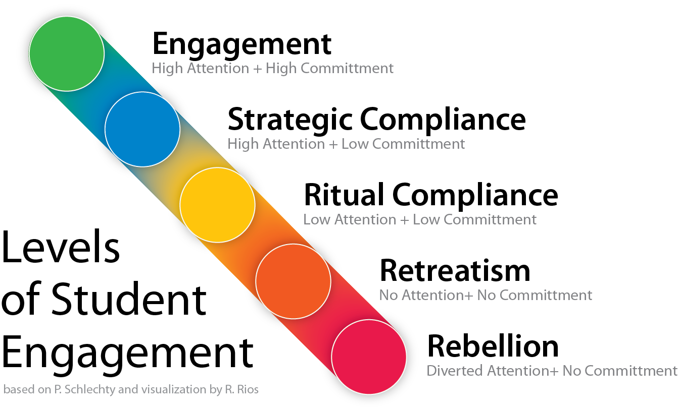

Slide 9
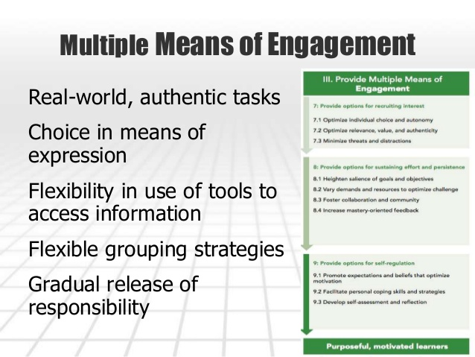


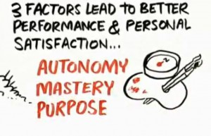

Slide 10
Questions for you on your students’ behalf:
Why even learn this?
What good will it do them?
What good will it do for others?
How many choices do your students have?
Is your class time exciting and/or interesting?
Do you vary the method of delivery?
How can you give students a pathway to make your class their own?

Slide 11
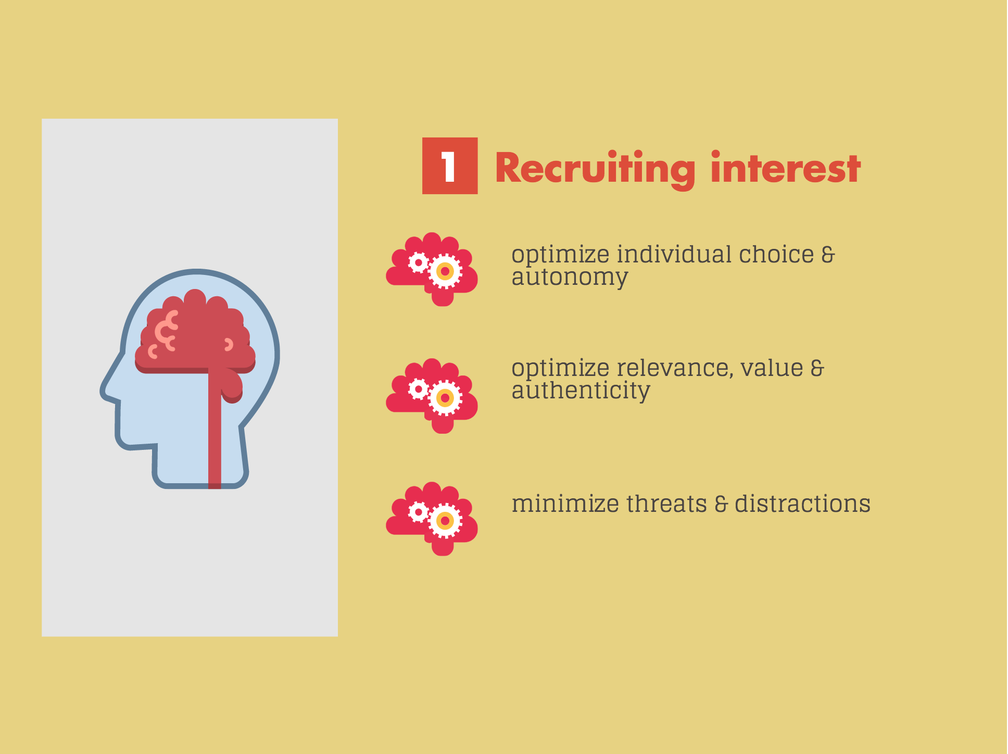

Slide 12


Optimize individual choice & autonomy (w/ Kahoot)
Allow autonomy for tools used in information gathering and/or production (prezi, pecha kucha, powerpoint, tiki toki)
Allow learners to help in design of classroom activities or tasks (how many review days/what kind?)
Allow learner input in setting personal/academic goals (In this class, I want to use what I learn to help me….)

Slide 13
Optimize relevance, value and authenticity (w/Google forms)
Personalize and contextualize activities to learners’ lives (Twitter for discussion, emojis for feedback)
Design activities so that learning outcomes are authentic, communicate to real audiences, and reflect a purpose that is clear to the participants
(final project on youtube/wikipedia)
Allow for exploration and experimentation (improv, Yes, And…, Fortunately, Unfortunately, Many headed monster)

Slide 14
Minimize threats and distractions
Create accepting class environment (all students valued, classroom etiquette in syllabus, involve all students, electronics policy)
Use charts, calendars, schedules, visual clues to what’s next (detailed course calendar)
Options for the unexpected, novel in highly routine activities (getting fake fired)

Slide 15
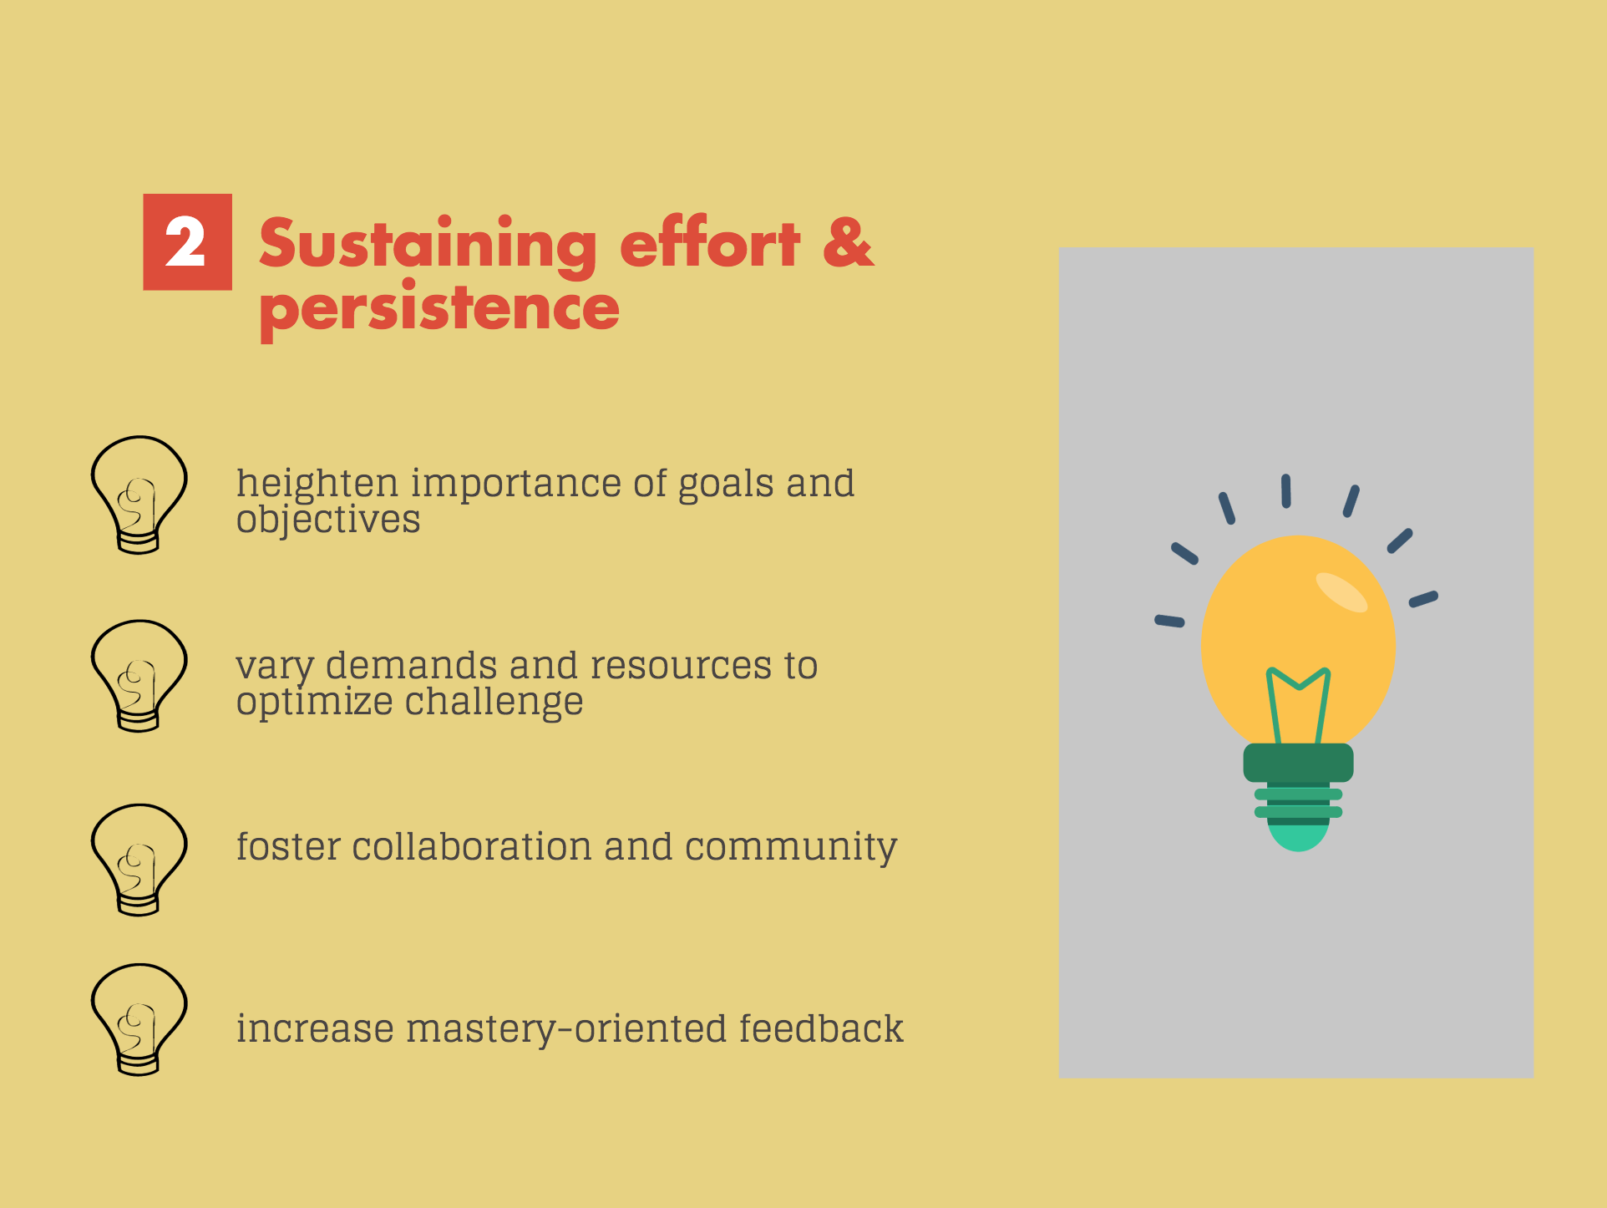

Slide 16


Heighten salience of goals and objectives
Vary demands & resources to optimize challenge
Display goals in multiple ways (Syllabus, infographic, course calendar, assignments)
Divide long-term goals into succession of short-term objectives (Opportunities for learning)
Discuss what constitutes excellence & provide examples (rubrics/ exemplary work)
Learners are motivated in different ways (intrinsic/extrinsic motivation)
Vary degree of difficulty & complexity (high/low stakes)

Slide 17
Foster collaboration and community
Increase mastery- oriented feedback
Create cooperative learning groups (jigsaw)
Encourage opportunities for peer-peer interactions and support (think-pair-share)
Provide frequent, timely and specific feedback (in-class and out-of-class)
Provide feedback that encourages effort and perseverance (not performance- or competition-based)

Slide 18
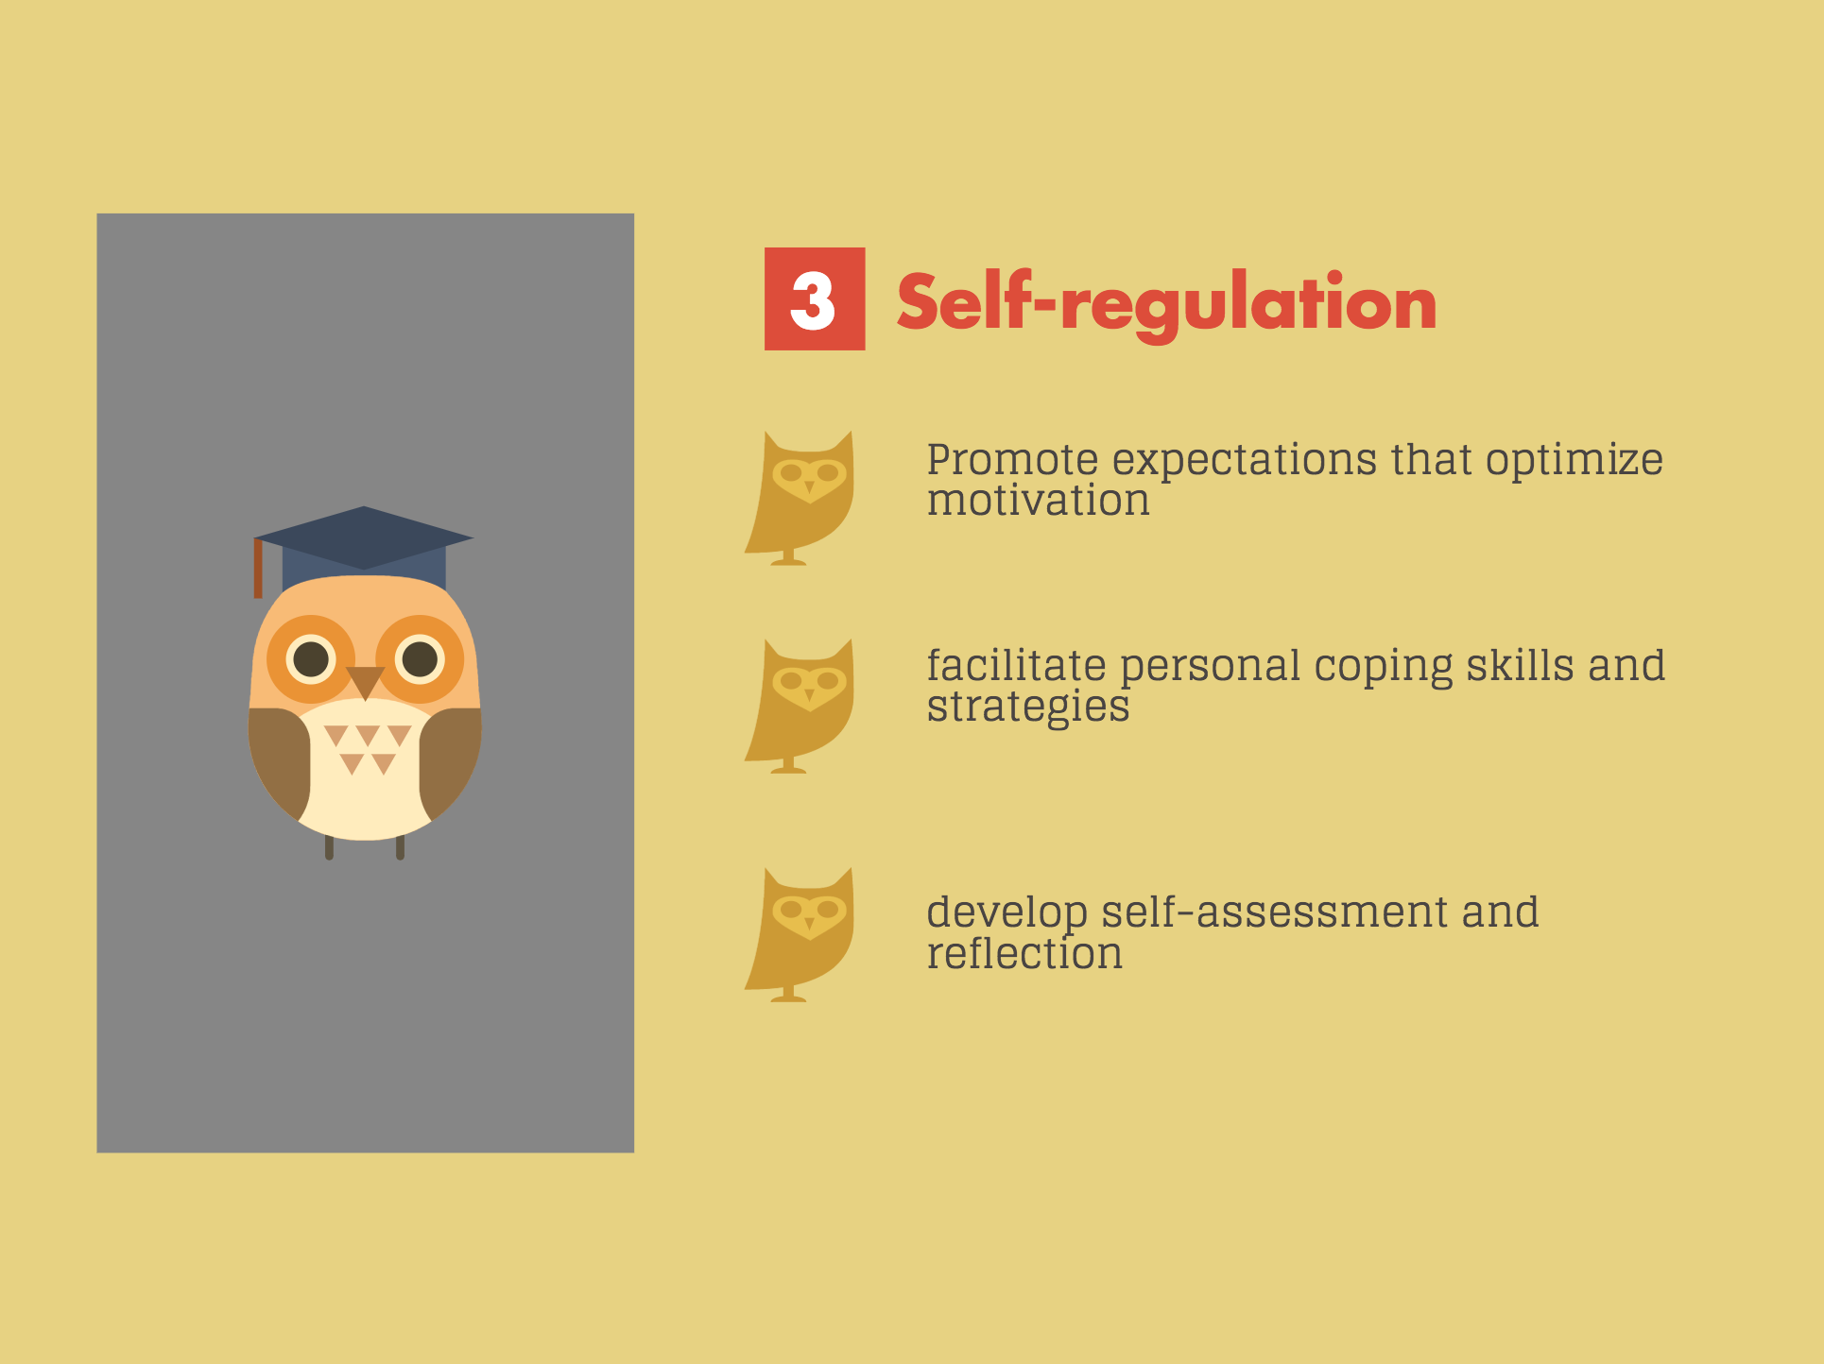

Slide 19


Promote expectations that optimize motivation
Provide prompts, reminders, rubrics, checklists, guides that increase self-reflection (so what, now what?)
Support activities that promote self-reflection (journal entries, reviews, pre-test and post-test exercises)
Provide coaches/mentors to model self-reflection (you!)
Facilitate personal coping skills and strategies
Provide models and feedback to demonstrate coping skills (“OK, we are missing the point, let’s see where we went wrong and how to correct it”)
Model learning approaches (eg., “how can I improve in this difficult area?” rather than, “I’m not good at math”)

Slide 20
Develop self-assessment and reflection
Offer ways in which students can map their progress towards a goal (rubrics, charts, graphic organizers)
Provide class time and throughout the course for student reflection (e-portfolio)
Introduce the idea of metacognition and provide checkpoints throughout the semester to monitor changes in thinking
(what is my thinking on this question now and how is it different from the beginning of the semester?)

Slide 21
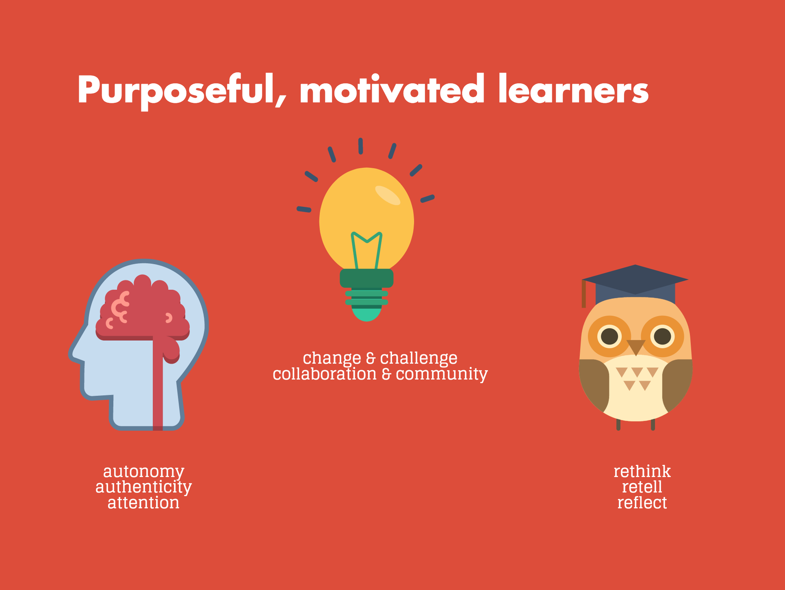

Slide 22
Represent
(Acquisition)

Slide 23





Chances are...
you are probably already doing this...
...can you do more?

Slide 24
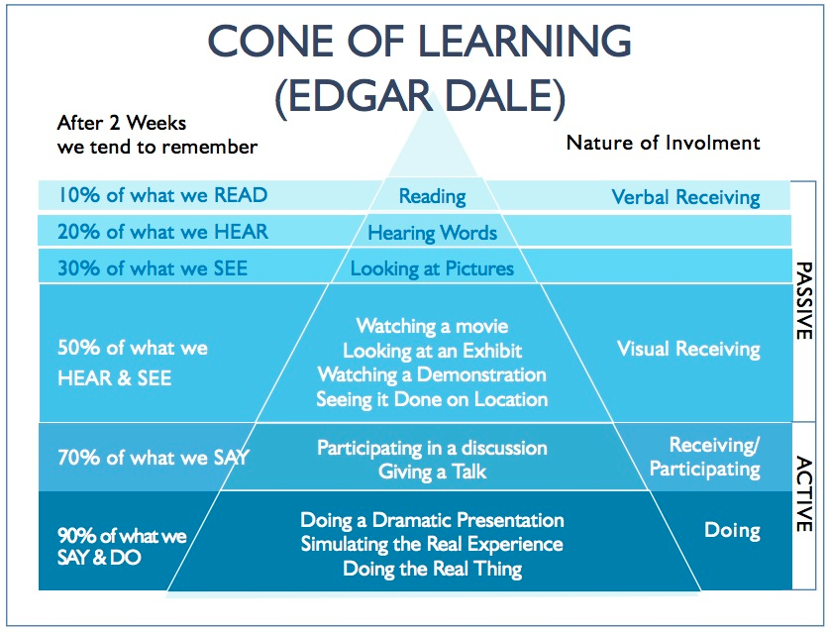

Slide 25
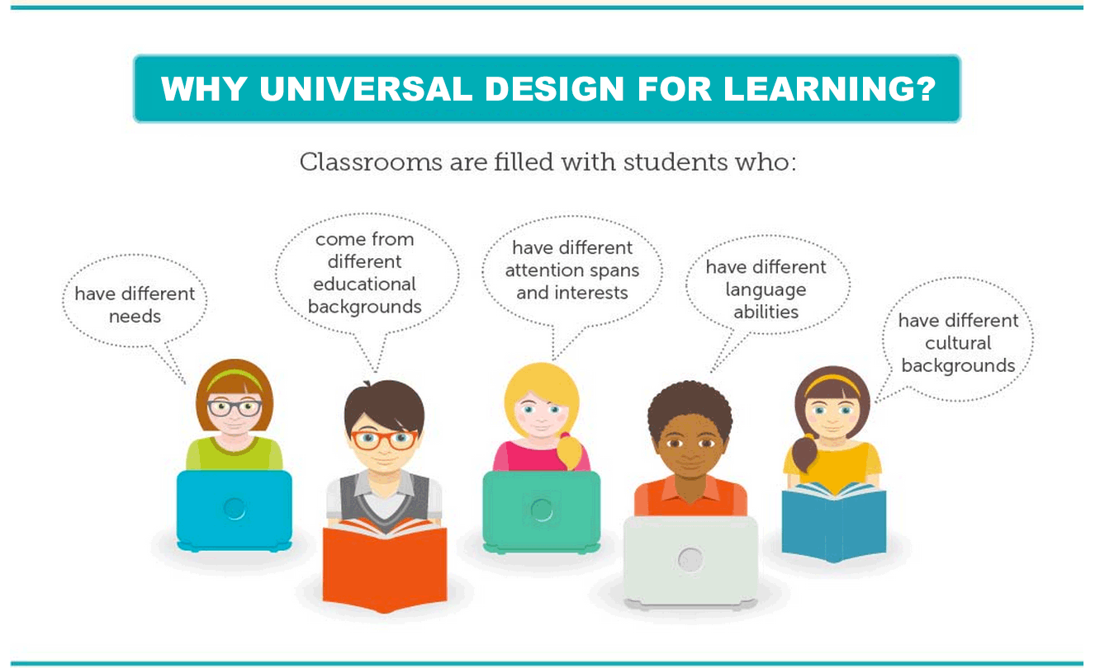

Slide 26
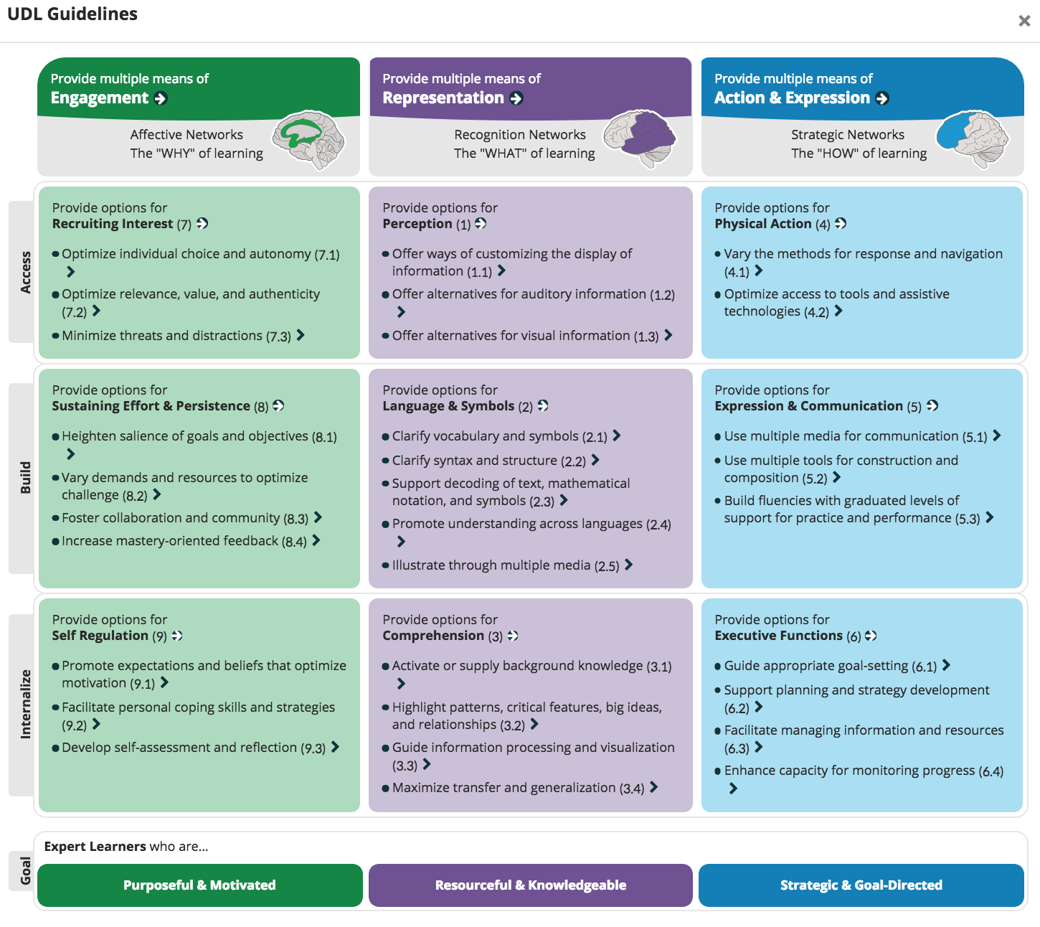
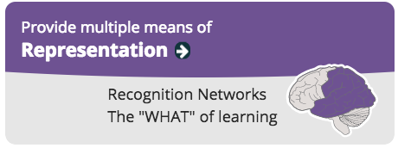
Provide options for:
Perception
1.1 Customize information display
1.2 Alternative to auditory info
1.3 Alternative to visual info
LINK to PERCEPTION

Slide 27

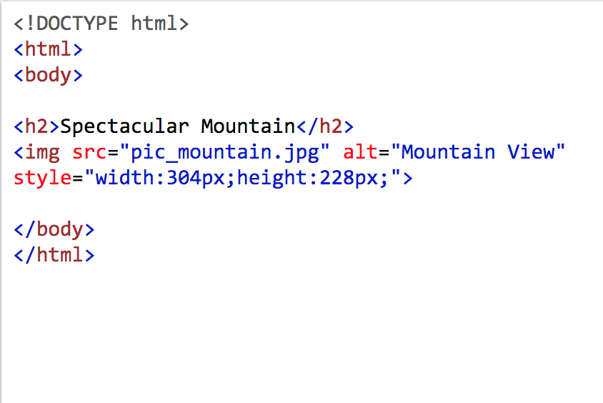

Perception
Learning is impossible if information is imperceptible to the learner
and difficult when information is presented in formats that require extraordinary effort or assistance
Therefore:
Offer ways of customizing the display of information
Notes:
To reduce barriers to learning, it is important to ensure that key information is equally perceptible to all learners by: 1) providing the same information through different modalities (e.g., through vision, hearing, or touch); 2) providing information in a format that will allow for adjustability by the user (e.g., text that can be enlarged, sounds that can be amplified). Such multiple representations not only ensure that information is accessible to learners with particular sensory and perceptual disabilities, but also easier to access and comprehend for many others.

Slide 28



Contrast between background and text/image:
Lighthouse International Effective Color Contrast link

Slide 29
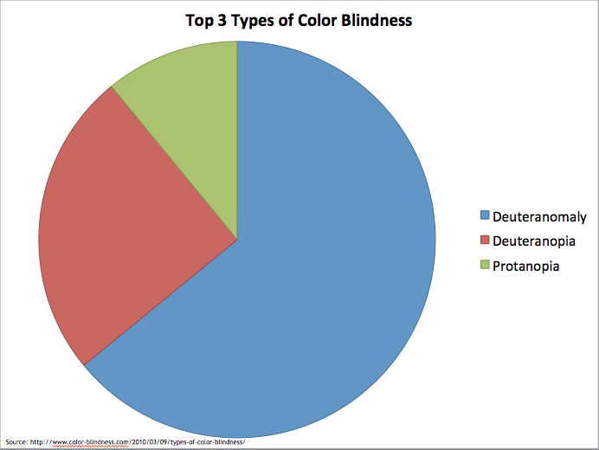
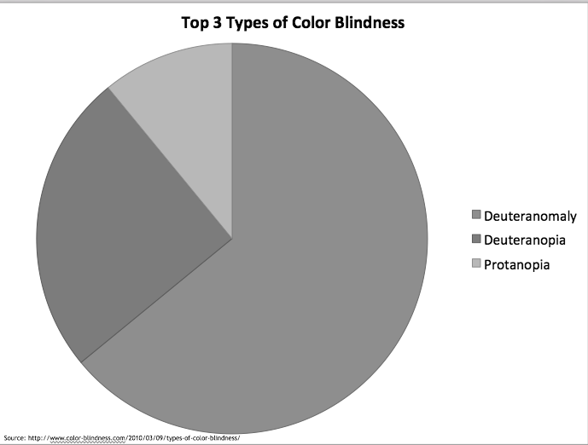
What color you see may NOT be others see:
https://accessibility.umn.edu/core-skills/color-contrast

Slide 30

Use color + patterning for information or emphasis:
https://accessibility.umn.edu/core-skills/color-contrast

Slide 31

Text,
Graphs,
Charts,
Tables,
Images,
And other visual criteria in perceptible formats
Eye chart maker link
How Can I Improve the Look of My Powerpoint Presentation

Slide 32
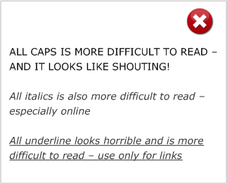

Simplify layout of visual elements &
fonts used

Slide 33

Toolkit for making written material clear and effective

Slide 34

This can be accomplished within the settings of youtube videos, or with a Chrome add-on, or other free web-based sources
The volume or rate of speech or sound
The speed or timing of video or animation

Slide 35

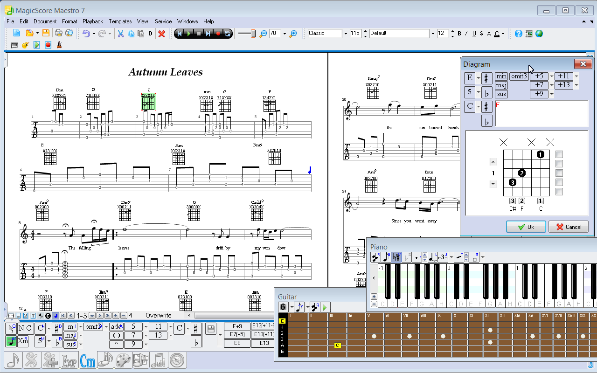
1.2
Offer alternatives for auditory information
Provide visual diagrams, charts, notations of music or sound
Provide visual and/or emotional description for musical interpretation

Slide 36
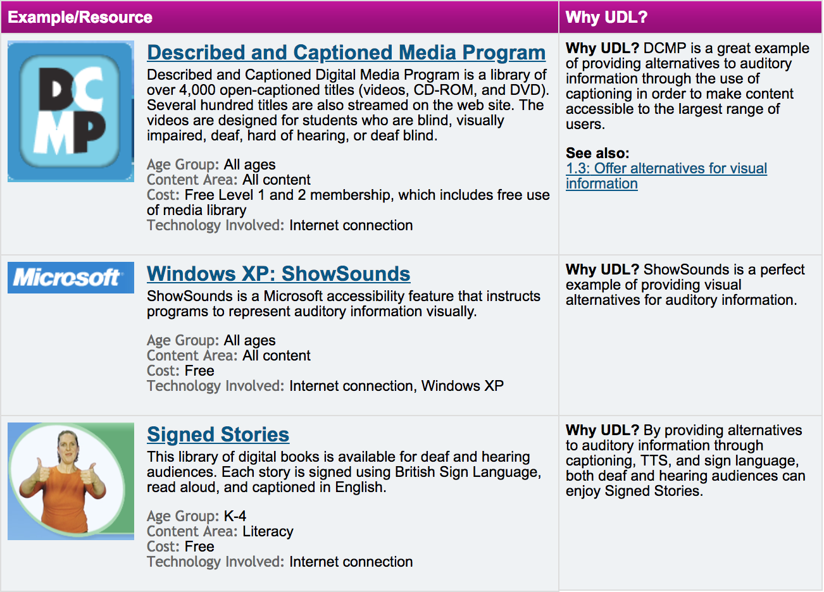

Use text equivalents like captions, speech-to-text (voice recognition) for spoken language
Provide written transcripts for videos & auditory clips
Provide American Sign Language (ASL) for spoken English
UDL center link

Slide 37
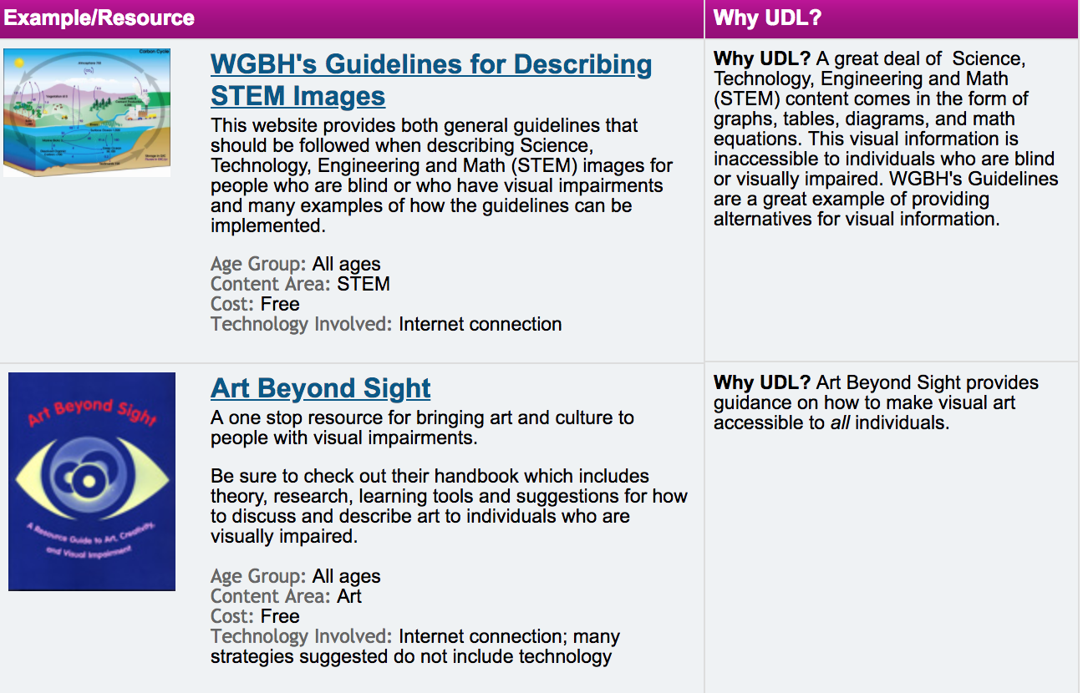

Offer alternatives for visual information
UDL center examples

Slide 38
Provide options for:
Language and Symbols
2.1 Clarify vocabulary & symbols
2.2 Clarify syntax and structure
2.3 Support decoding (text, mathematical notation, symbols)
2.4 Promote understanding across languages
2.5 Illustrate through multiple media

Slide 39
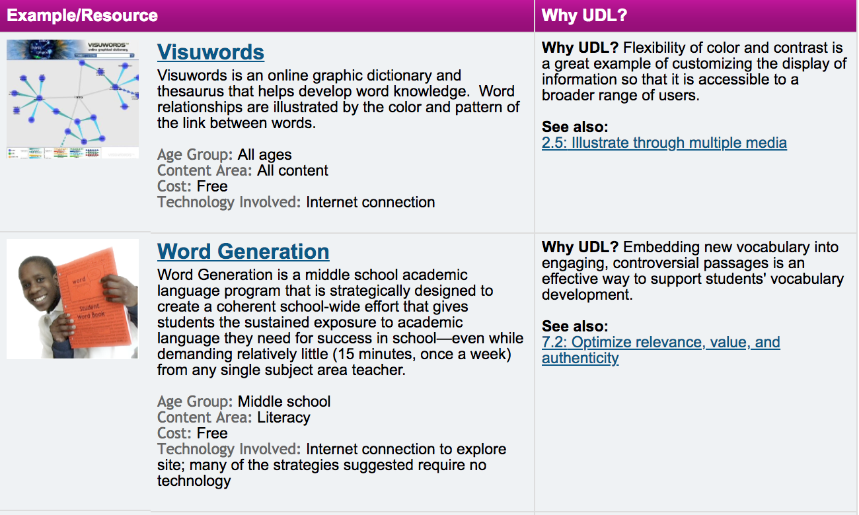
2.1
Clarify vocabulary and symbols
UDL 2.1 examples

Slide 40
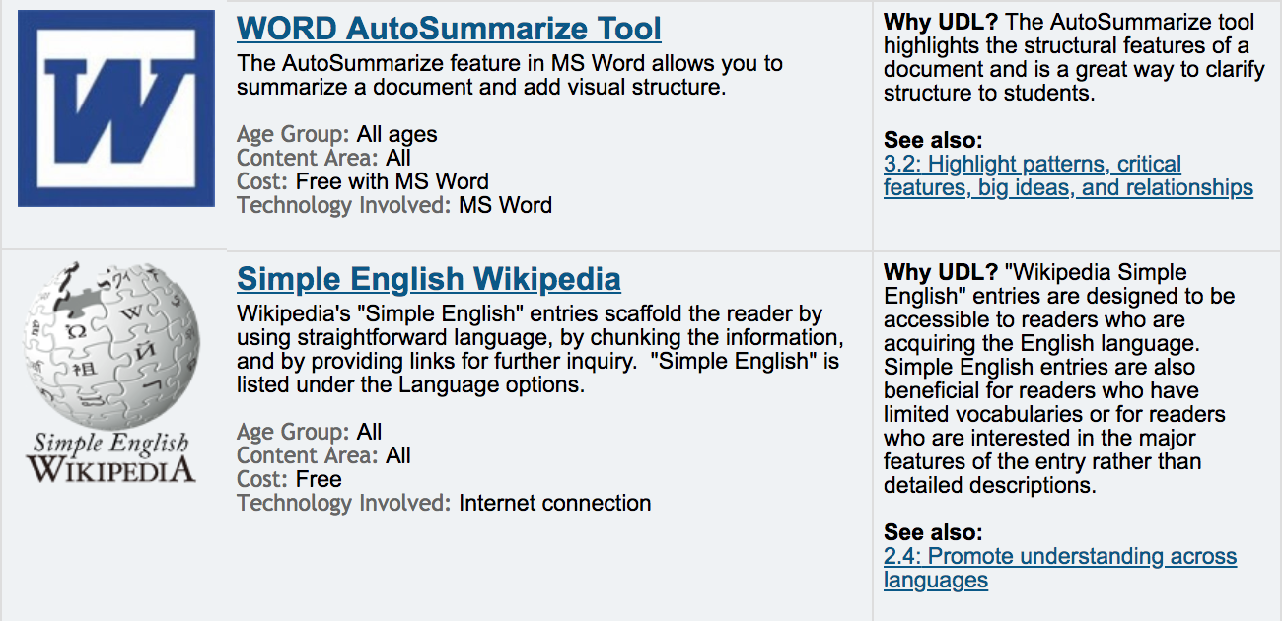
Clarify syntax and structure
2.2
UDL 2.2 guidelines link

Slide 41
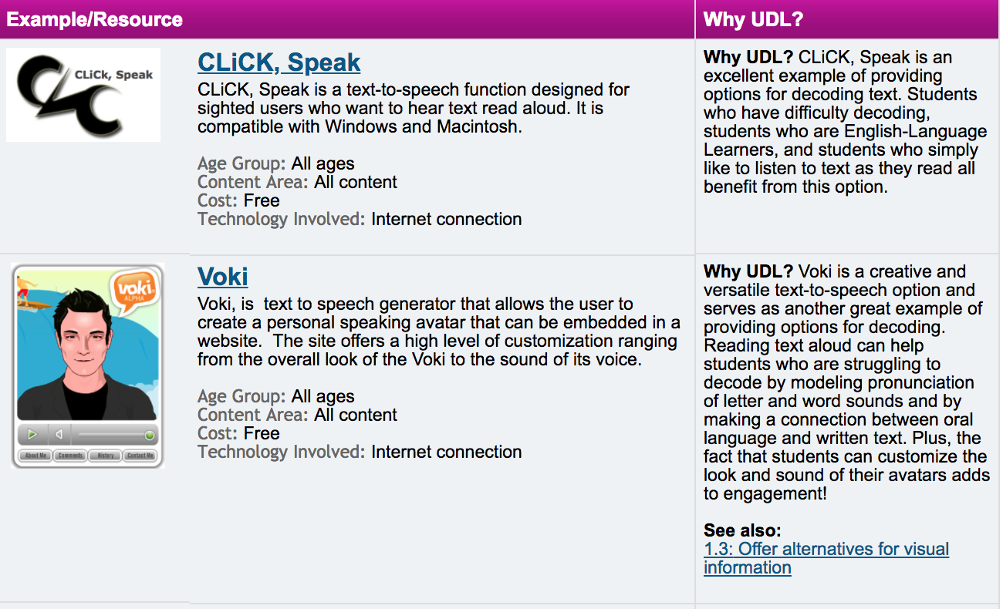
2.3
Support decoding of text, mathematical notation and symbols
UDL resources link 2.3

Slide 42
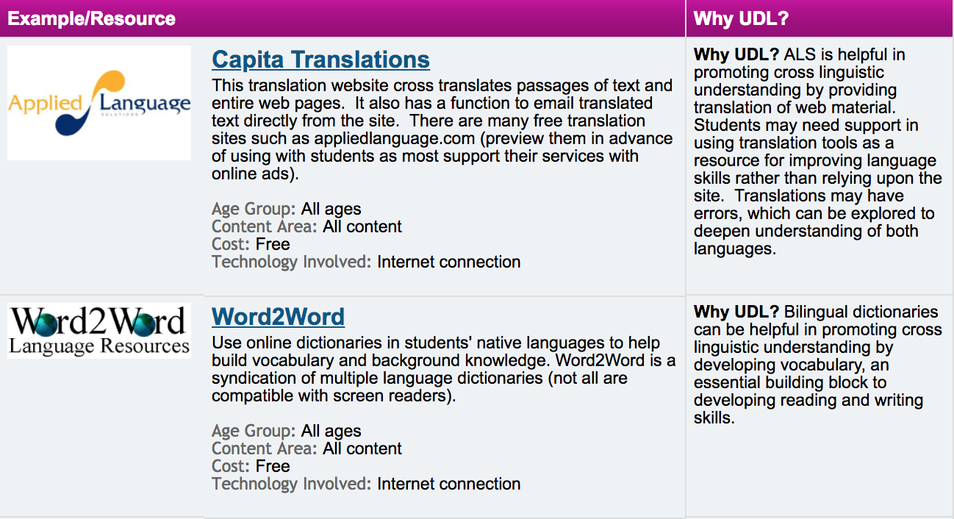
2.4
Promote understanding
across languages
UDL link for 2.4

Slide 43
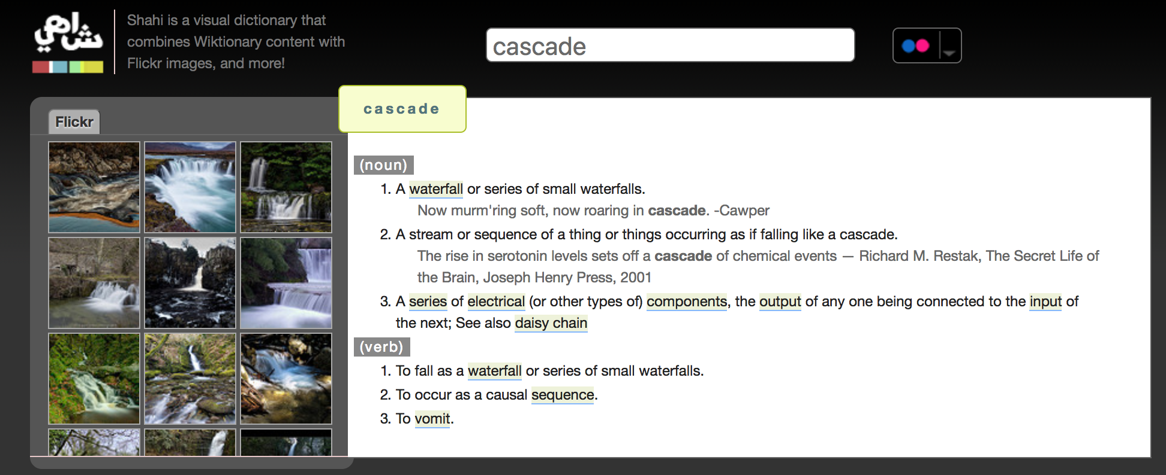
Illustrate through multiple media
UDL 2.5 link
2.5

Slide 44
Provide options for:
Comprehension
3.1 Activate or supply background knowledge
3.2 Highlight patterns, critical features, big ideas, and relationships
3.3 Guide information processing and visualization
3.4 Maximize transfer and generalization

Slide 45
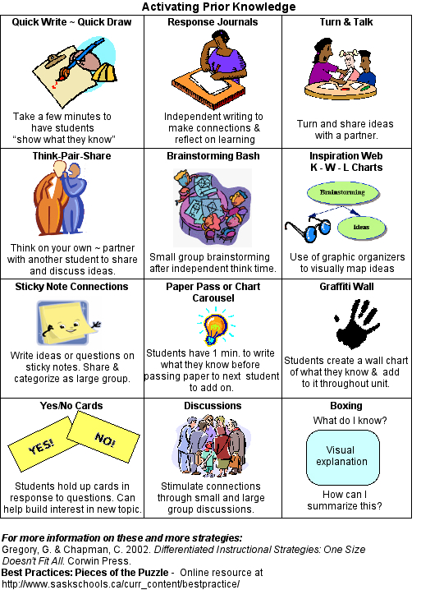
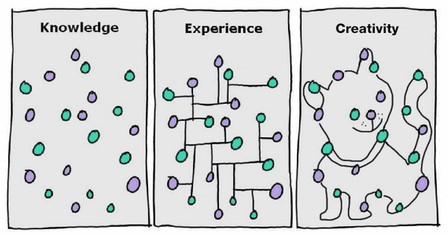
3.1
Activate or supply background knowledge

Slide 46

3.2
Highlight patterns, critical features, big ideas, and relationships

Slide 47
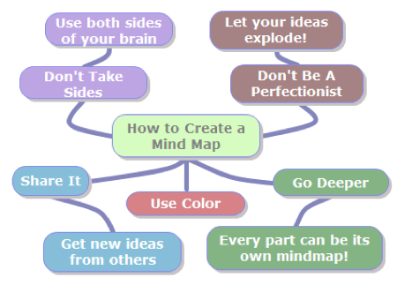
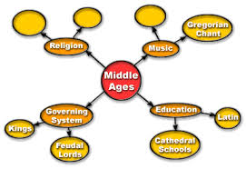
3.3
Guide information processing, manipulation, and visualization

Slide 48
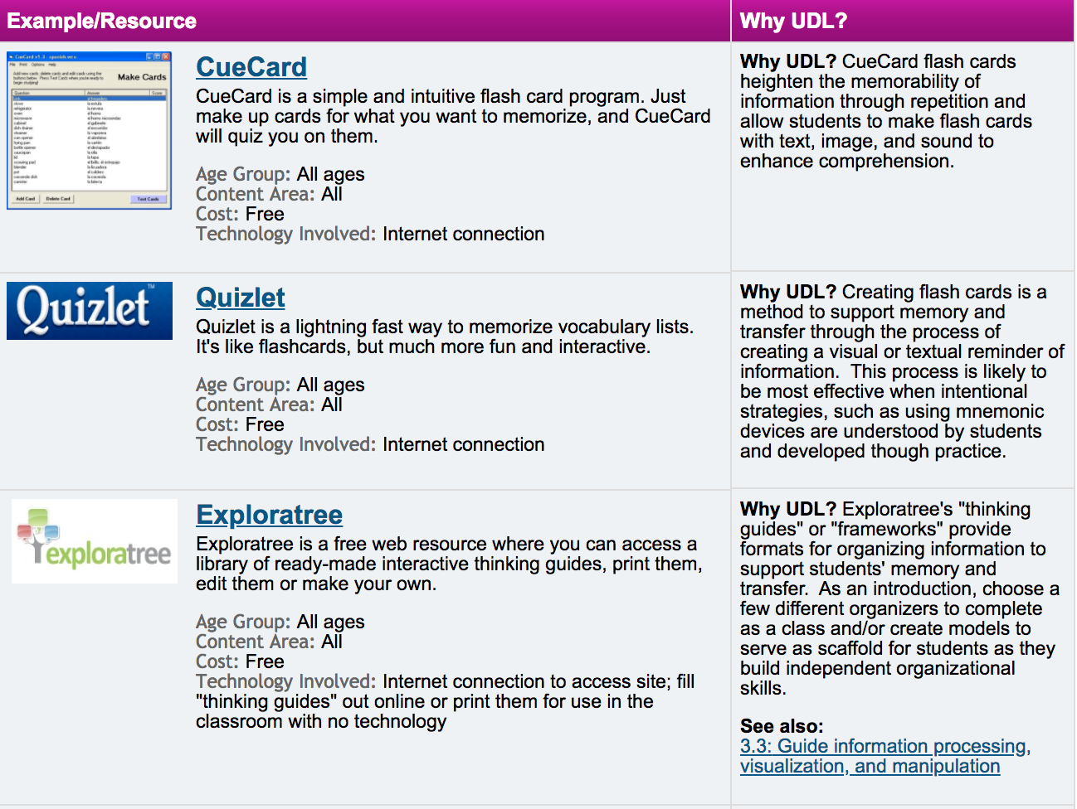
3.4
Maximize transfer and generalization
UDL 3.4 link

Slide 49
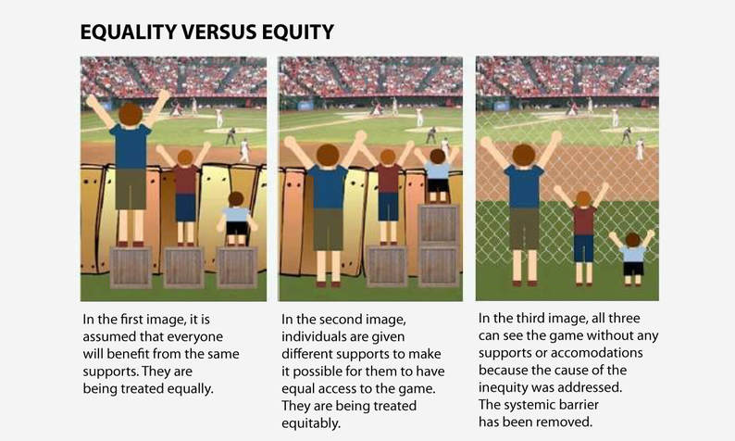

Slide 50
Express
(Action)

Slide 51

Learners differ in the ways they can navigate a learning environment and express what they know.

Slide 52
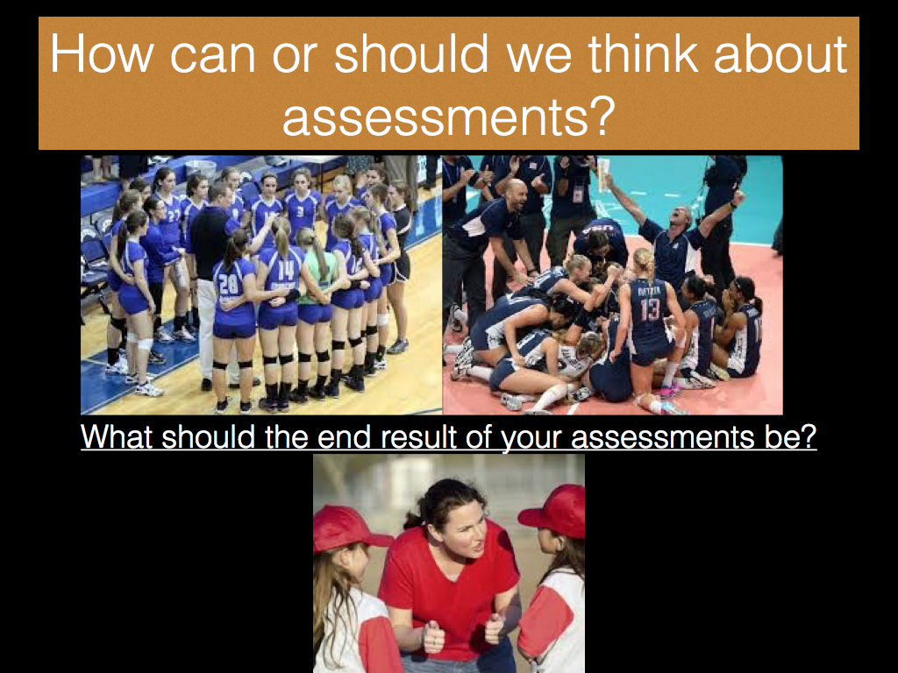

Slide 53
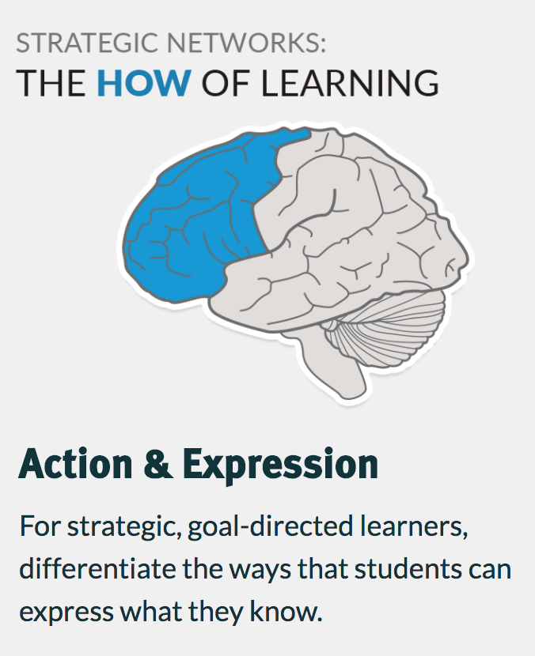
Provide Options for:
Physical Action
Expression & Communication
Executive Functions
Notes:
Learners differ in the ways that they can navigate a learning environment and express what they know. For example, individuals with significant movement impairments (e.g., cerebral palsy), those who struggle with strategic and organizational abilities (executive function disorders), those who have language barriers, and so forth approach learning tasks very differently. Some may be able to express themselves well in written text but not speech, and vice versa. It should also be recognized that action and expression require a great deal of strategy, practice, and organization, and this is another area in which learners can differ. In reality, there is not one means of action and expression that will be optimal for all learners; providing Options for action and expression is essential.

Slide 54

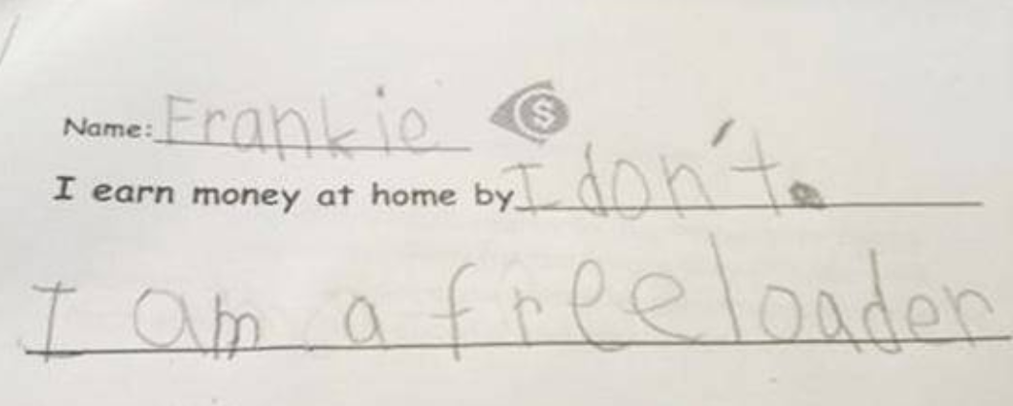
4. Provide Options for Physical Action:
4.1 Vary the methods for response and navigation
Provide alternatives in the requirements for rate, timing, speed, and range of motor action required to interact with instructional materials, physical manipulatives, and technologies
Provide alternatives for physically responding or indicating selections (e.g., alternatives to marking with pen and pencil, alternatives to mouse control)
Provide alternatives for physically interacting with materials by hand, voice, single switch, joystick, keyboard, or adapted keyboard
Voice Thread
Notes:
A textbook or workbook in a print format provides limited means of navigation or physical interaction (e.g., turning pages, handwriting in spaces provided). Many interactive pieces of educational software similarly provide only limited means of navigation or interaction (e.g., using a joystick or keyboard). Navigation and interaction in those limited ways will raise barriers for some learners—those with physical disabilities, blindness, dysgraphia, or who need various kinds of executive functioning supports. It is important to provide materials with which all learners can interact. Properly designed curricular materials provide a seamless interface with common assistive technologies through which individuals with movement impairments can navigate and express what they know—to allow navigation or interaction with a single switch, through voice activated switches, expanded keyboards and others.

Slide 55
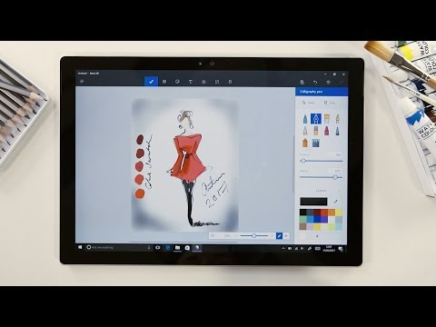
5. Provide Options for Expression & Communication:
5.1 Use multiple media for communication
Compose in multiple media such as text, speech, drawing, illustration, design, film, music, dance/movement, visual art, sculpture or video
Use physical manipulatives (e.g., blocks, 3D models, base-ten blocks)
Use social media and interactive web tools (e.g., discussion forums, chats, web design, annotation tools, storyboards, comic strips, animation presentations)
Solve problems using a variety of strategies
Notes:
Unless specific media and materials are critical to the goal (e.g., learning to paint specifically with oils, learning to handwrite with calligraphy) it is important to provide alternative media for expression. Such alternatives reduce media-specific barriers to expression among learners with a variety of special needs, but also increases the opportunities for all learners to develop a wider range of expression in a media-rich world. For example, it is important for all learners to learn composition, not just writing, and to learn the optimal medium for any particular content of expression and audience.

Slide 56
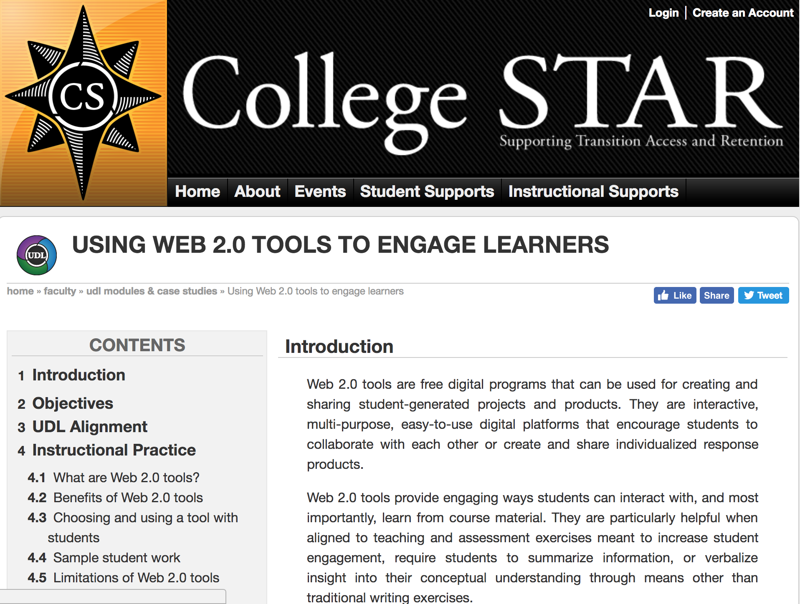
5. Provide Options for Expression & Communication:
5.2 Use multiple tools for construction and composition
Provide spellcheckers, grammar checkers, word prediction software
Provide Text-To-Speech software (voice recognition), human dictation, recording
Provide calculators, graphing calculators, geometric sketchpads, or pre-formatted graph paper
Provide sentence starters or sentence strips
Use story webs, outlining tools, or concept mapping tools
Provide Computer-Aided-Design (CAD), music notation (writing)
software, or mathematical notation software
Provide virtual or concrete mathematics manipulatives
Use web applications (e.g., wikis, animation, presentation)
Using Web 2.0 tools
Notes:
There is a tendency in schooling to focus on traditional tools rather than contemporary ones. This tendency has several liabilities: 1) it does not prepare learners for their future; 2) it limits the range of content and teaching methods that can be implemented; 3) it restricts learners ability to express knowledge about content (assessment); and, most importantly, 4) it constricts the kinds of learners who can be successful. Current media tools provide a more flexible and accessible toolkit with which learners can more successfully take part in their learning and articulate what they know.Unless a lesson is focused on learning to use a specific tool (e.g., learning to draw with a compass), curricula should allow many alternatives. Like any craftsman, learners should learn to use tools that are an optimal match between their abilities and the demands of the task.

Slide 57

5. Provide Options for Expression & Communication:
5.3 Build fluencies with graduated levels of support for practice and performance
Provide differentiated models to emulate (i.e. models that demonstrate the same outcomes but use differing approaches, strategies, skills, etc.)
Provide differentiated mentors (i.e., teachers/tutors who use different approaches to motivate, guide, feedback or inform)
Provide scaffolds that can be gradually released with increasing independence and skills (e.g., embedded into digital reading and writing software)
Provide differentiated feedback (e.g., feedback that is accessible because it can be customized to individual learners)
Provide multiple examples of novel solutions to authentic problems
Merging Silly and Serious for
Creative Expressions of Learning
Notes:
Learners must develop a variety of fluencies (e.g., visual, audio, mathematical, reading, etc.). This means that they often need multiple scaffolds to assist them as they practice and develop independence. Curricula should offer alternatives in the degrees of freedom available, with highly scaffolded and supported opportunities provided for some and wide degrees of freedom for others who are ready for independence. Fluency is also built through many opportunities for performance, be it in the form of an essay or a dramatic production. Performance helps learners because it allows them to synthesize their learning in personally relevant ways. Overall, it is important to provide options that build learners’ fluencies.

Slide 58
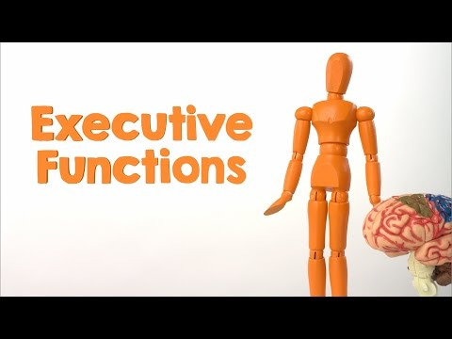
6. Provide Options for Executive Functions:
Notes:
At the highest level of the human capacity to act skillfully are the so-called “executive functions.” Associated with networks that include the prefrontal cortex, these capabilities allow humans to overcome impulsive, short-term reactions to their environment and instead to set long-term goals, plan effective strategies for reaching those goals, monitor their progress, and modify strategies as needed. In short, they allow learners to take advantage of their environment. Of critical importance to educators is the fact that executive functions have very limited capacity due to working memory.This is true because executive capacity is sharply reduced when: 1) executive functioning capacity must be devoted to managing “lower level” skills and responses which are not automatic or fluent thus the capacity for “higher level” functions is taken; and 2) executive capacity itself is reduced due to some sort of higher level disability or to lack of fluency with executive strategies. The UDL framework typically involves efforts to expand executive capacity in two ways: 1) by scaffolding lower level skills so that they require less executive processing; and 2) by scaffolding higher level executive skills and strategies so that they are more effective and developed. Previous guidelines have addressed lower level scaffolding, this guideline addresses ways to provide scaffolding for executive functions themselves.

Slide 59
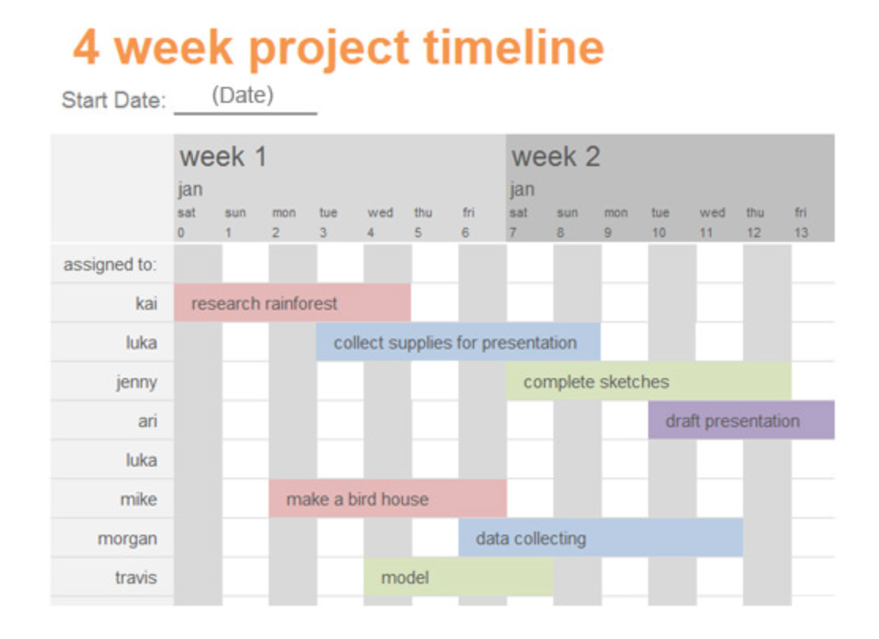
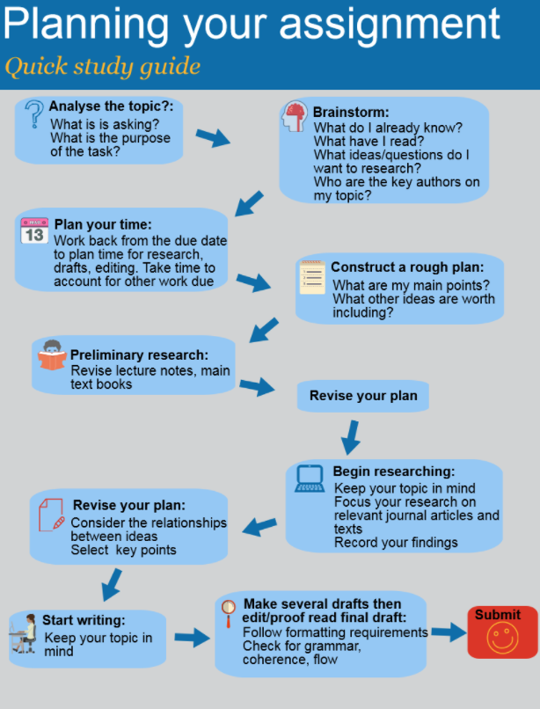
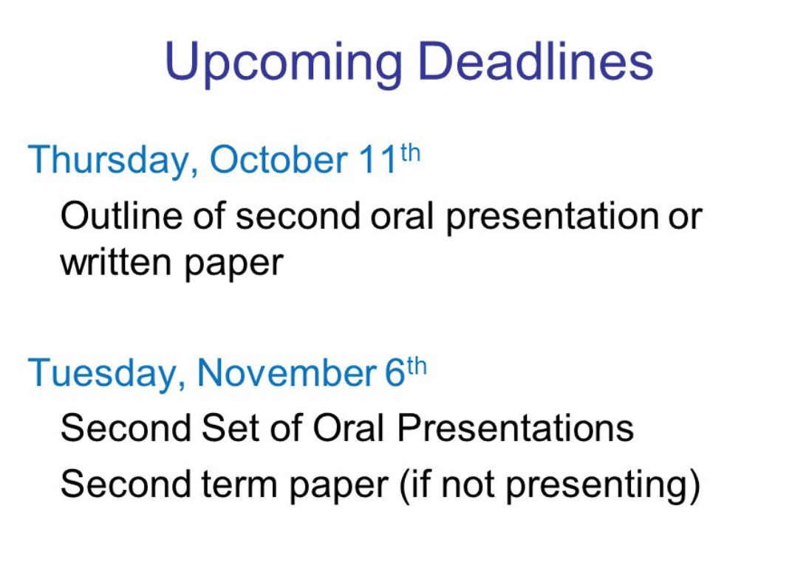
6. Provide Options for Executive
Functions:
6.1 Guide Appropriate goal-setting
Provide prompts and scaffolds to estimate effort, resources, and difficulty
Provide models or examples of the process and product of goal-setting
Provide guides and checklists for scaffolding goal-setting
Post goals, objectives, and schedules in an obvious place
Notes:
It cannot be assumed that learners will set appropriate goals to guide their work, but the answer should not be to provide goals for students. Such a short-term remedy does little to develop new skills or strategies in any learner. It is therefore important that learners develop the skill of effective goal setting. The UDL framework embeds graduated scaffolds for learning to set personal goals that are both challenging and realistic.

Slide 60
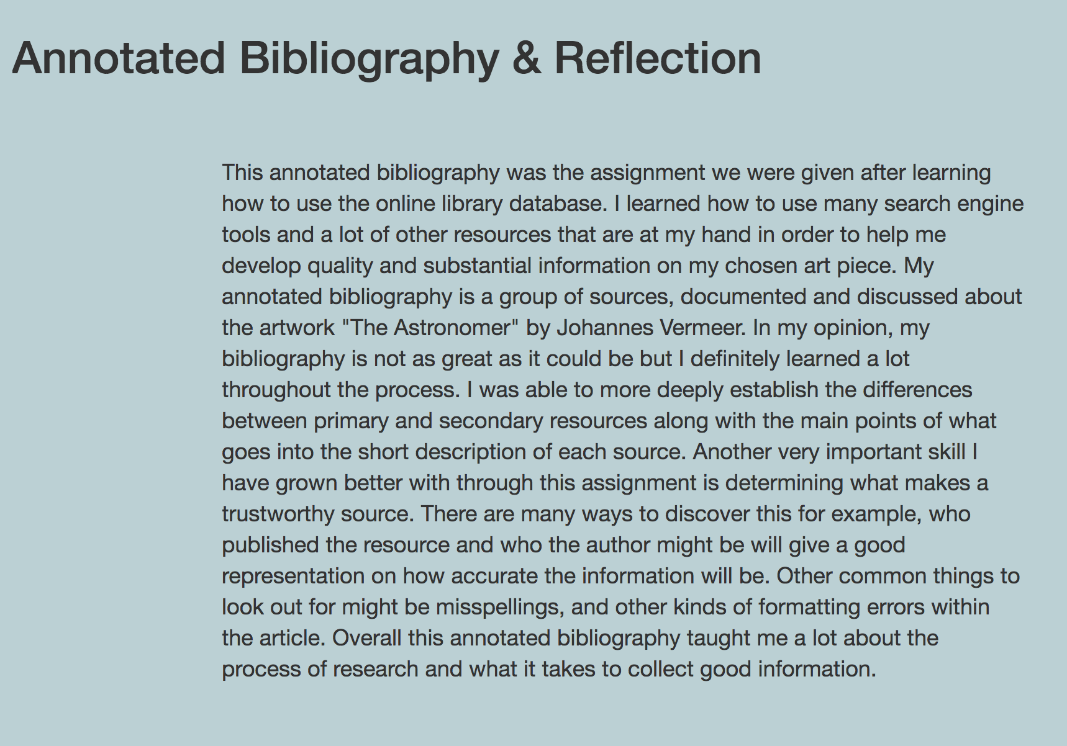
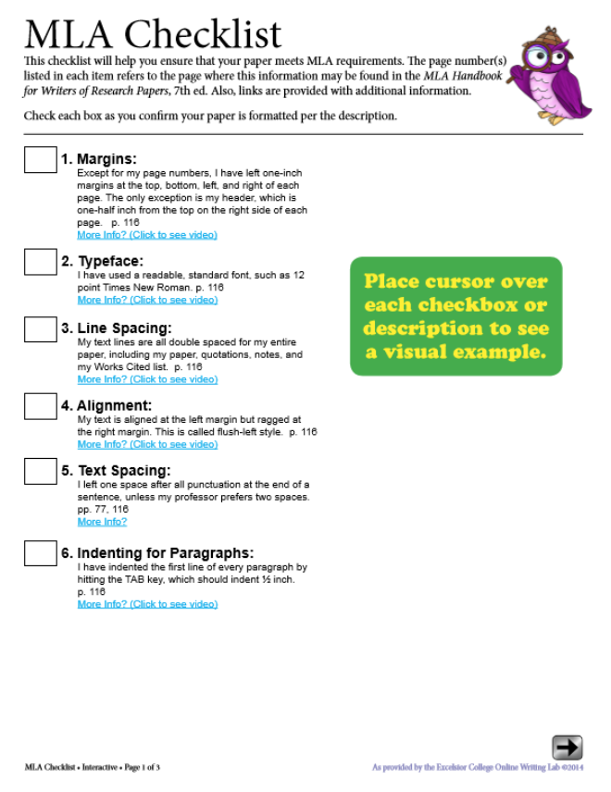
6. Provide Options for
Executive Functions:
6.2 Support Planning and Strategy Development
Embed prompts to “stop and think” before acting as well as adequate space
Embed prompts to “show and explain your work” (e.g., portfolio review, art critiques)
Provide checklists and project planning templates for understanding the problem, setting up prioritization, sequences, and schedules of steps
Embed coaches or mentors that model think-alouds of the process
Provide guides for breaking long-term goals into reachable short-term objectives
Notes:
Once a goal is set, effective learners and problem-solvers plan a strategy, including the tools they will use, for reaching that goal. For young children in any domain, older learners in a new domain, or any learner with one of the disabilities that compromise executive functions (e.g., intellectual disabilities), the strategic planning step is often omitted, and trial and error attempts take its place.To help learners become more plan-full and strategic a variety of options are needed, such as cognitive “speed bumps” that prompt them to “stop and think;” graduated scaffolds that help them actually implement strategies; or engagement in decision-making with competent mentors.

Slide 61
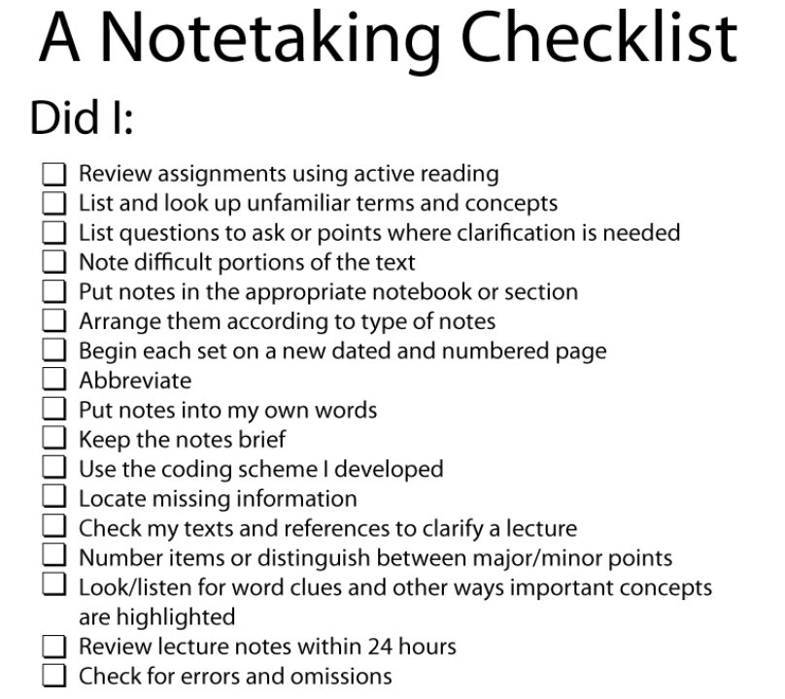
6. Provide Options for Executive Functions:
6.3 Facilitate managing information and resources
Provide graphic organizers and templates for data collection and organizing information
Embed prompts for categorizing and systematizing
Provide checklists and guides for note-taking
Notes:
One of the limits of executive function is that imposed by the limitations of so-called working memory. This “scratch pad” for maintaining chunks of information where they can be accessed as part of comprehension and problem-solving is very limited for any learner and even more severely limited for many learners with learning and cognitive disabilities. As a result, many such learners seem disorganized, forgetful, and unprepared. Wherever working memory capacity is not construct-relevant in a lesson, it is important to provide a variety of internal scaffolds and external organizational aids—exactly those kinds that executives use—to keep information organized and “in mind.”

Slide 62
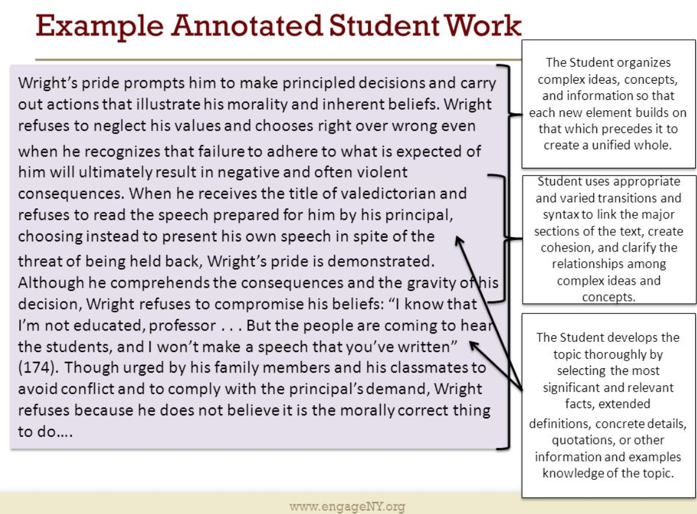
6. Provide Options for Executive Functions:
6.4 Enhance capacity for monitoring progress
Ask questions to guide self-monitoring and reflection
Show representations of progress (e.g., before and after photos, graphs and charts showing progress over time, process portfolios)
Prompt learners to identify the type of feedback or advice that they are seeking
Use templates that guide self-reflection on quality and completeness
Provide differentiated models of self-assessment strategies (e.g., role-playing, video reviews, peer feedback)
Use of assessment checklists, scoring rubrics, and multiple examples of annotated student work/performance examples
Notes:
Learning cannot happen without feedback, and that means learners need a clear picture of the progress that are (or are not) making. When assessments and feedback do not inform instruction or when they are not given to the students in a timely manner, learning cannot change because students do not know what to do differently. This lack of knowledge about what to improve can make some learners seem “perseverative,” careless, or unmotivated. For these learners all of the time, and for most learners some of the time, it is important to ensure that options can be customized to provide feedback that is more explicit, timely, informative, and accessible. Especially important is providing “formative” feedback that allows learners to monitor their own progress effectively and to use that information to guide their own effort and practice.

Slide 63


Slide 64

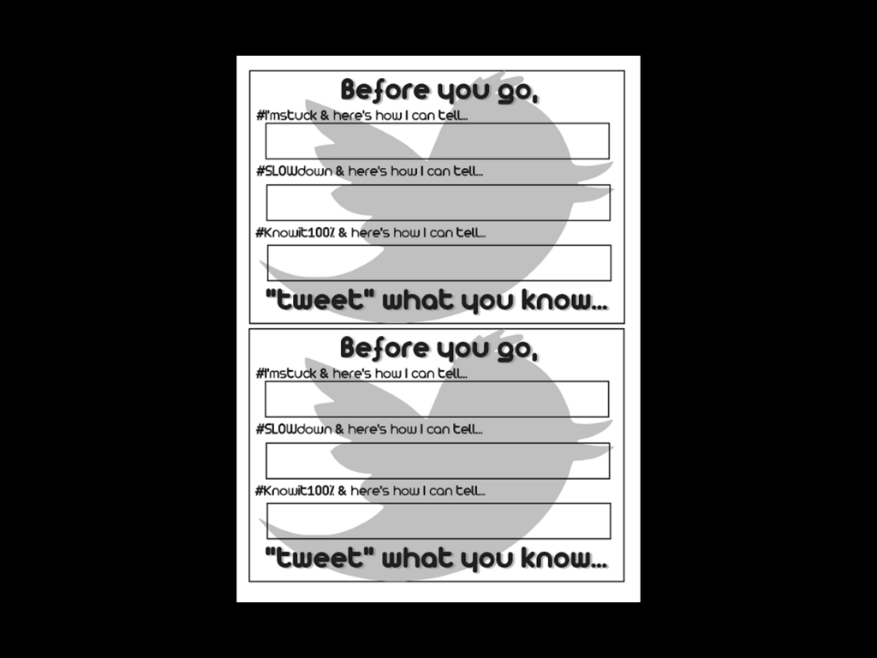

Slide 65
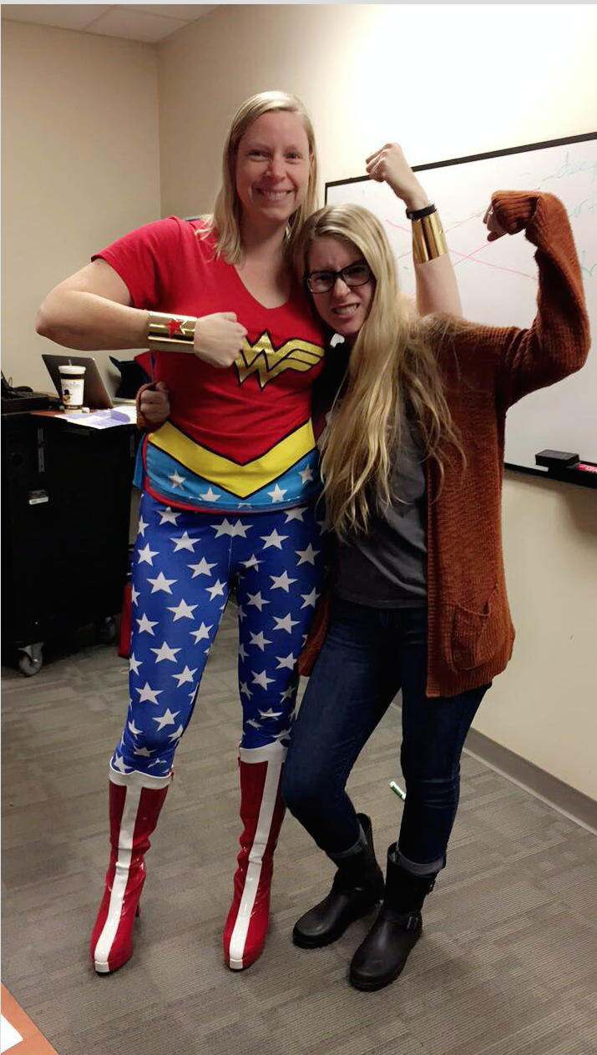
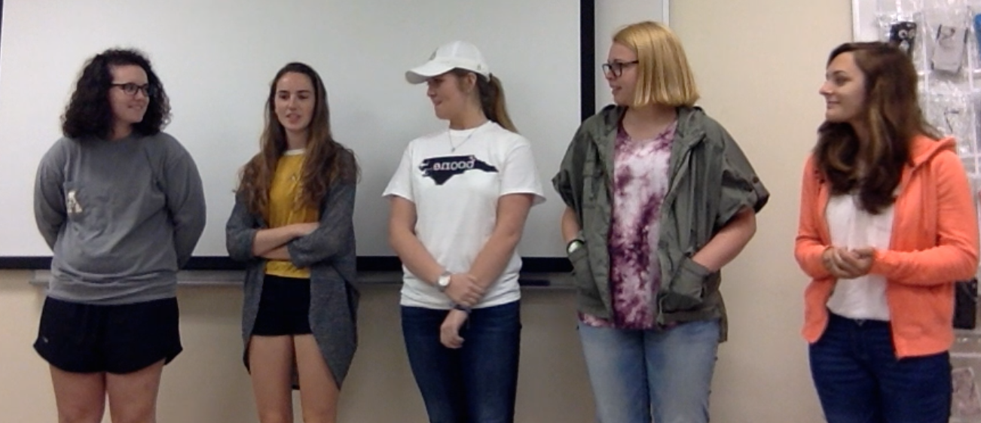


IMPROV TECHNIQUES
Be a superhero to your students

Slide 66
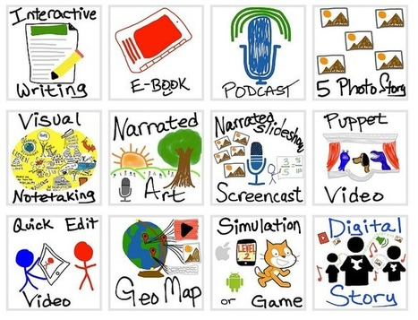
Options
Options
Options
Options
Options

Slide 67
Review

Slide 68
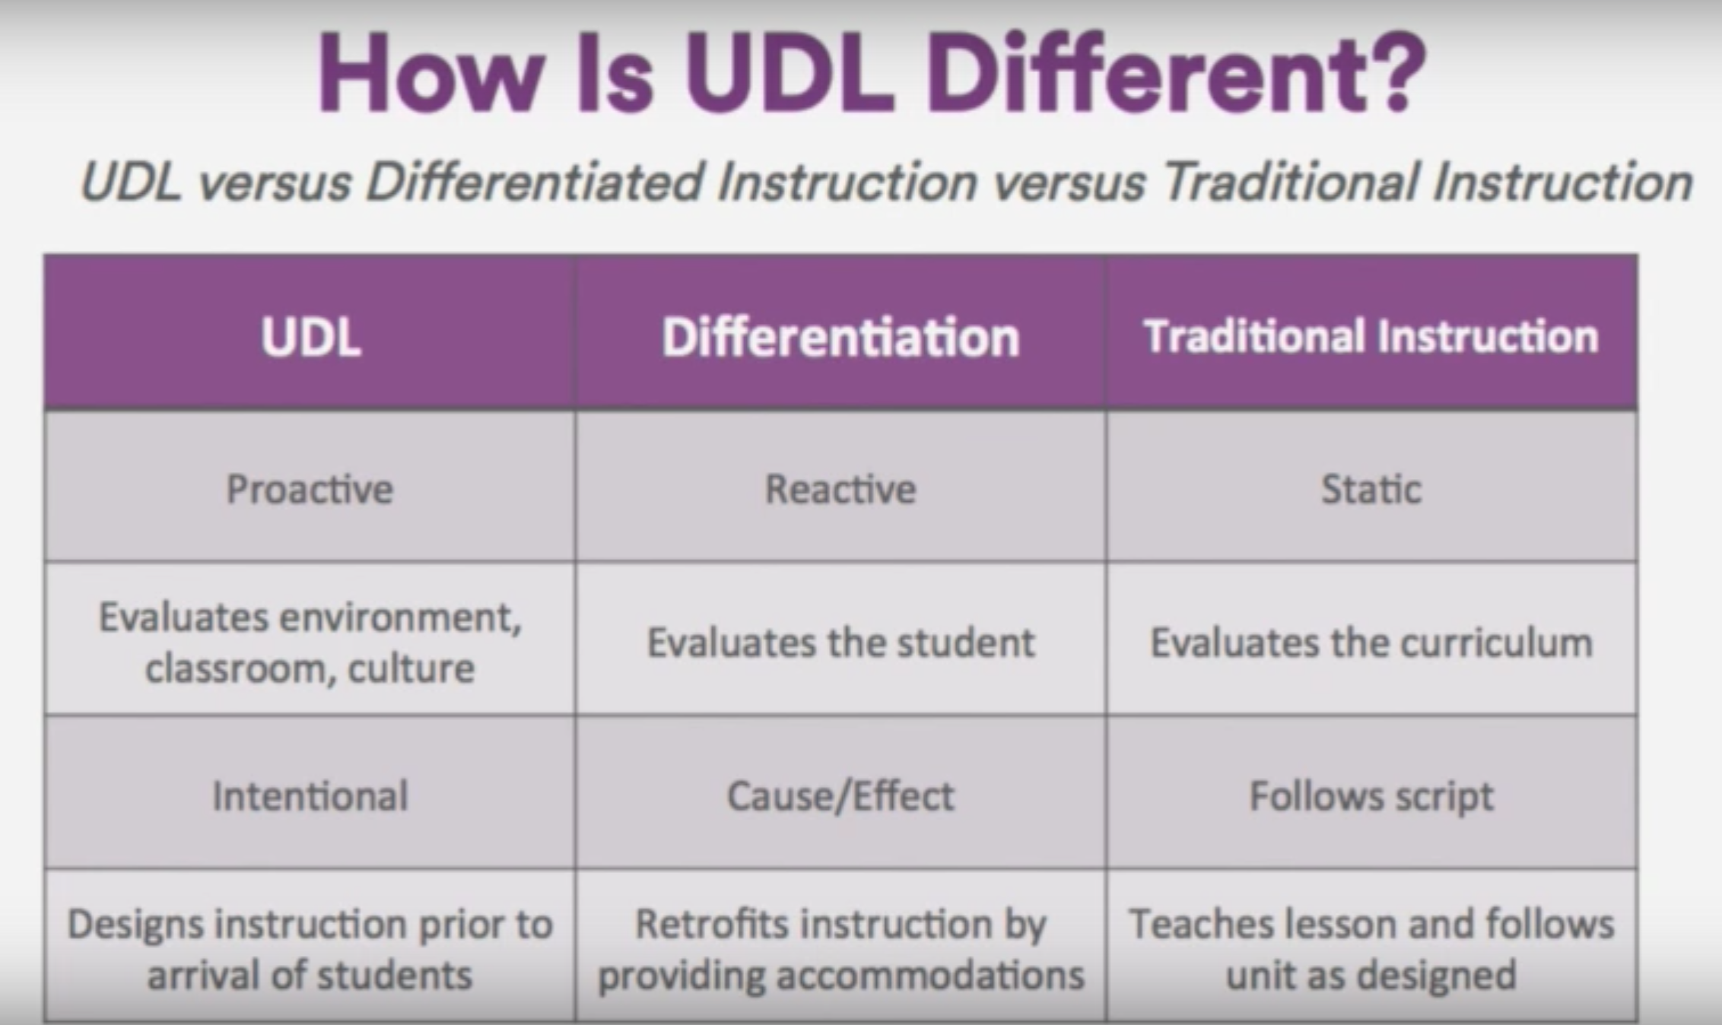

Slide 69


Slide 70
Resources

Slide 71

Link to UDL guidelines

Slide 72

collegestar.org

Slide 73

Lillian Nave
navely@appstate.edu
Senior Lecturer, University College
UDL Coordinator,
Center for Academic Excellence
Appalachian State University

