Slide 1
Distance Learning: Thru a Malawi Lens :
Presented by
Rusty Presley, Auburn University
James Witte, Auburn University

Slide 2
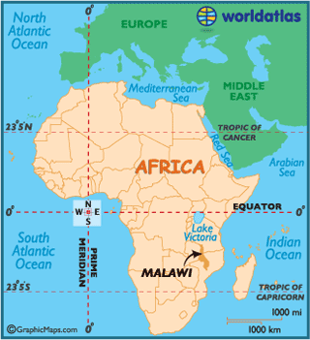
Background

Slide 3
The People
“The Warm Heart of Africa”
Small country / big lake
One of world’s least developed countries
Low life expectancy – Hi infant mortality (AIDS Factor)
Language: English (0fficial) Chichewa (common)
Historically Malawians left country to seek work
School life expectancy: 11 years
Unemployment: total: 8.6%
male: 9.1%
female: 8.2% (2013 est.)

Slide 4
Economy
Agriculture
Tobacco
Sugarcane
Tea
Wood products
Malawi Gold
Cement
Consumer goods
80% of population farms
Agriculture is only 27% of GDP

Slide 5
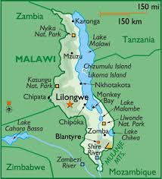
Education

Slide 6
Education Opportunity
There are four public universities in Malawi namely:
Mzuzu University
Lilongwe University of Agriculture and Natural Resources
Malawi University of Science and Technology and
University of Malawi has the following constituent colleges:
Chancellor College
College of Medicine
Kamuzu College of Nursing
The Polytechnic

Slide 7
Overview of Platform
Hardware housed in Malawi on local networks.
Not dependent on an internet connection.
Video Content Management ​and Capture System​ (VCMS) – Panopto
Can integrate with a Learning Management System (LMS) – like Moodle, Sakai, etc.

Slide 8
What is Panopto
Panopto supports the capture of any content, screen or PowerPoint, with audio or video overlay, from your computer or other computers that you use.
Automatically uploads and publishes it to the server http://auburn.odl.ac.mw for web-rich viewing.
Automatically creates audio and video podcast, RSS feed, HTML links and embed codes.
Uses Optical Character Recognition (OCR) for written items on your computer screen, or whiteboard.

Slide 9
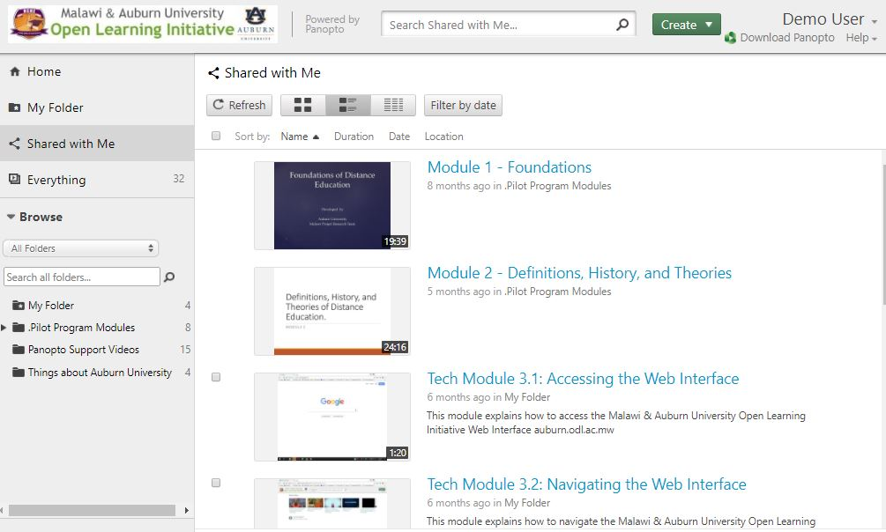
https://auburn.odl.ac.mw - Authenticated

Slide 10
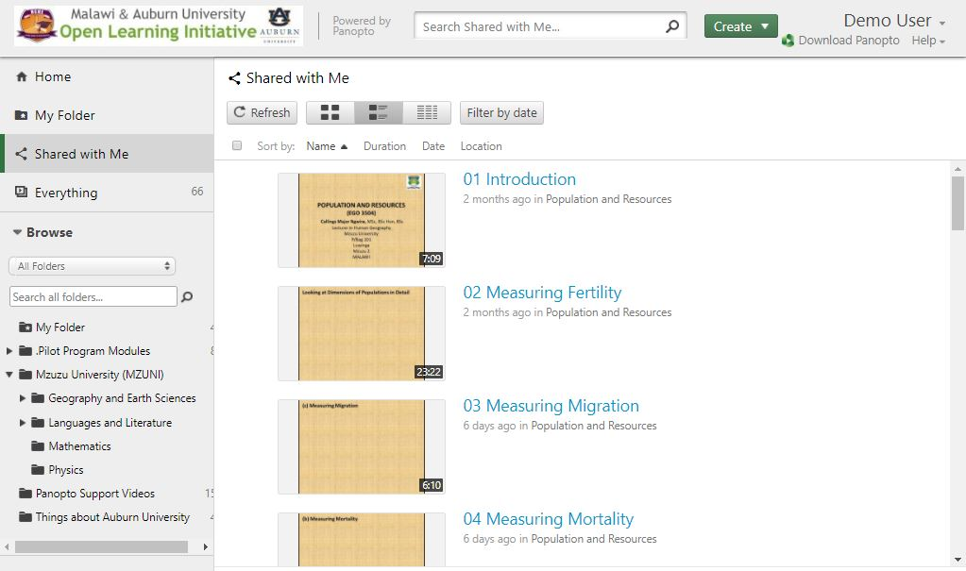
https://auburn.odl.ac.mw - Student

Slide 11
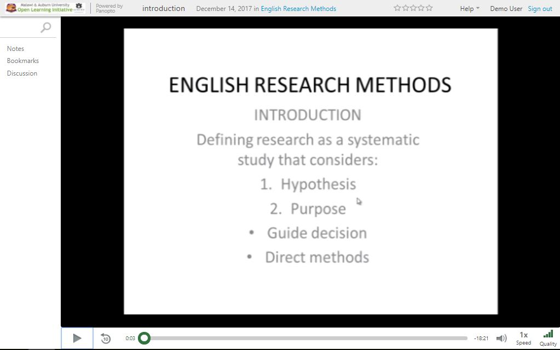
https://auburn.odl.ac.mw - Course

Slide 12

https://auburn.odl.ac.mw - Course Callings Major Ngwira – Lecturer – Mzuzu University

Slide 13
Initiative Objectives
Servers and software that will allow:
The instructors to create and publish courses programs:
From their office, home, field, classroom, etc.
Build a curriculum database tailored for Malawi
The learners to access programs and courses in multiple ways:
Online: Web-based web-rich, video or audio podcast.
Offline: video or podcast, which can be delivered over traditional broadcast media

Slide 14
How else it can be used.
Academic – Review, Contingency, Instruction
Emergency Response
Internal training
Specialized Trainings
Special Events from the Field
Public Programs

Slide 15
Summary
Questions
Comments
Observations

