Slide 1
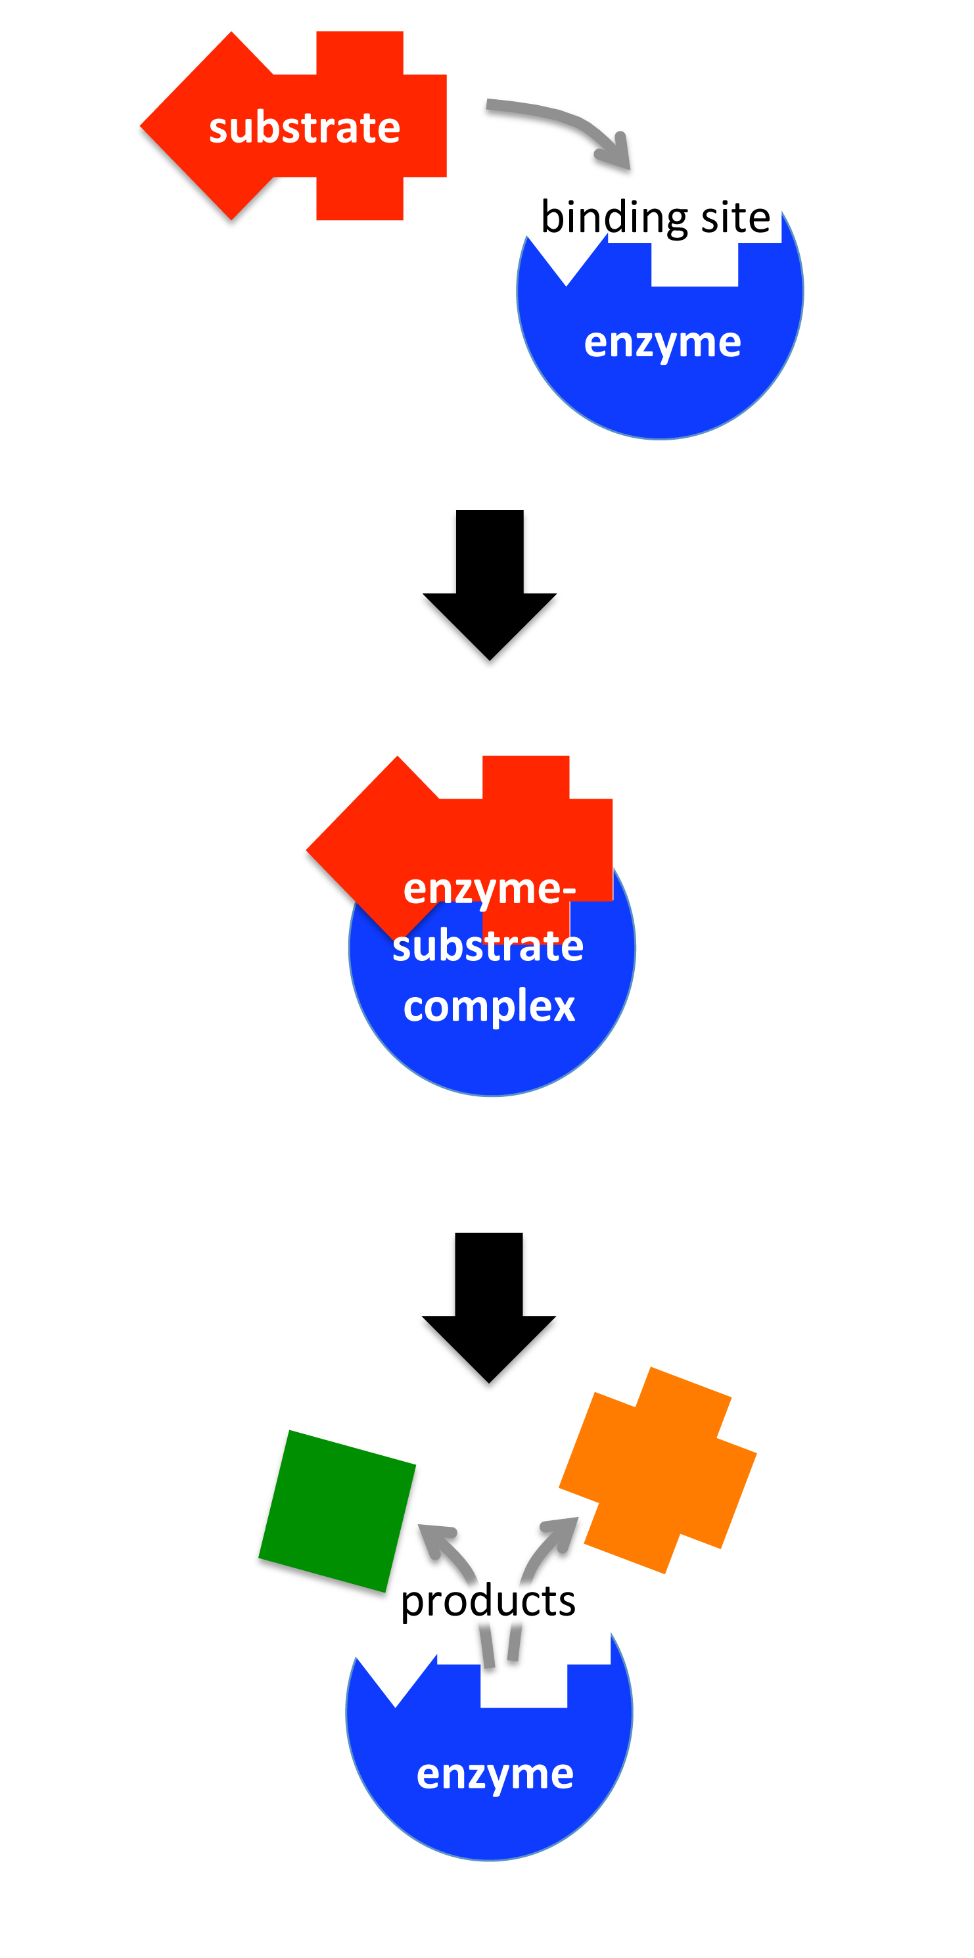
Enzymes are proteins found in all living cells that speed up naturally occurring reactions.
Cells have thousands of different types of enzymes.
When a substrate attaches to the binding site of a enzyme, the enzyme facilitates rapid production of products.
Enzymes may require one or multiple substrates to function.
Enzymes may contribute to the production of one or more products

Slide 2
What are the two products described in your reading?

Slide 3
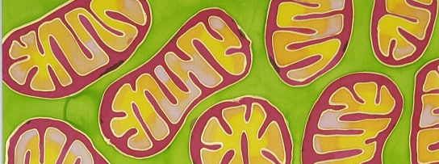
The mitochondrion houses several different kinds of enzymes.
There enzymes complexes that are involved in making ATP during cellular respiration.
There are enzymes involved in preventing damage from free radicals during cellular respiration.
Free radicals
Free radicals
Free radicals
ATP
The electron transport chain of the mitochondria produces ATP.
It also produces a small amount of free radicals as a by-product of ATP production

Slide 4
Catalase is a special type of enzyme called an antioxidant. Antioxidants convert free radicals to a less toxic compound.
Specifically, catalase converts hydrogen peroxide to water and oxygen.
Free radical (O₂.)
ATP
Antioxidant called superoxide dismutase
2 H₂O₂
2 H₂O
H₂O
H₂O
H₂O₂
H₂O₂
H₂O₂
H₂O₂
Catalase
O₂
O₂

Slide 5
Dr. Hood’s lab measures the amount of catalase produced by differ organs to understand how the organs respond to activities that alter free radical production by the mitochondria.
What organ do you think Dr. Hood’s lab typically measures the most catalase in per gram of tissue?
Liver
Skeletal muscle

Slide 6
Here is data from Dr. Hood’s lab where they measured the amount of catalase produced by non-reproductive mice and reproductive mice to understand if the stress of reproduction has on the mitochondria.
Results from a recent Hood lab study.
Non-reproductive mice
Reproductive mice

