Slide 1

Data analysis is used to characterize and determine the strength of patterns within a researcher’s data.
Notes:
AP Biology Quantitative Skills Manual

Slide 2
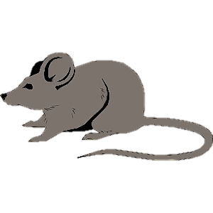
Example: Data from Dr. Hood’s lab at Auburn University
Mice that reproduced
Experimental group
Mice that did not reproduce
Control group
ID | Mitochondrial Respiration (mmole O²/min)
345 | 34.2
567 | 46.7
455 | 40.3
982 | 29.5
123 | 44.5
876 | 35.9
ID | Mitochondrial Respiration (mmole O²/min)
724 | 71.6
111 | 45.2
456 | 60.5
745 | 63.4
392 | 42.0
693 | 68.3

Slide 3
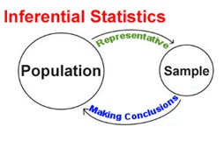
Inferential statistics involves inferring values in a natural population from a sample. Dr. Hood and her students use inferential statistics to characterize patterns that are common to mice.
Notes:
AP Biology Quantitative Skills Manual

Slide 5
All 6 month old mice that have reproduced 1 time
All 6 month old mice that have never reproduced
What was the sample size for each group?
Why didn’t Dr. Hood and her students measure mitochondrial respiration for all of the mice?
Notes:
It would be very time consuming and expensive to measure all of the mice in the world that fall into these categories.
House mice live on every continent except Antarctica. Indeed measuring mitochondria respiration would be impossible.
Instead, we select a sample that we believe will be a good representative of all mice in that category.

Slide 6
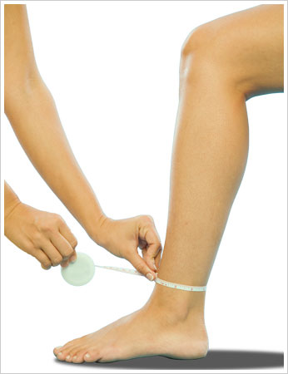
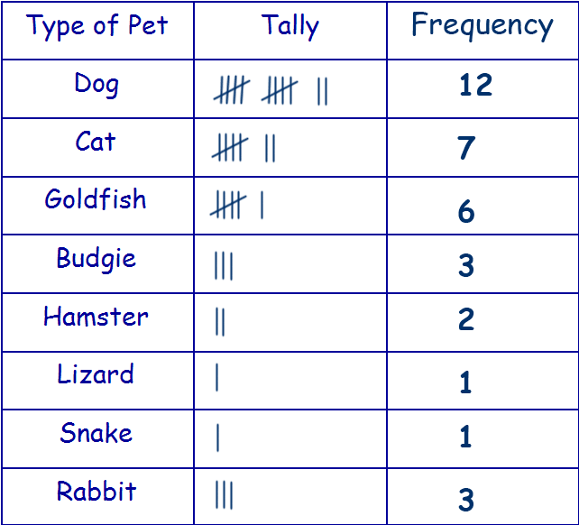
Most of the data you will collect will fit into two categories: measurements or counts.
Measurement data
Count data
Notes:
AP Biology Quantitative Skills Manual

Slide 7
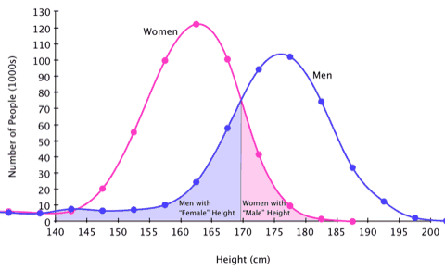
Most measurements are continuous, meaning there is an infinite number of potential measurements over a given range.
Notes:
AP Biology Quantitative Skills Manual

Slide 8
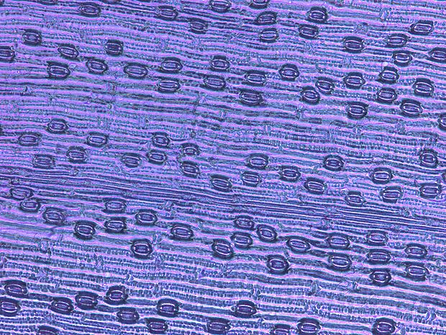
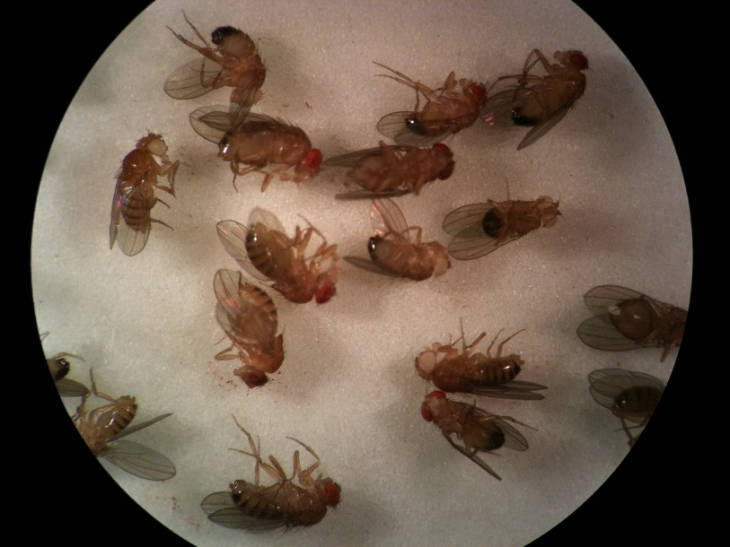
Count data are recordings of qualitative, or discrete, data.
Number of leaf stomata
Number of white eyed individuals
Notes:
AP Biology Quantitative Skills Manual

Slide 9
Quantifying respiration in mitochondria represent measurement data. Dr. Hood and her students measure how much oxygen mitochondria use.

Slide 10
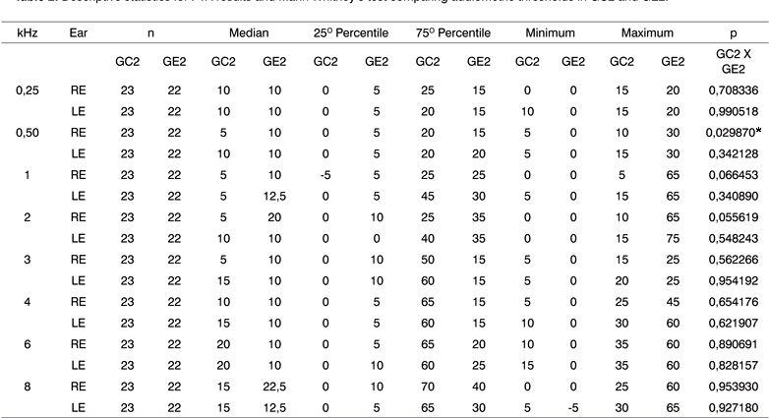
Descriptive statistics summarize data. Descriptive statistics are used to describe patterns and variation in the data.
Notes:
AP Biology Quantitative Skills Manual

Slide 11
Dr. Hood uses descriptive statistics to determine the average mitochondrial respiration rate for each group
Mice that did not reproduce
Control group
Mice that reproduced
Experimental group
ID | Mitochondrial Respiration (mmole O²/min)
345 | 42.0
567 | 31.4
455 | 38.8
982 | 28.3
123 | 44.6
876 | 31.5
ID | Mitochondrial Respiration (mmole O²/min)
724 | 71.6
111 | 45.2
456 | 60.5
745 | 63.4
392 | 42.0
693 | 68.3

Slide 12
How do you calculate the average?

Slide 13
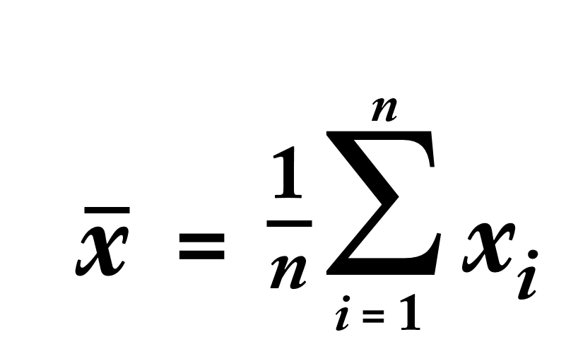
How do you calculate the average?
ID | Mitochondrial Respiration (mmole O²/min)
345 | 42.0
567 | 31.4
455 | 38.8
982 | 28.3
123 | 44.6
876 | 31.5
Take the sum ( )
(i.e. add them together)
= 216.7

Slide 14
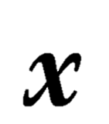
How do you calculate the average?
ID | Mitochondrial Respiration (mmole O²/min)
345 | 42.0
567 | 31.4
455 | 38.8
982 | 28.3
123 | 44.6
876 | 31.5
Divide by the sample size (n)
(i.e. number of values)
= 216.6 / 6
= 36.1
Take the sum ( )
(i.e. add them together)
= 216.6

Slide 15
The mean (x) of the sample is the average. The mean summarizes the entire sample and might provide an estimate of the entire population’s true mean.
Notes:
AP Biology Quantitative Skills Manual

Slide 16
You will also see the mean represented by this equation
Notes:
This looks intimidating but its just an average.

Slide 17
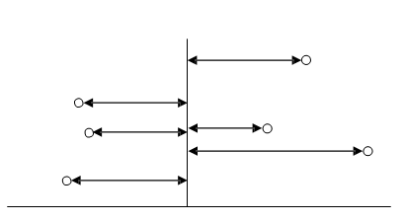
Variance (s²) and standard deviation (s) measure how far a data set is spread out. A variance of zero indicates that all the values in a data set are identical.
36.1
42.0
31.4
28.3
38.8
44.6
31.5
Distance from the mean
Notes:
AP Biology Quantitative Skills Manual

Slide 18
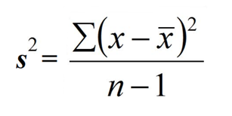
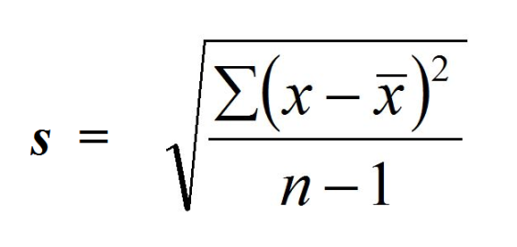
Equations for variance (s²) and standard deviation (s) are below. Because the differences from the mean are squared to calculate variance, the units of variance are not the same units as in the original data set. The standard deviation is the square root of the variance. The standard deviation is expressed in the same units as the original data set, which makes it more useful than the variance.
Standard deviation
Variance
Notes:
AP Biology Quantitative Skills Manual

Slide 19
To calculate standard deviation for Dr. Hood’s data:
ID | Mitochondrial Respiration (mmole O²/min)
345 | 42.0
567 | 31.4
455 | 38.8
982 | 28.3
123 | 44.6
876 | 31.5
Calculate the mean (you just did this)
= 36.1

Slide 20
To calculate standard deviation for Dr. Hood’s data:
ID | Mitochondrial Respiration (mmole O²/min) | (x-x)
345 | 42.0 | 5.9
567 | 31.4 | -4.7
455 | 38.8 | 2.7
982 | 28.3 | -7.8
123 | 44.6 | 8.5
876 | 31.5 | -4.6
Subtract the mean from each value

Slide 21
To calculate standard deviation for Dr. Hood’s data:
ID | Mitochondrial Respiration (mmole O²/min) | (x-x) | (x-x)²
345 | 42.0 | 5.9 | 34.8
567 | 31.4 | -4.7 | 22.1
455 | 38.8 | 2.7 | 7.3
982 | 28.3 | -7.8 | 60.8
123 | 44.6 | 8.5 | 72.3
876 | 31.5 | -4.6 | 21.2
Square each value

Slide 22
To calculate standard deviation for Dr. Hood’s data:
ID | Mitochondrial Respiration (mmole O²/min) | (x-x) | (x-x)²
345 | 42.0 | 5.9 | 34.8
567 | 31.4 | -4.7 | 22.1
455 | 38.8 | 2.7 | 7.3
982 | 28.3 | -7.8 | 60.8
123 | 44.6 | 8.5 | 72.3
876 | 31.5 | -4.6 | 21.2
Take the sum = 218.4
Divide by n-1 = 6-1 = 43.7
Take the square root s = 6.6

Slide 23
How can we present the data graphically?
Mice that did not reproduce
Control group
Mice that reproduced
Experimental group
ID | Mitochondrial Respiration (mmole O²/min)
345 | 42.0
567 | 31.4
455 | 38.8
982 | 28.3
123 | 44.6
876 | 31.5
ID | Mitochondrial Respiration (mmole O²/min)
724 | 71.6
111 | 45.2
456 | 60.5
745 | 63.4
392 | 42.0
693 | 68.3
x = 36.1
s = 6.6
x = 63.5
s = 8.7

Slide 24
Two common types of graph used by scientist are
bar graphs and scatter plots
Oxygen consumed
(mmols/g)
Oxygen consumed
(mmols/g)
Control Experimental
Number of pups
Bar graph
Scatter plot

Slide 25
The top of the bar represents each mean. Error bars can be used to represent the standard deviation for each mean. Based on what you learned in your reading, are these groups likely to be statistically different?
Dr. Hood’s data graphed:
Oxygen consumed
(mmols/g)
Control Experimental
Bar graph

