Slide 1
The food you take in ultimately supports the production of ATP and energy via cellular respiration.
Some of your food will include glucose. Much of the rest of the food you take in is used to produce ATP via alternative inputs into the same pathway that have the same products.
complex carbohydrates
carbon dioxide
CO₂
water
H₂O
ATP
glucose
C₆H₁₂O₆
+
oxygen
O₂
+
+
proteins
fats

Slide 2
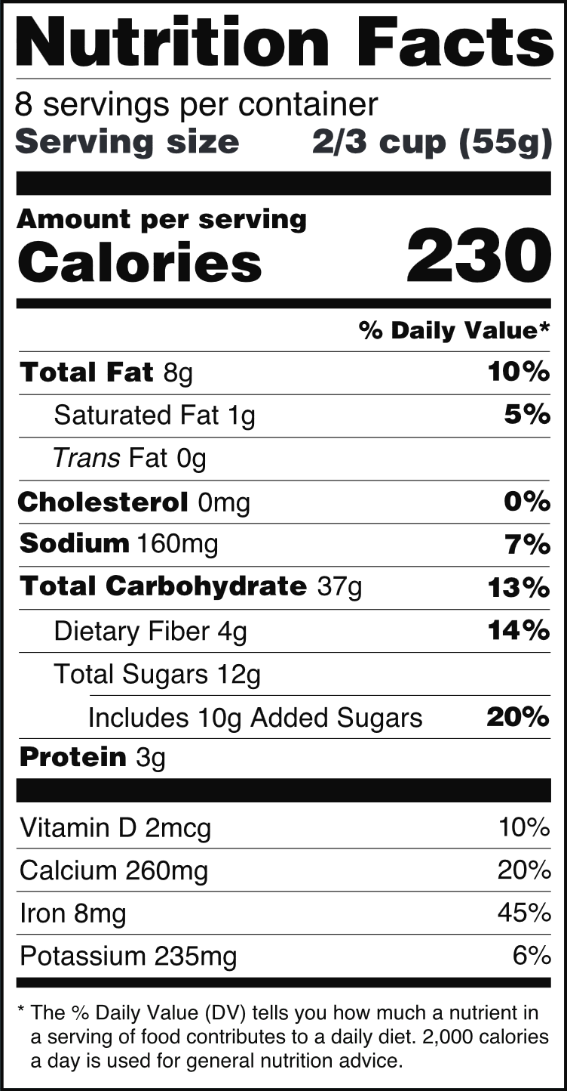
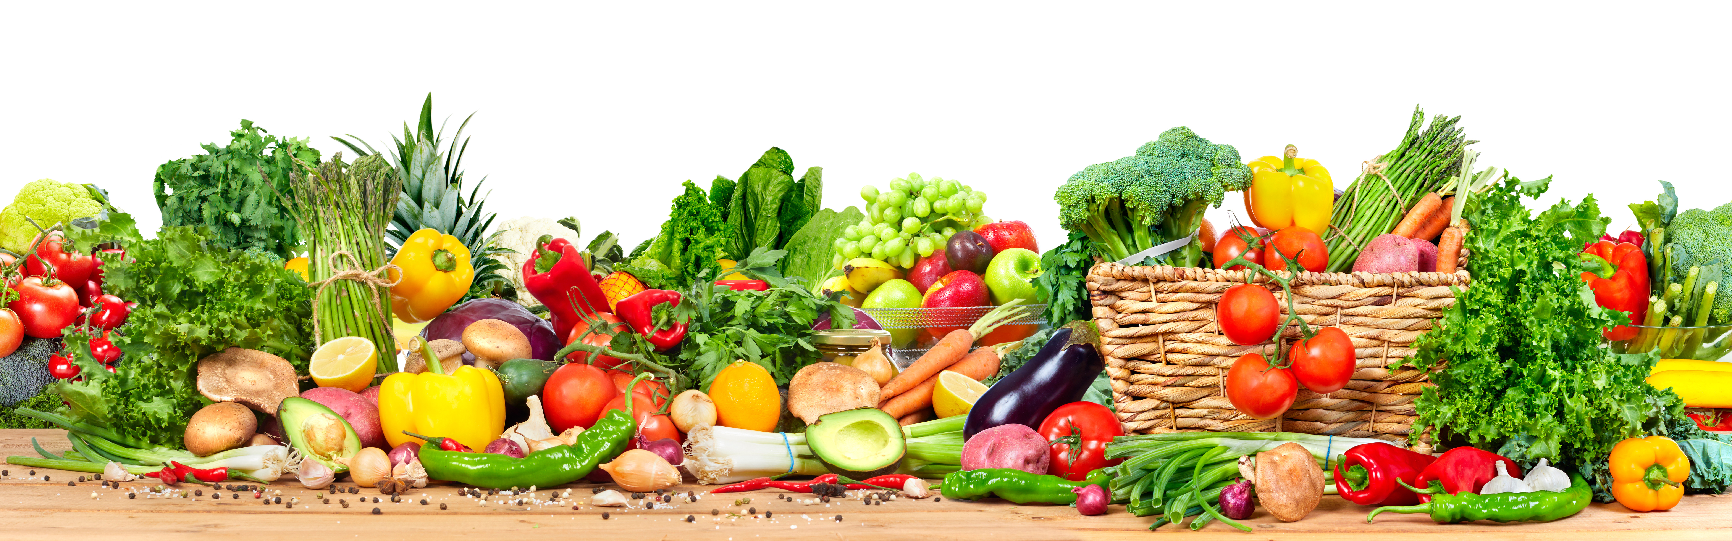
How much glucose and other nutrients a person or other animal takes in determines how much energy it has to support all of challenges it is faced with.
Each food item consumed has an energy content.
Quantifying the energy content of food allows us to determine the value of that item in supporting ATP production which supports physiological processes throughout the body.
The calorie content of a food item is a measure of its energy content.

Slide 3
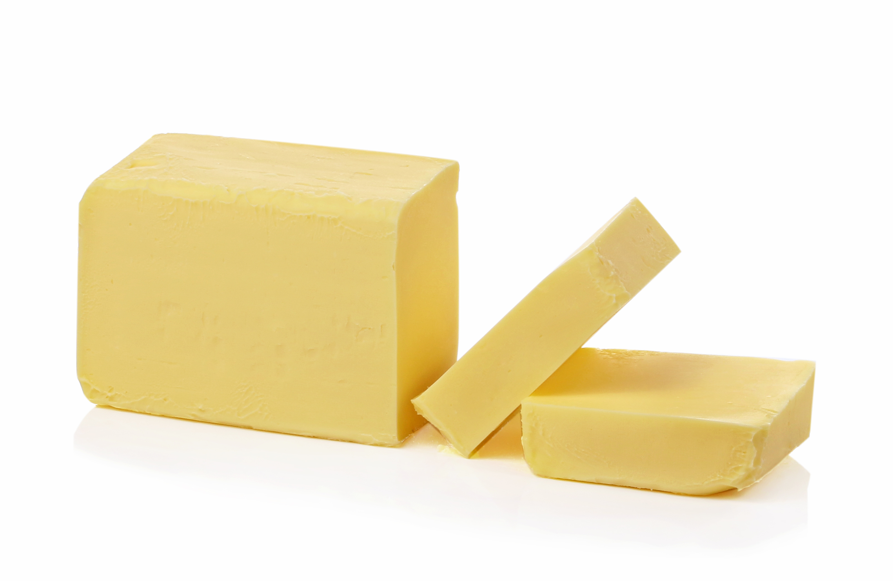


Carbohydrates, fats, and proteins are all macronutrients.
Each macronutrient varies in its energy content per unit of mass.
Based on your reading, which macronutrient has the highest energy content per gram of food?
The energy content of food is measured by its heat production. Which item below will have the highest energy content per gram?

