Slide 1
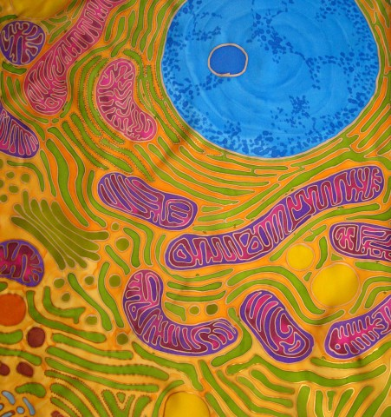
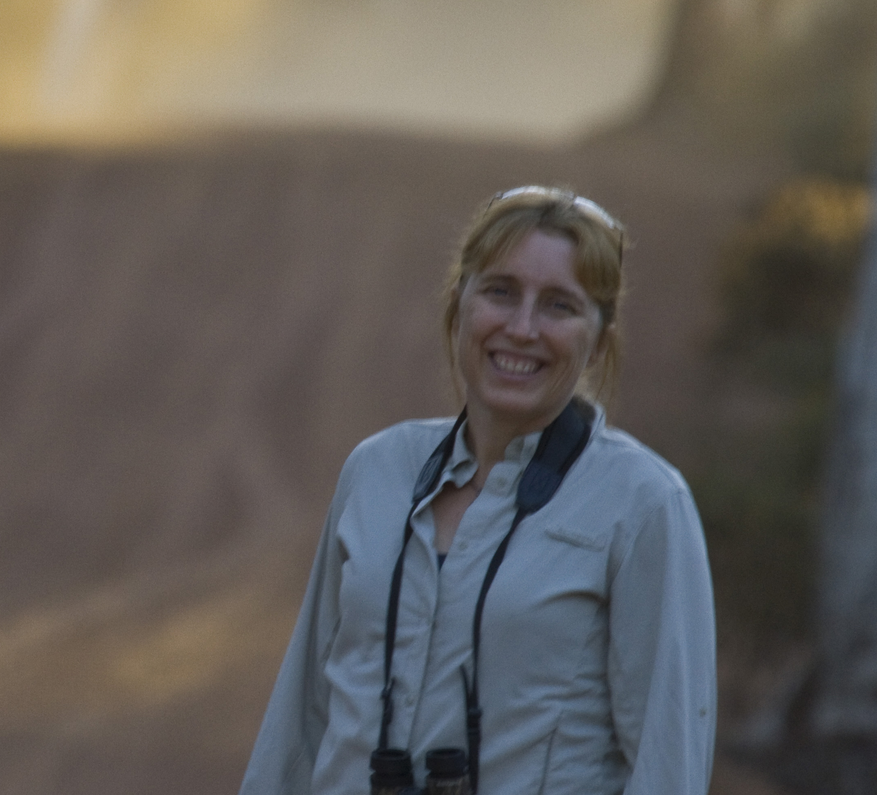
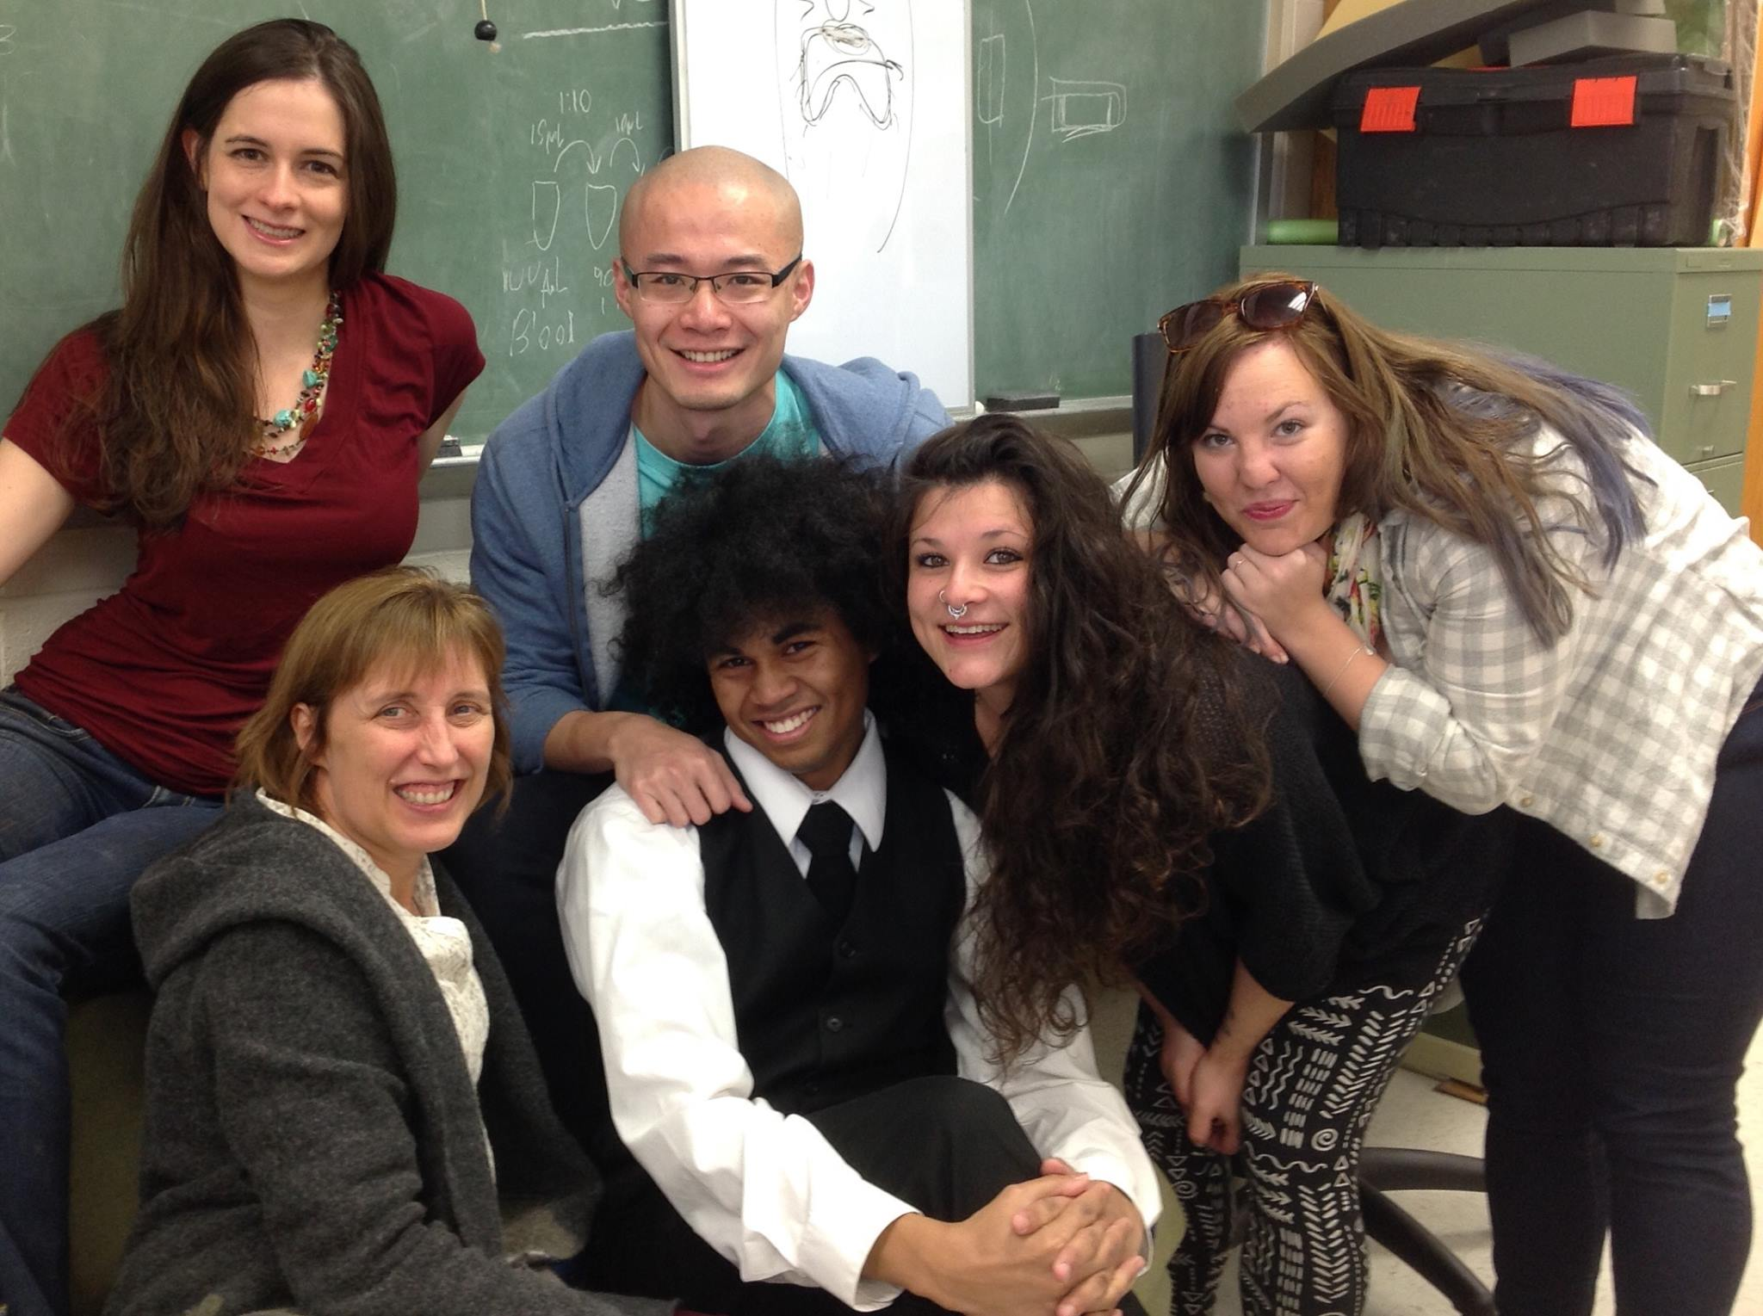
The Hood lab at Auburn University
Research on the role of mitochondria in
reproduction and aging
Dr. Wendy Hood
Dr. Hood and her students
Notes:
I’d like to thank Hippokratis for organizing this symposium.
As most of you are aware, Hippokratis and I were recently successful in obtaining an EPSCoR grant from NSF
The Auburn portion of this project largely deals with measuring reproductive performance in the mice that Hippokratis and many of the people in this room are working on genotyping
Our first goal has been building enclosures for Peromyscus that will be used for breeding in the near future
But ultimately, we our plan it to tie many of the ideas that we have been working on in house mice to Peromyscus
Since we are in the construction phase of this project, I don’t have any Peromyscus data to share with you today
So today, I’d like to describe to you our recent findings in house mice,
as set up for studies in peromyscus present to you in this venue in the future
All of the work that I’ll be presenting has been done in collaboration with Andreas Kavazis, who is also on faculty at Auburn.

Slide 2
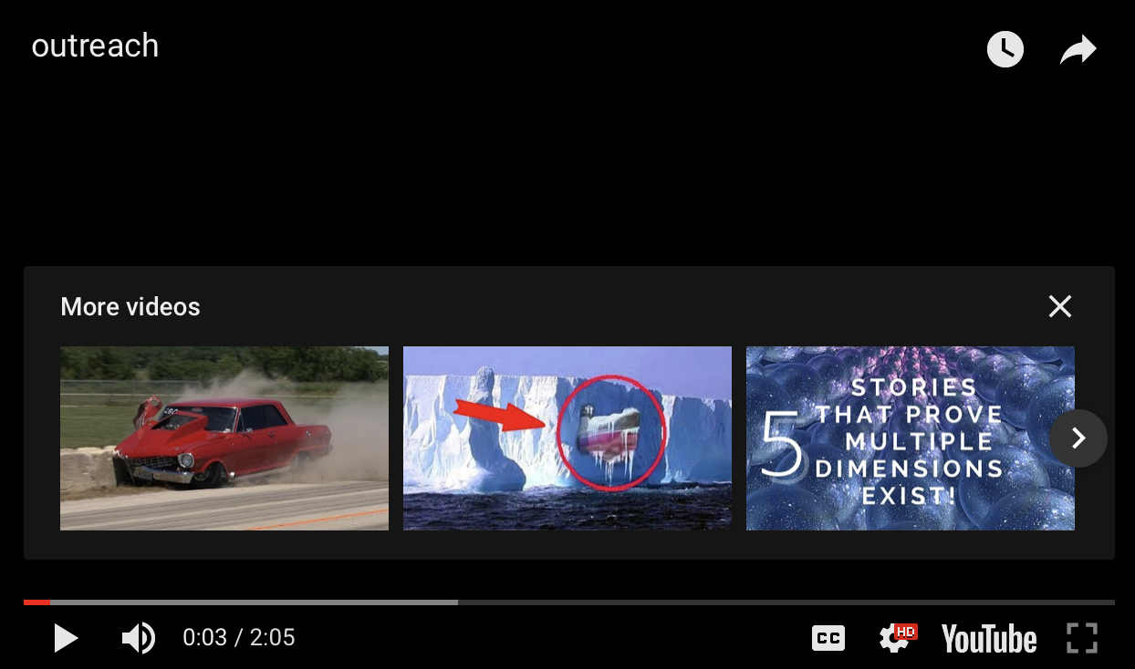
Research at Auburn University vs. labs in your classroom
Notes:
I’d like to thank Hippokratis for organizing this symposium.
As most of you are aware, Hippokratis and I were recently successful in obtaining an EPSCoR grant from NSF
The Auburn portion of this project largely deals with measuring reproductive performance in the mice that Hippokratis and many of the people in this room are working on genotyping
Our first goal has been building enclosures for Peromyscus that will be used for breeding in the near future
But ultimately, we our plan it to tie many of the ideas that we have been working on in house mice to Peromyscus
Since we are in the construction phase of this project, I don’t have any Peromyscus data to share with you today
So today, I’d like to describe to you our recent findings in house mice,
as set up for studies in peromyscus present to you in this venue in the future
All of the work that I’ll be presenting has been done in collaboration with Andreas Kavazis, who is also on faculty at Auburn.

Slide 3
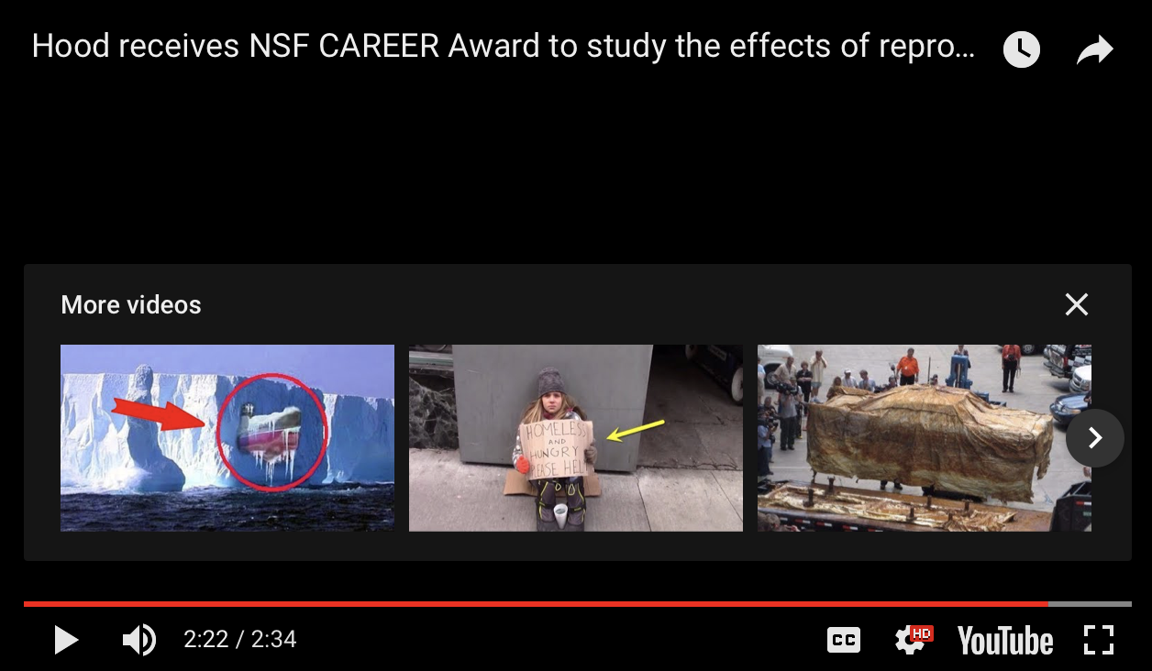
Introduction to Dr. Hood and her research
Notes:
I’d like to thank Hippokratis for organizing this symposium.
As most of you are aware, Hippokratis and I were recently successful in obtaining an EPSCoR grant from NSF
The Auburn portion of this project largely deals with measuring reproductive performance in the mice that Hippokratis and many of the people in this room are working on genotyping
Our first goal has been building enclosures for Peromyscus that will be used for breeding in the near future
But ultimately, we our plan it to tie many of the ideas that we have been working on in house mice to Peromyscus
Since we are in the construction phase of this project, I don’t have any Peromyscus data to share with you today
So today, I’d like to describe to you our recent findings in house mice,
as set up for studies in peromyscus present to you in this venue in the future
All of the work that I’ll be presenting has been done in collaboration with Andreas Kavazis, who is also on faculty at Auburn.

