Slide 1
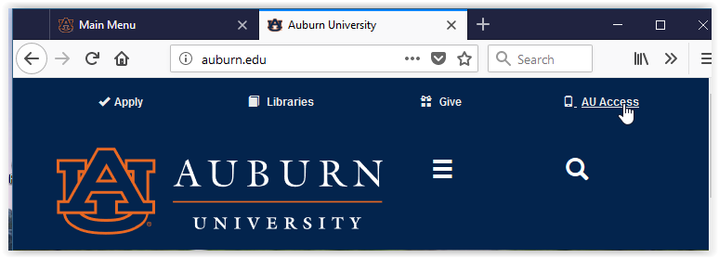
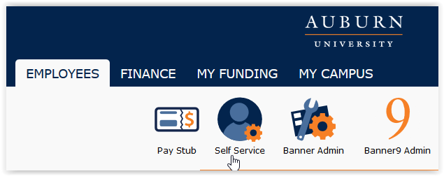
EPAF Lookup – Self Service Banner
This new feature allows the EPAF Administrator to view EPAF history on a specific employee.
1
AU Access
2
Employee Tab -> Self-Service Banner (SSB)
3
Locate the EPAF Lookup option in the list of SSB selections.
Select the result
LF 10.2020
Page 1

Slide 2
4
Enter the Employee Name OR Banner ID in the designated fields. Click on GO to execute the query.
5
The list of EPAF History will display. You can view the individual EPAFs and/or you may PRINT ALL EPAF9s on this page.
Note that there may be more than one page of EPAF History.
---EXAMPLE---
LF 10.2020
Page 2

