Slide 1
Changes in the Course Materials Process and Landscape
Update for the Faculty Senate
October 6, 2015
Russell Weldon,
Assistant Director, Auburn University Bookstore

Slide 2
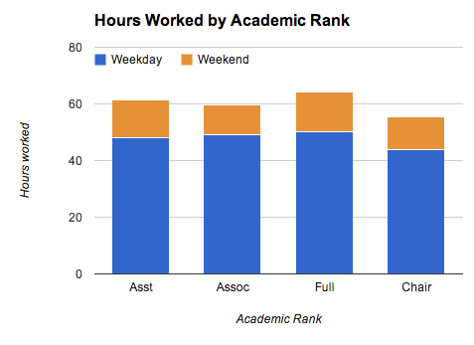
First things first.

Slide 3
Beginning in December, students will have the ability to charge up to $1,000 each semester toward their e-bill for course materials and supplies.

Slide 4
THIS IS AFFORDABILITY.
THIS IS ACCESSABILITY.
THIS IS AVAILABILITY.

Slide 5
We need your help.
Understand how textbook request system is built
Responsiveness to Bookstore requests for course material information
Understand how course material process has changed and how time-sensitive process has become
“Teamwork—coming together is a beginning, keeping together is progress, working together is success.” Henry Ford

Slide 6
Our starting point
Since Fall 2011:
Requests in the six weeks leading to the first day of class average 38 percent of total orders for a given semester
The average number of student seats affected by these orders is 29,221
Student and parent feedback has risen dramatically during this period in the form of complaints and requests for information
The Auburn University Bookstore is designated as the sole source point for distribution of course material information

Slide 7
State of the Bookstore
Institutionally-owned and operated
Low-profit operation in course materials
Focus on student outcomes and choice
Operational excellence

Slide 9
Secret to Success
Transparency
Savings
Choice
Cooperation
Innovation
RELATIONSHIPS

Slide 10
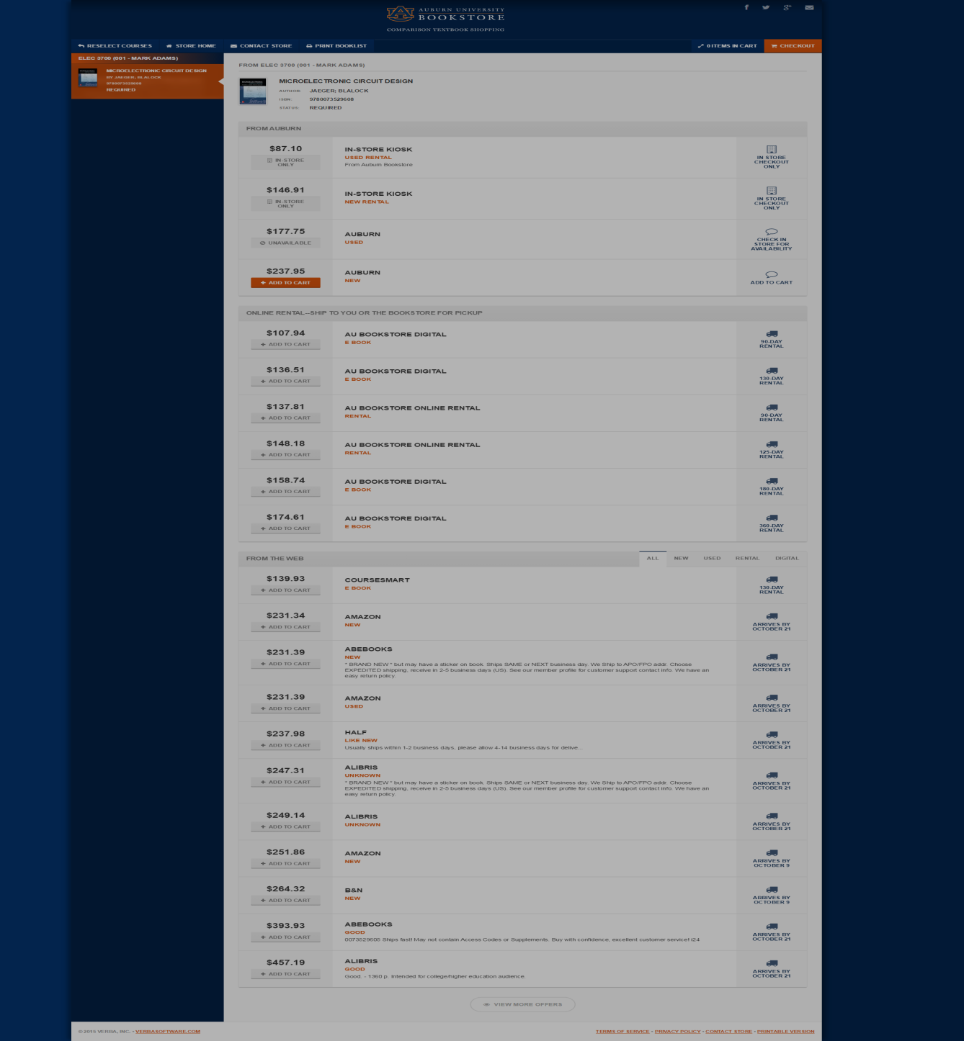
Bookstore purchase and rental options
Rental and digital options from online partners
Prices from online vendors including Amazon, Half, CourseSmart(digital)

Slide 11
Call to Action
Sense of urgency in goals to collect timely and complete information
Feedback always encouraged and welcomed
Unity in purpose moving forward

Slide 12
When You Need Us
Russell Weldon/Textbook Dept.
books@auburn.edu
844-1361

