Slide 1
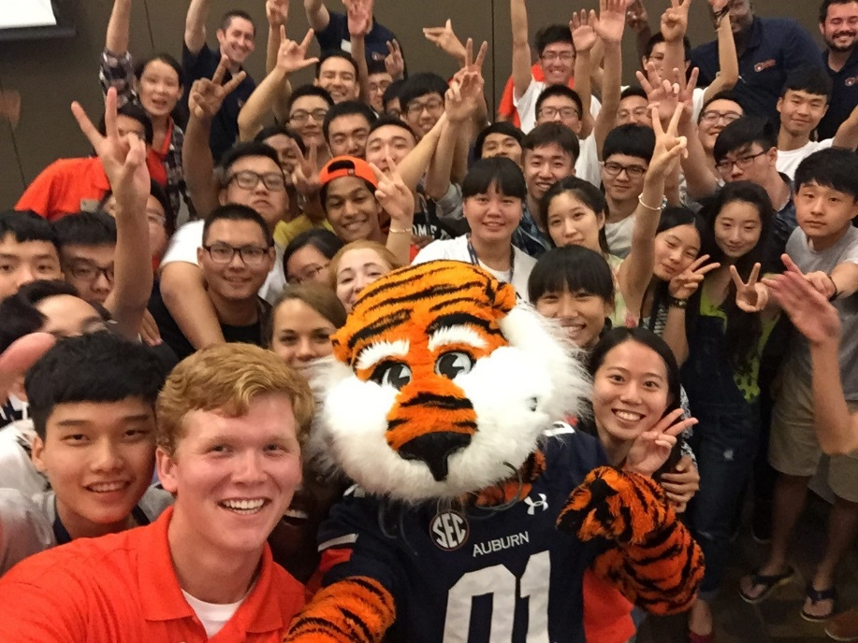
General Faculty Meeting
October 6, 2015
AUBURN GLOBAL

Slide 2
INTERNATIONAL Student FACTS Where Students Study
2001
2.1 million students
2012
4.3 million students
2001:
1. U.S. (28%)
2. U.K. (11%)
3. Germany (9%)
4. France (7%)
5. Australia (4%)
6. Other (41%)
2012:
1. U.S. (19%)
2. U. K. (11%)
3. China (8%)
4. France (7%)
5. Germany (6%)
Other (49%)
SOURCE: UNESCO STUDENT MOBILITY DATA

Slide 3
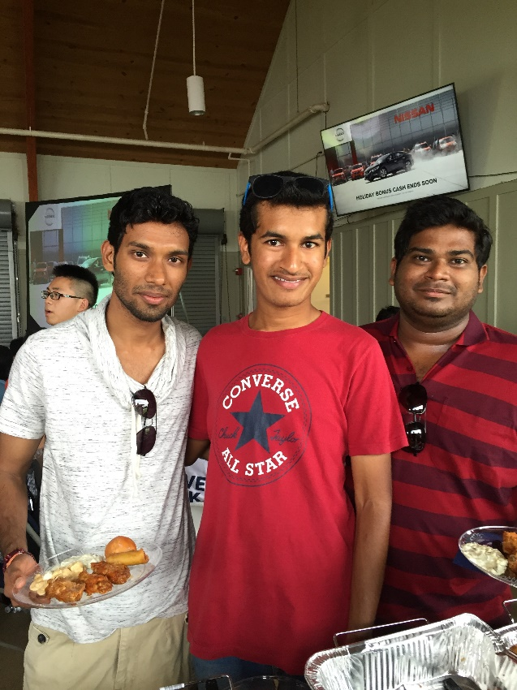
INTERNATIONAL Students STUDYING IN THE u.s.
2014: 886,394
2025: 1,750,000 (est.)
Source: IIE Open Doors; SEVIS; Shorelight Analysis

Slide 4
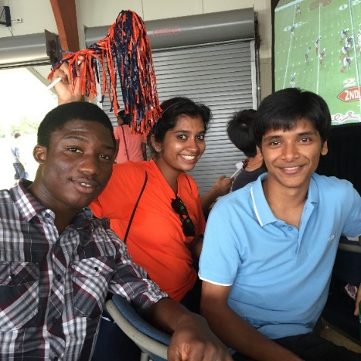
WHAT IS AUBURN GLOBAL?
Partnership between Auburn University and Shorelight Education
We recruit, orient and
provide support
services to transition
and retain
international students
Focus: “Student Success”

Slide 5
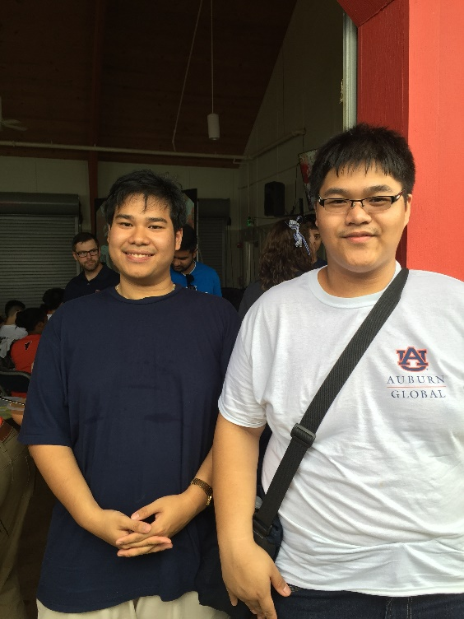
Overarching goal
To support Strategic Priority 1: Enhance Student Success
Strategic Goal #2: “The University will strengthen the student experience and broaden its influence by serving new groups of students and emphasizing the academic importance of diversity. We will support the talents of all qualified students and prepare them to thrive in an increasingly global environment.”
1,000 International Undergraduate Students by 2018

Slide 6
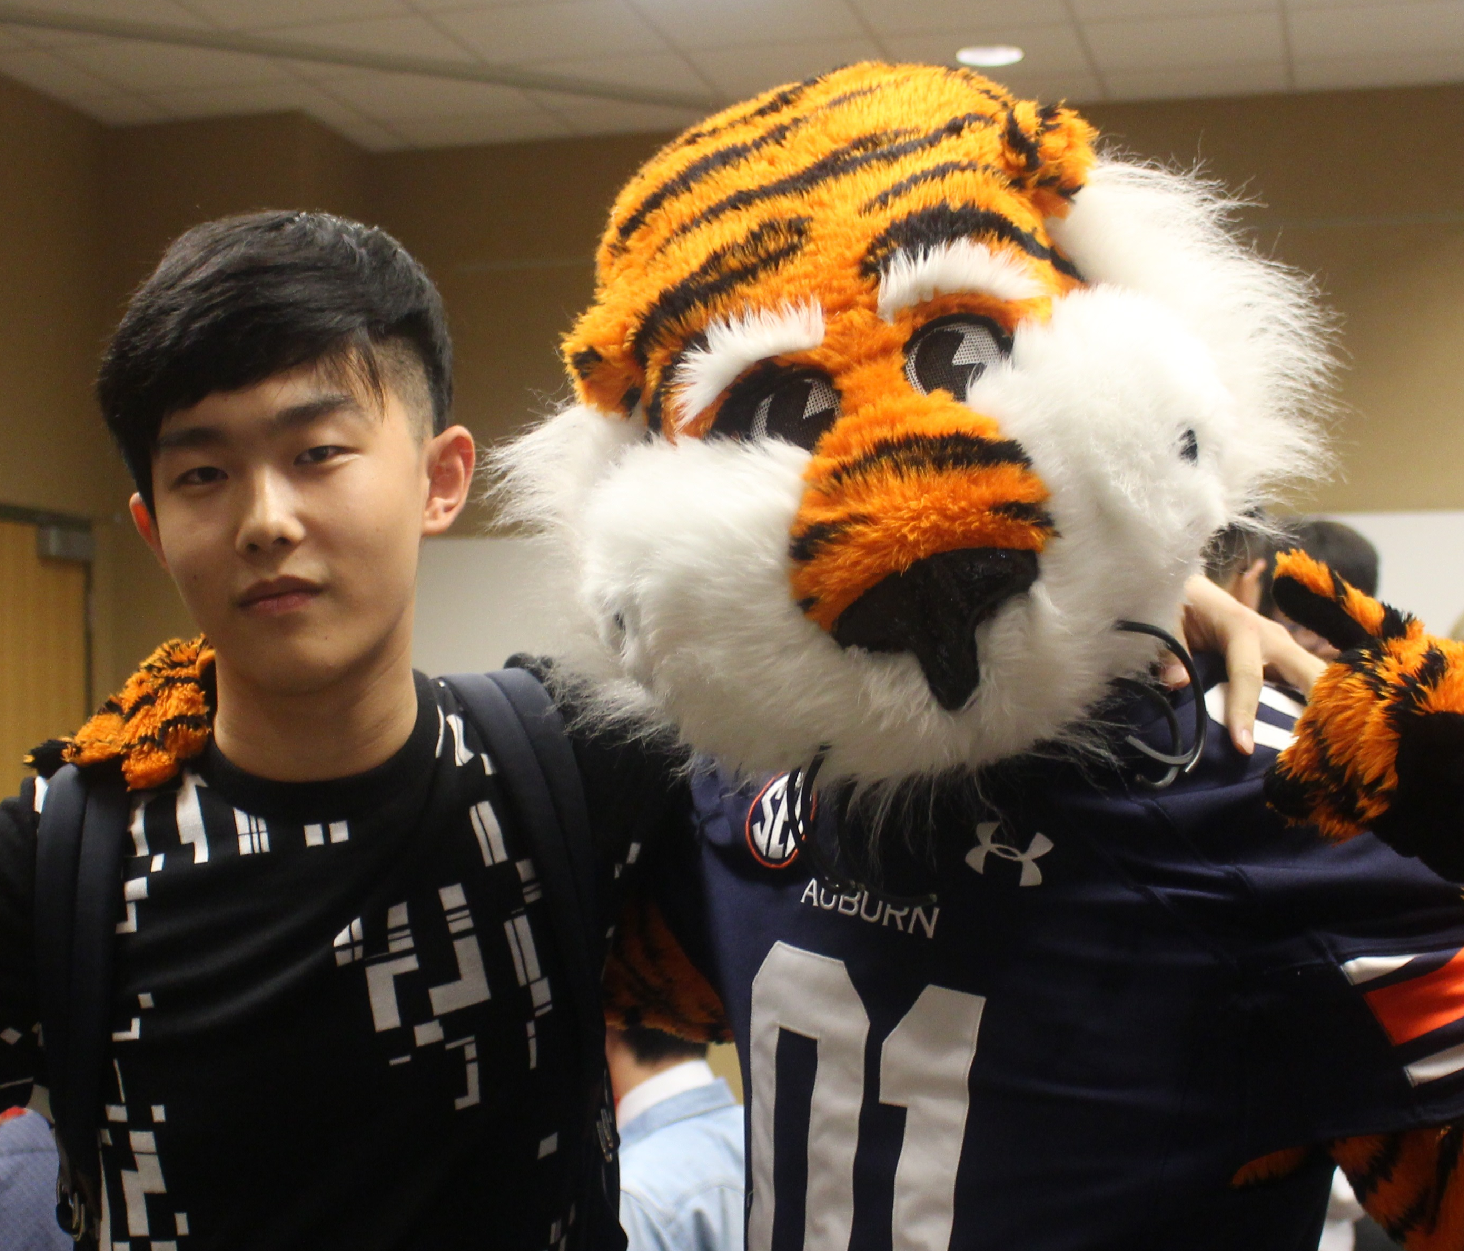
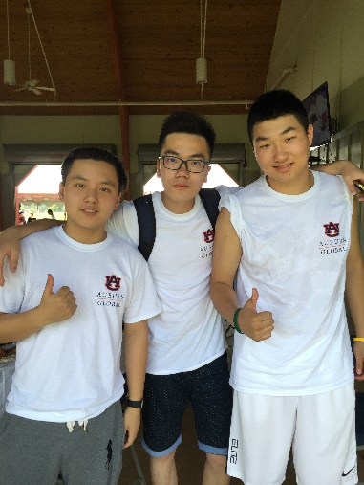
Student success MODEL
Student Success
ACADEMICS
* Graduate -18 Degrees
* Undergraduate
* ESL
* Tutoring
PROFESSIONAL DEVELOPMENT
* PDS Courses
* Career Accelerator Program
STUDENT SERVICES
* Involvement
* Cultural & Social Programs
* Health & Wellness

Slide 7
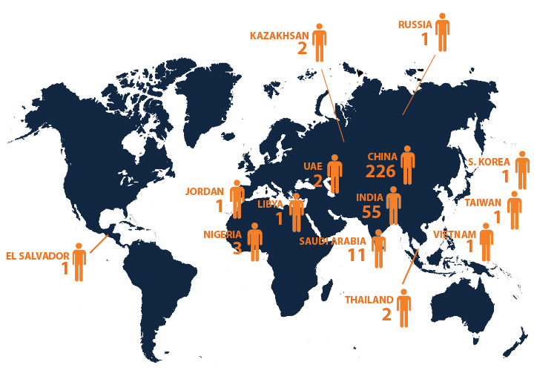
RECRUITMENT & admissions
By the Numbers:
8 Regional Recruitment Offices
1,200+ applications to Auburn Global
310 students:
UG: 185
GR: 63
ESL: 62

Slide 8
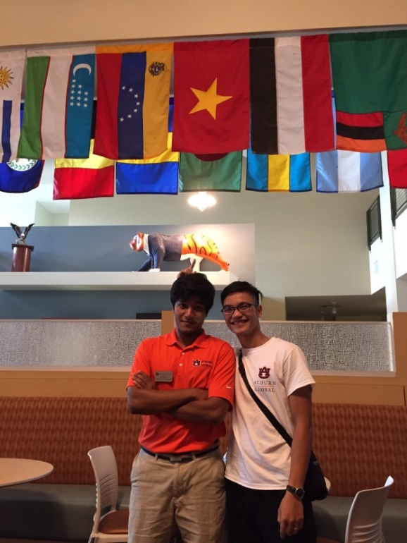
Progression & Benefits
Auburn Global
2-3 semesters - Undergraduate
1-2 semesters – Graduate
Progression into University
Undergraduate: University standard
Graduate: Standard set by Department
Faculty Support
Monthly workshops
Auburn Global supports:
Diversity for the benefit of all
Increases economic development in state

Slide 9
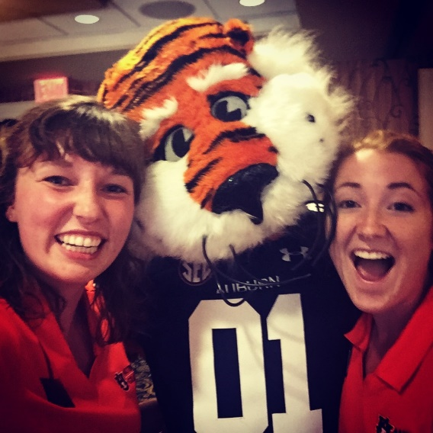
Thank YOU! For more Information: 332 Foy Hall 334-844-5753 Dawn C. Sherman, Ed.D., Managing Director Robert Weigel, Ph.D., Academic Director Sean Busenlener, B.S., Student Services Director Nazanin Tork, M.A., Partner Admissions Director

