Slide 1
Hopper The next step in High Performance Computing at Auburn University
February 16, 2016

Slide 2
Hopper? – Named for groundbreaking computer scientist Grace Hopper.
Cluster? – A collection of computers configured to work together.
Community? – A joint effort funded with investments by:
Office of the Provost
Office of Information Technology
College of Science and Mathematics
Samuel Ginn College of Engineering
Roughly 25 Researchers and Research Groups

Slide 4
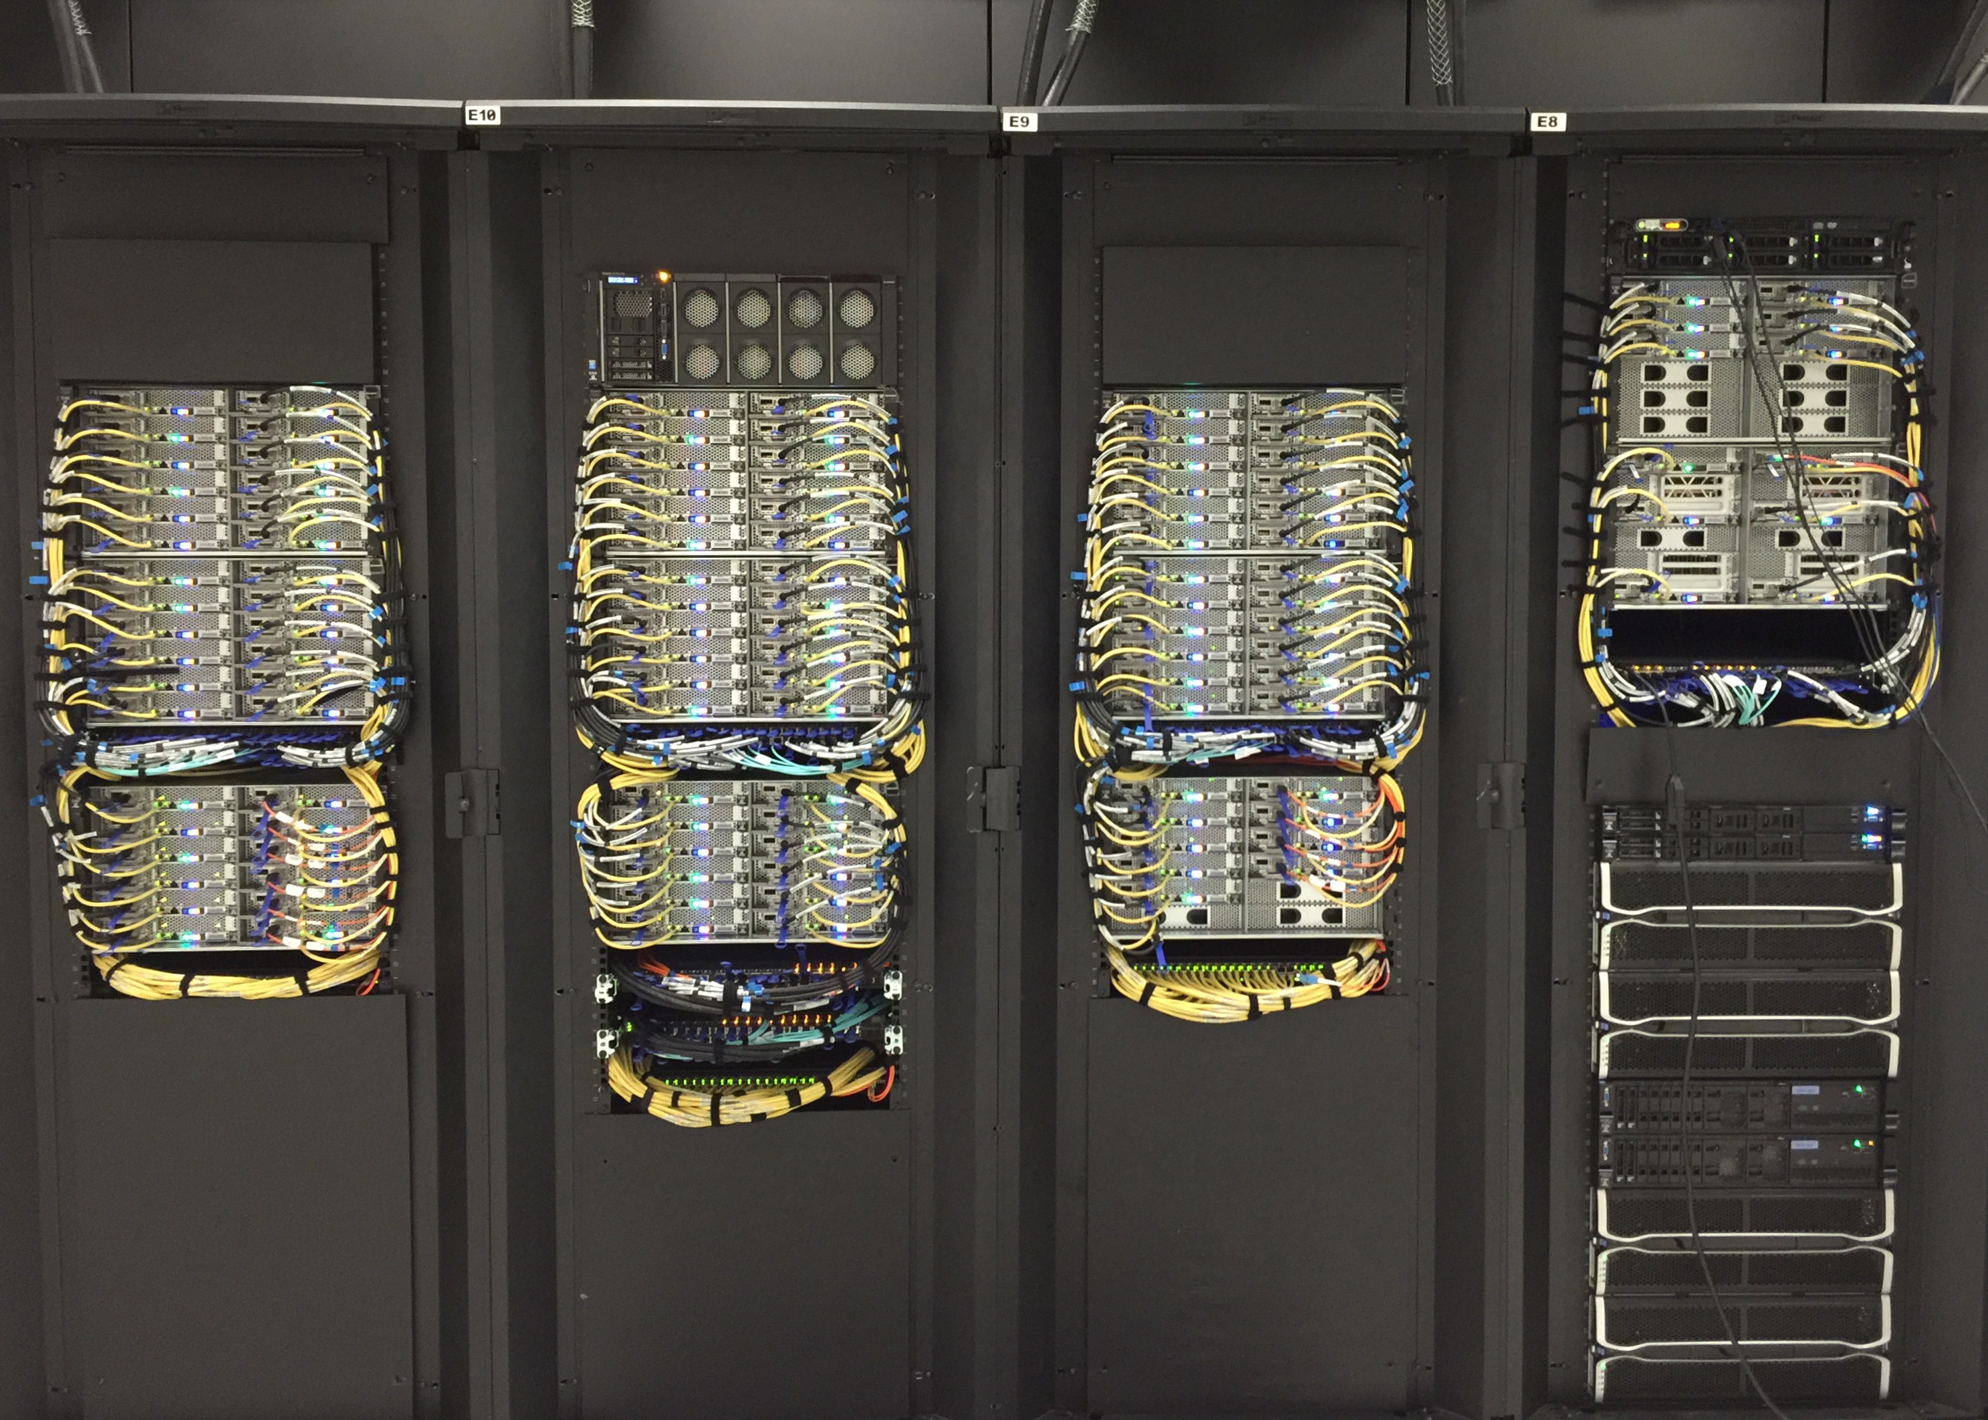
?

Slide 5
Speeds and Feeds
120 Nodes
2,000 cores
15 Terabytes of Memory
1.4 Petabytes of Disk Storage
Infiniband Storage Network
102 Teraflops of compute capacity
Bonus:
Two nVidia Tesla K80 nodes
Two Intel Xeon Phi 7120P nodes

Slide 6
The Real Strength of Hopper…
Central Technical Support
Infrastructure In Place
Room to Grow
Support from the Administration
Researchers Define Usage Policies
Researchers Pooling Resources

Slide 7
?
hpcportal.auburn.edu

