Slide 1
University Faculty Senate Presentation
September 2013
Jennifer L. Kerpelman, Ph.D.
Research Week 2014 Chair
Associate Dean for Research and Graduate Studies, College of Human Sciences
Carl A. Pinkert, Ph.D.
Associate Vice President for Research
Notes:
Either this one or the one that follows…

Slide 2
AU Research Week 2014
April 14-17

Slide 3
Auburn University
Research Week 2014
OUR CALL TO FACULTY
Encouraging Engagement
in Research
by Designing
Research Week 2014
into
Course Syllabi and Assignments

Slide 4
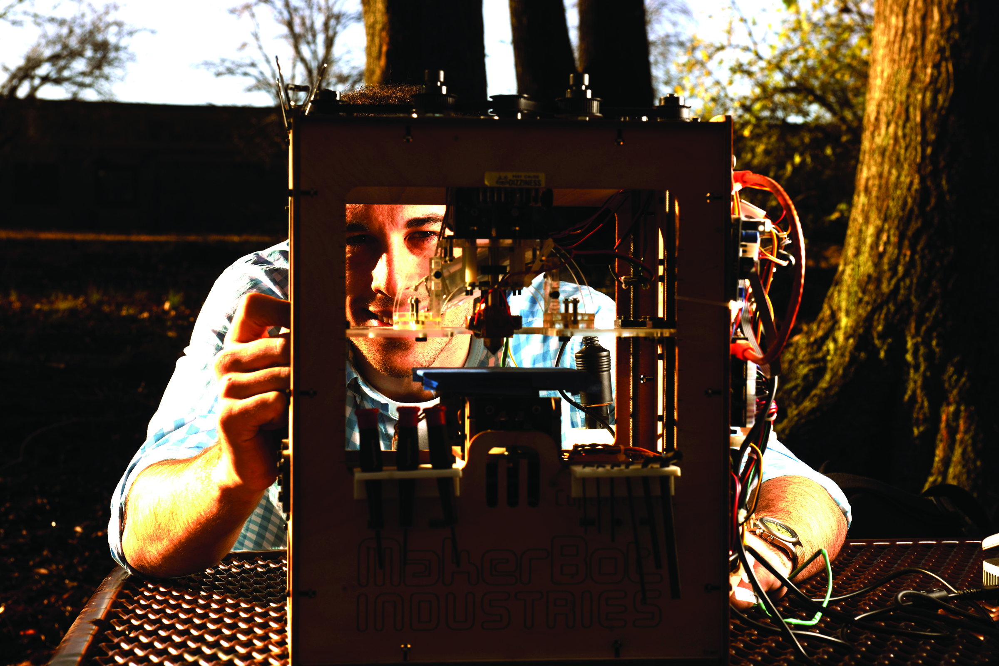
Auburn University Research Week 2014 April 14th – 17th 2014
Monday, April 14, 2014 – The Hotel at Auburn University and Dixon Conference Center
1:00 pm – 5:00 pm Nursing Research Poster Sessions
Monday, April 14, 2014 – Auburn University at Montgomery
4:00 pm – 6:00 pm AUM Kick off Reception/Durr Lecture
Tuesday, April 15, 2014 – The Hotel at Auburn University and Dixon Conference Center
8:00 am – 5:00 pm Sponsor Exhibits, and Vendor Displays
8:00 am-9:45 am Poster Sessions
10:00 am – 12:00 am Research Week Kickoff , Undergraduate Alumni Speaker, Opening Featured Speaker
12:00 pm – 1:00 pm Networking Luncheon
1:00 pm – 4:45 pm Combined Symposia; Special Sessions and Panels; Creative Scholarship
2:00 pm - 3:30 pm Poster Sessions
5:15 pm – 6:15 Film Screening; Jule Collins Smith Museum of Fine Art
2013
Research Week 2014
Research and Creative Scholarship
Notes:
Our Research Orientation…

Slide 5
Auburn University Research Week 2014 April 14th – 17th 2014
Wednesday, April 16, 2014 – The Hotel at Auburn University and Dixon Conference Center
8:00 am – 5:00 pm Sponsor Exhibits, and Vendor Displays
8:00 am-9:30 am Poster Sessions
8:00 am – 10:45 Combined Symposia, Creative Scholarship
11:00 pm – 1:00 pm Undergraduate Research Opportunities Fair
11:00-1:230 Networking Luncheon
1:00 pm – 4:45 pm Combined Symposia; Special Sessions and Panels; Creative Scholarship; Grantsmanship Workshop
2:30 pm - 4:00 pm Poster Sessions
6:00 pm – 8:00 pm Keynote Address and Reception
Thursday, April 17, 2014 – The Hotel at Auburn University and Dixon Conference Center
8:00 am – 5:00 pm Grantsmanship Workshop; Special Sessions and Panels , Creative Scholarship
6:00 pm – 8:30 pm Research Awards Gala
Research Week 2014
Research and Creative Scholarship
Notes:
Our Research Orientation…

Slide 6
Auburn University
Research Week 2012 & 2013
AU Research Week is a partnership between AU –AU at Montgomery and other regional institutions to bring students and faculty together to celebrate, and share research and creative scholarly activity.
Paula Bobrowski and her committee took a huge leadership role.
Between 1000 and 2000 participants per year.
Undergraduate, graduate and faculty efforts showcased.
Auburn Speaks and AUJUS introduced/highlighted.
Galas well-attended.
Participation of Research Advisory Board.

Slide 7
Auburn University Research Week 2014
General Areas
Topic Areas
STEM
Social Sciences
Humanities
Education
Creative Scholarship
Interdisciplinary
Food Systems, Safety, Security…
Energy & Environment
Cyber Research
Health Sciences
Transportation
Gulf Research and Restoration
Gender Issues
Infrastructure
Sustainability
Fine/Applied Art, Design
Performance

Slide 8
Auburn University
Research Week 2014
Integrating research/creative scholarly activity across stakeholders
Promoting community engagement
Inviting Tuskegee, ASU, Morehouse, Spelman…
Employing new communication vehicles and methods
Continuing to visit with all constituencies to look at successes and areas to improve.
Recruiting Tool: Undergraduate, Graduate, HBCU’s; Participation of Bridge Program students
Increasing sponsorships to help continue what we hope will become an Auburn tradition.

Slide 9
Auburn University Research Week 2014 April 14th – 17th, 2014
Activities include:
AU and AUM activities
Themed poster and oral paper sessions that connect students and faculty
Themed panels
Auburn Speaks
Creative Scholarship
Keynote/featured speakers
Phi Kappa Phi Centennial
Grantsmanship Workshop
Special sessions
Awards Gala
2014

Slide 10
Auburn University Research Week 2014 April 14th – 17^{h} 2014
Research Week 2013
Q and A
Research Week 2014
Dr. Jennifer Kerpelman, RW2014 Steering Committee Chair
Contact: jkerpelman@auburn.edu
Research and Creative Scholarship

