Slide 1
AU Research Week 2013
April 1-4
University Senate Presentation
January, 2013

Slide 2
Auburn University
Research Week 2013
OUR CALL TO FACULTY
Encouraging Engagement
in Research
by Designing
Research Week 2013
into
Course Syllabi and Assignments

Slide 3
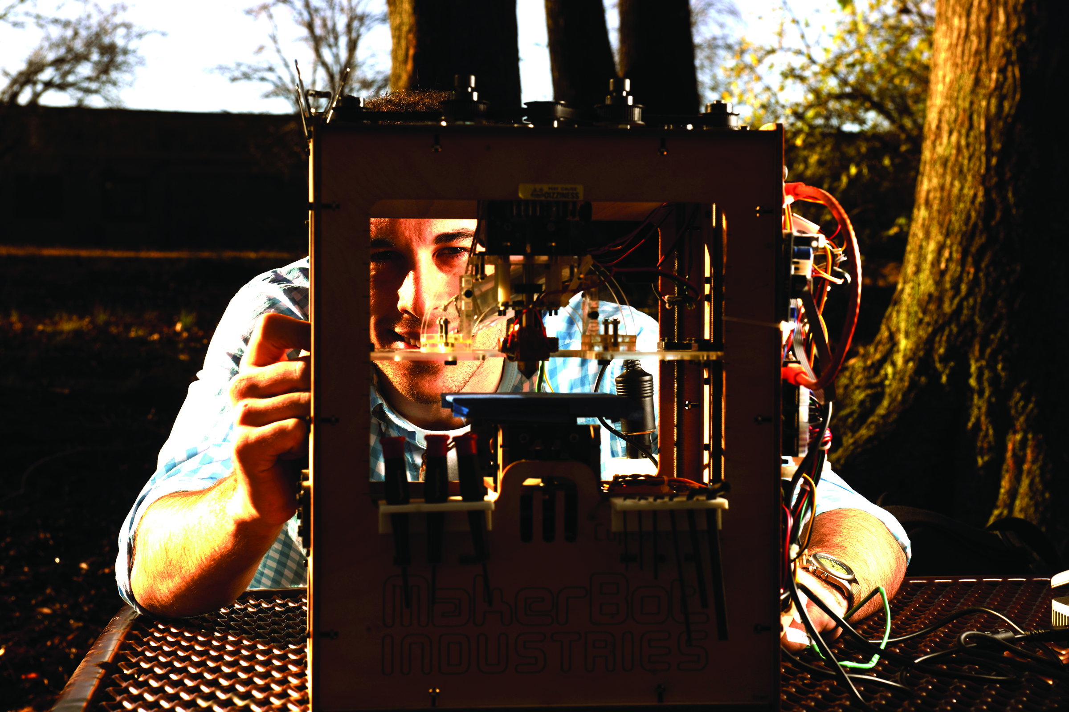
Auburn University Research Week 2013 April 1st – 4th 2013
Monday, April 1, 2013 – The Hotel at Auburn University and Dixon Conference Center
1:00 pm – 5:00 pm Nursing Research Poster Sessions
Monday, April 1, 2013 – Auburn University Montgomery
7:00 pm – 8:00 pm Potential Speaker - TBD
Tuesday, April 2, 2013 – The Hotel at Auburn University and Dixon Conference Center
8:00 am – 11:00 pm Undergraduate, Graduate and Faculty Research Symposiums
11:00 am – 12:00 am Research Week Kickoff & Undergraduate Opening Speaker
12:00 pm – 2:00 pm Networking Luncheon
Undergraduate, Graduate and Faculty Poster Sessions
2:00 pm – 5:00 pm Undergraduate, Graduate and Faculty Research Symposiums
All Week – Ralph Brown Draughon Library
Creative Scholarship Exhibitions
2013
Research Week 2013
Research and Creative Scholarship
Notes:
Our Research Orientation…

Slide 4
Auburn University Research Week 2013 April 1st – 4th 2013
Wednesday, April 3, 2013 – The Hotel at Auburn University and Dixon Conference Center
8:00 am – 12:00 pm Undergraduate, Graduate and Faculty Research Symposiums
12:00 pm – 1:30 pm Networking Luncheon
1:30 pm – 5:30 pm Undergraduate, Graduate and Faculty Research Symposiums
Grantsmanship Workshops and Seminars
Panel Discussions
Thursday, April 4, 2013 – The Hotel at Auburn University and Dixon Conference Center
8:00 am – 5:00 pm Grantsmanship Workshops and Seminars
Panel Discussions
6:00 pm – 8:30 pm Keynote Address Dr. Peter Karevia
Research Awards Gala
All Week – Ralph Brown Draughon Library
Creative Scholarship Exhibitions
Research Week 2013
Research and Creative Scholarship
Notes:
Our Research Orientation…

Slide 5
Auburn University
Research Week 2013
AU Research Week is a partnership between AU –AU Montgomery and other regional institutions to students and faculty together to celebrate, and share research and creative scholarly activity
Last year over 1000 registered participants, 1200 attendees – including Auburn Connects --over 2000 attendees
Undergraduate, graduate, and faculty presentations/poster session
Highlights Auburn Speaks and AUJUS

Slide 6
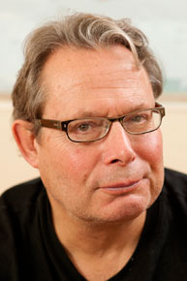
Keynote Address Peter Kareiva, Ph.D. Chief Scientist & Director, Nature Conservancy
VIDEO: Watch Peter Kareiva's talk about a “New Environmentalism" as part of the National Academy of Sciences Distinctive Voices program.
Peter Kareiva is chief scientist for The Nature Conservancy. He is responsible for developing and helping to implement science-based conservation throughout the organization and for forging new linkages with partners.
In May 2011, he was named a member of the National Academy of Sciences for his excellence in original scientific research.
Peter received a master’s of science degree in environmental biology from the University of California, Irvine, and his Ph.D. in ecology and evolutionary biology from Cornell University.

Slide 7
Auburn University Research Week 2013 Health and Wellbeing
General Areas
Topic Areas
STEM
Social Science
Humanities
Education
Water & Environment
Gender Issues
Food Systems
Health Sciences and Systems
Infrastructure
Sustainability
Arts & Literature
Society/Social and Political Structures and Issues
Other

Slide 8
Auburn University
Research Week 2013
Advancements
Integration of research/creative scholarly activity across stakeholders
Special Programs
Bridge Program/SENCER/Library Institutional Repository/AU Speaks
Inviting Tuskegee as a partner
Recruiting Tool
Undergraduate, Graduate, HBCU’s
Increase Sponsorship

Slide 9
Auburn University
Research Week 2013
Reminder: CALL TO FACULTY
Encouraging Engagement
in Research
by Designing
Research Week 2013
into
Course Syllabi and Assignments

Slide 10
Auburn University Research Week 2013 April 1st – 4th 2013
Q&A
Research Week 2013
Research Week 2013
Research and Creative Scholarship
Notes:
Our Research Orientation…

Slide 11
Please Design
Research Week 2013
into
Course Syllabi and Assignments

