Slide 1
FINANCIAL
LIAISON
MEETING
December 7, 2012

Slide 2
Budget Services Update
Bryan Elmore

Slide 3
Budget Services
One-Time Supplement
  Labor Distribution Issues
  SCP, LWOP, etc.
  Transfer
Budget Requests
  Permanent (due February 28th, 2013)
  One-time (no deadlines)

Slide 4
PPS Update
Shawn Asmuth & Melissa Morris

Slide 5
PPS
Reminders

Slide 6
Financial Reporting Update
Michelle Hancock

Slide 7
E-JOURNAL VOUCHERS ACCESS
Current employees with Banner Finance access
  User must complete training, either through a class or through online demos https://iss.auburn.edu/dokuwiki/doku.php?id=public:fupload#training_videos
  Financial Liaison sends request e-mail to finrptg@auburn.edu
    Include User ID, Department, Rule Classes (CRG, DEC), Chart and Bank
    Include list of Approval Queues needed
    Include confirmation that user completed training

Slide 8
E-JOURNAL VOUCHERS ACCESS
New Employees & Current employees w/o Banner Finance access
  User must complete training, either through a class or through online demos https://iss.auburn.edu/dokuwiki/doku.php?id=public:fupload#training_videos
  Request access through Administrative Computing Coordinator (ACC)
    Include confirmation of training
    Complete request form provided by ACC

Slide 9
E-JOURNAL VOUCHERS
Your help is requested
  Supporting Documentation
    Numbers match entry
    Order of documentation matches entry
    Banner screenshots for DECs (include Program Code – see example)
  Month-End Volume
    Submitters and Approvers

Slide 10
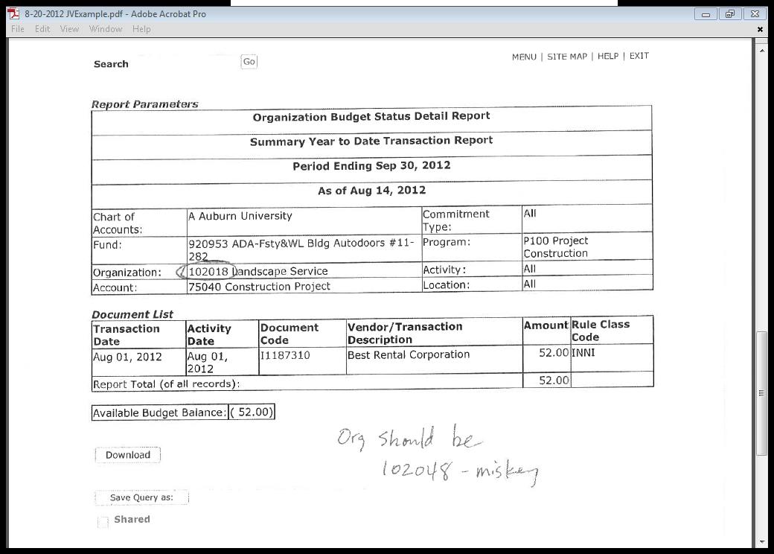

Slide 11
ISS Update
Felicia Roberson & Scott Tisdale

Slide 12
ARGOS
What is Argos?
What skills do I need?
Why would I use Argos?
Are you currently using Argos?
Do you want to see a presentation?
Do you want training on the upgrade?

Slide 13
Reports in Eprint
Suggested for Removal
FGRBDSC – replaced by FZRBDSC
FZOBBUD – Base budget report not used
Suggested for Archive
Deferred Grant Process

Slide 14
TES Charge Back System
Would replace faxing of timesheets to TES
Payroll runs first, then data is pulled for billing
Demo

