Slide 1
Financial Liaison Meeting
Presented by the AU Business Office
July 15, 2011

Slide 2
E~PRINT KEY
ISS

Slide 3
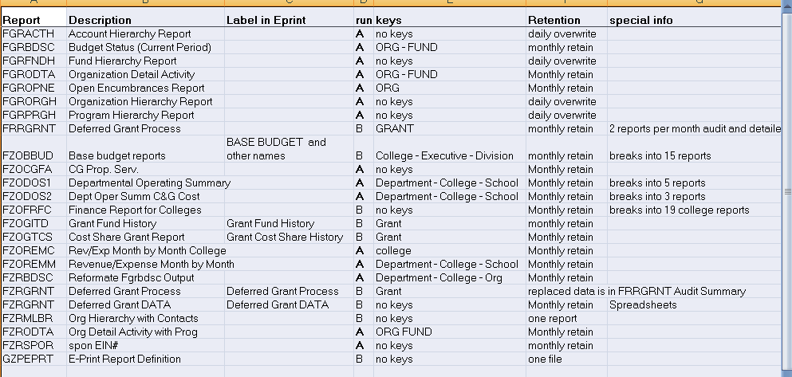
A: All Users can run in ADMIN or view in eprint; B: Available to end users in eprint at month end

Slide 4
FRINGE BENEFITS
Controller’s Office

Slide 5
Negotiated Fringe Benefit Rate
Proposed rate based on actual data from FY 2010 and FY 2011 (annualized).
Proposal sent to Federal Government for review and negotiation.

Slide 6
Negotiated Fringe Benefit Rate
New rates will go into effect October 1, 2011
For fiscal year 2011 carryover, benefit budgets will be treated as salary and wage budgets are currently

Slide 7
Proposed Fringe Benefit Rates
Full time personnel (including summer)
27.5%
primarily due to decrease in employer’s portion of Teacher’s Retirement.
Part time personnel 11.9%
Graduate Assistants 2.6%

Slide 8
ACTIVITY CODES
Controller’s Office

Slide 9
Activity Codes
Another FOAPAL element (Fund, Org, Account, Program, ACTIVITY, Location)
Used to track transactions within a Fund/Org
Will be implemented for use on Chart A for FY2012 on an as-needed basis

Slide 10
Activity Codes
Already in use for Chart F and Chart T
  See handouts – Chart F, Athletics
For use by departments – the Business Office will not enforce use
  No budgeting to activity code level
  No DECs for missing activity codes
Can query in SSB by activity code as with other FOAPAL elements*

Slide 11
Activity Codes
6 characters (alpha-numeric)
  No spaces or special characters
Revised account create form
  Select FOAPAL element from a list
  Same approval process; Fin Rptg will create new activity codes
Deadline for activity code requests for use beginning Oct 1, 2011 is August 31

Slide 12
SSB FUPLOADS
Controller’s Office

Slide 13
JV SSB System
Initial roll out to departments that direct charge.
Means to eliminate paper and reduce time .
Plans to expand slowly with training over the next year.
Incorporates electronic approval queues.

Slide 14
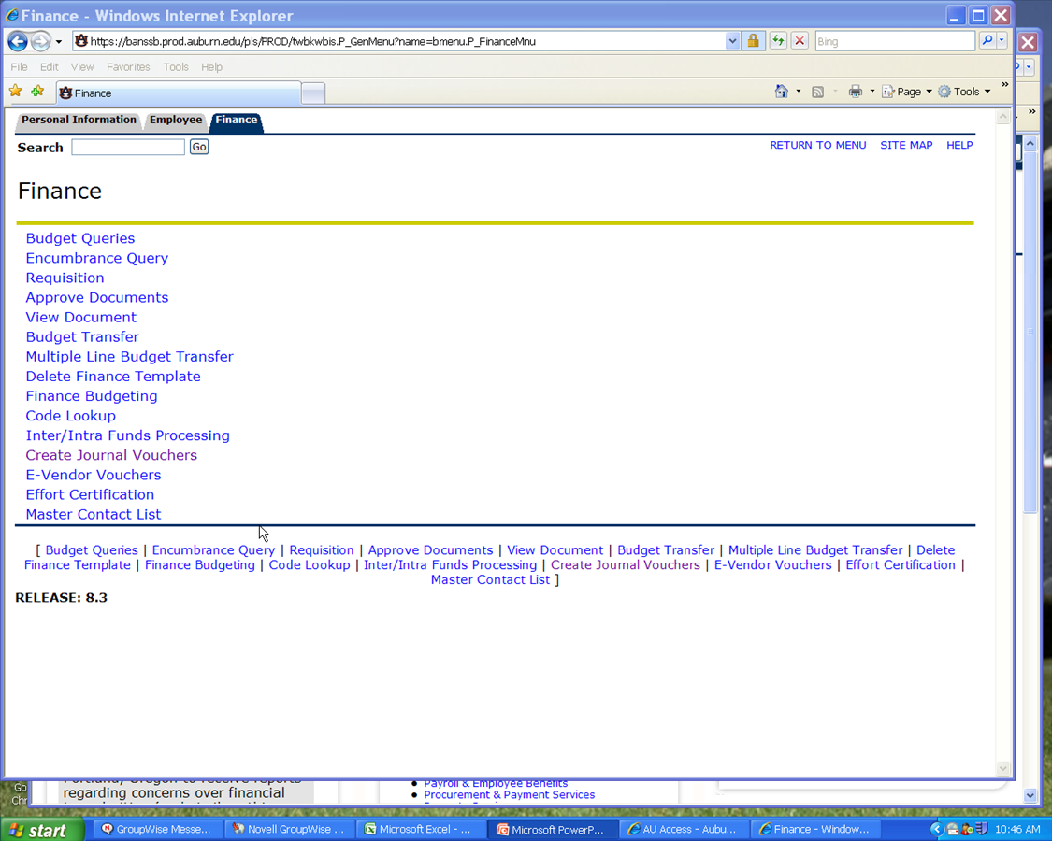
Where Do I Find It?

Slide 15
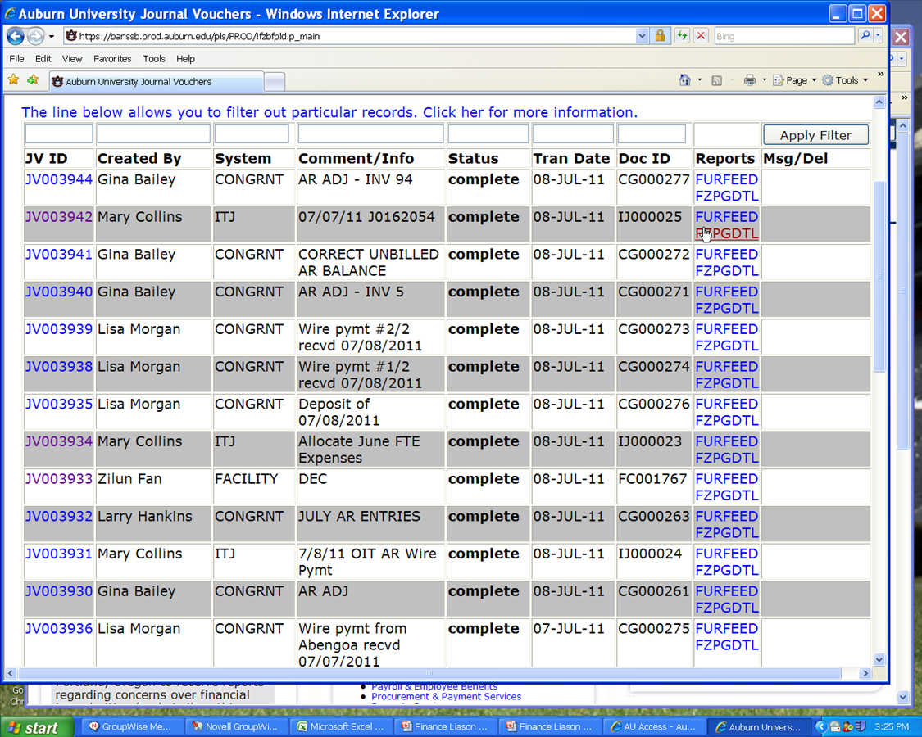
Example of Entered Documents

Slide 16
Types of Documents Processed
Direct Charges (CRGs)
Departmental Error Corrections (DECs)
Journal Entries (JE15s & 16s)
Collection Reports (CR05s)

Slide 17
Types of System IDs
FINRPT (Financial Reporting Fuploads)
document id: FRxxxxxx
COPYCAT (Copy Cat Direct Charges)
document id: CCxxxxxx
CONGRNT (Contract & Grant Accounting)
document id: CGxxxxxx
FACILITY (Facilities Direct Charges)
document id: FCxxxxxx

Slide 18
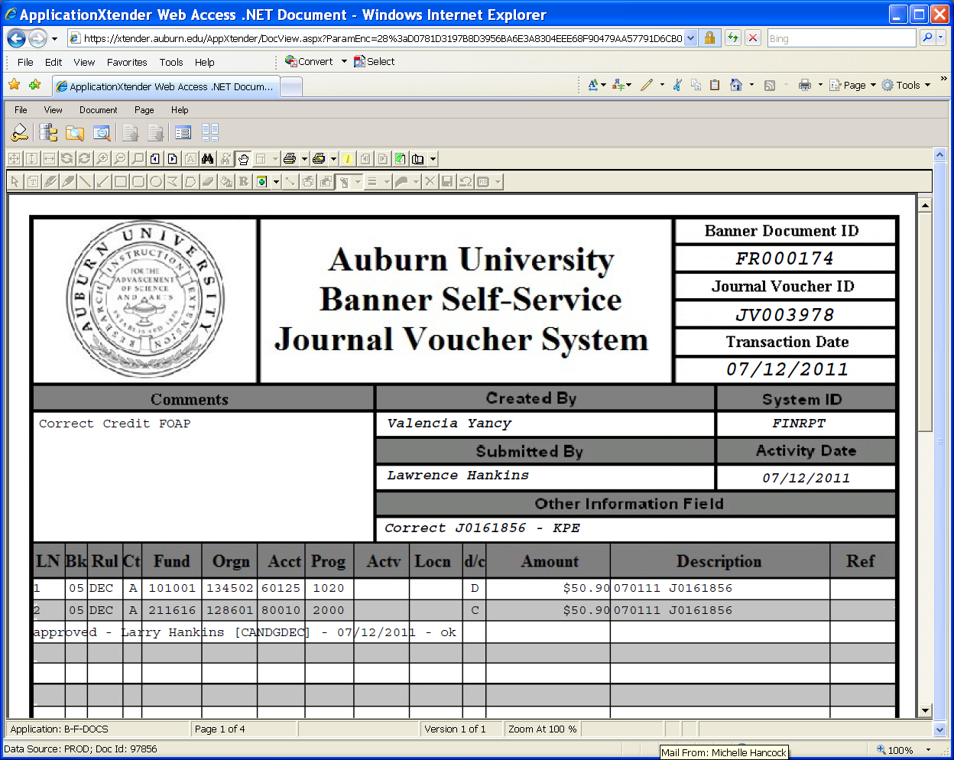
What You Will See in Xtender

Slide 19
BUDGET UPDATE
FY12
Budget Services

Slide 20
Budget Update
Salaries will be copied to positions this afternoon
Begin working on balancing your budgets in Stripes (also make sure your revenue accounts have corresponding revenue to offset expenses)
One-time supplement guidelines are still being finalized
Questions on budget process?

Slide 21
Restricted Budget Transfers
Budget Services

Slide 22
Restricted Budget Transfers
Amount
Name of from and to funds
To and From Fund/Org Codes
The restrictions of the funds
The reason for the transfer (explain why it can’t be spent directly out of the fund)
The reason it does not violate the donor’s wishes

Slide 23
E-Vouchers, Apple, Grainger, Vendor Show
PPS

Slide 24
PPS Updates
E Vendor Voucher System
  PPS is continuing implementation of the new E Vendor Voucher System with a goal of having all campus departments live in production with the system by this fiscal year end
Apple Products
  Apple computer hardware, software, and peripherals can now be purchased at AU Bookstore

Slide 25
PPS Updates
Grainger Kick-off Event
  Grainger is AU's preferred vendor for Maintenance, Repair, and Operations supplies and equipment (MRO). The Grainger Kick-off event will be held Wednesday, July 20, from 9-11 at AUHDCC
Preferred Vendor Show
  PPS will host Annual Preferred Vendor Show from 9:00- Noon on Thursday, September 8 at AUHDCC. The event will feature all of AU’s Preferred Vendor and many of their suppliers

