Slide 1
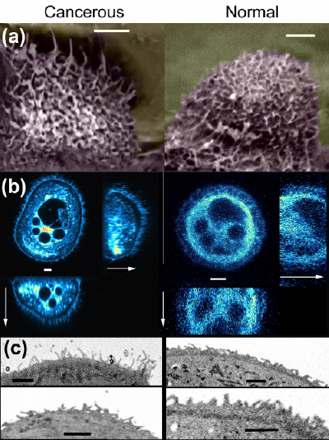
Challenge: detecting cancer cells in the presence of normal cells
Idea: can brushes change interaction of cell with nanomaterial?
Sokolov, et al., Nature Nanotechnology, 2009

Slide 2

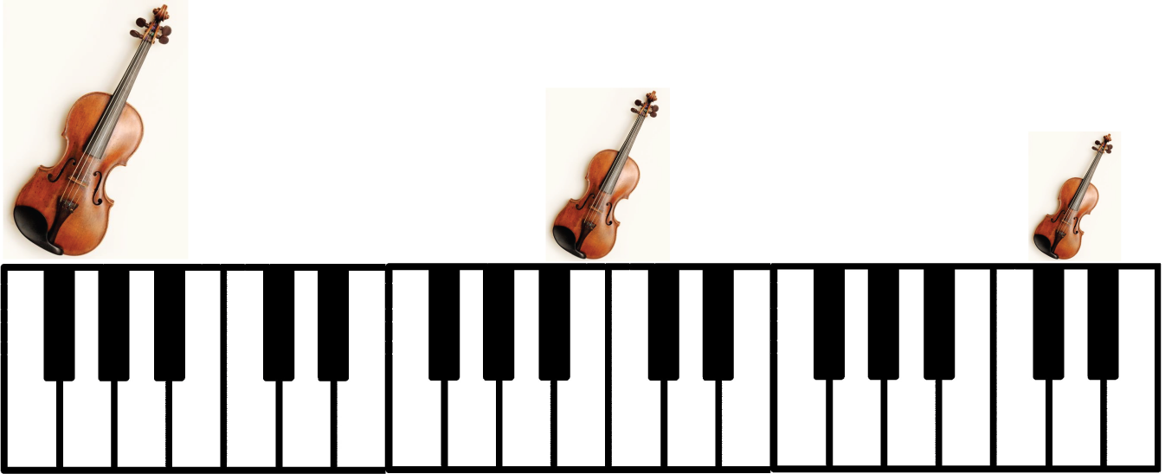

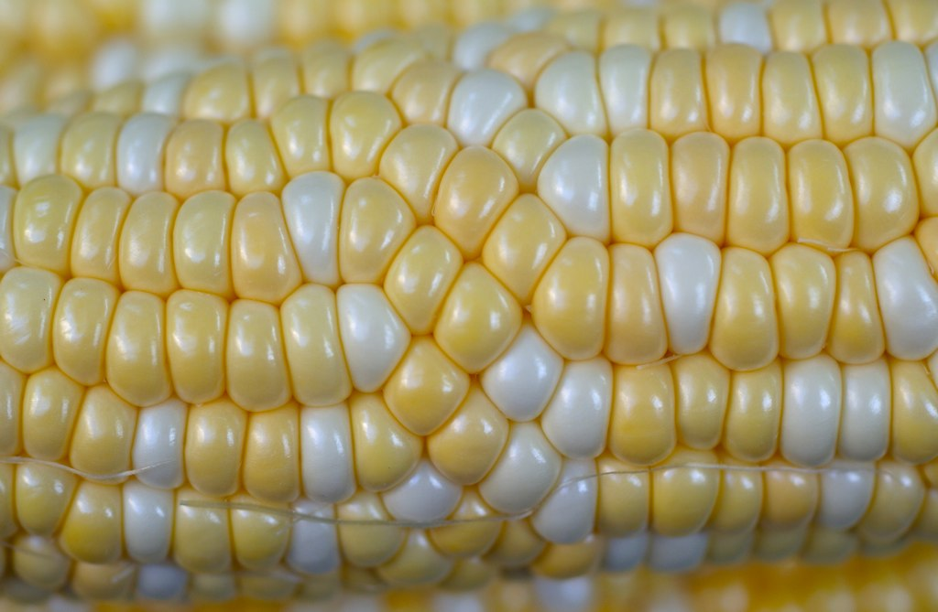
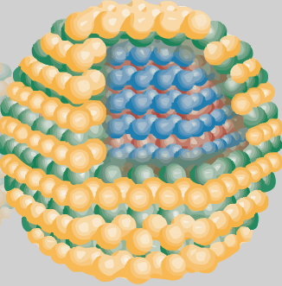
Three key attributes of nanomaterials
  Properties depend on SIZE
  High surface area compared to bulk
  Defects can be controlled
Flickr: stephen w morris

Slide 3
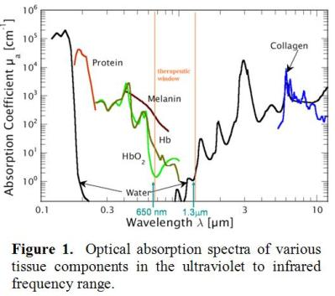
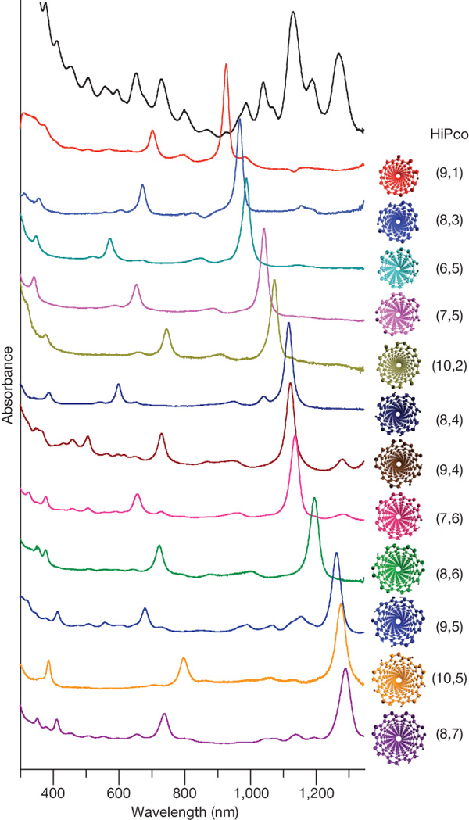
Nanotube absorption overlaps ‘therapeutic window’
XM Tu et al. Nature 460, 250-253 (2009)

Slide 4
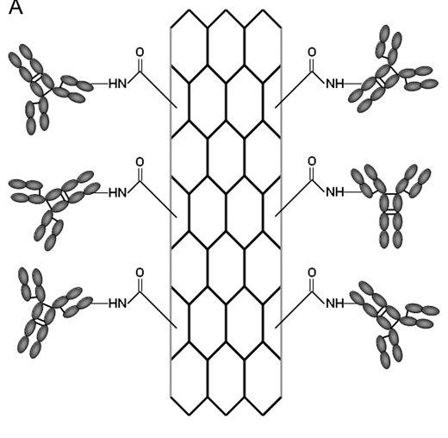
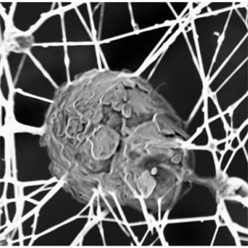
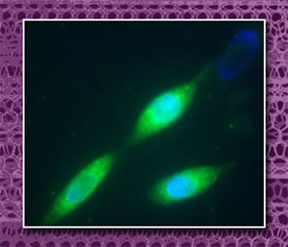
Target and destroy cancer cells using modified CNTs

