Slide 1
Species interaction models

Slide 2
Goal
Determine whether a site is occupied by two different species and if they affect each others' detection and occupancy probabilities.
Examples
Predator-prey interactions
Competitive exclusion
Compares:
Expected rates of occupancy to occupancy when another species is present
Expected rates of detection to detection when another species is present

Slide 3
Saturated model
Model that perfectly fits the data.
Deviance = -2*Σln(x_{i})
x_{i} - proportion times of each history is observed
“standard” upon which all of our co-occurrence occupancy models will be judged

Slide 4
Similarities to single season occupancy
Relates encounter histories and detection probabilities to a site.
Occupancy is assumed closed during sampling period
Site is sampled multiple times
Encounter history is obtained for both species
Based on repeated sampling
Spatial or temporal replication

Slide 5
Parameters of interest – ugh!
ψ^{A} – Probability of occupancy by species A (unconditional)
ψ^{B} – Probability of occupancy by B (unconditional)
ψ^{AB} – Probability of occupancy by A & B (co-occurrence)
p ^{A} – Probability of detecting species A when only A is present
p ^{B}– Probability of detecting species B when only B is present
r ^{AB} – Probability of detecting species A & B when both are present
r ^{Ab} – Probability of detecting species only A when both present
r ^{Ba} – Probability of detecting species only B when both present
r^{ab} – Probability of detecting NEITHER when both present = 1 – r ^{AB} – r ^{Ab} – r ^{Ba}

Slide 6
Many parameters = much data required!

Slide 7
Occupancy – Venn diagram
ψ^{Α}
ψ^{Β}
ψ^{AB}
1−ψ^{A}−ψ^{B}+ψ^{AB}

Slide 8
Occupancy parameters – 4 states
ψ^{A} – Probability of occupancy by species A (unconditional)
ψ^{B} – Probability of occupancy by B (unconditional)
ψ^{AB} – Probability of occupancy by A & B (co-occurrence)
Could estimate ψ^{AB} ₌ ψ^{A} ψ^{B} if no interaction
Interaction estimated by: η = ψ^{AB}/(ψ^{A}ψ^{B})
η < 1 − avoidance (less frequent than expected)
η > 1 − convergence (more frequent than expected)
4th State – absence of both species – 1-ψ^{A}-ψ^{B}+ψ^{AB}

Slide 9
Detection parameters
Given both species are present 4 possibilities:
Detecting species A only – r ^{bA}
Detecting species B only r ^{Ba}
r ^{AB} – Probability of detecting species A & B
r ^{ab} – Probability of detecting NEITHER species 1 - (r ^{Ab}- r^{aB} – r ^{AB} )

Slide 10
Probability of encounter histories
Pr(11 11) = ψ^{AB}*r^{AB}₁*r^{AB}₂
Pr(11 00) = ψ^{AB}*r^{Ab}₁*r^{Ab}₂+(ψ^{A}-ψ^{AB})*p^{A}₁*p^{A}₂
Pr(00 00) = ψ^{AB}*p^{ab}₁*r^{ab}₂ +(ψ^{A}-ψ^{AB})*(1-p^{A}₁)*(1-p^{A}₂) +(ψ^{B}-ψ^{AB})*(1-p^{B}₁)*(1-p^{B}₂) +(1-ψ^{A}-ψ^{B}+ψ^{AB})
Uggh!

Slide 11
Estimation & modeling
Estimate parameters (MLEs) via ln(L)
Introduce covariates via link functions
All parameters constrained between 0 and 1
Usually use the logit link

Slide 12
Model selection
Usually use QAICc
Model fit via χ² – not the best but it will do
c-hat ≈ χ²/df (df = degrees of freedom)
biased high
Could use parametric bootstrap, but not readily available
Sample size – number of sites surveyed

Slide 13
Model parameterizations
Phi/delta parameterization
PsiA = Pr(occ by A)
PsiB = Pr(occ by B)
PsiAB = Pr(occ by A and B)
phi = PsiAB/(psiA*psiB)
to make psiA and psiB independent FIX phi to 1 and delete column from DM

Slide 14
Model parameterizations
PsiBa/rBa parameterization
PsiA = Pr(occ by A)
PsiBA = Pr(occ by B, given occ by A)
PsiBa = Pr(occ by B, given NOT occ by A)
to make psiA and psiB independent set psiBA equal to psiB in DM

Slide 15
Model parameterizations
nu/rho parameterization
PsiA = Pr(occ by A)
PsiBa = Pr(occ by B, given NOT occ by A)
nu = log-odds of how occupancy of B changes with presence of A
To make psiA and psiB fix nu = 1 and delete column in DM

Slide 16
Additional Occupancy models
(most in Presence)

Slide 17
Single-season mixture models (Mackenzie et al. Ch 5.1)
Use to estimate occupancy and detection rates
Same repeated presents/absence survey approach
Attempt to estimate unobservable heterogeneity
Covariates are observable sources
Discrete mixture:
Finite (small) number of sites with similar occupancy and/or detection rates
Continuous mixture
All sites have different occupancy and/or detection but they come from some estimable distribution
Very data hungry!

Slide 18
Royle-Nichols abundance induced heterogeneity
Royle, J.A. and J.D. Nichols. 2003. Ecology 84(3):777-790
Used to estimate abundance [density] from presence-absence data
Main assumptions
Distribution of animals follows a prior [Poisson] distribution
Detection probability is a function of how many animals are present (p = 1-(1-r)^{N(i).}
No covariates!

Slide 19
Royle-N-Mixture Count (repeated count) Model
Royle, J.A. 2004. Biometrics 60, 108-115.
Estimates density from repeated counts
Assumptions
Spatial distribution prior distribution [Poisson distribution]
Detection n animals at a site represents a binomial trial.

Slide 20
Single-season removal model
Similar to single-season occupancy
Estimates occupancy and detection
Sites are no longer surveyed once species is detected
More efficient – allows more sites.
Assumptions:
Detection constant across surveys (not p(t))
Allows covariates but no site interactions

Slide 21
Single-season multiple method
Allows for different survey methods
Example large-scale and small-scale sampling
Assumption: if an individual is detected by one method, another is immediately available for detection by other method at that site.
Similar to robust design approach

Slide 22
Species misidentification Royle, J. A., and W. Link. 2006. Ecology 87:835-841
Extends occupancy analysis to allow for false positives
Similar to mixture model
Some portion observations are false positives

Slide 23
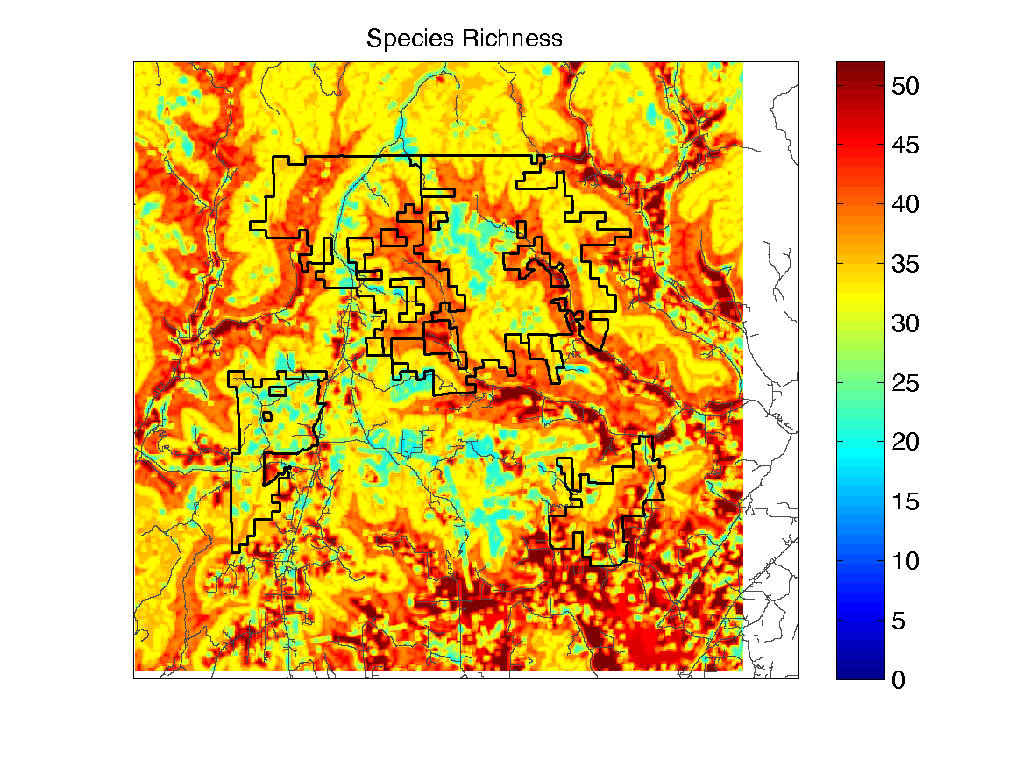
Species richness occupancy Royle et al. 2006. Ecology 87:842-854.
Estimate the number and composition of species.
Uses presence-absence data
For each species estimates:
Probability of occupancy
Probability of detection
For all species
Mean probability of occupancy and detection
Expected species richness
Number of species ‘missed’
Assumptions
Closed to changes in population size
Number of species is Poisson process

Slide 24
Multi-state occupancy
Occupied sites are classified into multiple states
Estimates:
Occupancy, detection and probability of state
Assumption
Some state(s) can be identified with certainty
Example:
Breeding or non-breeding
Occupied-breeding-probable breeding

Slide 25
Multi-season, multi-state occupancy
Estimated parameters
Estimates occupancy given suitable initially
Probability that site is unsuitable in season
Detection given occupied
Extinction given suitable each season
Extinction given change from suitable to unsuitable
Colonization given change from unsuitable to suitable
Colonization given that suitable each season
Change from suitable to unsuitable
Change from unsuitable to suitable
Derived parameter
Remains suitable

Slide 26
Occupancy with spatial correlation Hines et al. (in press)
Estimates:
Occupancy
Detection
Spatial autocorrelation biases occupancy estimates

